Slide 1

Understanding the Utility Bill and Energy Affordability
2026 NGA Gas Operations School
June 5, 2026
William Hinkle

Slide 2
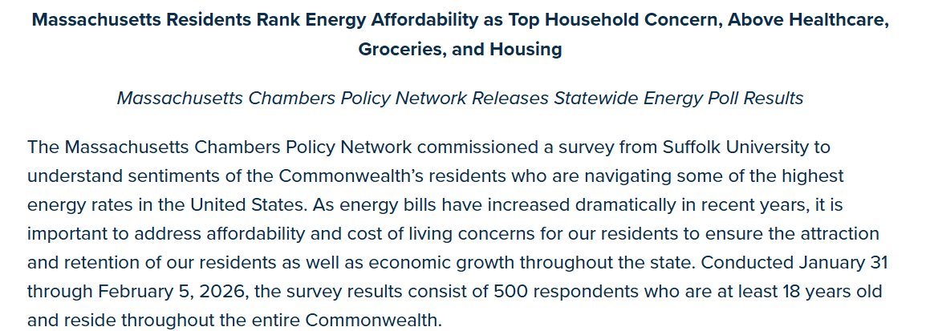
Agenda
Setting the Stage – Energy Affordability in the Public Discourse
Understanding the Bill
Rates and Affordability Communications
Improving Transparency and Coordinated Communications
Programs to Help
Exercise and Questions

Slide 3
Affordability is Top of Mind
Lower billing and review any alleged programs that is affecting cost delivery to consumers.
- Customer
…not to mention the delivery charges, no one has ever come out here to deliver anything!
- Customer
Amazon delivers for free, why can’t Eversource?
- Customer
So, shame on all of you. It now takes my entire pension over $1000 a month to keep our home in a freeze and I always pay in advance but to no avail. Something has to give.
- Customer
“…My electric bill tripled, then quadrupled, and has continued to rise. The extra charges you charge your consumers is outrageous and exorbitant.
- Customer
Customers are waking up, showing up, and they are angry!
Matt Nelson,
former Massachusetts Department of Public Utilities Commission Chair,

Slide 4
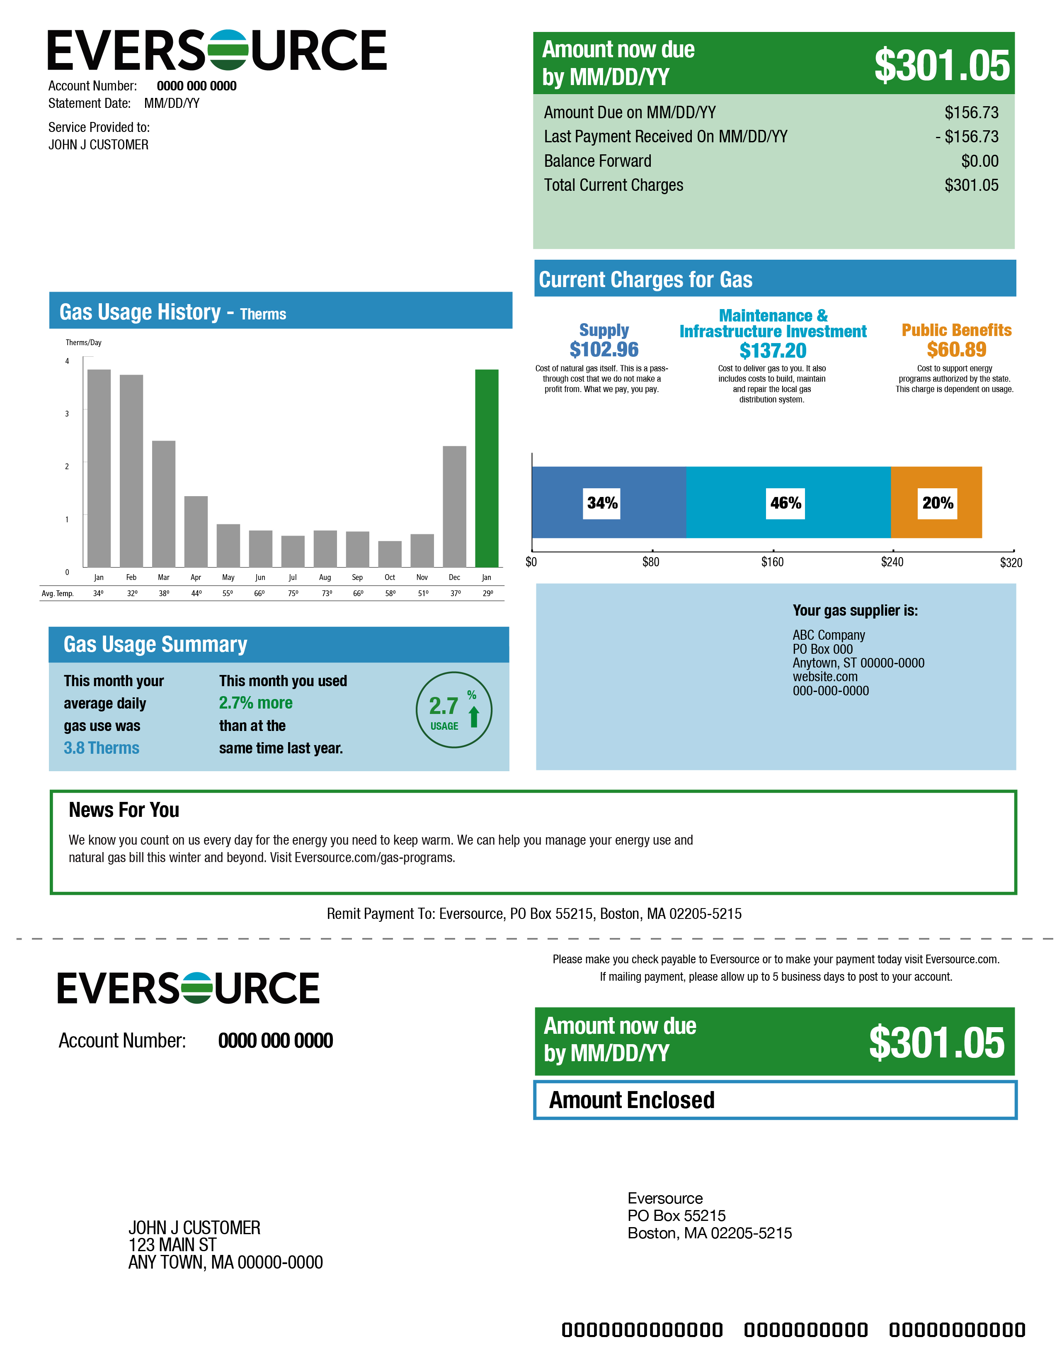
Components of a Gas Bill
The charges on your natural gas bill are driven by the amount of gas you use each month.
Your charges are broken into three categories:
Supply - Cost of gas from Eversource or your third-party supplier.
Maintenance and Infrastructure Investment – Cost to safely and reliably get natural gas to your home; skilled employees who operate and maintain the local gas distribution system and provide customer service; improvements to make the system more resilient and reliable.
Public Benefits – The costs of programs, including energy efficiency and payment assistance, that provide value by helping reduce energy usage and enabling you to better manage your monthly bills.

Slide 5
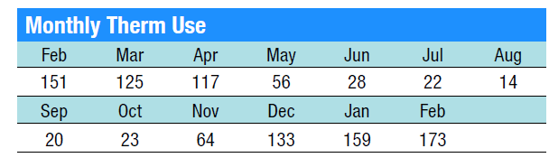
What is Supply?
Eversource purchases natural gas for customers twice a year.
The supply charge reflects the cost of purchasing natural gas for our customers with no profit and is based on the current market price of natural gas.
How You Are Charged:
Your usage is measured in therms.
The therms you use during your billing cycle are multiplied by the supply rate.
Supply rate x therms (usage) = Supply charge

Slide 6
What is Maintenance and Infrastructure Investment?
The Maintenance and Infrastructure Investment category is the cost to deliver gas to you and includes operating, maintaining and upgrading the natural gas system safely and reliably.
It includes the cost of skilled labor, trucks and equipment, and other expenses.
Like the supply portion of your bill, the delivery charge is driven by how much natural gas you use – it is not a flat rate.

Slide 7
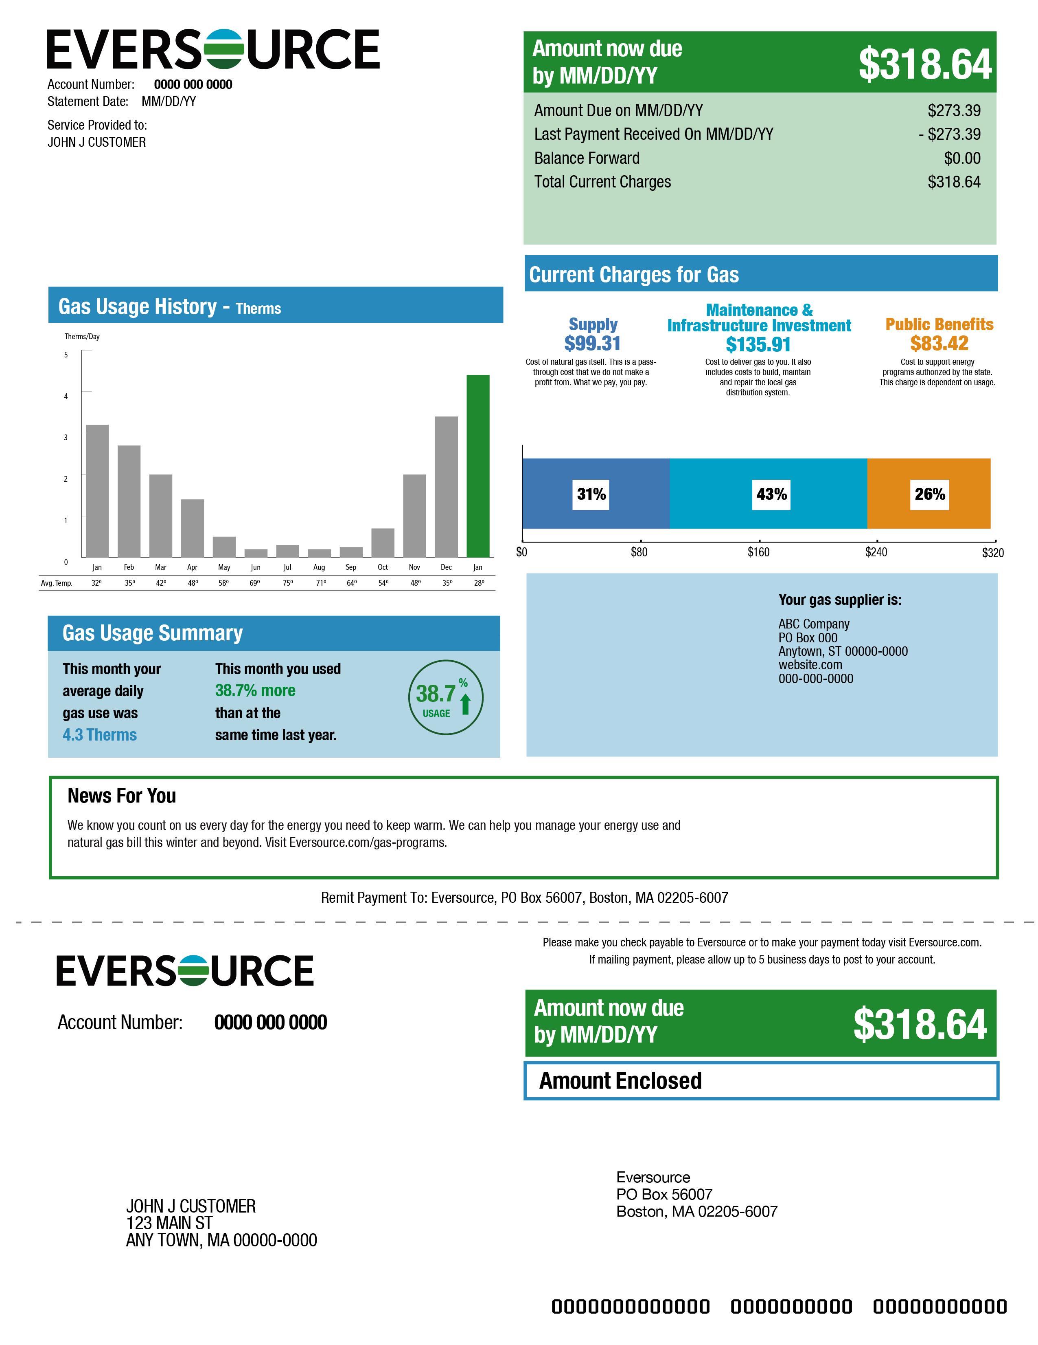
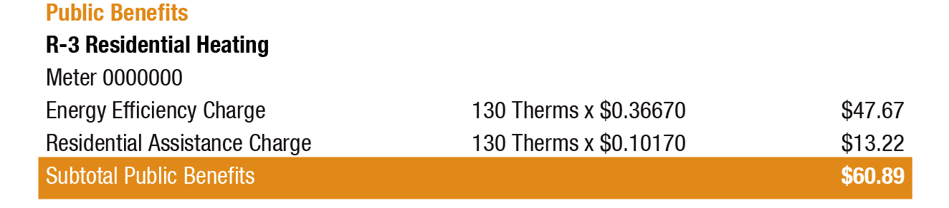
What are Public Benefits?
The line items you will see in this category are:
Energy Efficiency Charge - Recovers the cost of energy efficiency program costs such as the Mass Save® programs we offer.
Residential Assistance Charge – Recovers the cost of bill discounts to eligible customers, plus costs associated with the arrearage management program.
Through these charges you're paying to fund these programs, so we encourage you to take advantage of what's available to you.

Slide 8
Key Principles – Don’t Shy Away from the Facts
Education, Outreach and Empowerment
Transparency
Regular Proactive Communications – Early and Often
Coordinated Approach Across All Available Channels
How to Help and Support Customers
Constantly Evolving Messages Based on Customer Feedback

Slide 9
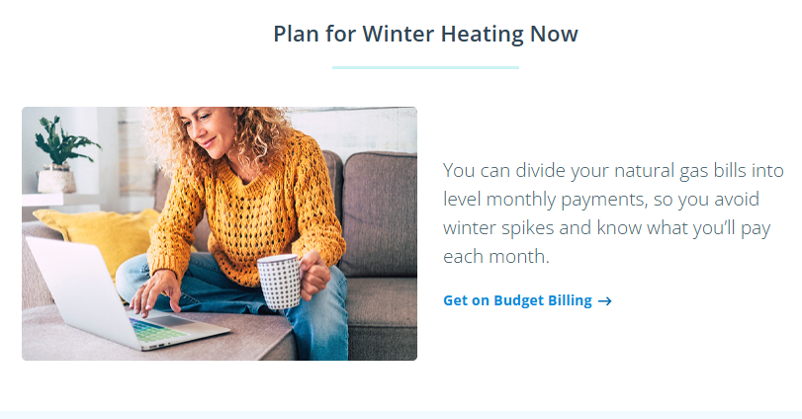
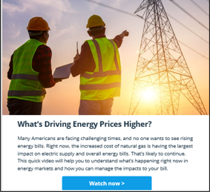

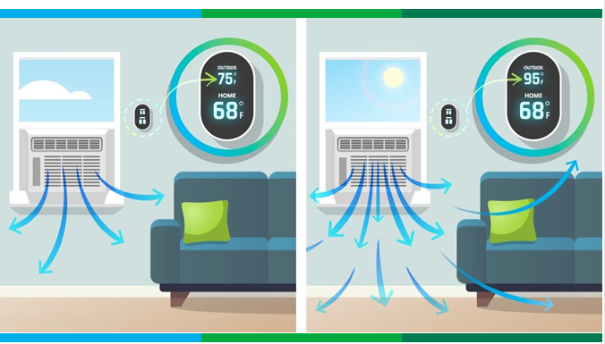
Messaging Framework
We continue to learn and adapt our communications to:
Strike the right balance
Prepare customers early and often
  Proactive, not reactive
Offer meaningful help
  Income-based assistance
  Energy efficiency
Make the connection to usage
  Partner with our communities, legislators and other key stakeholders

Slide 10
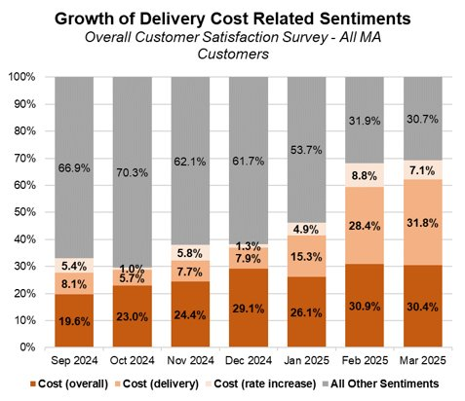
Improving Transparency – MA Gas Bill Redesign Background
In February 2025, Eversource MA recorded the largest decline in Customer Satisfaction primarily tied to a significant spike in both usage and their total costs coupled with difficulty understanding their bills.
Customers find it challenging to understand why their overall bill and associated charges may increase and how their usage can further compound their charges.
Customers do not have a clear understanding of how the rates are set and what different charges represent.
The Department of Public Utilities also recognized the need for greater transparency and ordered the Gas Distribution Companies to add an “Energy Efficiency” line item to the gas bill by Winter 2025.
Delivery-related sentiments more than tripled over the course of 3 months.

Slide 11
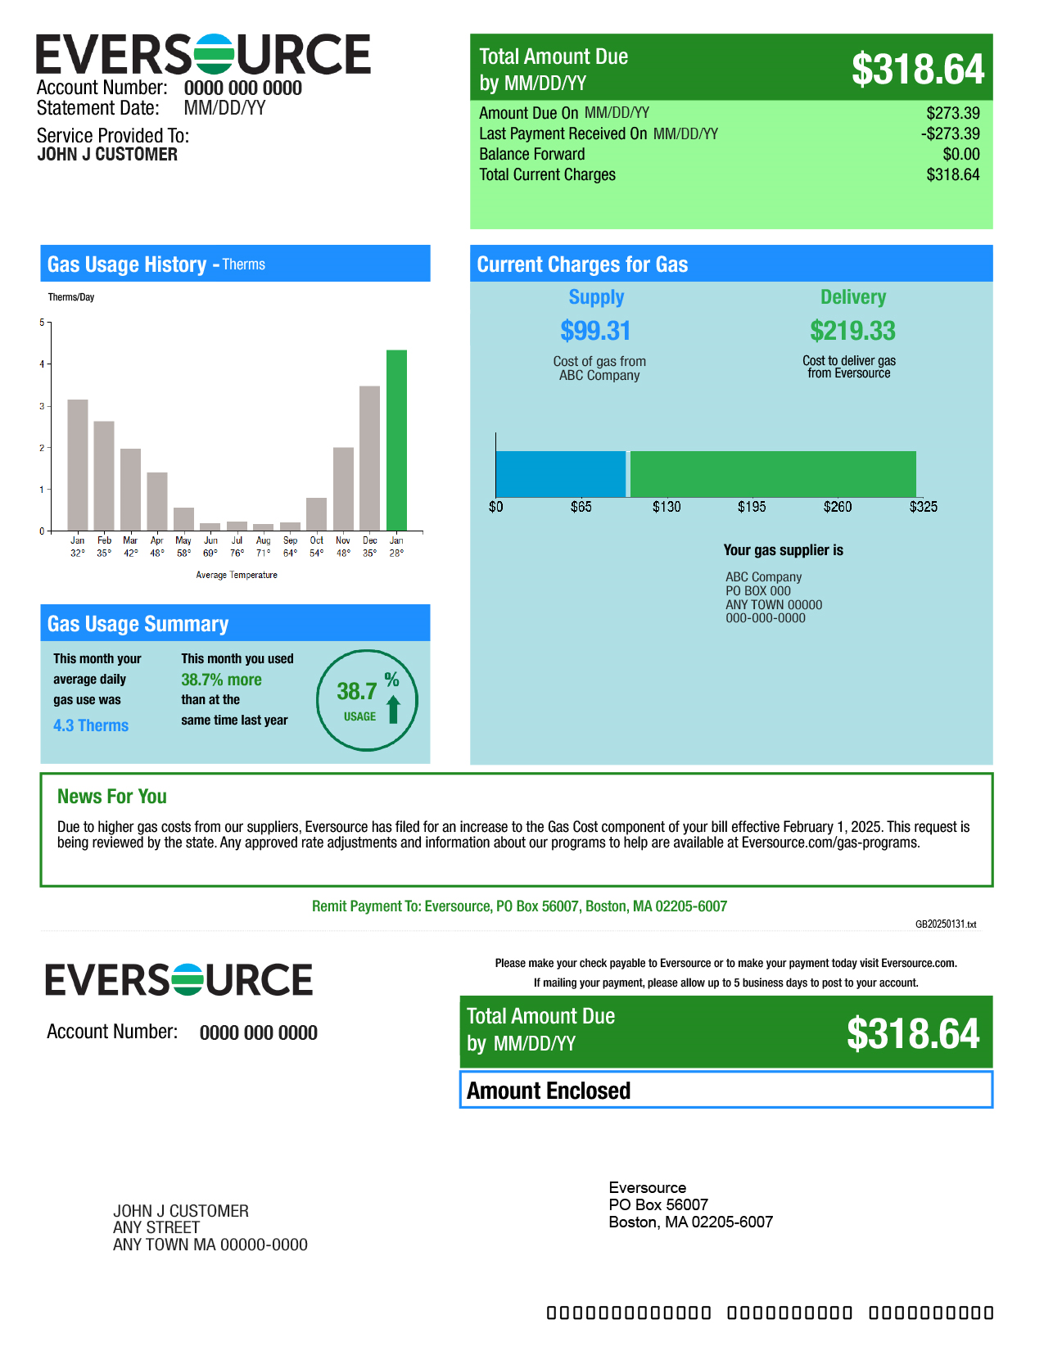
Transparency of Costs Changes the Conversation
Previous MA Gas Bill
Redesigned MA Gas Bill

Slide 12

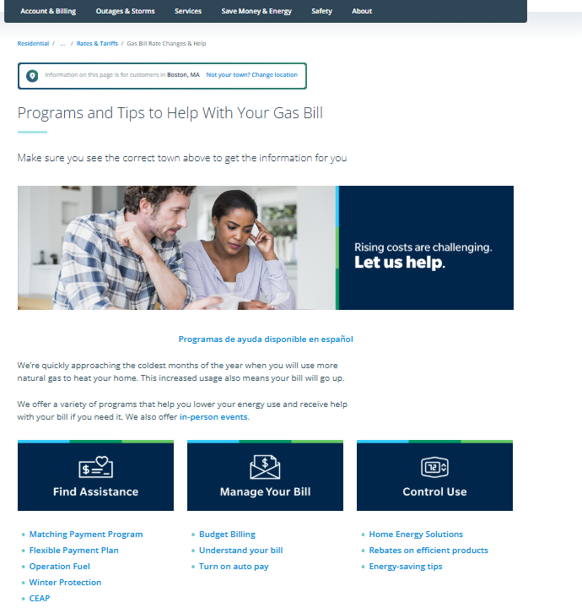
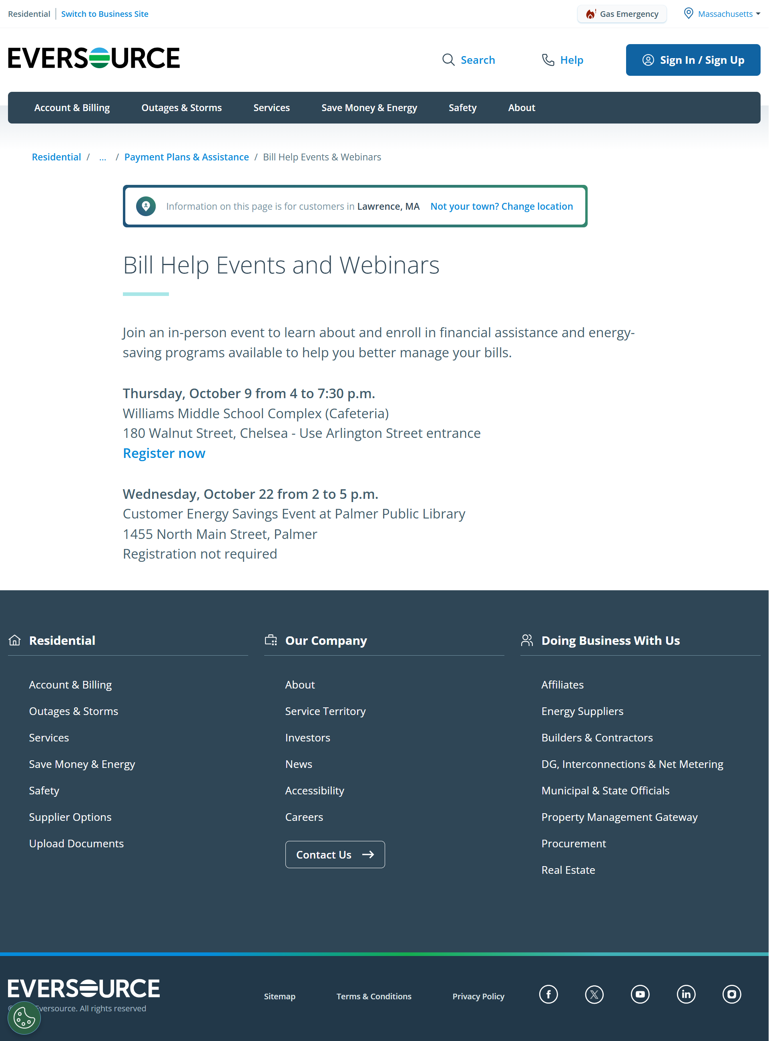
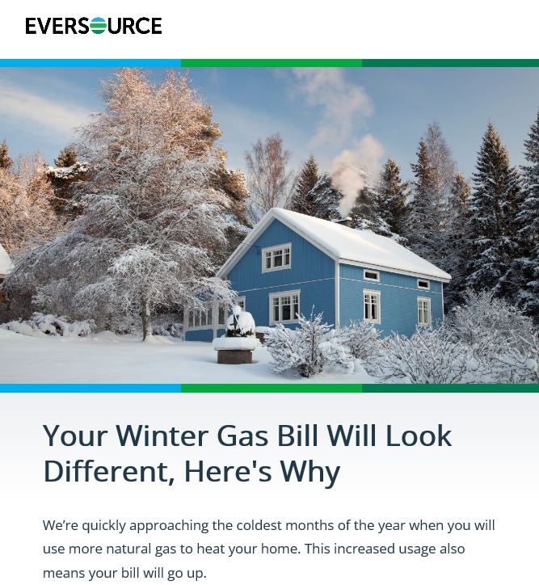
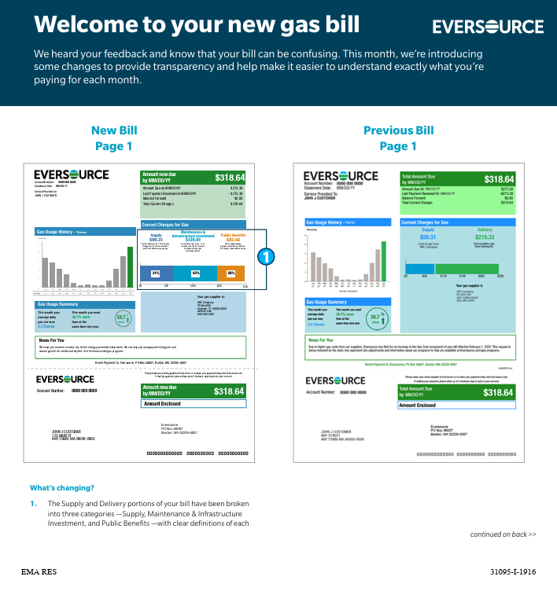
How We Communicate
A 360-degree approach to reach gas customers across channels
Eversource.com
  Eversource.com/gas-programs
  Eversource.com/high-bill
  Eversource.com/gasbill
Email and email newsletters
Bill inserts and bill messages
Paid advertising
Traditional media
Social media
Talking points
Fact sheets
Webinars
Events
Outreach to communities, legislators and other key stakeholders

Slide 13
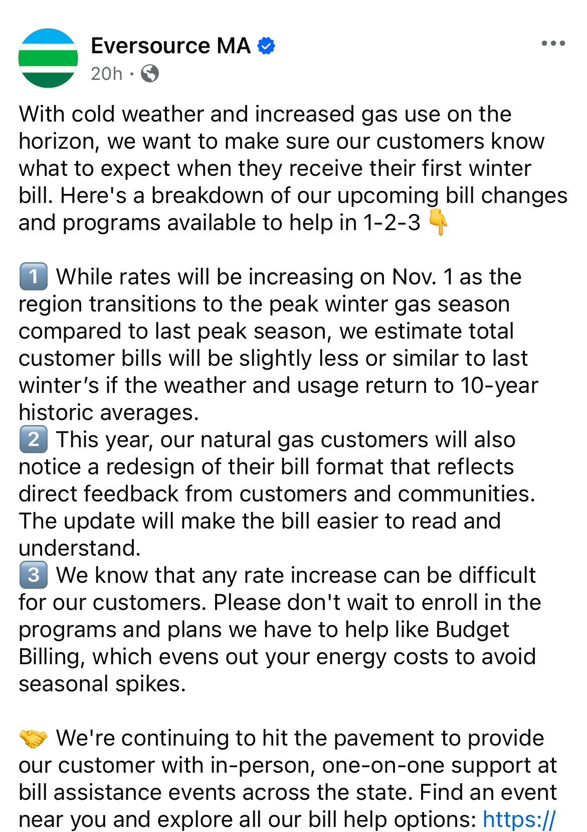
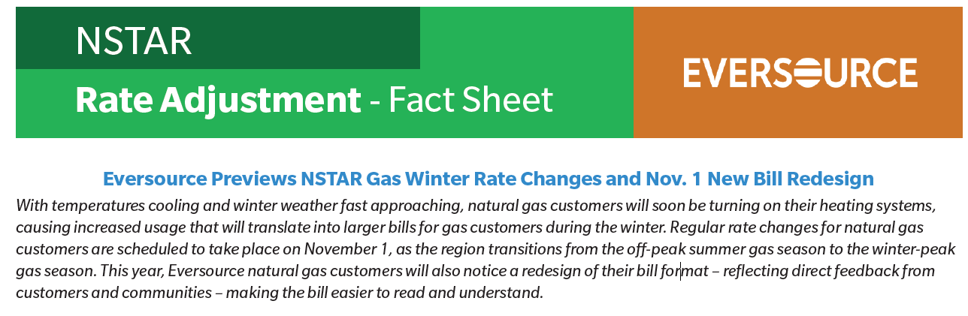
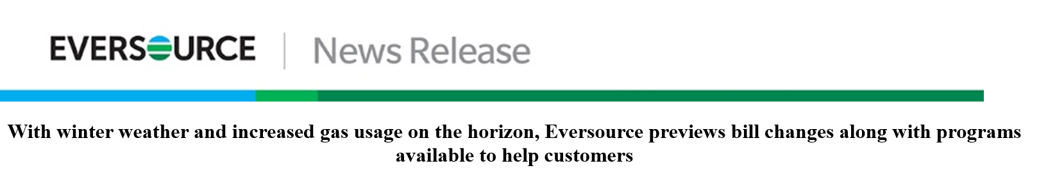
Message Examples

Slide 14
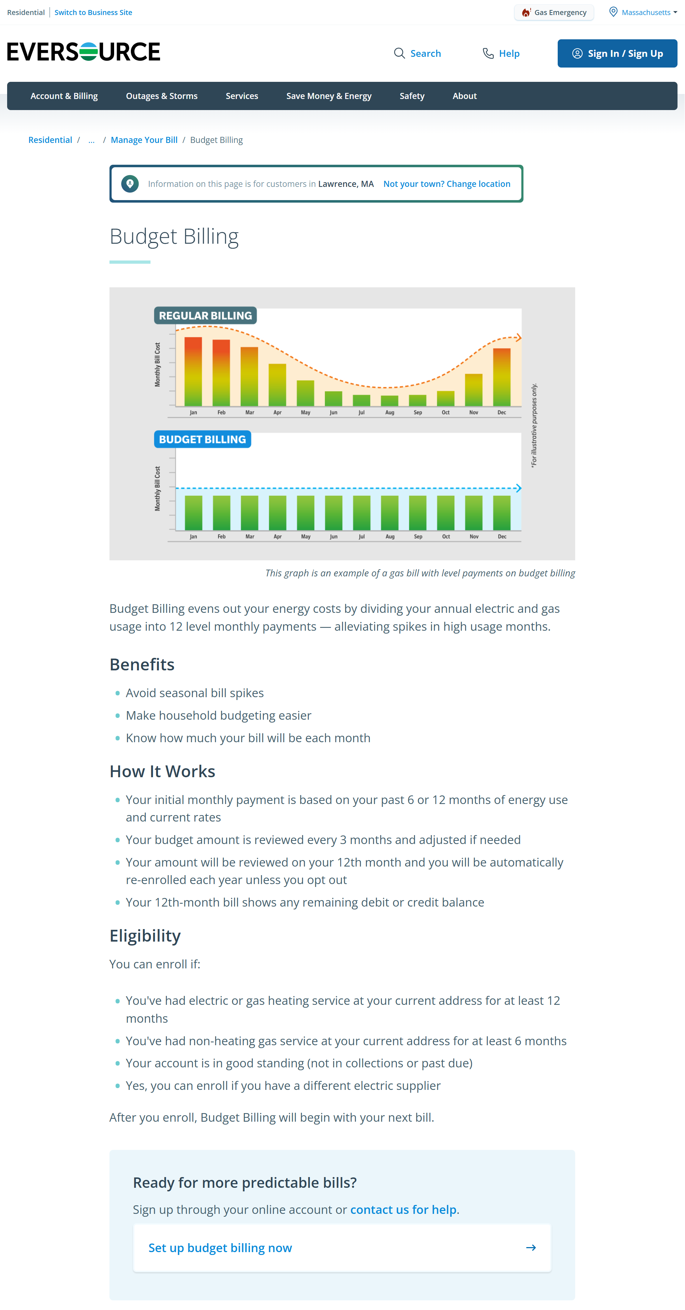
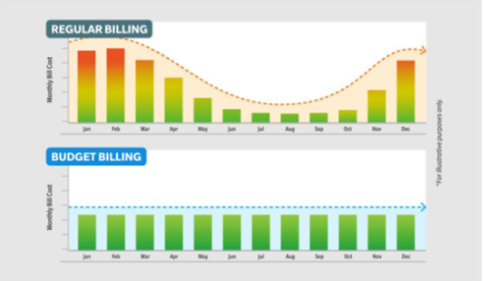
Message Examples

Slide 15
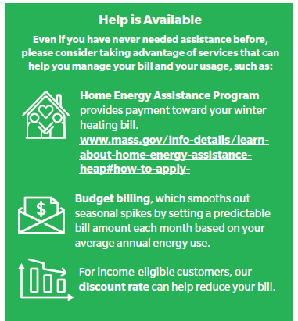
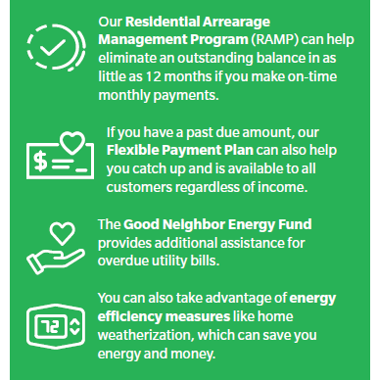
Programs to Help
Visit eversource.com/gas-programs to learn more about our programs and payment plans or call 866-861-6225

Slide 16
Exercise
In addition to working in the industry, we are all also utility customers – and none of us enjoy paying our bills
  Do you understand your utility bill(s)? If not, what would help you better understand it?
  When your bills increase:
    What would you like to hear from your utility?
    How can your utility better explain rate changes?
  If your parents or neighbors ask you about your company’s rates:
    How do you explain it?
    What can your company do to better prepare you for these conversations?

Slide 17
Questions

