Slide 1

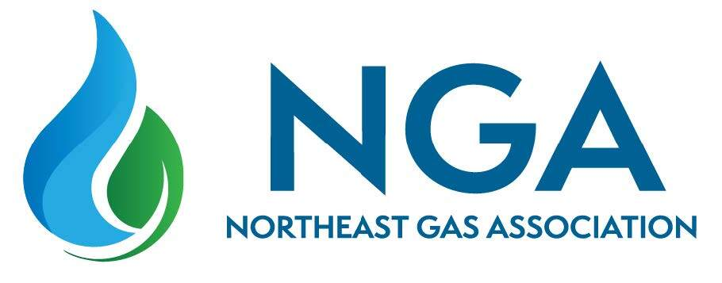

Pipeline Safety
Regulatory Update
Regional Regulator and Industry Perspectives Panel
Chris McLaren
Executive Consultant, RCP Inc.
PROFESSIONAL ENGINEERS | REGULATORY EXPERTS | TRUSTED PARTNERS

Slide 2
What are PHMSA and NTSB Thinking?
Recent Priorities and Actions of PHMSA and NTSB
PHMSA Priorities – Memo from Linda Daugherty on July 17, 2025
https://www.phmsa.dot.gov/sites/phmsa.dot.gov/files/2025-07/PHMSA%20OPS%20Inspection%20and%20Enforcement%20Priorities%20Memo.pdf
https://primis.phmsa.dot.gov/enforcement-data/summaries
NTSB Open Investigations and Reports
https://www.ntsb.gov/investigations/Pages/Investigations.aspx

Slide 3
PHMSA Recent Inspection Policy Memo
PHMSA priorities are detailed in the Memo on Inspection and Enforcement Priorities, dated July 17, 2025, which directs OPS staff to focus on these priorities when conducting inspections and investigations and when initiating enforcement actions against owners and operators of pipeline facilities.
This directive is intended to concentrate inspection resources on areas with the highest potential safety impact and to ensure nationwide consistency in compliance. Regulators are also expected to verify operator adherence to recent, more stringent rulemakings, including the 2025 IBR standards updates.
State authorities operating under agreements to perform inspections and investigations on behalf of PHMSA are expected to follow these priorities to the same extent as OPS staff.
Notes:
OPS has identified the following inspection and enforcement priorities through careful analysis of incident and accident data, inspection and investigation findings, and input from staff and other stakeholders.

Slide 4
Recent Priorities of PHMSA
Priority 1: Incidents and Accidents
In support of incident investigations, PHMSA is issuing Corrective Action Orders (CAOs), often including Root Cause Failure Analysis (RCFA), and then almost immediately conducts an integrated inspection on operators who have failed to identify systemic issues.
Priority 2: High and Moderate Consequence Areas
In audits of HCA and MCA determinations, we have consistently observed this as a common weakness, with operators often struggling to accurately identify and classify these areas.
Continued..

Slide 5
Recent Priorities of PHMSA
Priority 3: Control Room Management and Leak Detection
This has long been a focus area for PHMSA, and we continue to see increased scrutiny and aggressive enforcement related to control room management and leak detection programs.
Priority 4: Damage Prevention
We are seeing an increase in specialized audits focused on damage prevention and public awareness programs.
Priority 5: Transactions and Due Diligence
In supporting due diligence activities, we are observing that operators are placing greater emphasis on understanding the assets they are acquiring in order to better assess and manage potential liabilities.
Notes:
OPS has identified the following inspection and enforcement priorities through careful analysis of incident and accident data, inspection and investigation findings, and input from staff and other stakeholders.

Slide 6
PHMSA Enforcement Trends
In inspections, there is increased focus on reporting and procedures.
In incident investigations, there is increased focus on control room management (CRM), leak detection, and procedures.
A lack of sufficient specificity in procedures is being noted in enforcement actions.
Procedures are not policies; they must provide step-by-step instructions detailed enough for two different individuals to perform the same task and achieve consistent results.
Procedures should clearly define how personnel conduct specific tasks and may include required notes and cautions.

Slide 7
Recent Priorities and Actions of NTSB
The NTSB continues to focus on gas-fueled home and building explosions. Key trends identified in recent investigation reports include:
Aldyl A Piping Failures
Compression Coupling Leaks
Insufficient Leak Management Program
Inadequate Distribution Integrity Management Program (DIMP)
Ineffective Public Awareness Program
Absence of Natural Gas Detection Alarms in Buildings.
https://www.ntsb.gov/investigations/Pages/Investigations.aspx
Note: There are other investigations and reports on transmission and gathering, but I note only distribution investigations in this short statement today.
Notes:
Note the recent report issued for the incidents in Jackson, MS.

Slide 8



Chris McLaren
Executive Consultant, RCP Inc.
cmclaren@rcp.com
PROFESSIONAL ENGINEERS | REGULATORY EXPERTS | TRUSTED PARTNERS

