Slide 1
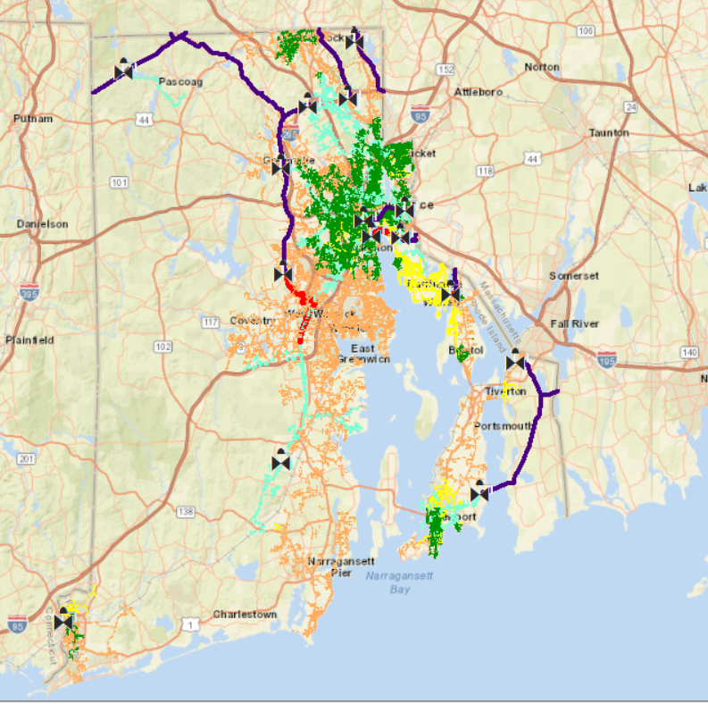
Northeast Gas Association
Distribution System Modeling
Presented by:
Brandon Flynn

Slide 2
System Design Goal
Safety & Reliability – Providing safe and reliable service at the lowest cost to the ratepayers.
System Awareness – Understanding distribution system operations, design parameters, and system constraints.
Risk Management & Identification – Fundamental Business Model.
Operational Risk
Safety Risk
Customer Risk
Finance/Investment Risk
Reputational Risk
Building Confidence –Improving efficiency, decision making, communication & knowledge sharing across the gas business, and understanding the process.

Slide 3
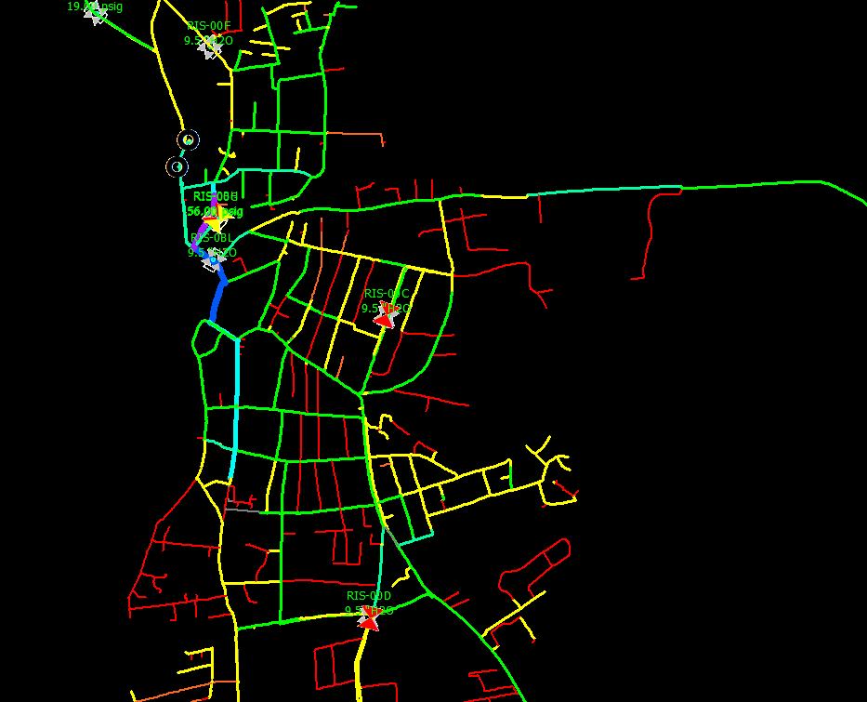
Agenda
Part 1: Model Development and Software Overview
DNV GL - Synergy Gas Steady State
Customer Management Module
Part 2: Using the Model
Various ways to apply model data

Slide 4
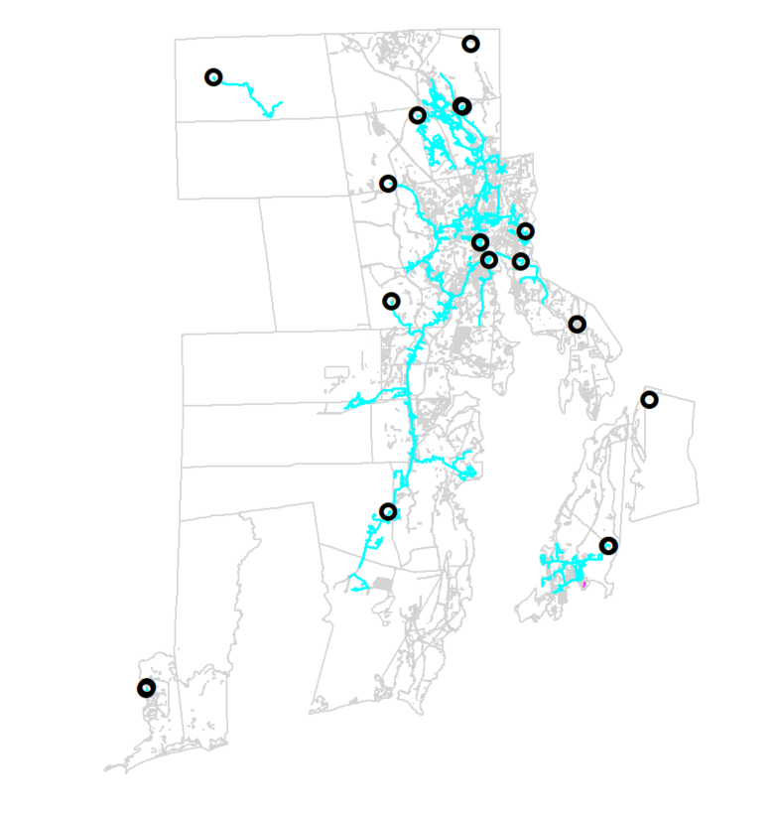
Model Development - Overview
GIS Extract of Facilities
“Skeleton Model”
“Dummy Loads”
Reg stations, valves
Node allocation, Supply Points
Customer Data Extract
Customer information
Load Usage & meter location
Base factor, heating co-efficient
Historical use trend
Assigned factor quality
Large use customers

Slide 5
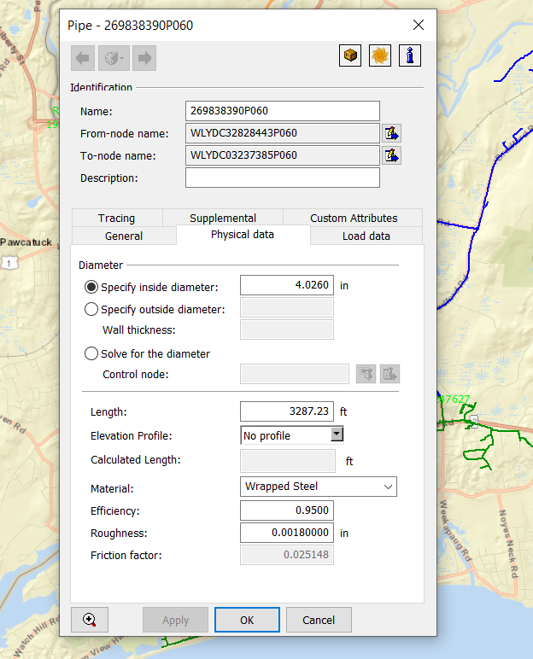
Model Development - Facilities
Synergy Facilities:
Pipes
-Inside Diameter (ID)
-Material (efficiency, roughness)
-Length
-elevation (data available)
-Friction Factor standard calc
(Colebrook-White equation)
-Custom Attributes
Scrub “floating pipes”
Segments not “snapped” in GIS
Can solve for “unknown diameter”
Neat Trick!

Slide 6
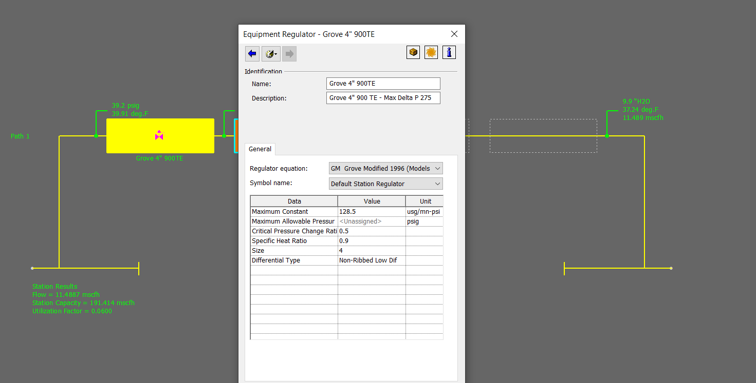
Model Development - Facilities
Regulator Stations
Known / Control Info
Type of regs
Size
# of runs (paths)
Specs
Constants
Outlet Set Point
Solving for:
Utilization %
Flow
Min inlet pressure
Max Flow Rate (capacity)

Slide 7
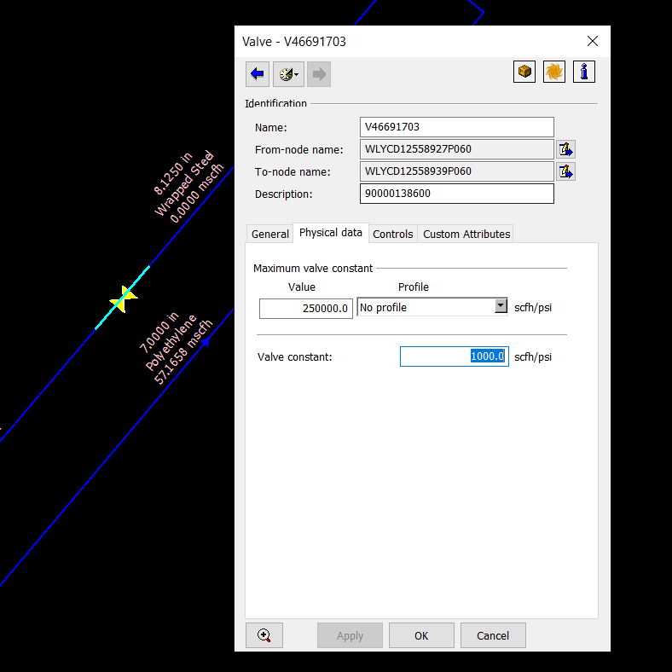
Model Development - Facilities
Synergy Facilities:
Valves
-Type (check valve, full port, etc)
-Constant (scfh/psi) = % open
-Normally closed/open
-Bypass valves

Slide 8
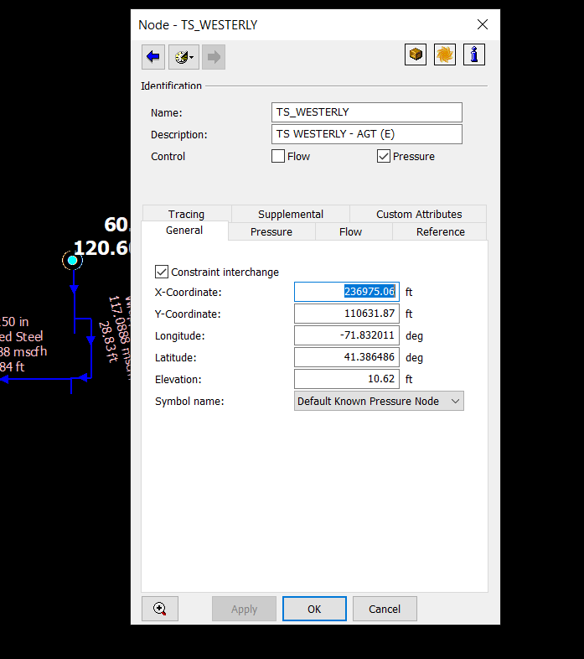
Model Development – Nodes
Nodes:
Segments between a facility (from & to nodes)
Known Pressure/Flow set nodes
Gas Composition (source nodes)
Pressure units - Primary (psig) or Secondary (inwc)
Elevation
XY Coordinates (customer assignment)
Types of Nodes:
Supply Points
-City Gates
-Storage/LNG
-Control nodes (regs)
Demand Nodes
-Customer data / load profile assigned to node
Load usage per HDD (flow categories)

Slide 9
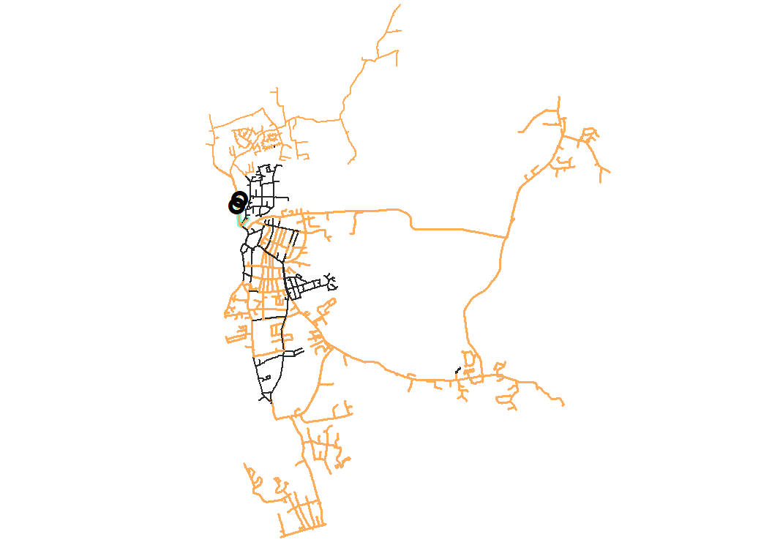
Model Development – Customer Load Profile
Extracting Customer Data
-Customer usage from company billing system (2-3 years historical)
-Weather Effector- Corresponding Temperature data for the local area (daily avg)
Load Factors
-Base Factor: non-temperature dependent (Cooking, Hot Water, Drying, etc)
-Heat Factor: Heating load which increases as temperature drops
Customer Loads = Base Factor + (Heat Factor x HDD)
Custom Loaded Customers – Large Commercial & Industrial / Special Contract
-Large Use trends >5dth/hr (typical resi / small commercial is .1 to 1 dth/hr)
-Dual Fuel Capabilities, Interruptible customers (Non-firm curtailment at x HDD)
Seasonal Usage (like Asphalt Plants), Special contracts
Customer Load profiles Created
-”Flow Categories” are created set up Synergy model where load profiles are allocated to the assigned nodes
-Can develop seasonal models or HDD specific models to specify analysis criteria

Slide 10
Model Development – Daily Usage Pattern
Example:
System Sendout 350,000 dth/d
RIE assumes 5% peak hour
17,500 dth/hr
Typical 1/24 supply contract to a city-gate (14,582 dth/hr, 4.1%)
Design Day Requirements
-Calculate Min LNG requirements
-Reviewing Gas Supply Portfolio (Capability of Supply/Demand balance between pipelines)
-Review MDQ or MHQ at City-Gates
  Daily Usage Pattern

Slide 11
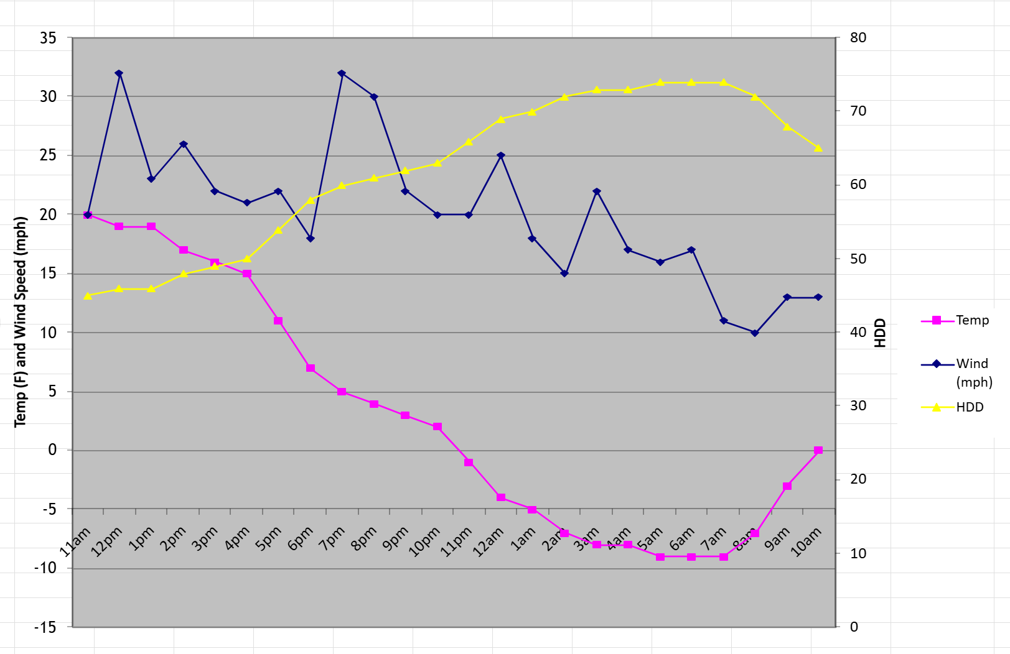
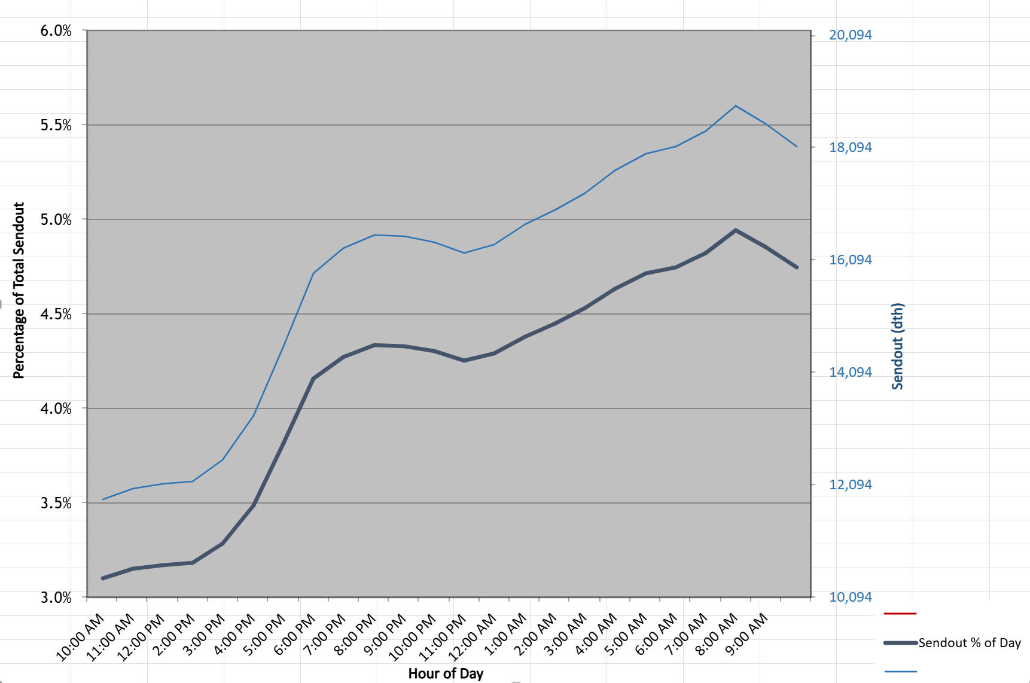
Model Development – Daily Usage Pattern
Temp / HDD
Sendout (Flow rate & % of total day sendout)
Typical Load Curve - Dinner load (5pm – 9pm) and morning load peaks (5am – 9am)
Synergy Steady State Application is a screenshot in time, typically to anticipate the peak hour of an anticipated daily sendout

Slide 12
Model Verification – How Accurate Are the Model Predictions?
Select Verification Day (Coldest observed gas day, highest sendout gas day, or operational discrepancy)
SCADA Extract, large customer meter/usage data
Review & update model - Completed or in progress work, reg station upgrades
Match Observed System Sendout peak hour to Model
Match Observed Operational set points (reg settings, LNG output, BTU value, etc)
Compare Model Data Vs Observed SCADA Data:
Investigation triggered when a point is out of acceptable tolerances
(ex: LP 1” wc variation, HP 10% MAOP)
Gate Station flow rate comparison
Regulator Station Performance – review utilization, unable to maintain set point (drooping outlet)
Compile findings in a Report & determine % accuracy of the model prediction to the observed field conditions

Slide 13
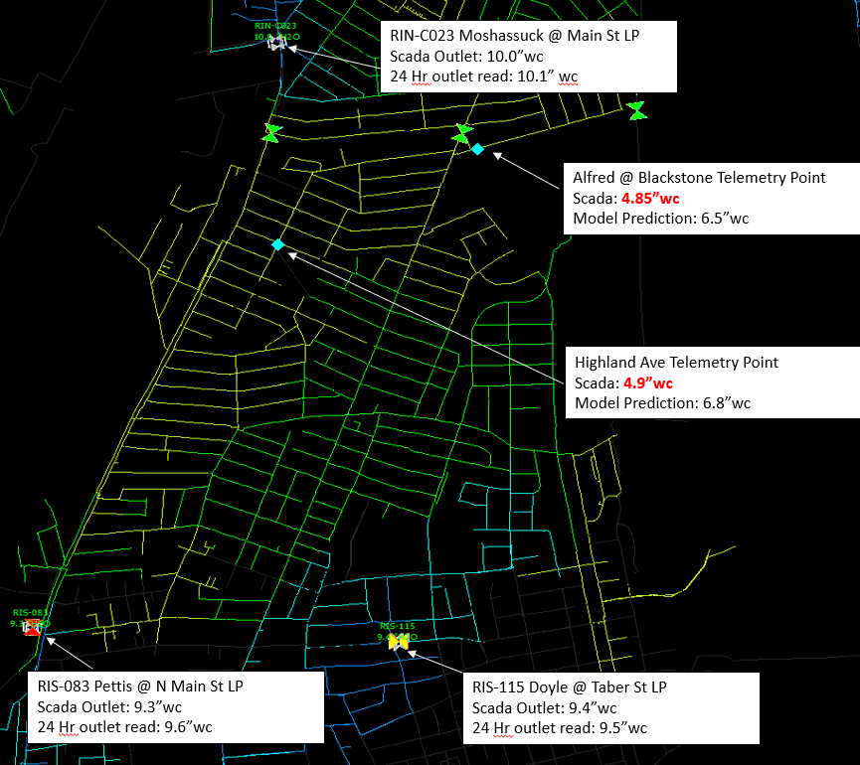
Model Verification – How Accurate Are the Model Predictions?
Field Issues:
Pressure worse at SCADA Point in field compared to Model
Examples- closed valve, unknown obstructions, missing pipe, GIS or Records error, Restrictive Fittings, leak concentration (pipe efficiency)
May require field coordination to inspect valves, camera mains, etc.
Model Issues:
Pressure worse in model compared to SCADA
Customer load assignment incorrect
Projects completed in field not updated in model Reg Station Facilities incorrect
Pipes may not be connected in the model

Slide 14
Part 2: Modeling Applications

Slide 15
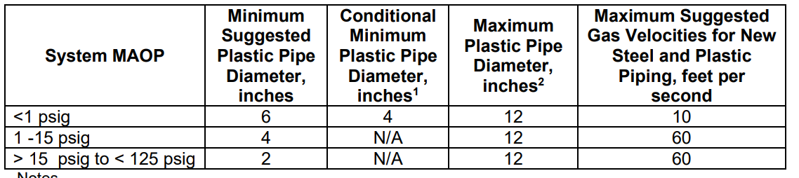
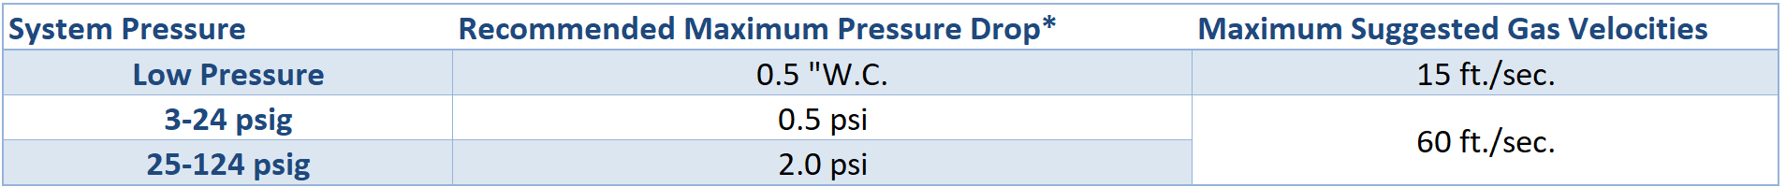
Part 2: System Planning – Design Parameters
Maximum Allowable Operating Pressure (MAOP)
-Determine MOP based on regulator set points
-Material and fitting requirements
-Excess Flow Valves
Minimum Design Pressure (MinOP)
Customer Requirements, etc
Velocity and Pressure Drop
New vs Existing parameters, mains, services, different MAOPs, etc.
Reg Station Utilization % -
Multi Run Redundancy,
MOP set points,
minimum inlet pressure requirements
Other Parameters
Minimum new main or service sizing for a range of MAOP subsystems (Table shown)
Allowable number of customers on a single feed system?
SCADA Alarm parameters, operational limitations
Isolation zones & critical valve criteria

Slide 16
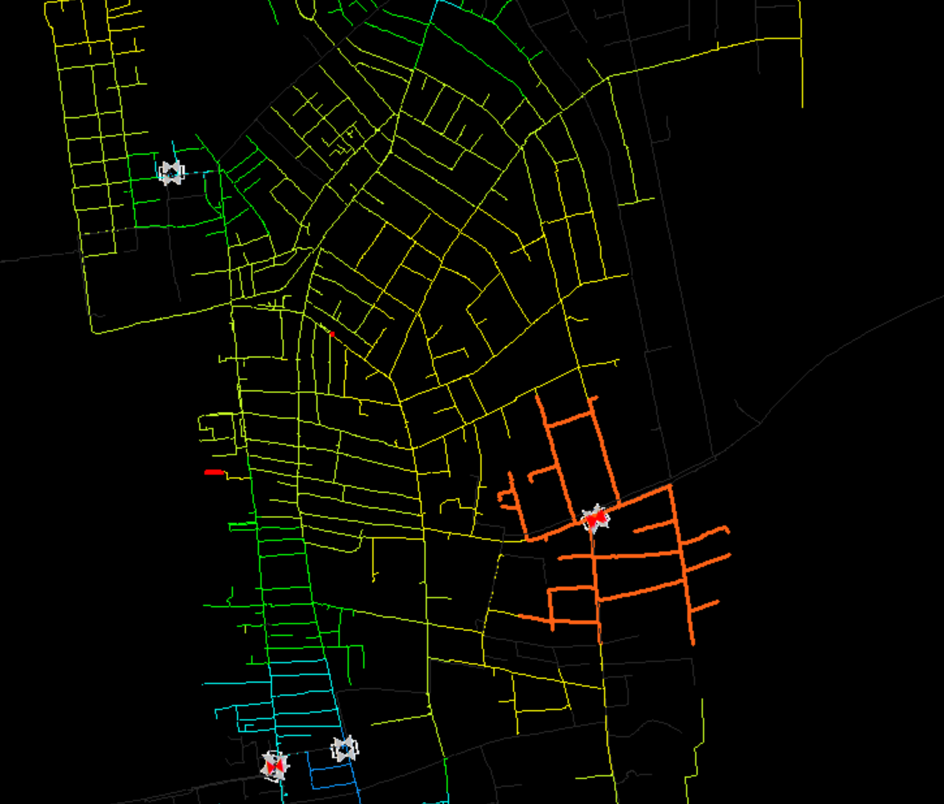
Part 2: Model Application - Overview
Utilizing Synergy Models for various business requirements:
-Developing a Capital Work Plan
Justification of capital project needs
Reinforcement projects for projected low points, Reg Station utilization
Supply Constraints, LNG Ops, Portable LNG needs
-Winter Operation Recommendations
Reg Settings, Anticipated Low Points, Special Operations
Field Ops troubleshooting (poor pressure investigation)
-Asset Management
Main Sizing, Regulator Station work (New/Replace/Abandon)
Low Pressure System Elimination strategy
Critical Valves / Area Isolation
Risk Assessments of Critical Infrastructure
-Gas Segment Decommissioning Feasibility (NPAs)
-Load Shed Planning, Contingency Planning
-Gas Capacity Request (New Customers, Growth Analysis)
-Reviewing Planned work (SOP)
tie-ins, cut offs, bypass requirements
Reg station shutdowns, Set point adjustments
Temperature / HDD restriction
-Emergency Response

Slide 17
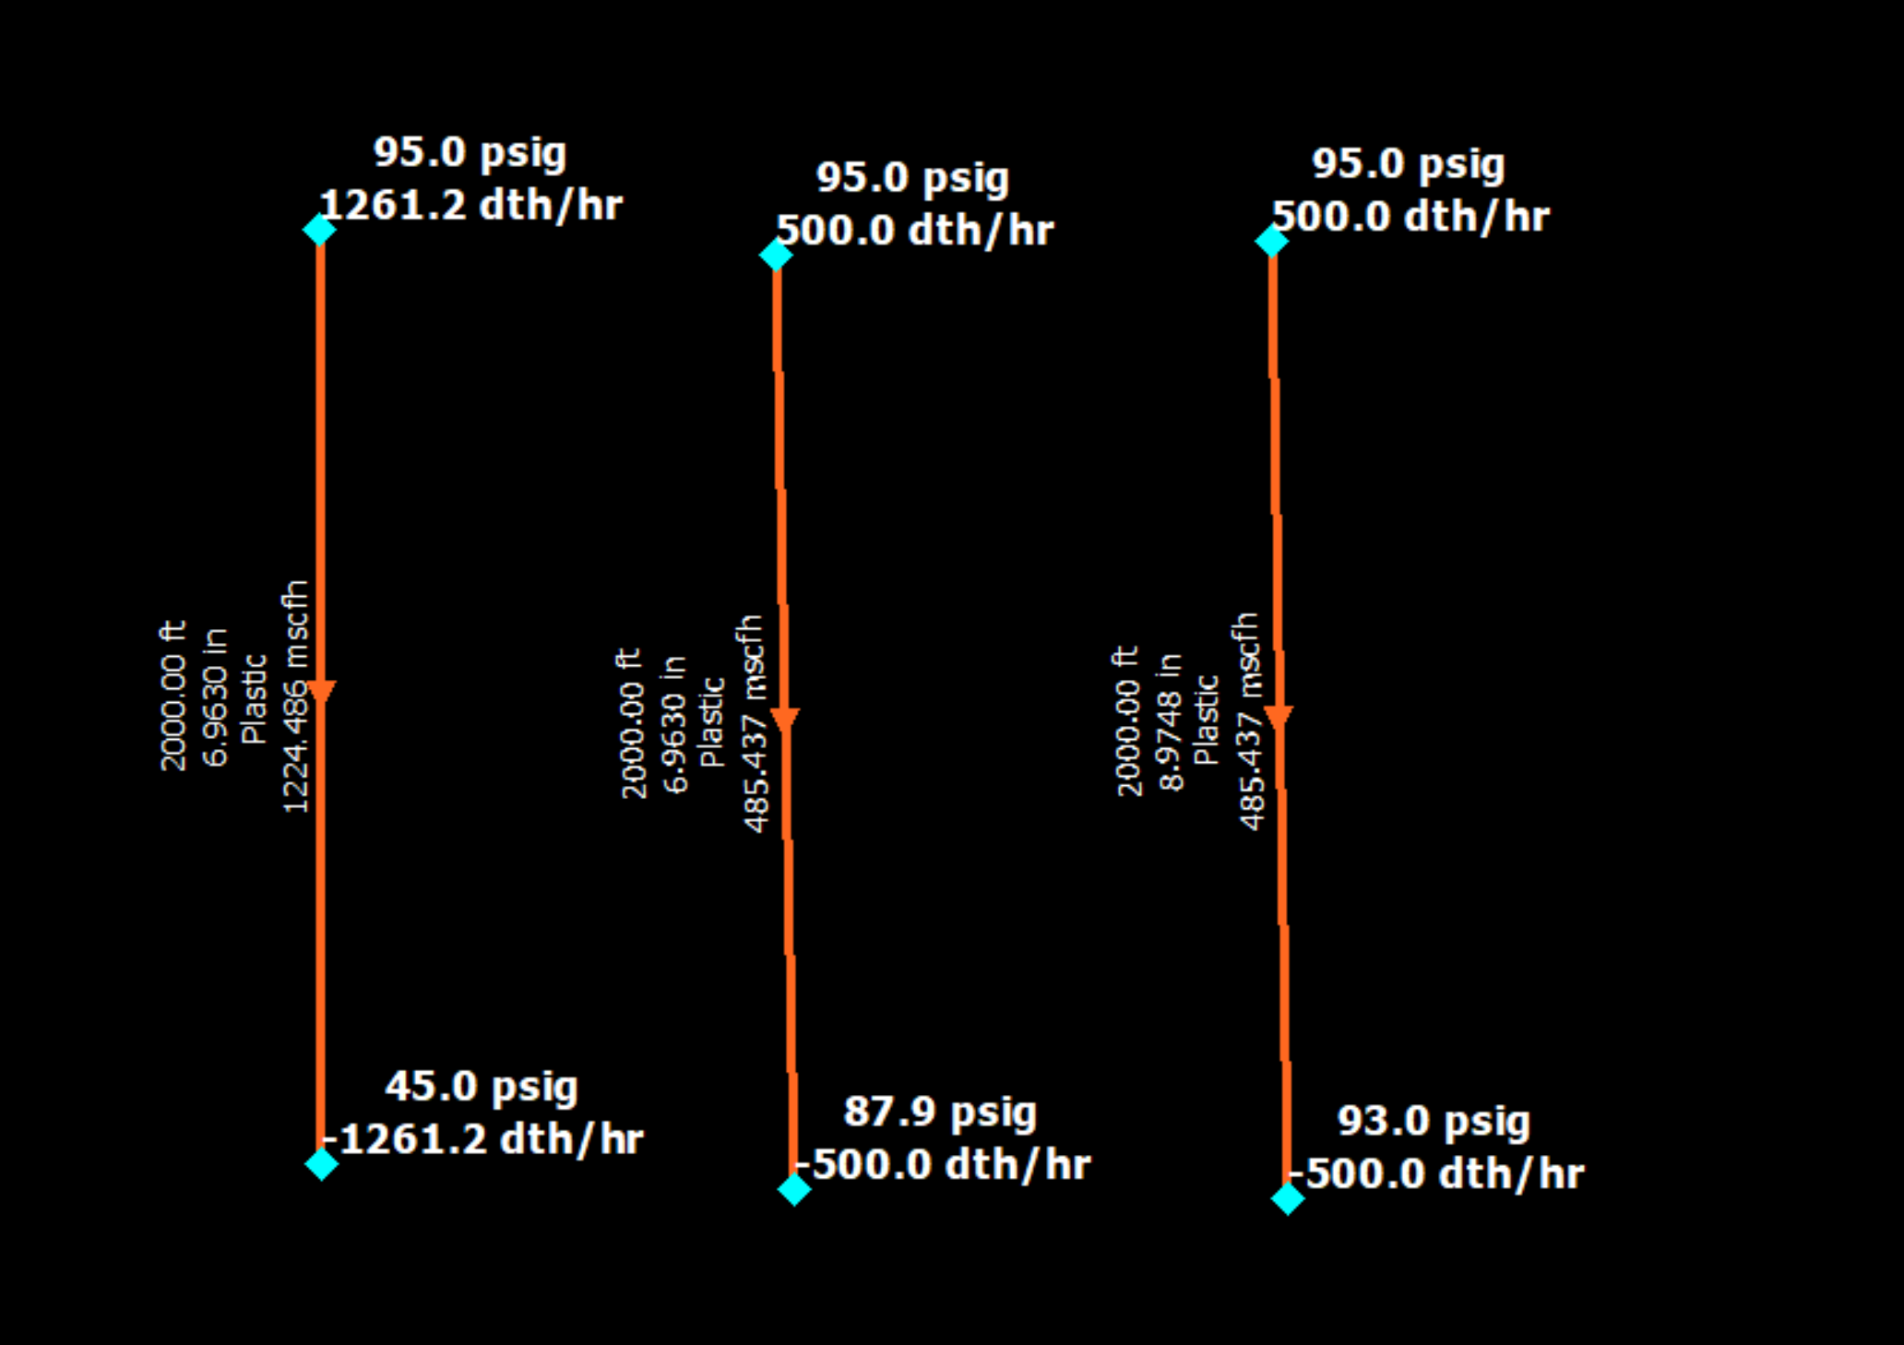
Model Application – Basic Concept
Solving for an Unknown variable
LEFT:
Solving for Flow rate
(Known pressure at the From node and To Node, Known pipe diameter, material specs, length)
Middle:
Solving for To Node pressure
(Known Pressure at From Node, Known demand at To Node, known pipe diameter material etc.)
RIGHT:
Solving for Pipe Diameter to achieve To Node Pressure
(Known From Node Pressure, Known To Node Pressure & Demand)

Slide 18
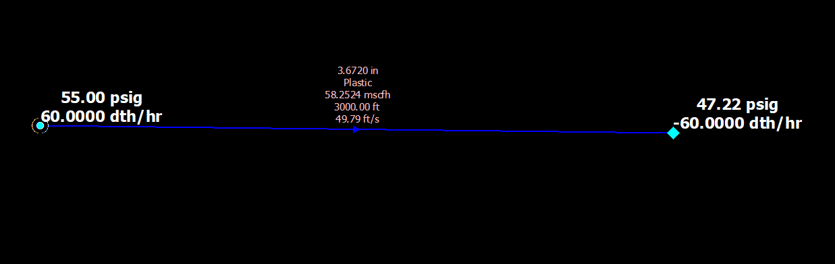
Model Application – Basic Concept Example 2
Example:
From Node – Pressure Set to 55 PSIG (KNOWN pressure)
Facility (pipe) – 4” PL 3,000 ft (Known Facility components such as ID, Length, material etc)
To Node – Flow Set demand to 60 Dth/hr (KNOWN flow rate)
Solving For → To Node Pressure
Supply equals Demand for a model to balance in the steady state application. Requires Known parameters to solve for unknown parameters
Model settings have different equations to solve for the parameters provided within a steady state application and are commonly used equations in the industry.
Known From Node Pressure
Known
SOLVED To Node Pressure
Also solves velocity through the facility based on the From & To Node data
Known

Slide 19
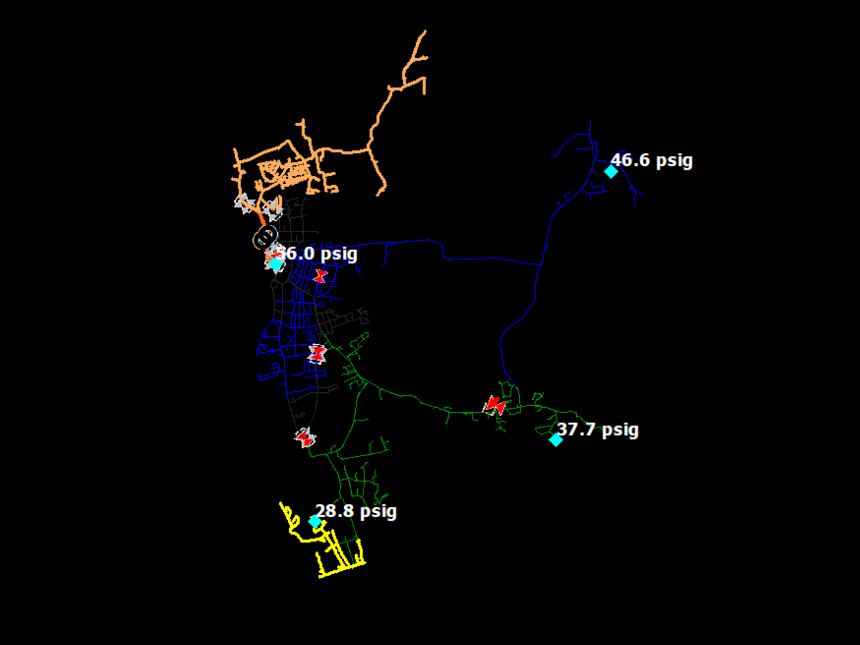
Model Application – Basic Concept
Normally solving for downstream node pressure based on customer demand (nodes other than supplys are known flows)
Known Material / Infastructure based on GIS
Set Reg station set points
Take Station Supply flow rate = Customer Demand
Supply Points
Solving For Pressure throughout system

Slide 20
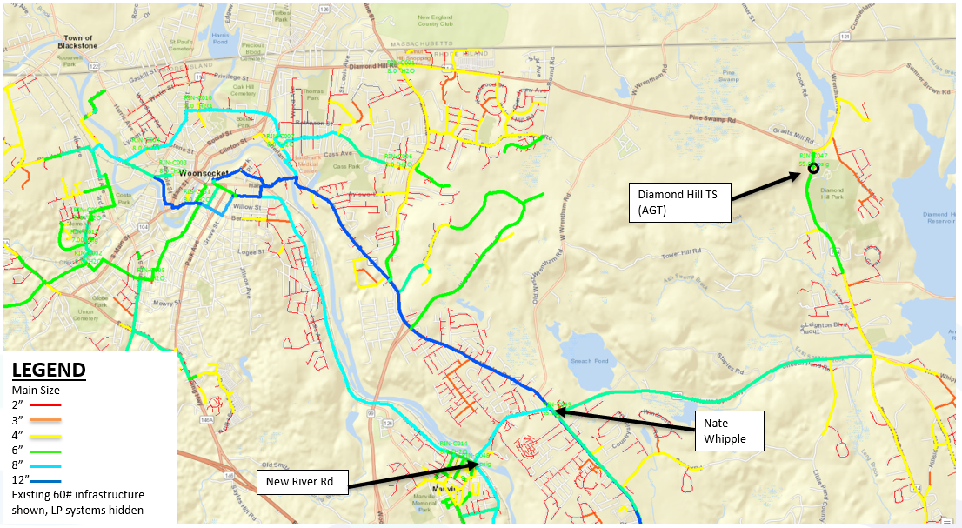
Model Application – Basic Concept
Visual Representation for Analysis
Reg Station
Bottleneck
Restrictive 8” main
Reg Station (At Max Capacity)
Reg Station

Slide 21
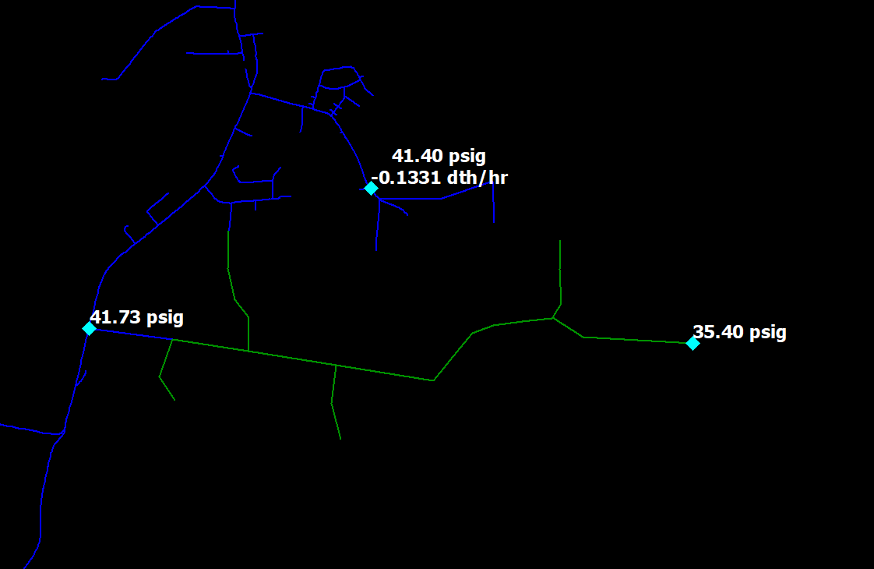
Part 2: Model Application – New Customer
-New residential development for 32 homes requesting gas. Total requested load - 8 dth/hr (.25 per home)
What is most cost effective way to serve this customer & maintain system integrity
Closest main – 2” 60 PSIG
Load diversifies to 5 dth/hr
New Customer Location

Slide 22
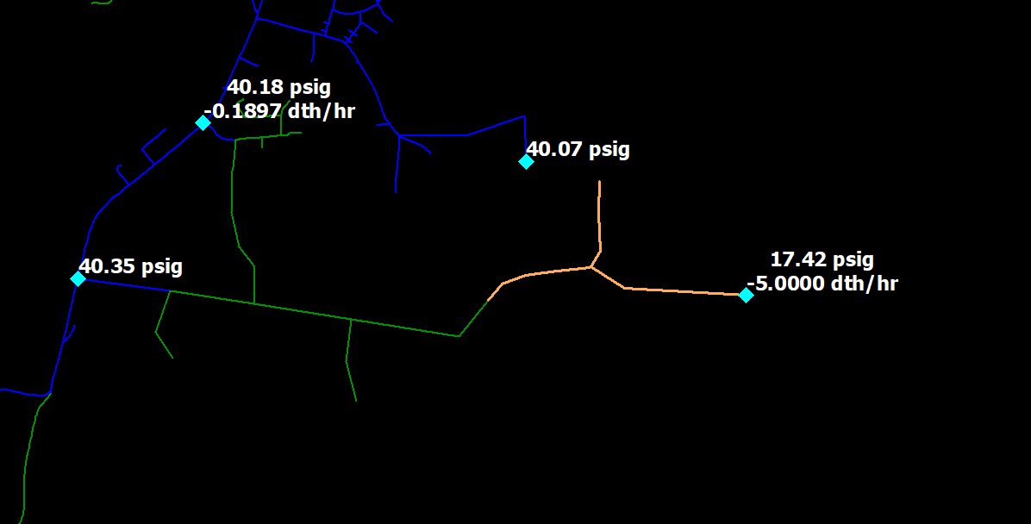
Part 2: Model Application – New Customer
Before: 35.4 psig
With Load: 17.4 psig
Not acceptable!!!
Two Key ways to reinforce a system
Increase Pipe Size
Integration of more supply points
2” main serving customer location is undersized

Slide 23
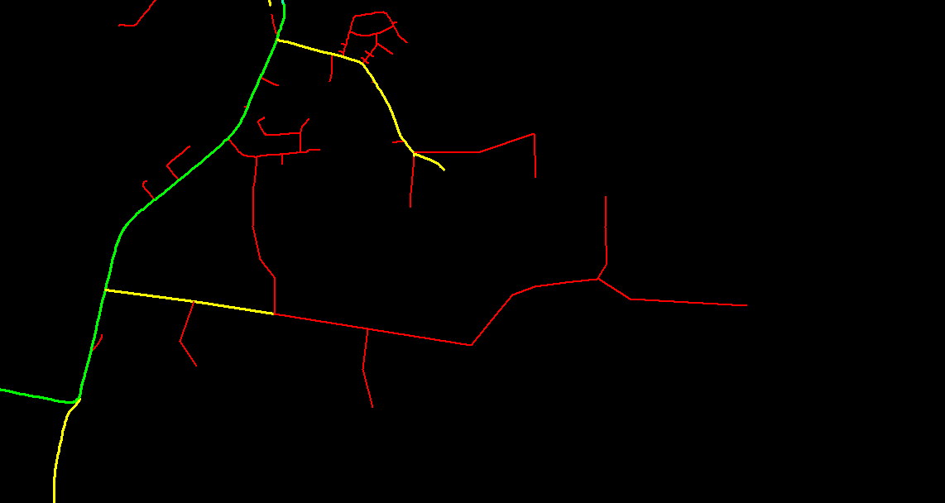
Part 2: Model Application – New Customer
Diameter View
Green – 6”
Yellow – 4”
Red – 2”
Looping Options?
Relay Option?
Compare lengths & size
Option 0
Go electric - Boo!!

Slide 24
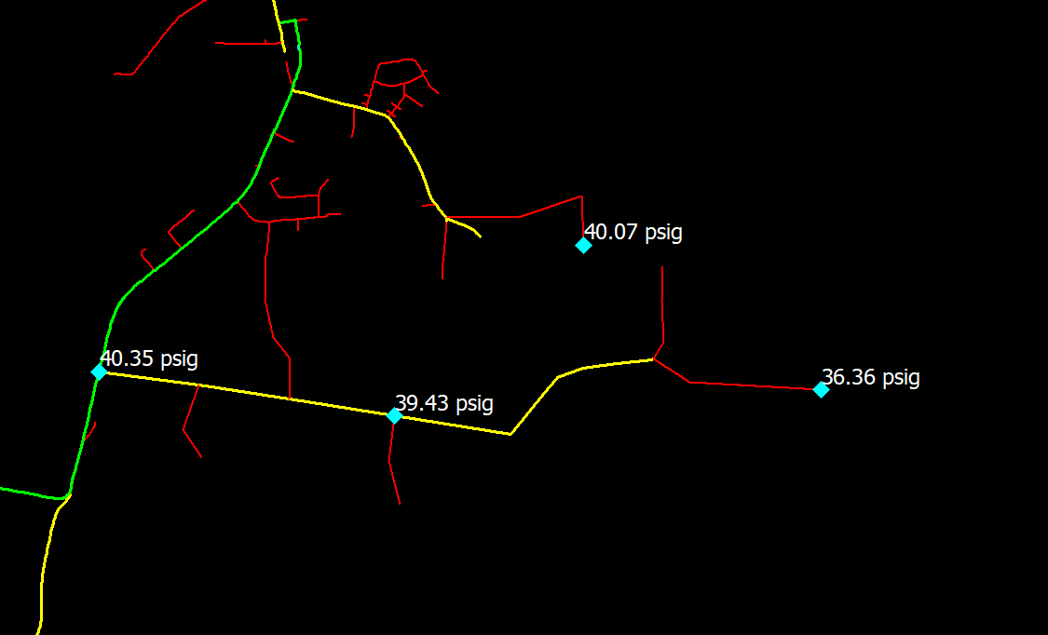
Part 2: Model Application – New Customer
Option 1:
Relaying 2” with 4”
$$$
RECAP
Before: 35.4 psig
No reinf: 17.42 psig
w/ 4” relay: 36.36 psig
Acceptable (better result)
Green – 6”
Yellow – 4”
Red – 2”

Slide 25
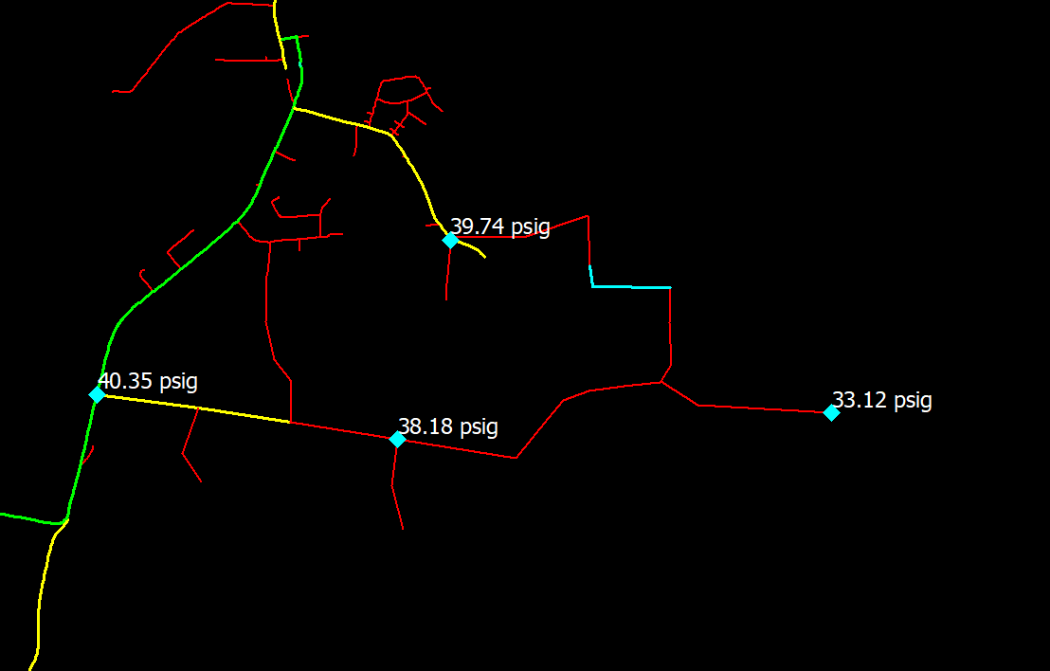
Part 2: Model Application – New Customer
Option 2A
Looping section of 2”
Cheapest option $
Constraints still shown (issue passed on to the next future development looking for gas)
RECAP:
Before: 35.4 psig
No reinf: 17.42 psig
w/ 4” relay: 36.36 psig
2” Loop: 33.12 psig
Green – 6”
Yellow – 4”
Red – 2”

Slide 26
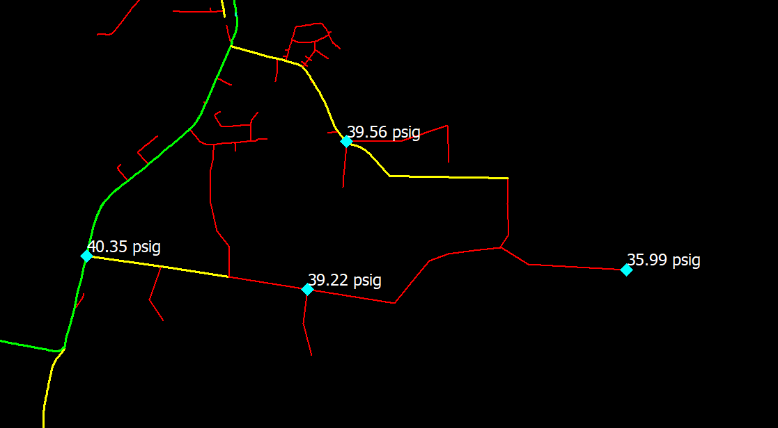
Part 2: Model Application – New Customer
Option 2B:
Looping with 4”
Improves pressure
Two way feed
$$ cheaper than Option 1
RECAP
Before: 35.4 psig
No reinf: 17.42 psig
w/ 4” relay: 36.36 psig
2” Loop: 33.12 psig
4” loop: 35.99 psig
Design Criteria:
Allowable system pressure drop = 2 psig
Min design pressure = 10 psig

Slide 27
Part 2: FIELD INVESTIGATION

Slide 28
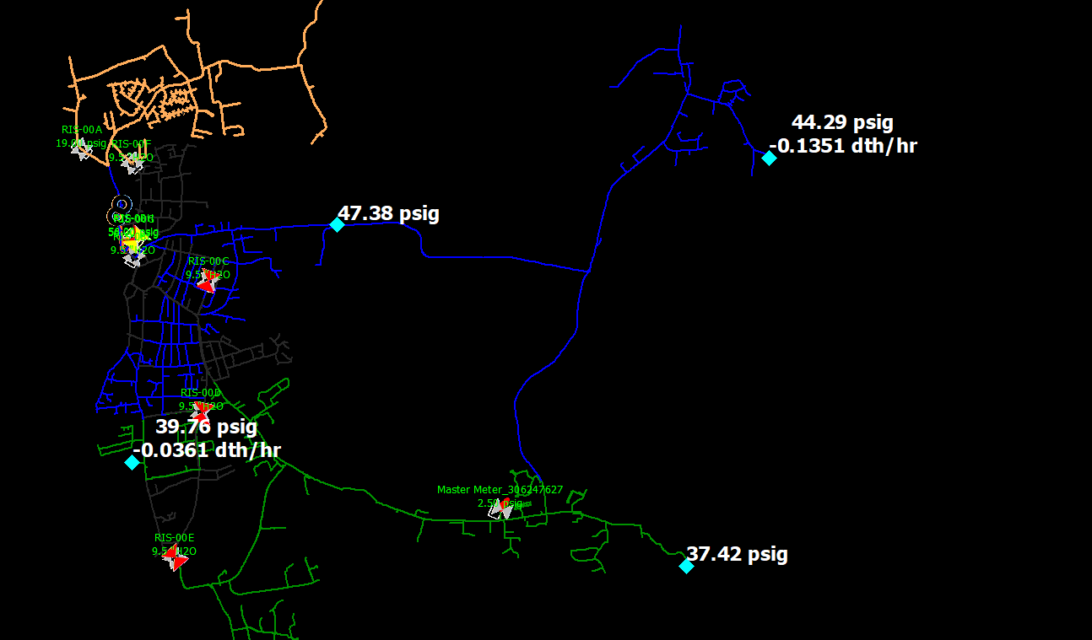
Part 2: Model Application - Troubleshooting
Model shows extremity point (top right) of 44.3 psig and (bottom right) 37.4 psig.
Verification points showed 49.6 psig (top right) and 25 psig (bottom right)
Gas Control asked to assist with troubleshooting what may be causing the southern points to be lower than anticipated
SCADA:
50 psig
SCADA:
26 psig

Slide 29
Part 2: Model Application - Troubleshooting
Identify System integration
Follow flow paths to location from Source
Restriction in lateral?
Inaccurate loading in model?
Any recent in progress or completed work in GIS?
Laterals feeding towards the extremity

Slide 30
Part 2: Model Application - Troubleshooting
Potential Suspects: Valves shown in GIS

Slide 31
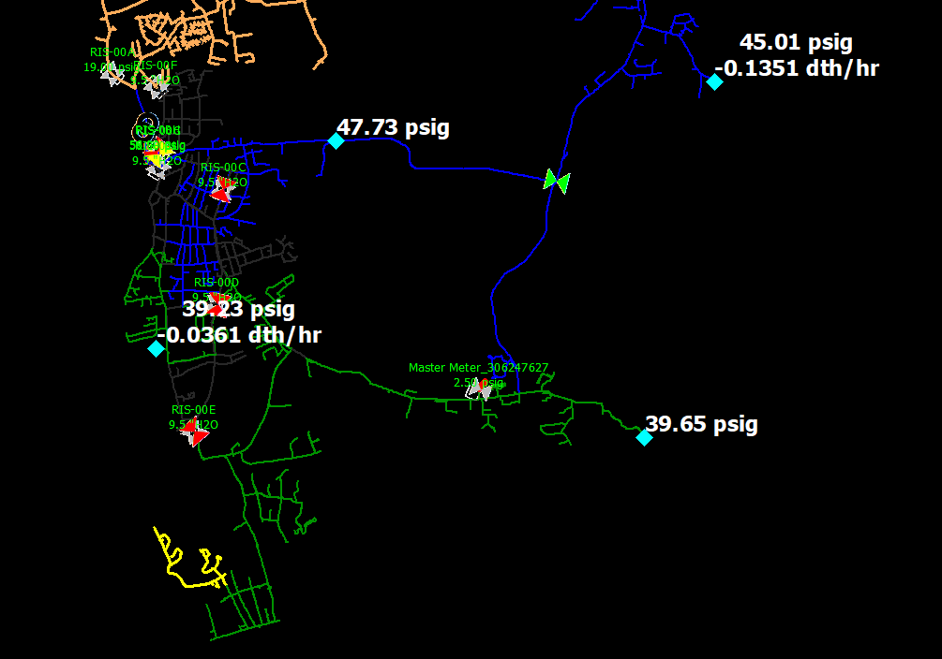
Part 2: Model Application - Troubleshooting
Suspect 1 investigation:
Not a likely suspect
Shows an improvement?!
Closed valve???
Old Main, no recent construction Activity
Shows an improvement?!

Slide 32
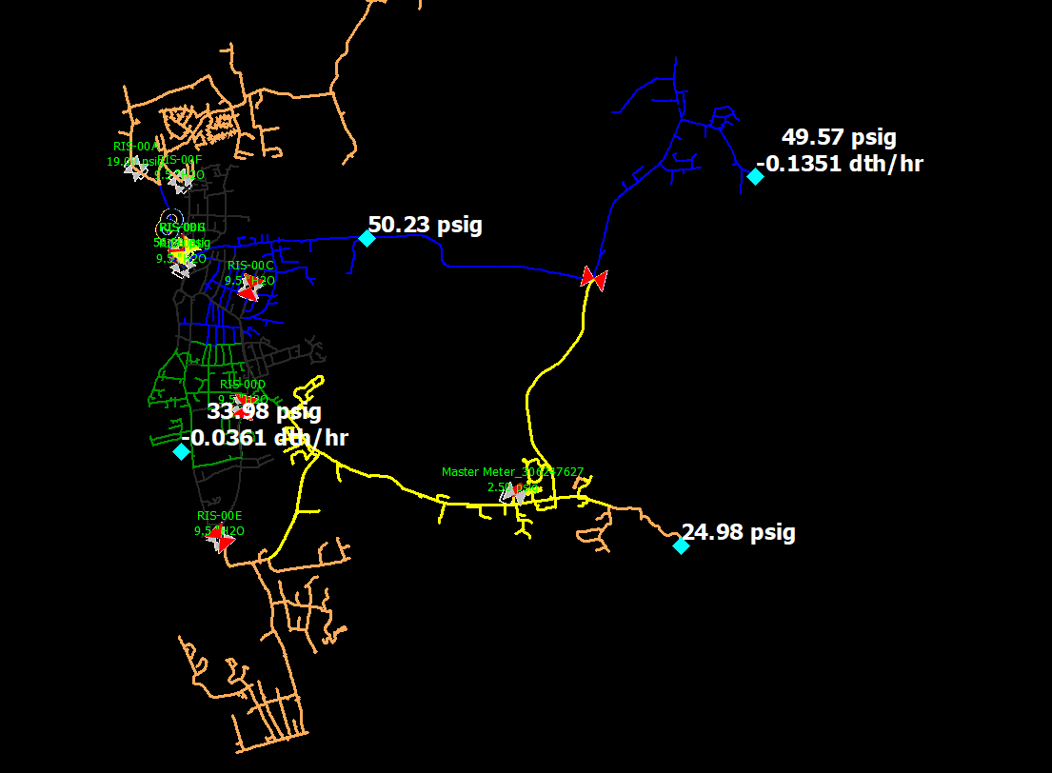
Part 2: Model Application - Troubleshooting
SCADA:
50 psig
Closed valve???? Work recently completed
SCADA:
25 psig

Slide 33
Synergy’s Relationship with Gas Departments
Coordination, Communication, & Support with other all parts of the gas business:
Gas Control
I & R
Field Ops
LNG
Gas Supply & Procurement
Load Forecasting (data & analytics)
Asset Management & Design Engineering (Sizing, scoping, future planning, risk assessments, prioritization)
Resource Planning, Work Coordination
Public Works
Compliance & Safety (Critical Valves, mandated programs)
Jurisdiction (Communication to customers on need for certain projects, etc)
Sales (growth project review)
Dispatch – (Emergency Response)
Meter Data Services (customer usage review)
Mapping (Corrections, GIS extracts)
Finance/Budgeting (Asset Management)
Electric Utility – (Power Gen supply, growth, electrification studies, rolling blackout issues on LP gas systems)
Future of Heat/ Act on Climate (hydrogen blending, RNG, segment decommissioning, etc)

Slide 34
Summary
Other Synergy Gas Modules
-Steady State (Typical LDC application)
-Compressor Stations
-Unsteady State (Transient) (Typical Transmission application)
-Regulator Station Module (relief valves, reg failure, overpressure protection)
-Area Isolation Module (AIM) – critical valve program
External Training – DNV GL Synergy Training classes (basic, advanced, etc)
Common Issues for Awareness:
-Complacency
-Lack of Communication across departments
-Lack of understanding system operations
-Lack of knowledge in standards, policy, code & procedure document
-System Design Criteria has gray areas
-Poor Data!!! (We are only as good as the data we get)

Slide 35
Questions???
“Where the needs of the world and your talents cross, there lies your vocation”
-Aristotle
Some Wisdom from the Stoic Mindset

