Slide 1



Pipeline Safety, Innovation & Management
Underground Assets – Sustainable Energy Programs
NGA Gas Operations School
Christopher A.Cavanagh, P.E.
Consulting Engineer
Gas Asset Management & Engineering
  06/04/2026

Slide 2
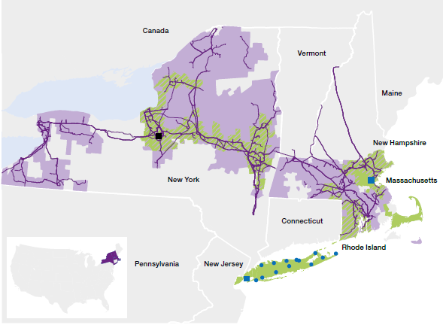

National Grid
National Grid is one of the world’s largest investor-owned utilities, with more than
7 million gas and electric U.S. customers and 22,000 employees in the U.S. and U.K.
National Grid U.S. by the numbers
3.6 million gas customers
  Gas network of 35,000 miles of gas distribution pipeline; 490 miles of gas transmission pipeline
3.4 million electric customers
  Electricity transmission network of 8,800 miles of overhead line; 100 miles of underground cable; 380 transmission substations
2026 NGA Gas Operations School

Slide 3
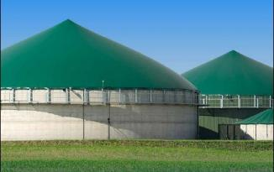
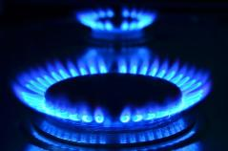
Agenda
Future of Heat
Pathways of multiple solutions consisting of sustainable ways to attain net zero in the energy we deliver and contribute towards greater environmental sustainability.
Current Energy Scenarios
Decarbonization Roadmap
Emissions
Renewable Natural Gas
Hydrogen Blending
Geothermal District Heating
Conclusions
2026 NGA Gas Operations School

Slide 4
Current Energy Scenarios
Most Primary Energy Use in Buildings Comes from Natural Gas
2026 NGA Gas Operations School

Slide 5
Energy – Current Scenario of MA
Underground Assets
Electric Resources
Actual peak hour send out for National Grid, MA 2020-21 was 17GWh respectively.
Note(s):
52.3% of Massachusetts depend on natural gas for heating. Fuel oil and propane account for 28% while 17% have electrified heat.
2026 NGA Gas Operations School

Slide 6

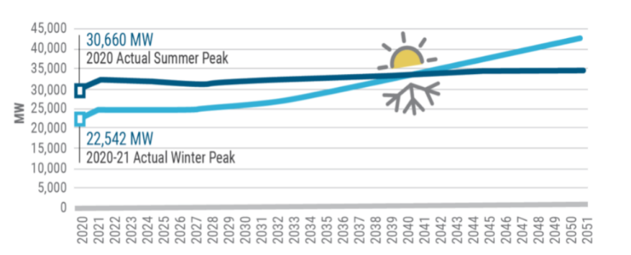
Electrification of Heat Will Impact the Electric System
2026 NGA Gas Operations School

Slide 7
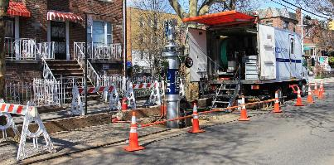
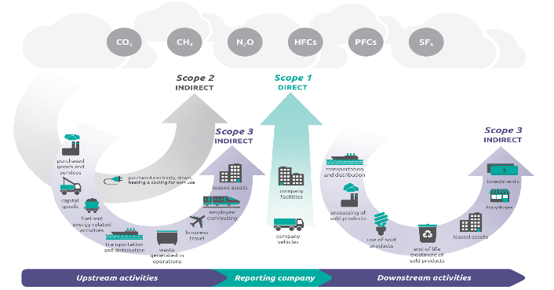
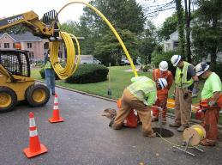
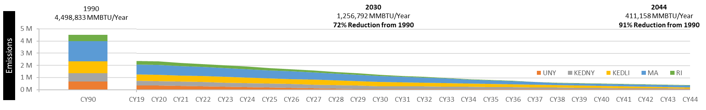
Large Potential Emissions Reductions
Direct (Utilities) & Indirect (Customers)
Cast Iron Joint Sealing Robot
Scope 1
Pipe Replacement
2026 NGA Gas Operations School
Image from https://www.epa.gov/climateleadership/scope-1-and-scope-2-inventory-guidance

Slide 8
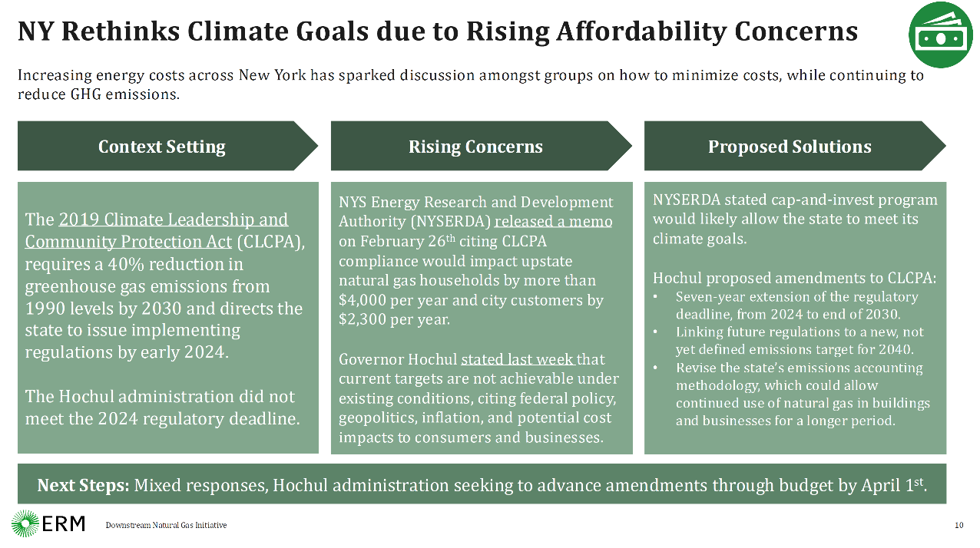

Slide 9
How the Gas Network Will Help Us Achieve Our Goals
Strategy Roadmap
Power-to-gas
Hydrogen blending
Geothermal
CCUS
Future Heating Solutions
New customer products
RNG supply goal
Investing in RNG projects
Legislative strategy & policy framework
Decarbonize the Gas Network
Modern infrastructure, replace LPP
Integrate advanced leak detection
Reduction goal, ONE Future
Engage entire value chain
Reduce Methane Emissions
Reduce Natural Gas Consumption
Accelerate EE & DR programs
“No regrets” electrification
Geothermal / electrification investments
2026 NGA Gas Operations School

Slide 10

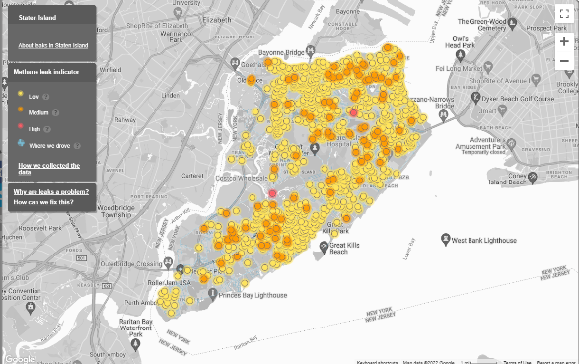
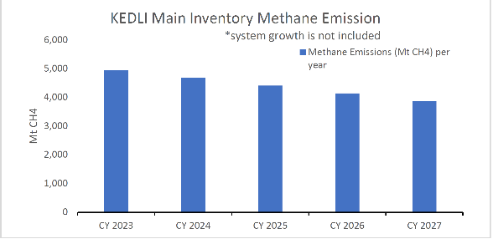
First: Minimizing Number of Small Leaks is an Imperative
Emissions impacts from LPP retirements result from reduced fugitive methane emissions
Source emissions factors are
available from “New York State Oil
and Gas Emissions Inventory”,
NY DEC November 2022
2026 NGA Gas Operations School
Gas Leak Mapping 2014 Environmental Defense Fund

Slide 11
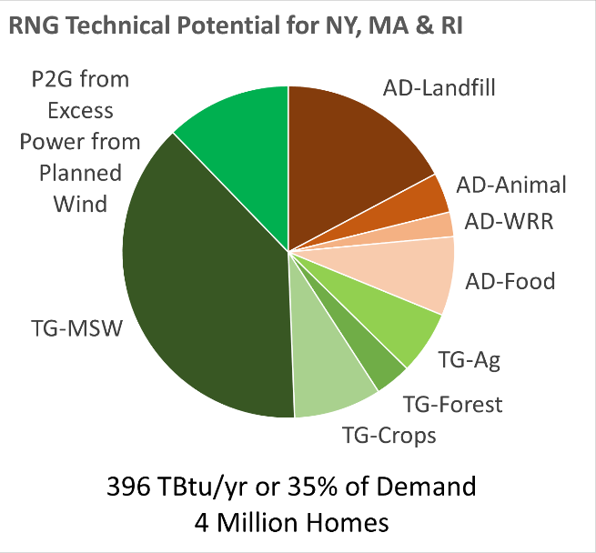
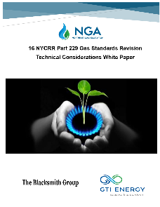
Renewable Natural Gas (ref. AGF)
Renewable natural gas (RNG) is a pipeline-quality gas that is fully interchangeable with conventional natural gas and thus can be used in natural gas vehicles. RNG is essentially biogas
(the gaseous product
of the decomposition
of organic matter)
that has been processed to purity standards.
2026 NGA Gas Operations School

Slide 12
RNG has a Environmental Advantage
2026 NGA Gas Operations School
Ref: Mahajan etc. al. Comparative Carbon Intensity Assessment for Renewable Natural Gas Transportation Options

Slide 13

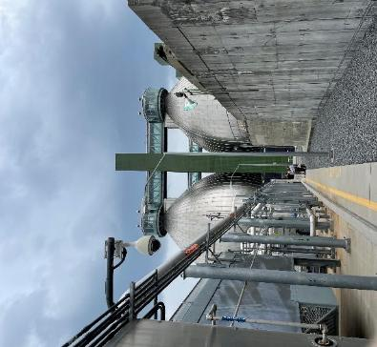
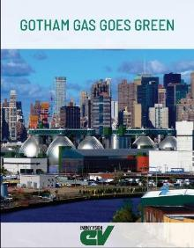



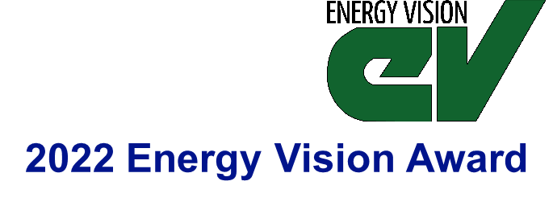
Renewable Natural Gas – Newtown Creek WRRF
Project commissioned and operational, March 2023.
FY25 Statistics:
    Excellent operational success in FY24, with over 91% operation.
    Newtown Creek RNG has injected over 140,000 dekatherms of RNG.
    Reducing emissions by approximately 36,500 MT of CO2e, equivalent to:
8,700 | 600,000 | 5,000
2026 NGA Gas Operations School

Slide 14
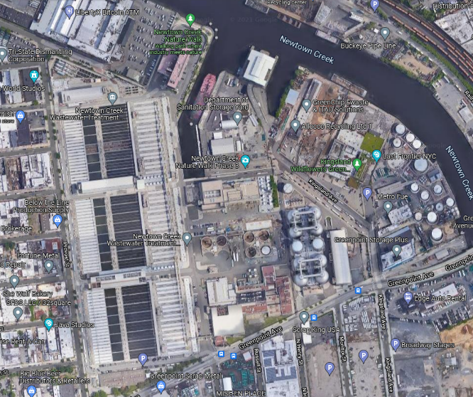
Newtown Creek RNG Project Location in NYC
Excellent access to utilities and biogas source
Allows thermal oxidizer placement adjacent to facility flare, suitable design conditions
Use of area consistent with current gas infrastructure use
Excellent street access for maintenance and response
Properly secured behind DEP perimeter
2026 NGA Gas Operations School

Slide 15
Bio-gas processing to become RNG - Process Flow
Point | Psi | Btu
1 | < 9 | ~600
2 | 100 | ~600
3 | 60 | ~990
4 | 3 | ~110
Pressure Swing Adsorption
(PSA)
Tail Gas
4
Gas
Drying
2
Vacuum Pump
Thermal Oxidizer
1
Compression
H₂O
2
3
Odorant
Anaerobic Digester
Pipeline Quality Renewable Gas
Purge Vessel
2026 NGA Gas Operations School

Slide 16
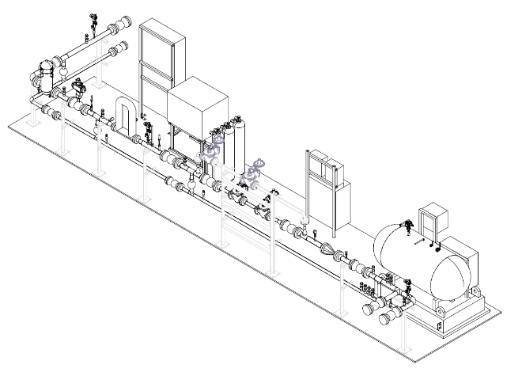
RNG Project Development and Strategy
Strategy going forward is to only own RNG interconnection, not any processing or conditioning equipment
  Ensures Safety
  Consistent with policy
CAMPOS
RNG interconnections are mini-City
Gate stations with the capability to automatically shut-in the producer
due to a gas quality issue
Partnership with NYSEARCH and Campos to develop prefabricated interconnection skid design
  Ideally will lower interconnection costs
  One system with wide flow capabilities
EPC
2026 NGA Gas Operations School

Slide 17


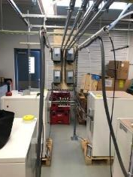
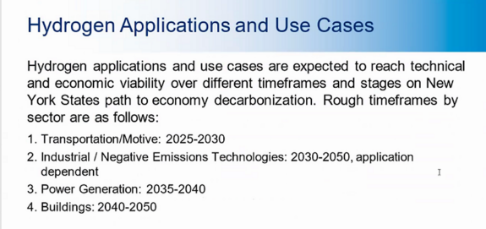

Why Hydrogen?
Hydrogen is very versatile
Hydrogen has a strong safety record
    Wider flammability limits than natural gas and higher pressures but
    Disperses very quickly
Hydrogen use has no GHG emissions
Gas Utilities have experience with hydrogen
    Hawaii Gas SNG typically 12% H₂ on Oahu
2026 NGA Gas Operations School

Slide 18

NYSERDA Zero by 40 Technoeconomic Assessment
September 2025 (EPRI)
Evaluates seven candidate dispatchable emissions free resources (DEFRs) that could provide clean, firm power to the New York State grid and other uses.
    Hydrogen
    Biofuels,
    Advanced
    Nuclear
    Carbon Capture
    and Storage
    Next-Generation
    Deep Geothermal
    (8 km deep in NY)
    Long-Duration
    Energy Storage
    Virtual Power Plants
Pathways from Primary Energy Source to Hydrogen to Peaking Power
2026 NGA Gas Operations School

Slide 19

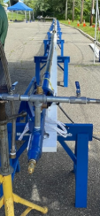
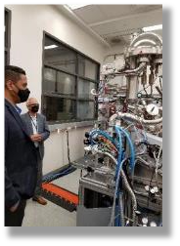





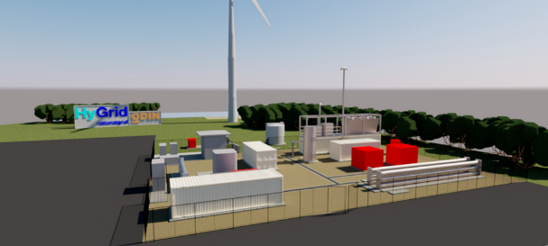


Hydrogen in National Grid’s Long-Term Plan
Prepare è Demonstrate è Transition
Focus on Delivery
Green Hydrogen
(or other zero carbon e.g., methane
pyrolysis aka Turquois)
Prove the safety case on
both sides of the meter
Expand Research & Development
Reinforce the environmental
case, continue leak reduction
Improve the economic case
compared to electrification
(seek IRA 45V tax credit of $3/kg)
Continue to raise public
awareness with other utilities
Develop internal capabilities
Support skills development
2026 NGA Gas Operations School

Slide 20
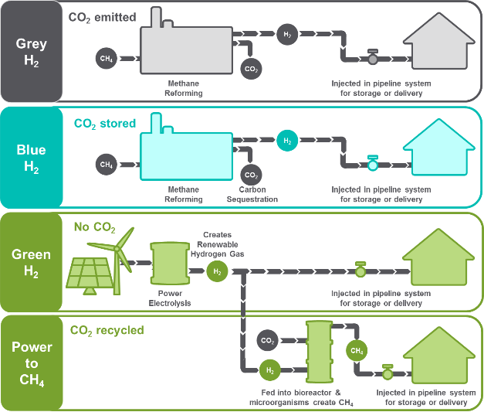
Where does hydrogen come from?
Its produced!
Efficiency, % Energy Conversion | Carbon Intensity, gCO₂e/MJ
80-90% | 110
80-90% | < 20
57-73% | ~ 0
50-64% | ~ 0
2026 NGA Gas Operations School
Rough Estimates
CI based on NREL 2013 H2 Pathways Paper
Green H2 and P2M conversions from SoCalGas 2015

Slide 21
Hydrogen Long-term Planning
Preparation
Time-Varying Resource Assessments
Pipeline Integrity and End-use Research (HyBlend & HyBlend2)
Gap Analyses
Safety Research
Cost/Benefit Analyses for Multiple Sectors
Blending Demonstrations
    Local Electrolysis
    Delivered Hydrogen
Hydrogen Microgrids (e.g., campuses, 100% H₂)
Advanced Storage (e.g., Absorbed)
High Temperature Applications (e.g., Industrial)
Demonstration
Transition
H₂ Readiness Reviews by Sector
Support Customer Transitions
    De-Blending or Methanation
  Codes, Standards & Developer Tools
2026 NGA Gas Operations School

Slide 22
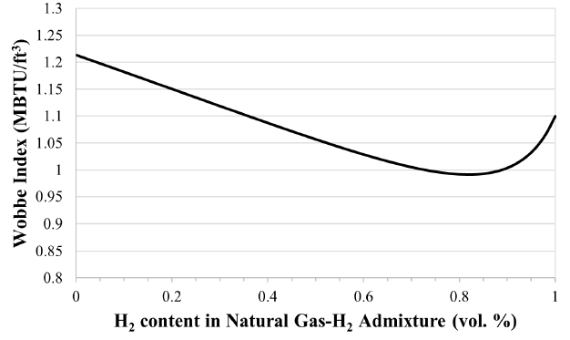
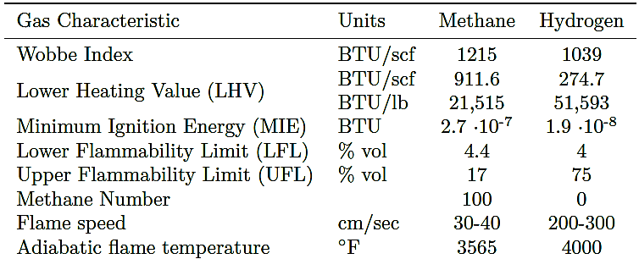
Blended Hydrogen - Combustion Properties
2026 NGA Gas Operations School
Data from HyBlend draft literature review

Slide 23
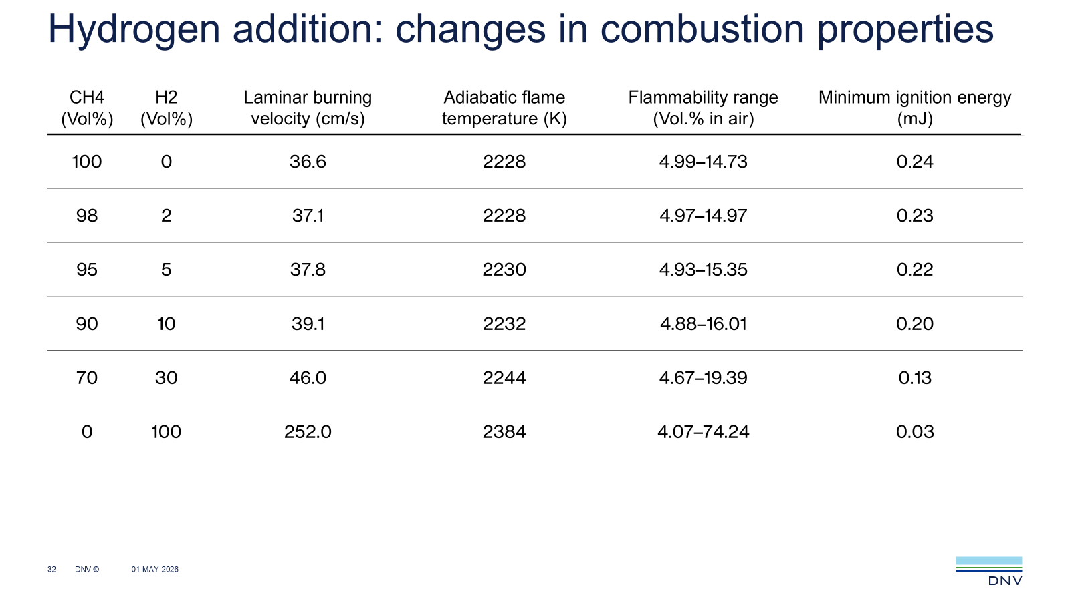
National Grid 2026 NGA Gas Operations School

Slide 24
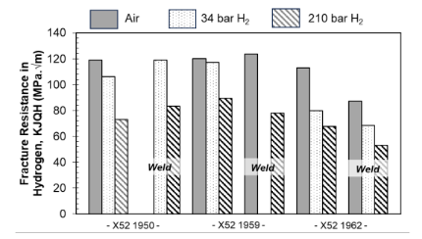
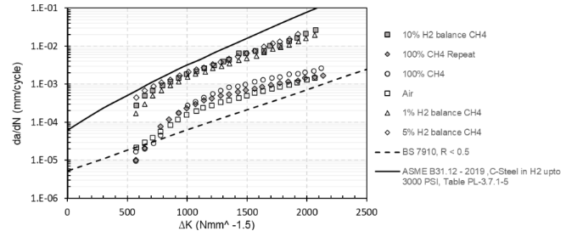
Hydrogen Impacts on Metallic Materials
Fracture Toughness (KIC)
Fatigue Crack Growth Rate (FCGR)
Magnitude of HE proportional to partial pressure of Hydrogen, however even relatively small amounts of hydrogen significantly impact toughness properties
Exact impact is material specific, requiring specialized material testing (Charpy V-notch is not valid); however, conservative assumptions of up to a 50% reduction in lower bound toughness can be made.
For distribution operating conditions, this is a pragmatic solution to validate fitness for service
Hydrogen significantly impacts FCGR. In many instances, up to an order of magnitude increase is realistic.
Exact impact is material specific, requiring specialized material testing; however, conservative assumption of a 10-fold increase can be reasonably made
For distribution operating conditions, this is a pragmatic solution to validate fitness for service

Slide 25
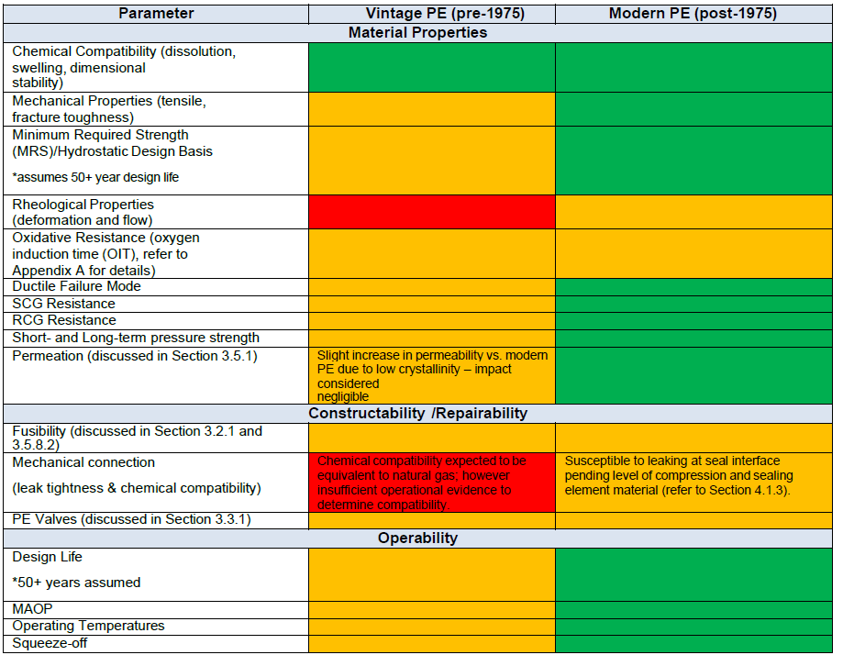
Hydrogen Impacts on Polymeric Materials
Green = Equivalent behaviour to natural gas expected
Yellow = Equivalent behaviour to natural gas likely
Red = Insufficient evidence to determine equivalence with natural gas

Slide 26


Hydrogen and End-Use Equipment
(CHS Best Safety Practice at h2tools.com)
Summary
Best Practices
0-5% - No concerns or significant performance or emission problems were noted (CSA).
5%-30% - Blends up to 20% hydrogen are well understood and pose very low risk when used in systems and appliances designed, tested, and certified for natural gas.(ref. NEEA)
Above 30% - Technical review required and modifications likely. 100% H2 appliances available (UK). See IGEM/H/1 Edition 2
Characteristics to Consider
Classes of Combustion (e.g. atmospheric, sealed combustion)
Codes and Standards and End-use Certification (new
codes, IFGC)
Equipment and Interior Leak Detection​
Technical Parameters for Review
Non-Utility Piping Compatibility (similar material)
& Pressure Regulation
Equipment Performance & Efficiency (Analytical
Tools Available)
Integral Safety Devices (IR, excess flow valve, nuisance
trips unlikely).
Flue Gas Venting & Local Emissions (e.g. IAQ
recommend ventilation)
Equipment Compatibility​ Reviewed
Blend Rates, Service Provider and Inspector Training
Automatic Leak Detection and Odorants (no sulfur interactions)
Key Takeaways
Blending Impact
Primary safety concerns are flashback and overheating, both rarely observed below a 20% H₂ blend rate. Leak rates and indoor air quality are unaffected by blending. Flame luminosity is not a concern below ~75%. Some industrial equipment and internal combustion engines require review.
Codes and Standards
Manufacturers have begun to certify their products for hydrogen blends. Standards updates (e.g., CSA/ANSI Z21, CSA P.17) are in progress.
26

Slide 27


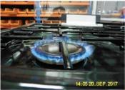




Transitioning to Hydrogen - Putting it All Together
New GHG and NO_{x} Factors – HyBlend &
NYSERDA Oil & Emissions Project at BNL
Update Codes and Standards
(e.g., NFPA-2, B31.12 etc.)
New Odorants and Illuminants
Developer Tools
(e.g., NYSEARCH RANGE Model, DOE-NLR)
Update Utility Processes (e.g., billing)
Academic Partnerships
Reducing Leakage
    Integrate H₂ into Leak Prone Pipe Programs
    Leaking Hydrogen has a GWP between 5 & 10
Gas Detection UL 1484
(Personnel Safety & Buildings)
  De-blending or Methanation for Sensitive Equipment
Fuel Cell w.H₂ Blend at BNL
HyDeploy UK
Bio-methanation SoCalGas
2026 NGA Gas Operations School

Slide 28
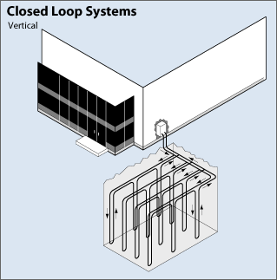

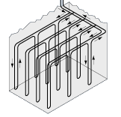
“Geothermal” Heating and Cooling – Shared Underground Assets
“The primary GHP market failure is the expectation that building owners finance the ―GHP infrastructure, or outside-the-building portion of the GHP system, such as the ground heat exchanger.”
“Geothermal (Ground-Source) Heat Pumps: Market Status, Barriers to Adoption, and Actions to Overcome Barriers”
Oak Ridge National Laboratory, ORNL/TM-2008/232 December 2008
2026 NGA Gas Operations School

Slide 29
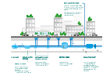



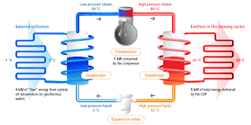
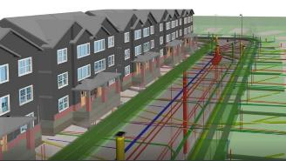
Geothermal Heat Pumps (aka Ground Source Heat Pumps)
Heat Pumps
“Geothermal” Loop
Geothermal energy is heat within the earth. The word geothermal comes from the Greek words geo (earth) and thermal (heat). Geothermal energy is a renewable energy source because heat is continuously produced inside the earth.
Heat Pumps expend energy to “move” energy from one cold to warm, instead of generating heat directly through combustion or chemical reaction.
Geothermal heat pumps use earth as the source to move energy to/from homes.
Air conditioner and refrigerators are one sided heat pumps
Connects multiple units of heating and cooling systems to the common ground source of energy
Could be vertical, horizonal and open loop systems based on the geography, economy and space constraints
Heat transfer takes place at the individual heat pump at the home water-to-refrigerant heat exchanger
2026 NGA Gas Operations School
Temperature Can Be a Challenge
Source(s): Adapted from a National Energy Education Development Project graphic, public domain & EIA

Slide 30
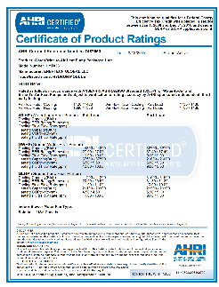
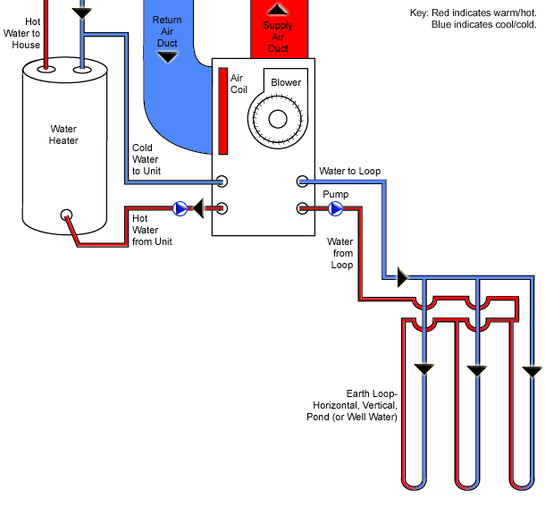
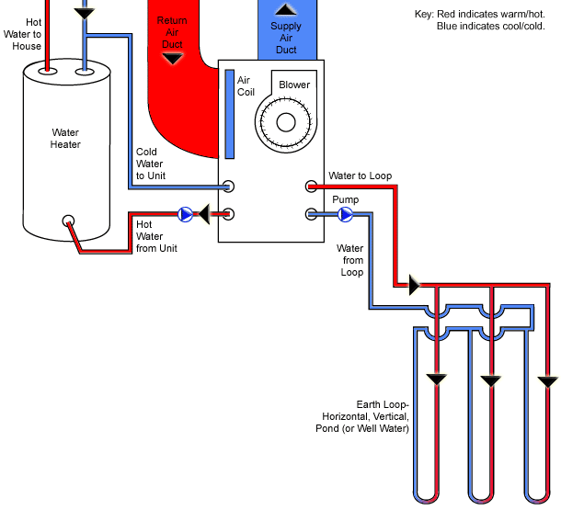
Ground Source Heat Pump Operation is Highly Efficient
Refrigeration (R-22 orR410A)
Includes compressor, expansion valve, water to refrigerant heat exchanger, air coil and reversing valve
Distribution
Distributes within the building and returns it to unit
Hot Water
Earth Loop
Vertical, horizontal or open
COP = 5.8
Heating Mode
Cooling Mode
2026 NGA Gas Operations School

Slide 31
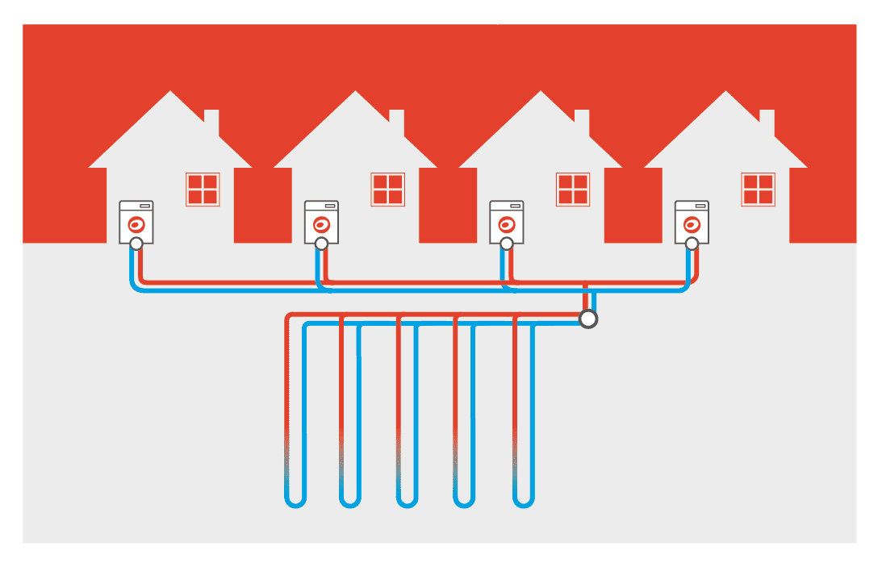
District Heating Demonstration Programs in NY and MA
National Grid will oversee the installation, operation, and maintenance of geothermal shared-loop systems that consist of ground-source heat pumps (“GSHP”) connected to a network of underground pipes that allow for highly efficient heat transfer at up to four sites within the Company’s natural service territory serving 20-40 residential and/or commercial customers.
The Geothermal Project is directed at:
  Reducing emissions resulting from customer energy use
  Promoting non-pipe alternatives
  Encouraging the development of sustainable
  heating options
  Developing new technologies to advance low-carbon
  heating solutions
2026 NGA Gas Operations School

Slide 32


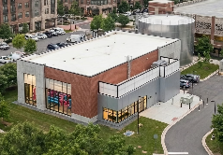
Utility Thermal Energy (UTENJA ) NY Proposals
KEDNY
NYCHA Vandalia Avenue
NMPC Pilot 1
City of Troy
NMPC Pilot 2
City of Syracuse
$108M for heating & cooling
$54.8M dist. & borefield
$24.4M customer equip.
28.4M 5-year O&M
333,000 ft²
Converting 5 existing buildings including:
2 high-rise apartment buildings
1 senior center
2 commercial strip malls
    Multiple businesses within the shopping center.
  Contractor:
$52.6M excluding borefield
$26.6M distribution only
$5.1M customer equip.
$20.9M 5-year O&M
317,000 ft²
Converting 9 existing multi-use buildings in downtown Troy
Borefield supplied by Troy LDC in a bifurcated business model where NG pays a negotiated thermal fee
$132.7M waste heat recovery
$91.9M dist. & heat recovery
$14.3M customer incentives
$26.5M 5-year O&M
1,200,000 ft²
Connecting 14 new multi-use buildings including:
1 large aquarium
      Offices
      Shops / commercial space
Contractor: CHA
Heat recovery from Metropolitan Wastewater Treatment Plant
The KEDNY, Troy, and Syracuse pilots have received Stage 1 Compliance from the PSC
and have been advanced to Stage 2.
2026 NGA Gas Operations School

Slide 33
District Heating Demonstration Program – Performance Assessment
National Grid will monitor the performance of geothermal shared loops and investigate how they may be deployed optimally to create value for existing gas customers and new customers by prioritizing shared-loop systems that evaluate:
    Assessing the thermal performance and economics serving many customers with more diverse load profiles
    Switching gas customers to geothermal energy as an alternative to LPP replacement
    Installing shared loops to manage gas system constraints and demands
    Installing shared loops to lower operating costs and GHG emissions for low-income and environmental justice communities
    Willingness of customers to adopt geothermal, including barriers
2026 NGA Gas Operations School

Slide 34
Conclusion: National Grid New York Gas Decarbonization Storyline
Policy
New York State’s gas utility policy is evolving at a slower than required pace to achieve the state’s commitments under the CLCPA mandate to target GHG emission reductions of 85% by 2050. The state is in the process of modifying the CLCPA.
Customer Affordability
The state has made clear one of its primary focuses in the utility sector is on energy affordability with over 2 million New York State households facing excessive energy costs
LCF Production
Low-carbon fuels are part of New York State’s broader decarbonization strategy. Utilities should not be involved in the production market but supports its development to progress LCFs holistically
Hydrogen
NYSERDA has called out the role of hydrogen as a long-term decarbonization tool, particularly for industrial and thermal applications. However, its role in New York remains nascent, with pilot projects and regulatory frameworks still under development
Renewable Natural Gas
RNG has gained traction as a transitional fuel to decarbonize the gas network. National Grid supports RNG integration into its system, but scaling remains limited due to supply constraints and cost considerations
UTENs
Utility thermal energy networks are being piloted in New York since the UTENJA was enacted. They remain a costly option comparative to the amount of GHG emission savings and customers they can impact. Pilot projects are not expected to be completed and reviewed until 2030
2026 NGA Gas Operations School

