Slide 1
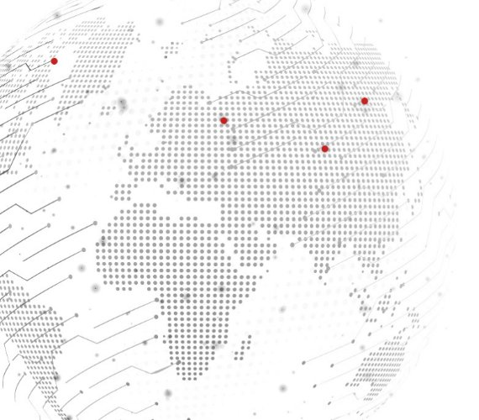
Understanding the
2024 Election
Jeff Berkowitz | CEO, Delve

Slide 2
3 Key Themes in the 2024 Elections
1.
The election no one wants
2.
50/50 Country = 50/50 Results
3.
Climate is on the ballot everywhere
www.delvedc.com

Slide 3
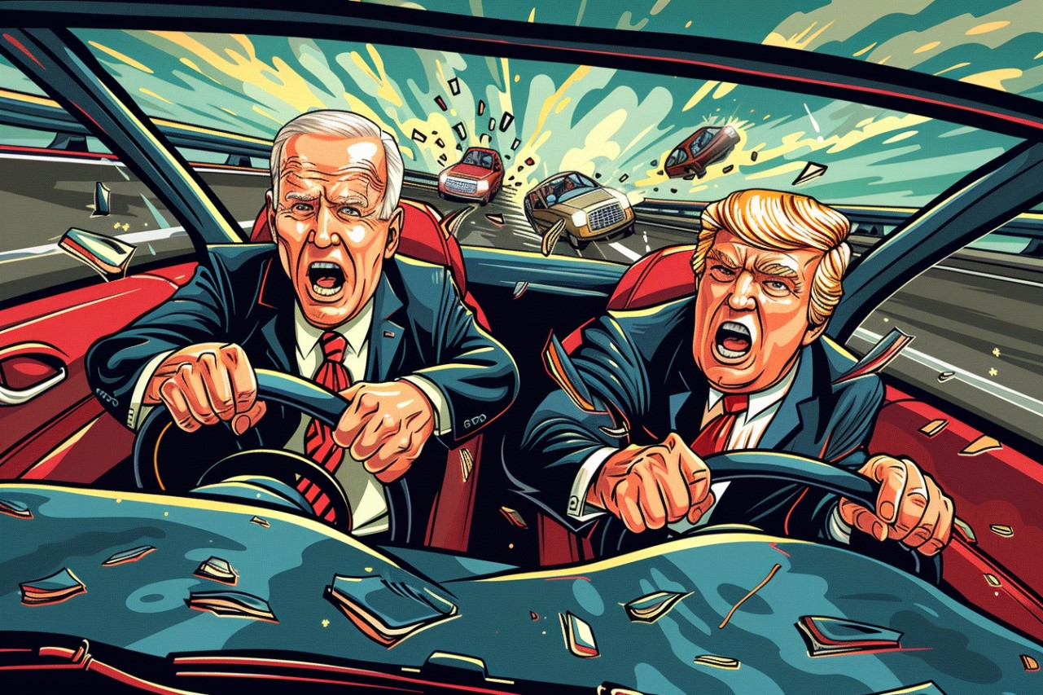

Slide 4
The Car Crash Election
29%
37%
of Republicans prefer
Trump not run
of Democrats prefer
Biden not run
www.delvedc.com
Notes:
https://www.reuters.com/world/us/americans-dismayed-by-biden-trump-2024-rematch-reutersipsos-poll-finds-2024-01-25/
https://www.masslive.com/politics/2024/02/2024-election-voters-dont-want-trump-biden-rematch-umass-amherst-poll-says.html

Slide 5
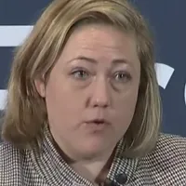
The Car Crash Election
Political Commentator Sarah Longwell
to The Associated Press
“I think we have an electorate that’s going through the stages of grief about this election. They’ve done denial — ‘Not these two, can’t possibly be these two.’ And I think they’re in depression now. I’m waiting for people to hit acceptance.”
www.delvedc.com
Notes:
Now you understand why we call this a car crash election.
Fever needing to break
This is going to be a margin of error election.

Slide 6
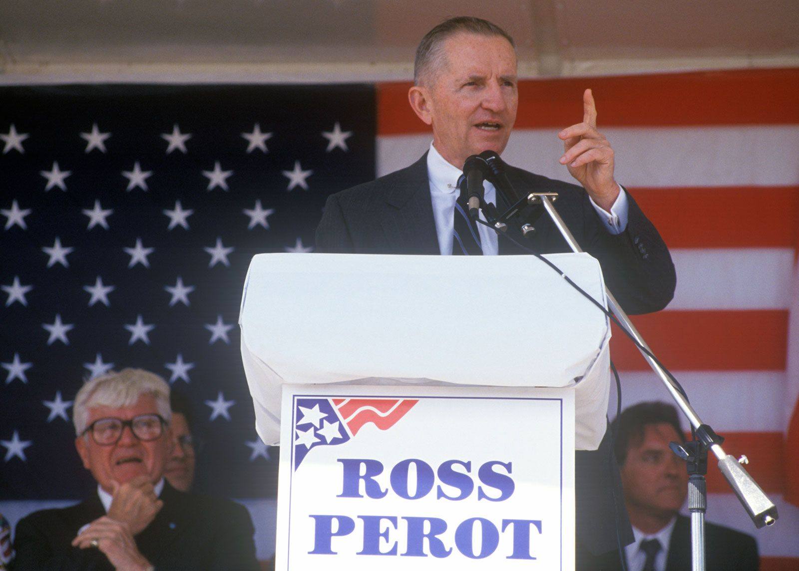
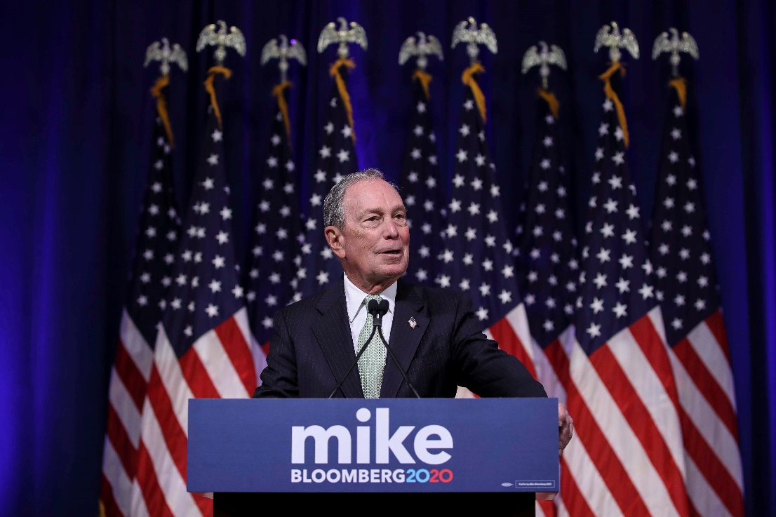
Will Third Parties Matter?
www.delvedc.com
Notes:
Ross Perot didn’t even get 1 electoral vote. 20% vote
Bloomberg more $ than God. Thought best path was Dem nom.
Even in this election, No Labels tried to find some set of candidates to break this two-party gridlock and finally gave up.
These candidates are going to be spoilers and that is the role they are going to play.

Slide 7
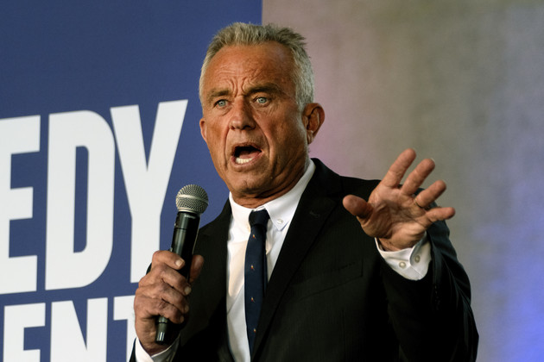
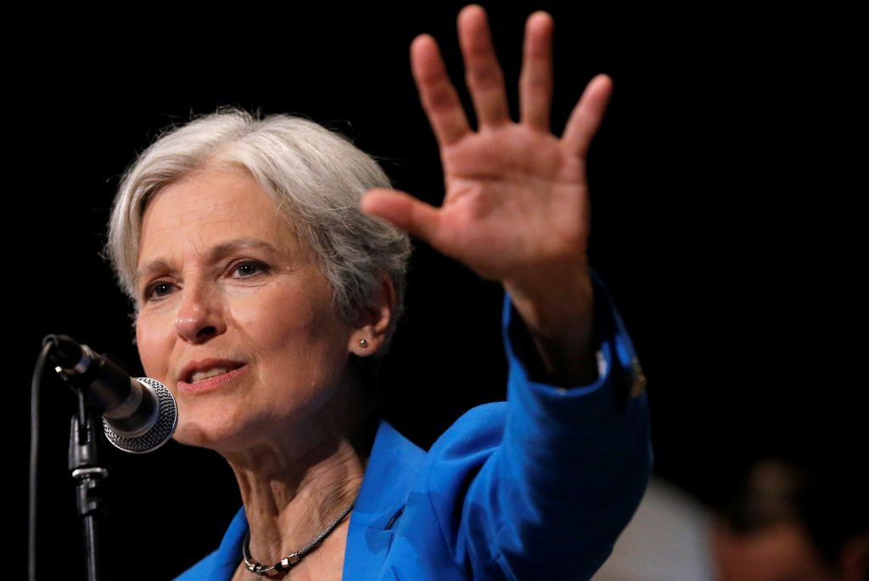
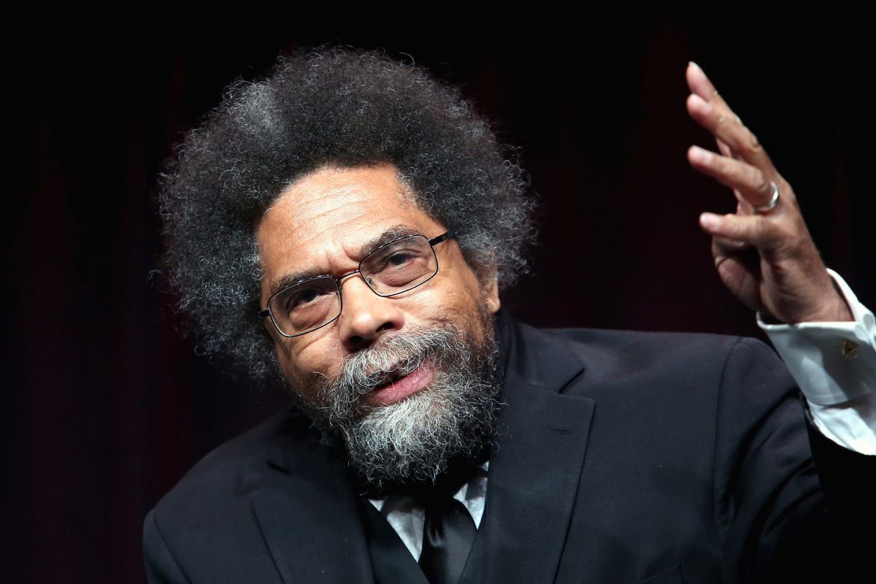
Will Third Parties Matter?
10.8%
2.0%
1.5%
RCP Polling Avg as of 5/8/2024
www.delvedc.com

Slide 8
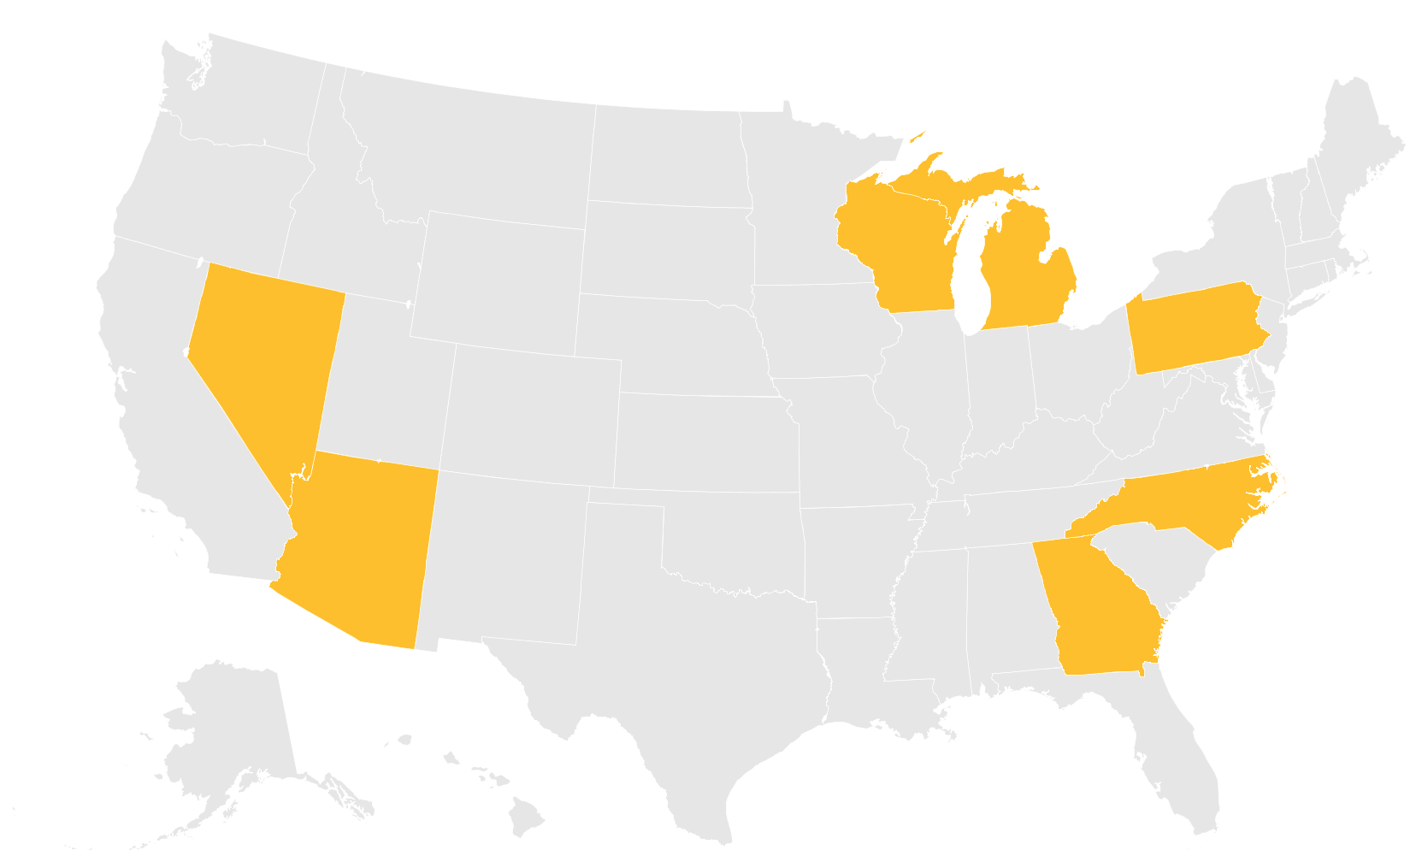
7 Swing States to Watch
?
WI
MI
NV
PA
?
NC
AZ
GA
?
?
www.delvedc.com

Slide 9
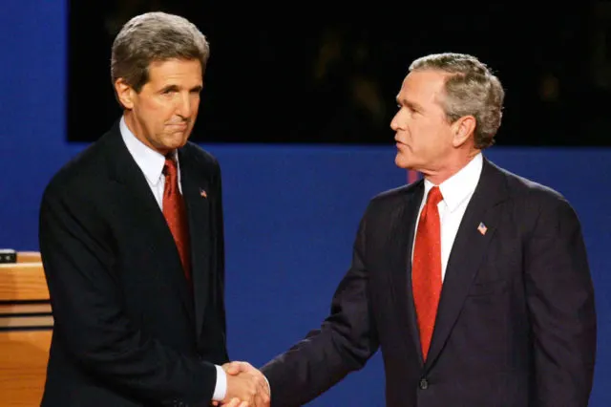
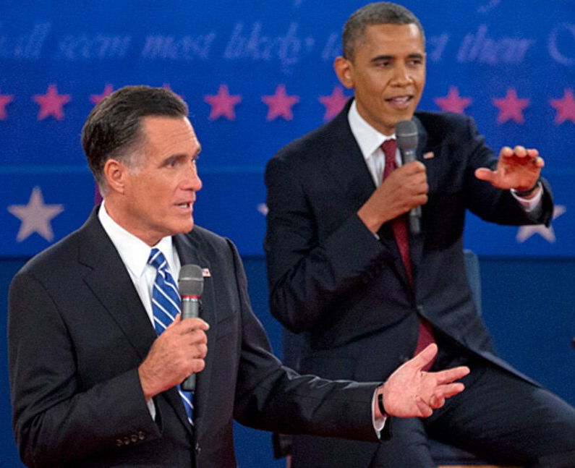
Forget everything you know about presidential elections
www.delvedc.com
Notes:
Grover Cleveland and Benjamin Harrison

Slide 10
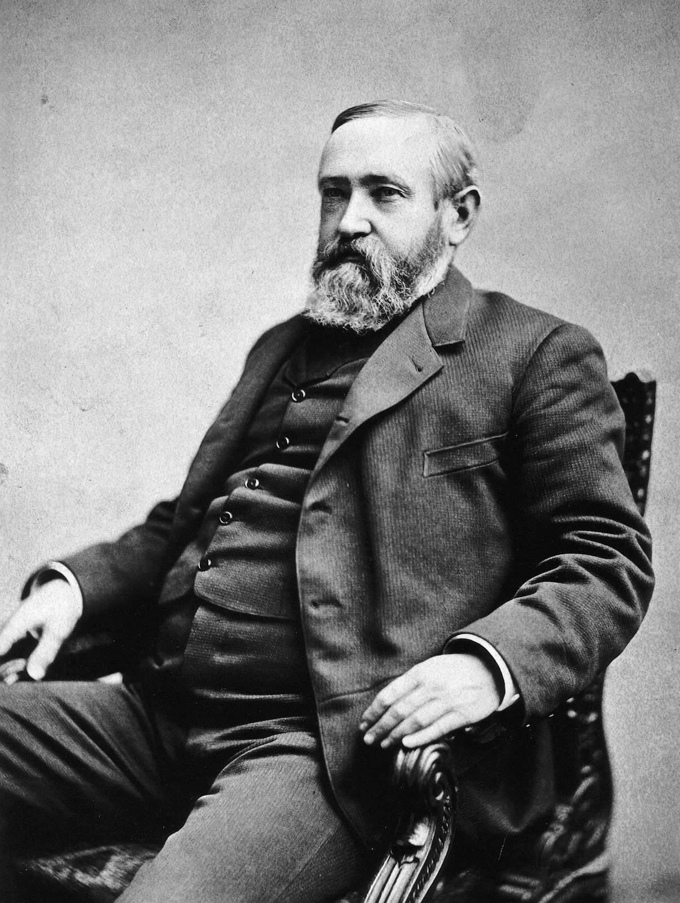
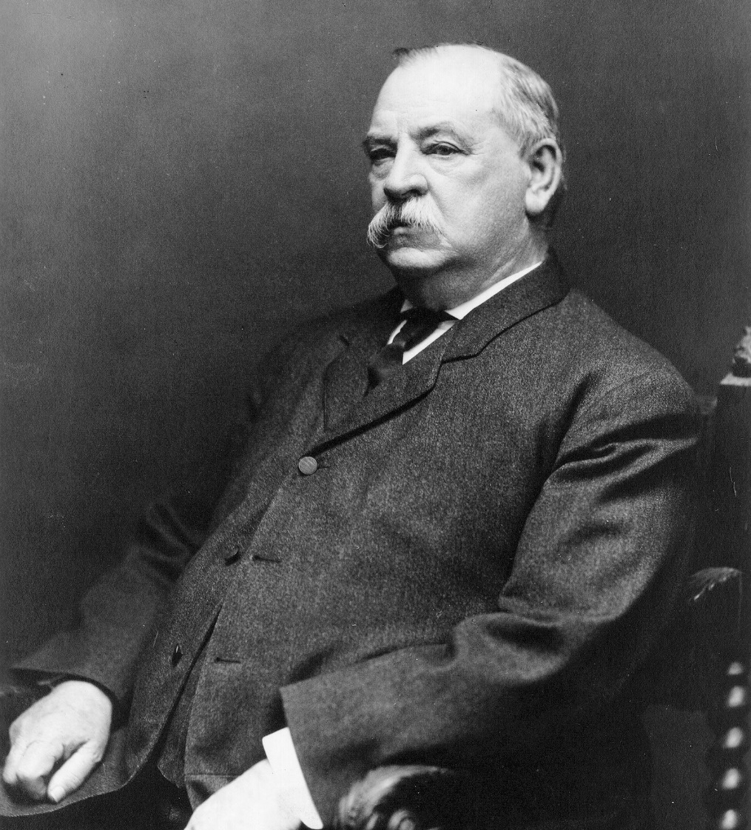
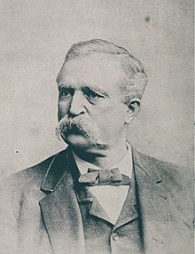
Forget everything you know about presidential elections
www.delvedc.com
Notes:
Grover Cleveland and Benjamin Harrison

Slide 11
Forget everything you know about presidential elections
www.delvedc.com
Notes:
Enter Populist James Weaver

Slide 12
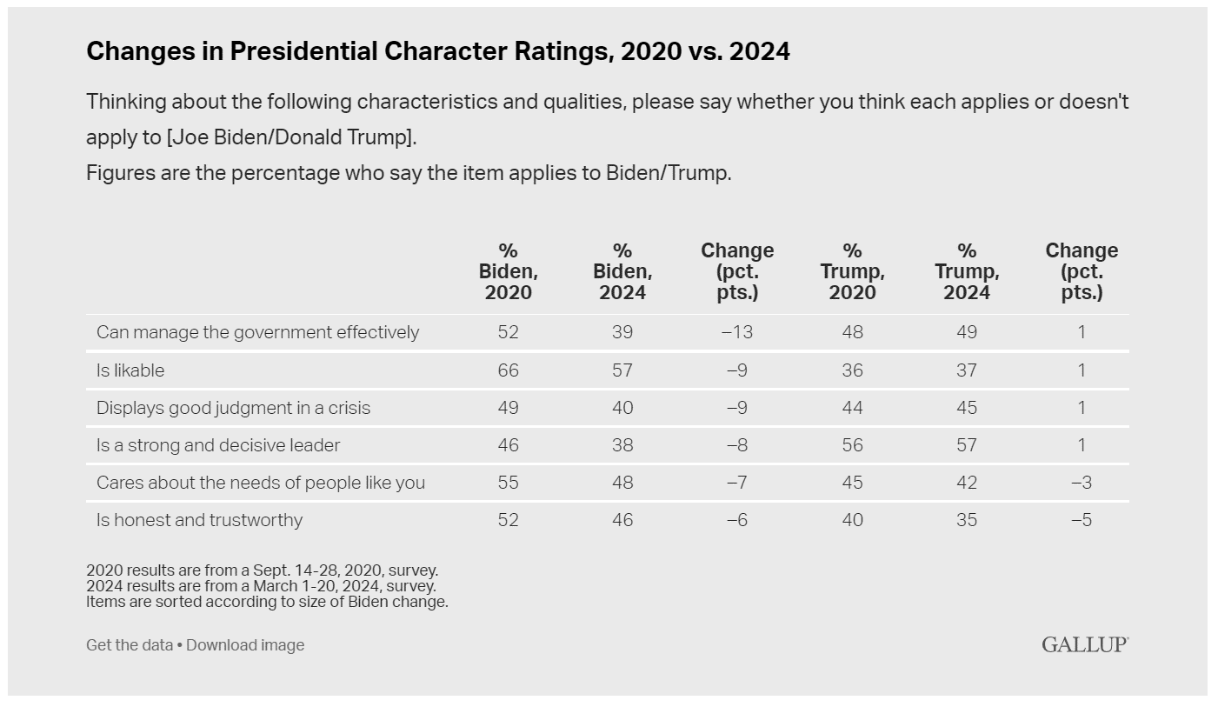
Forget everything you know about presidential elections
www.delvedc.com
Notes:
Grover Cleveland and Benjamin Harrison

Slide 13
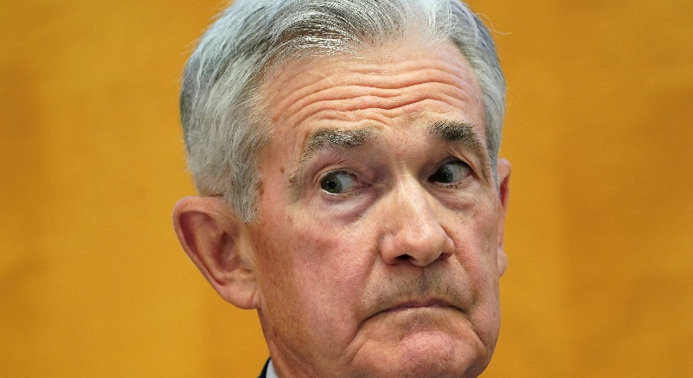
3 Traditional Election Metrics
1.
The stock market
“As is often the case, we are navigating by the stars under cloudy skies.”
- Fed Chair Jerome Powell
www.delvedc.com
Notes:
3results:
People vote with their pocket books… measuring the economy in all the wrong ways. People look at –stock, unemployment, price of gas. (find stat on every person looking to every job there is available)
The only one that is actually meaningful is $ of gas, which is a stand-in for how they feel about energy $ more generally.
ways people try to anticipate election
Even that has lost predictive power

Slide 14
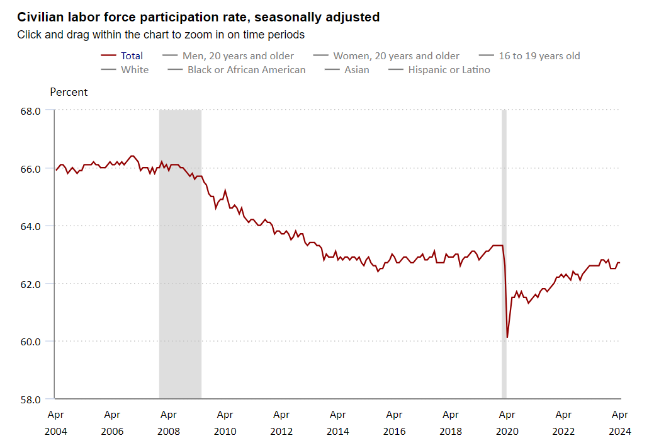
3 Traditional Election Metrics
2.
Unemployment rate
There are less than
75%
unemployed people needed to fill the available jobs in the U.S.
www.delvedc.com
Notes:
3results:
People vote with their pocket books… measuring the economy in all the wrong ways. People look at –stock, unemployment, price of gas. (find stat on every person looking to every job there is available)
The only one that is actually meaningful is $ of gas, which is a stand-in for how they feel about energy $ more generally.
ways people try to anticipate election
Even that has lost predictive power

Slide 15
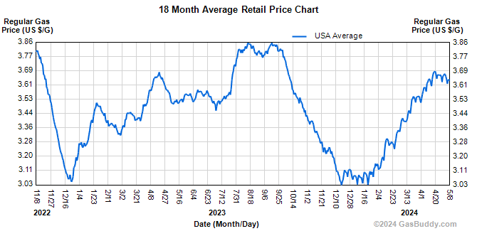
3 Traditional Election Metrics
3.
Gas prices
www.delvedc.com
Notes:
3results:
People vote with their pocket books… measuring the economy in all the wrong ways. People look at –stock, unemployment, price of gas. (find stat on every person looking to every job there is available)
The only one that is actually meaningful is $ of gas, which is a stand-in for how they feel about energy $ more generally.
ways people try to anticipate election
Even that has lost predictive power

Slide 16
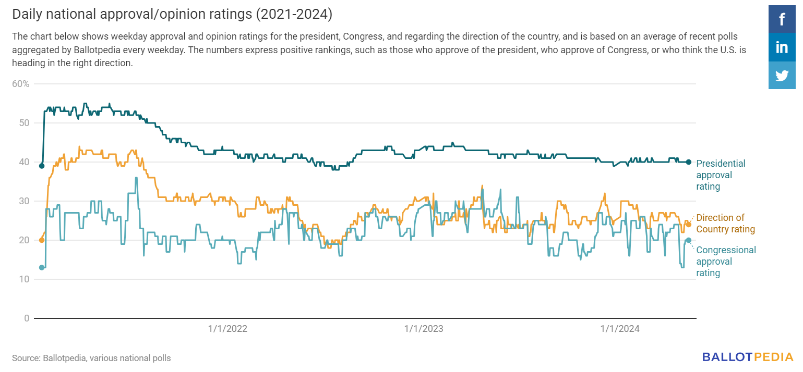
Forget everything you know about presidential elections
www.delvedc.com

Slide 17
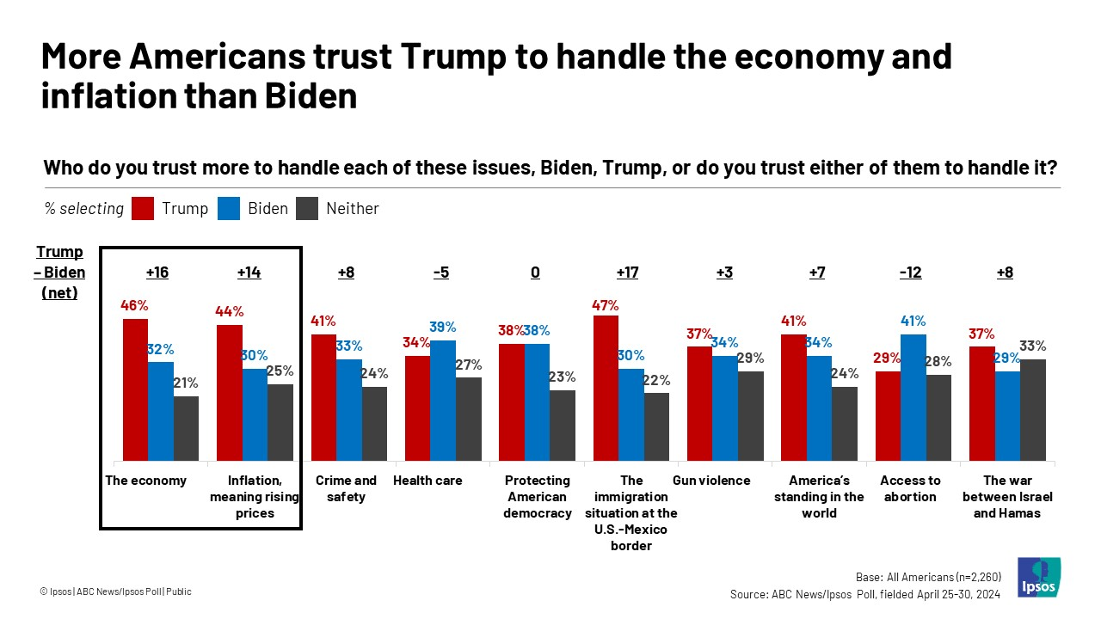
Forget everything you know about presidential elections
www.delvedc.com

Slide 18
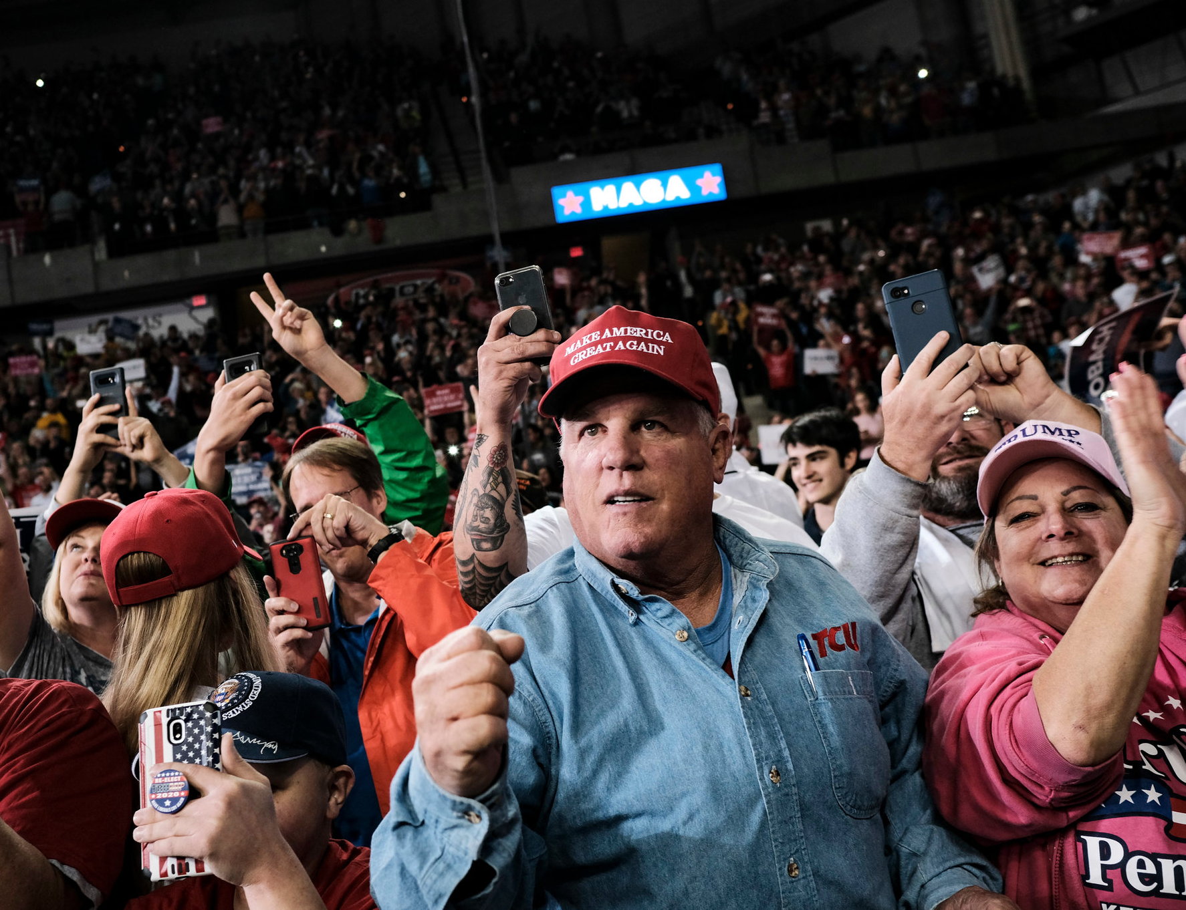
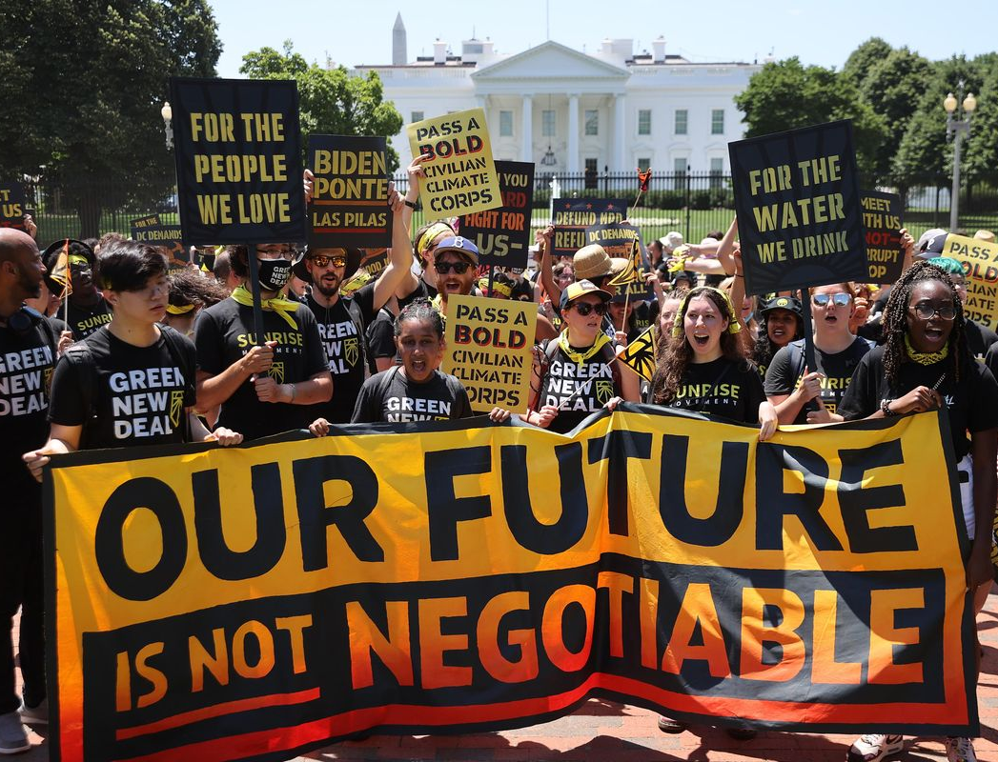
We’ve become tribal nations
www.delvedc.com

Slide 19
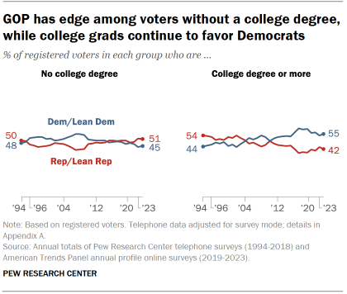
Welcome to the Great Realignment
www.delvedc.com

Slide 20
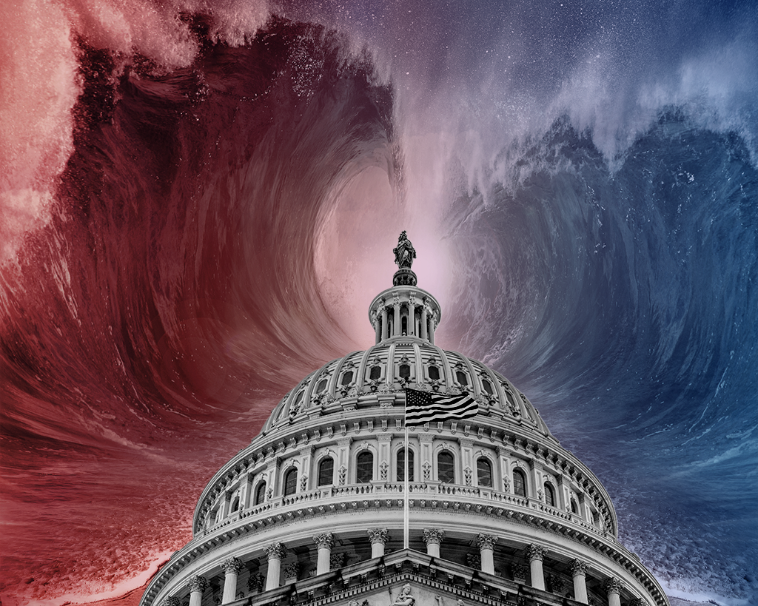
Swept up in the Twin Tides
www.delvedc.com

Slide 21
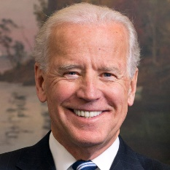
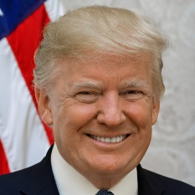
Presidential Election is Fundamentals
133+
offices
?
offices
www.delvedc.com
Notes:
Fundamentals:
Biden wins this bc he’s got org + $(money raised DNC + B vs RNC + T
Also Biden out organizing in tons of states

Slide 22
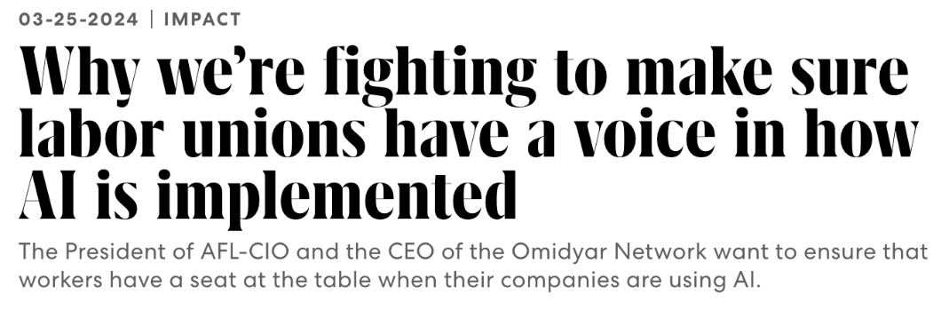
Presidential Election is Fundamentals vs. Atmospherics
84% Of Voters Concerned The U.S. Will Be Drawn Into Military Conflict In The Middle East
www.delvedc.com
Notes:
Atmospherics
Trump wins bc mood of country for change, Biden broke promises
Show people worried about Gaza, America’s place in world uncertainty.. Anxiety. Grocery prices. Gas prices. AI. Everything going on causing people anxiety and mistrust on Biden

Slide 23
All of which will impact the energy industry
www.delvedc.com

Slide 24
All of which will impact the energy industry
www.delvedc.com

Slide 25
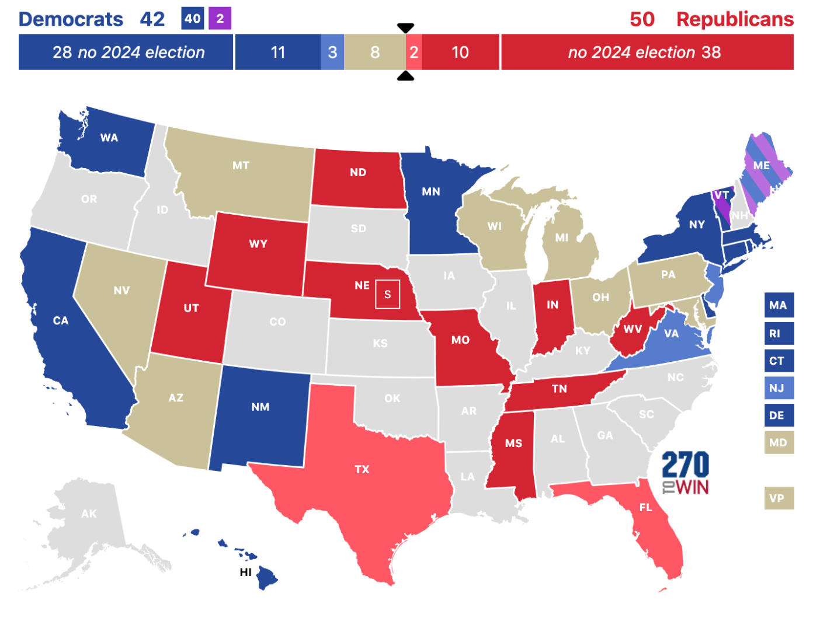
Senate Landscape Favors GOP
10 seats up this cycle
currently held by Republicans
22 seats up this cycle
currently held by Democrats and Independents who caucus with Democrats
www.delvedc.com
Notes:
Democrats (and sens who caucus with Dems) are defending 22 seats this cycle. Republicans are defending 10.

Slide 26
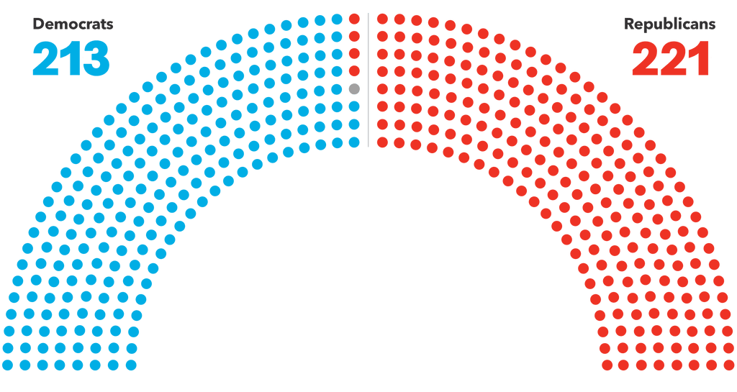
The House will remain ungovernable
And 7 of those 22 toss-up races are in the Northeast
www.delvedc.com

Slide 27
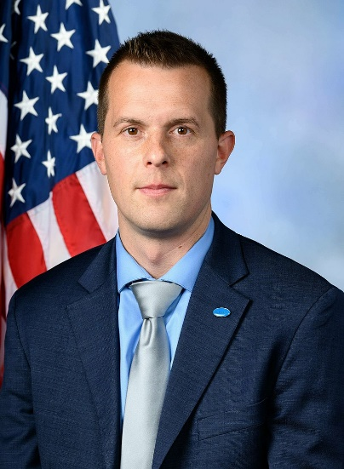
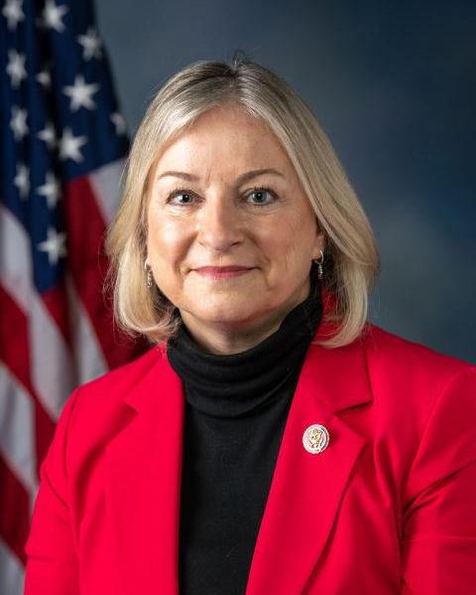
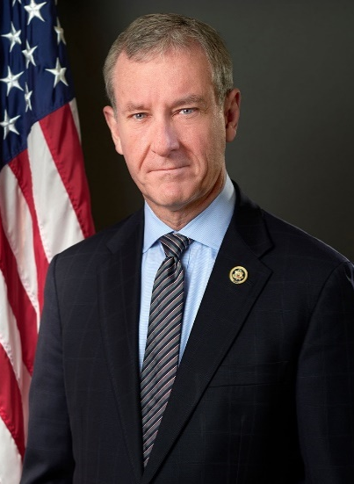
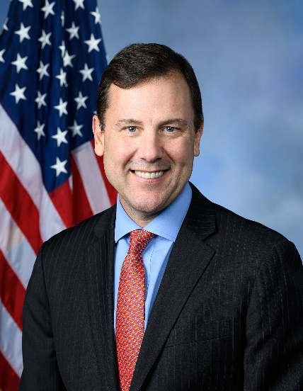
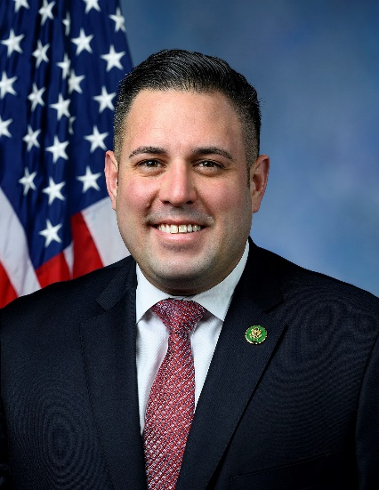
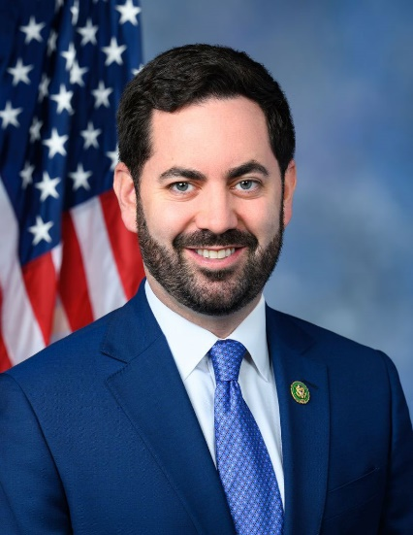
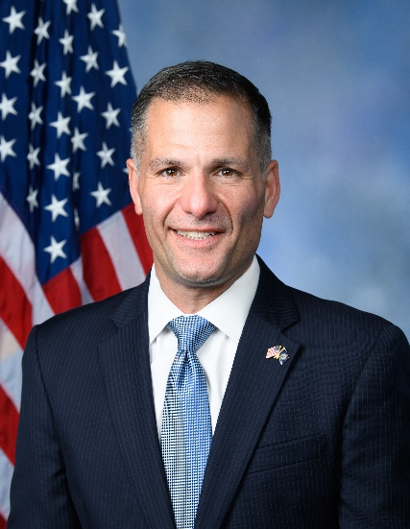
7 House Northeast Races to Watch
ME-02
Rep. Jared Golden
PA-07
Rep. Susan Wild
PA-08
Rep. Matt Cartwright
NJ-07
Rep. Thomas Kean Jr.
NY-04
Rep. Anthony D’Esposito
NY-17
Rep. Mike Lawler
NY-19
Rep. Marc Molinaro
www.delvedc.com

Slide 28
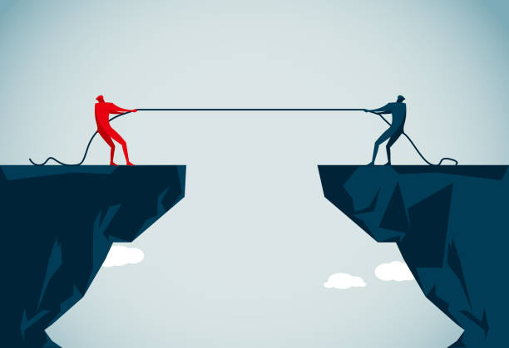
Climate is on the ballot in 2024…
www.delvedc.com

Slide 29
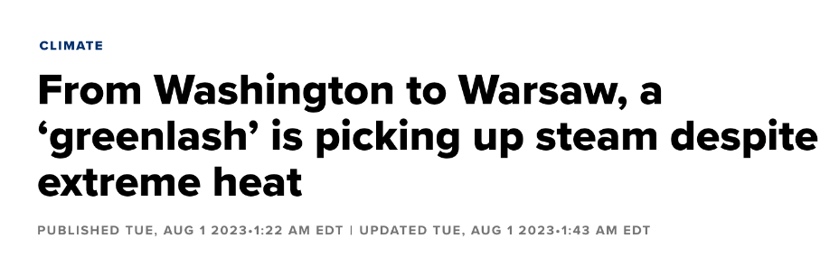
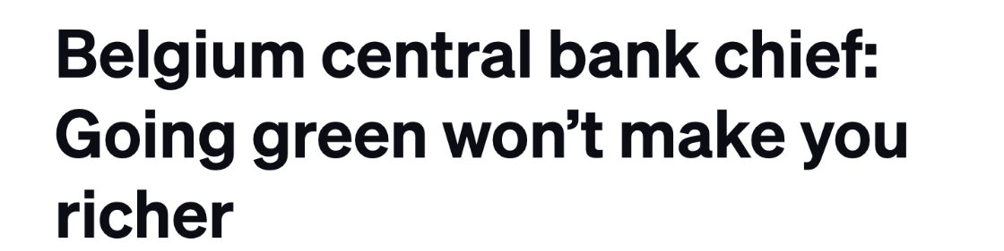
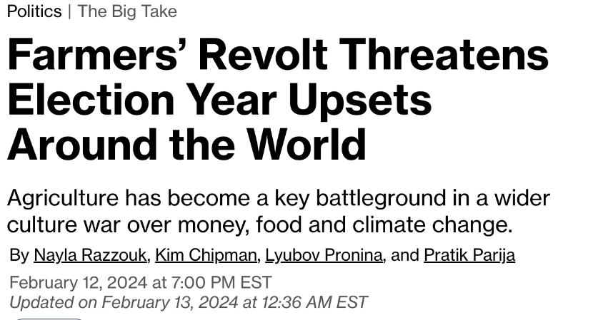
A Global Trend as Climate Costs Become Clear to Voters
www.delvedc.com
Notes:
More than 80 elections around the world. EU spring. UK before EOY.

Slide 30
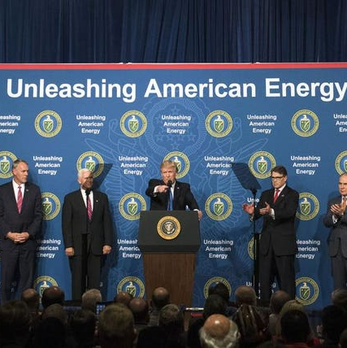
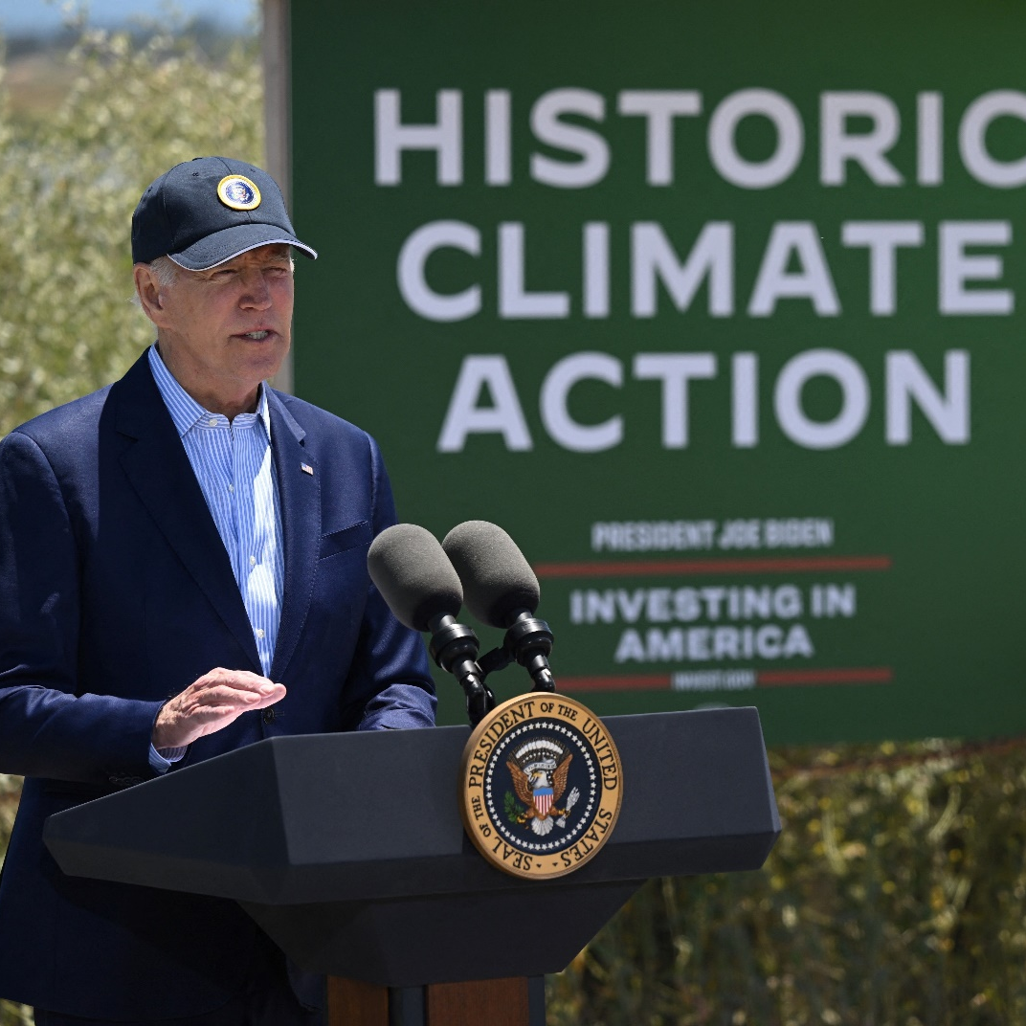
Energy Dominance vs. Energy Delusion
www.delvedc.com

Slide 31
6,477
Federal and state elections across the country
shaping the climate and energy debate
Including
VT:
11
Governors who collectively will appoint 36 PUC members and shape energy and climate policies in their states
NH:
10
Attorney Generals who direct energy and climate related investigations and lawsuits
DE:
10
Treasurers who drive ESG scrutiny and divestment pressures
9
Public Utility Commissions who regulate the energy sector and develop climate policies
1731
State legislative races in the
Northeast alone
www.delvedc.com
Notes:
ALL Gov appear same time. Then AG, then Treasurers, then PUCs. Then add in state legislators specific to North East

Slide 32
Dozens of Ballot Measures
www.delvedc.com

Slide 33
Your Broader Election Challenge
Notes:
So you as companies are expected to engage on all these issues and accept these red and blue state versions of reality

Slide 34
Businesses Last Remaining Trusted Institutions
2023 Global Trust Barometer
Trust (60-100)
Neutral (50-59)
Distrust (1-49)
78%
62%
59%
50%
50%
Business
NGOs
Media
My employer
Government
www.delvedc.com

Slide 35
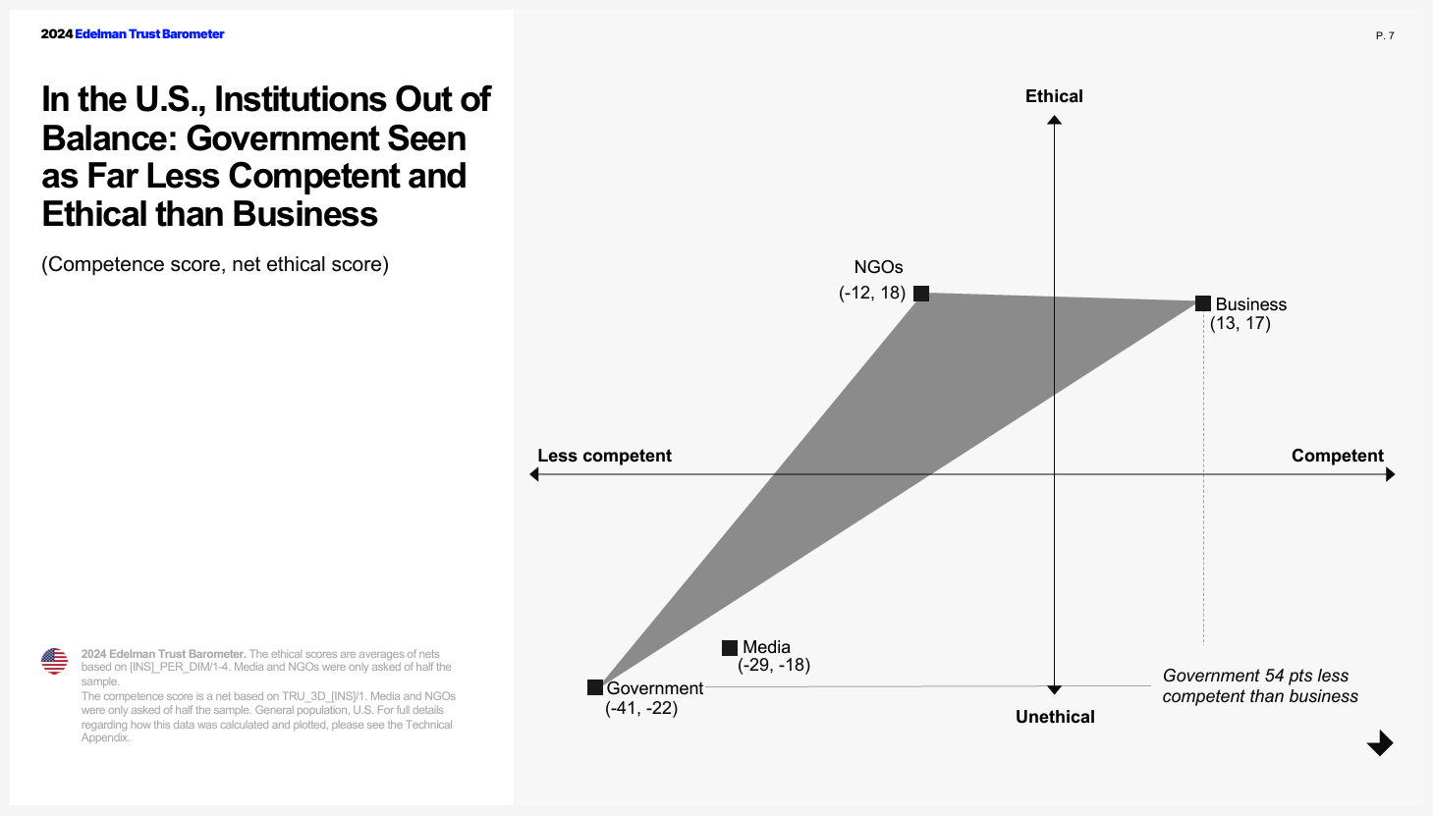
Businesses Last Remaining Trusted Institutions
www.delvedc.com

Slide 36
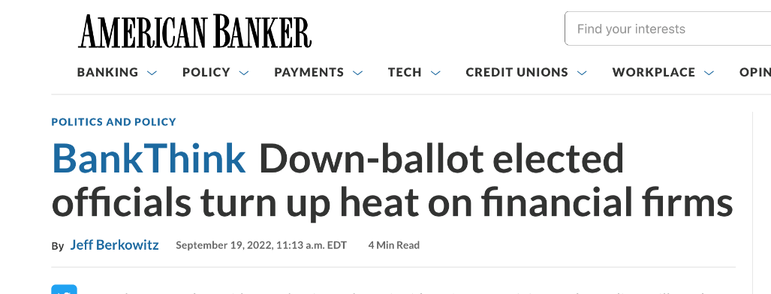
A New Era of Politicized Commerce
www.delvedc.com

Slide 37
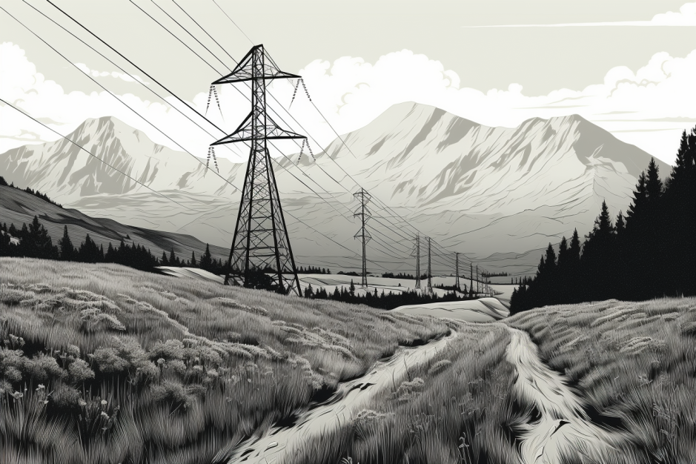
For weekly insights, join us at
Delve.Energy
jeff@delvedc.com

