Slide 1
Northeast Gas Association
Distribution System Modeling
Presented by:
Kasey Elkin
Manager – Gas Long Term Planning
Notes:
Introduce self, talk about what team does
Ask about audience background (any modeling experience, engineers, etc)
system is so old; look back 100 years ago and how they built system and what pipe sizes and pressures and how they determined; compared to today we have forecast and mapping
Ask for questions mid-presentation for engagement

Slide 2
System Design Goal
Safety & Reliability – Providing safe and reliable service at the lowest cost to the ratepayers.
System Awareness – Understanding distribution system operations, design parameters, and system constraints.
Risk Management & Identification – Fundamental Business Model.
Operational Risk
Safety Risk
Customer Risk
Finance/Investment Risk
Reputational Risk
Building Confidence – Improving efficiency, decision making, communication & knowledge sharing across the gas business, and understanding the process
Notes:
SOPs, GCRs risk management

Slide 3
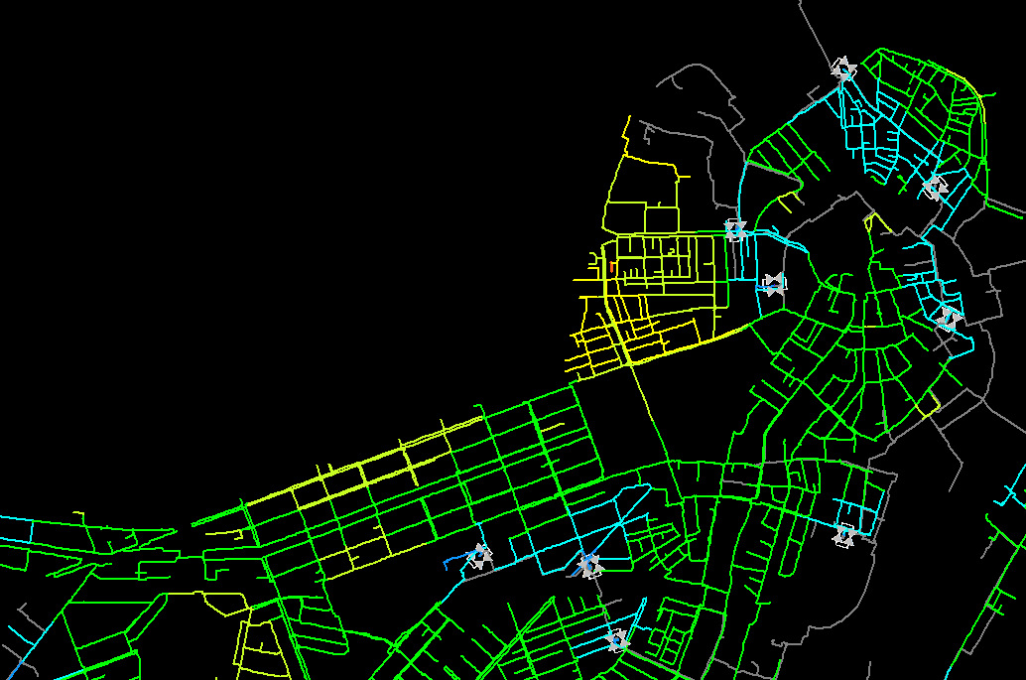
Agenda
Part 1: Model Development and Software Overview
DNV GL - Synergy Gas Steady State
Customer Management Module
Part 2: Using the Model
Various ways to apply model data

Slide 4
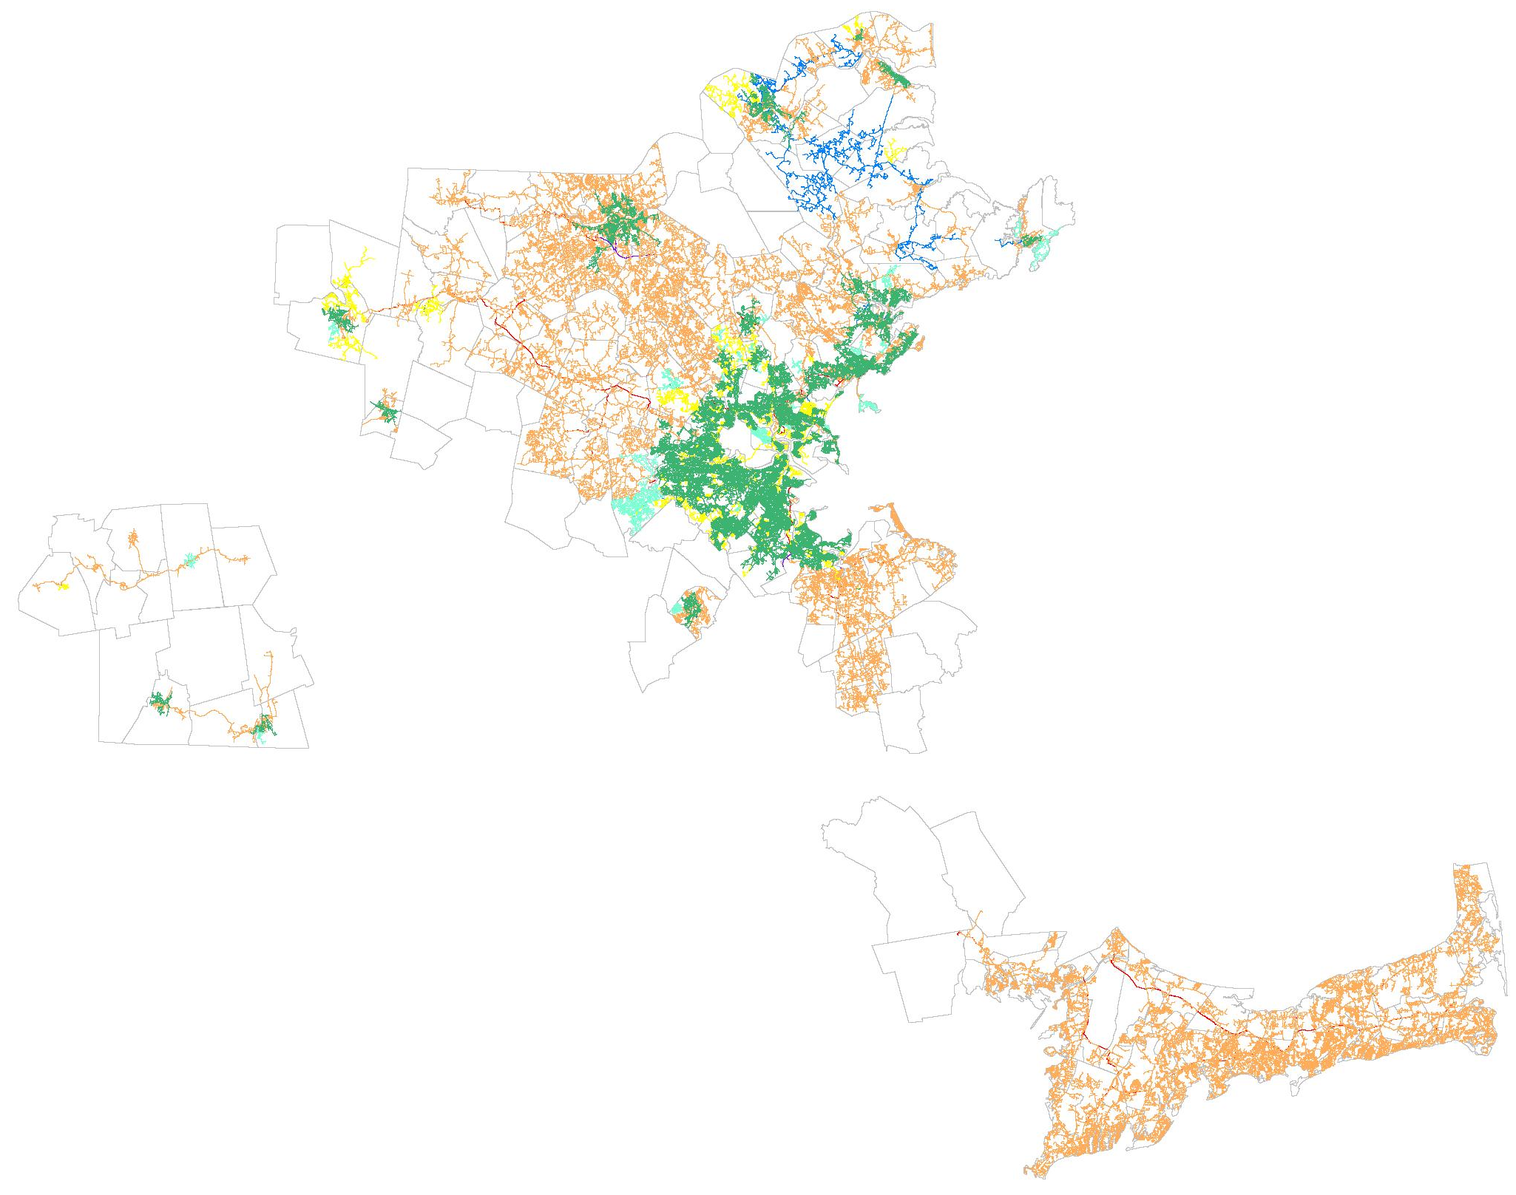
Model Development - Overview
GIS Extract of Facilities
“Skeleton Model”
“Dummy Loads”
Reg stations, valves
Node allocation, Supply Points
Customer Data Extract
Customer information
Load Usage & meter location
Base factor, heating co-efficient
Historical use trend
Assigned factor quality
Large-use customers

Slide 5
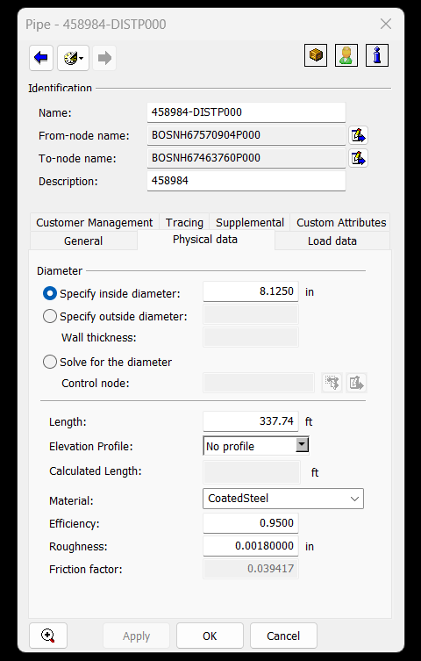
Model Development - Facilities
Pipes
Inside Diameter (ID)
Material (efficiency, roughness)
Length
Elevation (if data available)
Friction Factor standard calc (Colebrook-White equation)
Custom Attributes
Scrub “floating pipes”
Scrub for segments not “snapped” in GIS

Slide 6
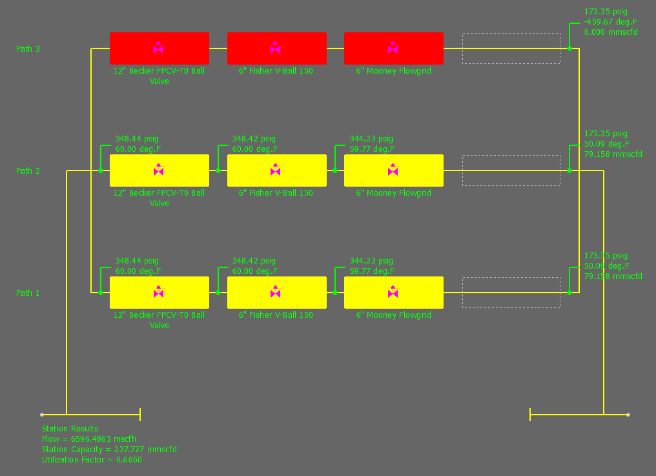
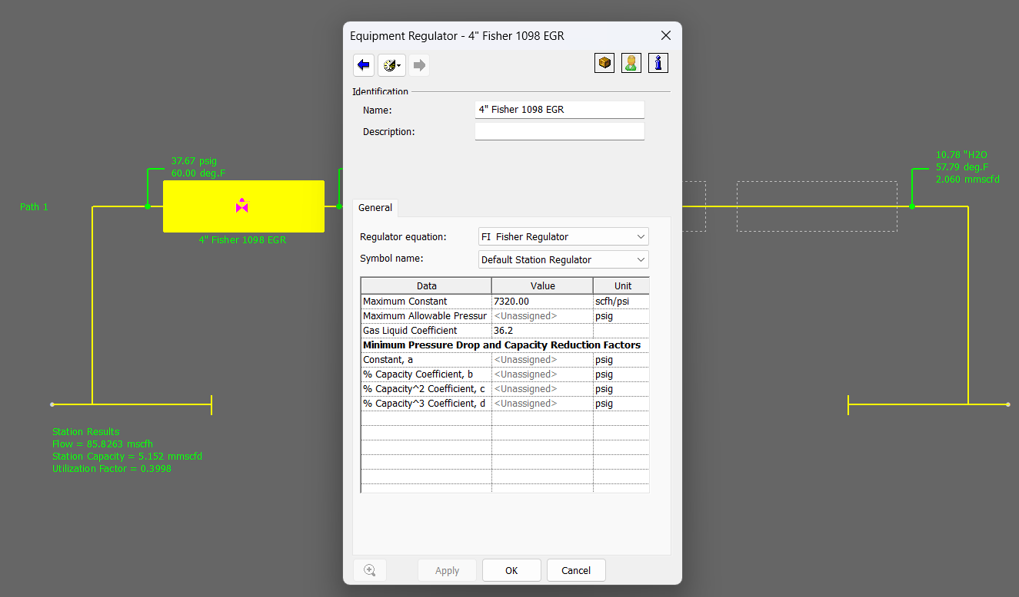
Model Development - Facilities
Regulator Stations
Known / Control Info
Type of regs
Size
# of runs (paths)
Specs
Constants
Outlet Set Point
Solving for:
Utilization %
Flow
Min inlet pressure
Max Flow Rate (capacity)
Notes:
Talk about redundancy

Slide 7
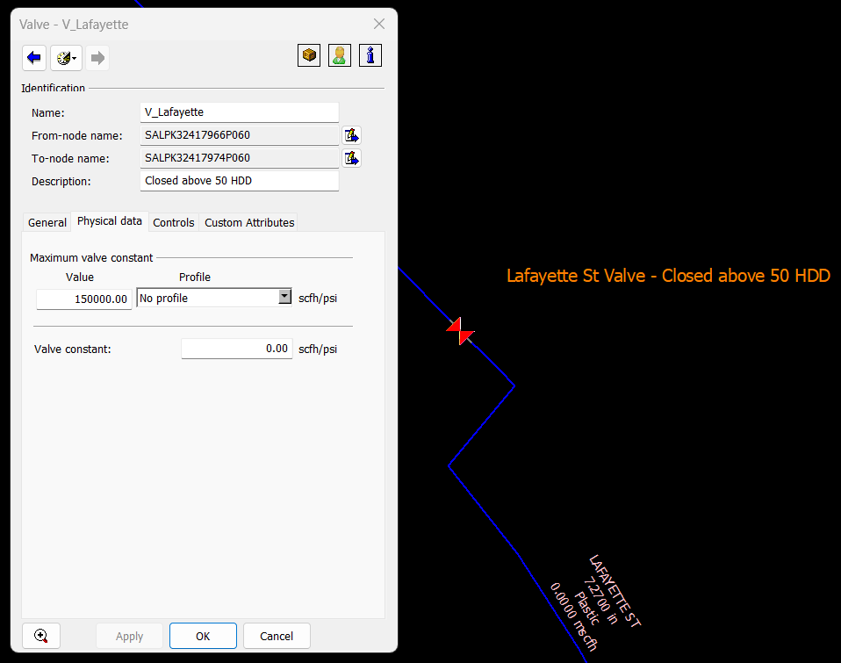
Model Development - Facilities
Valves
Type (check valve, full port, etc)
Constant (scfh/psi) = % open
Normally closed/open
Bypass valves
Notes:
Minimize valves, only include significant ones bc it bogs down file size

Slide 8
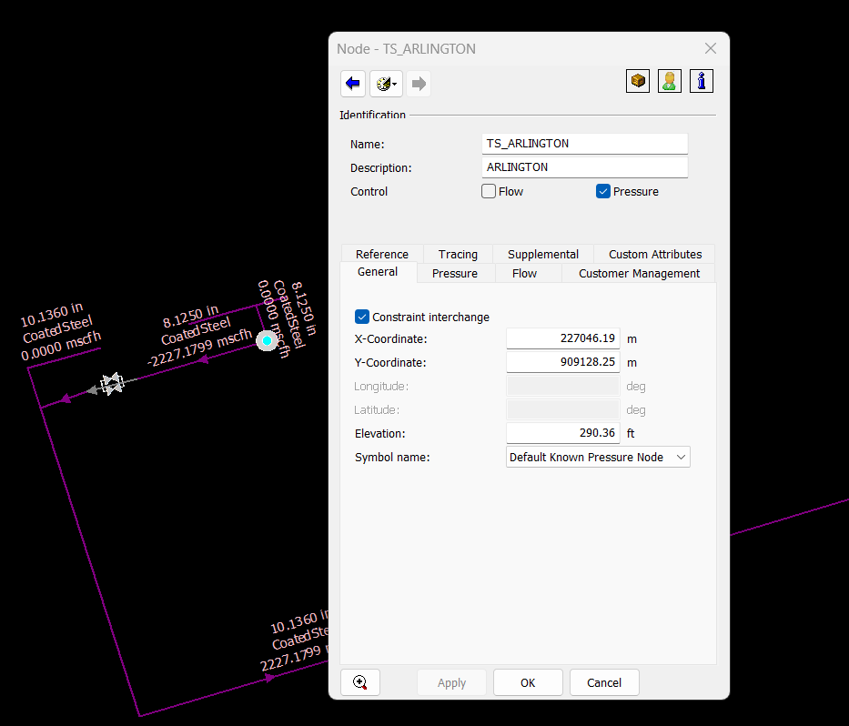
Model Development – Nodes
Nodes:
Segments between a facility (from & to nodes)
Known pressure/flow set nodes
Gas composition (source nodes)
Pressure units - Primary (psig) or Secondary (inwc)
Elevation
XY Coordinates (customer assignment)
Supply Nodes
City gates/take stations
Storage/LNG
Control nodes (regs)
Demand Nodes
Customer data/load profile assigned to node
Load usage per HDD (flow categories)

Slide 9
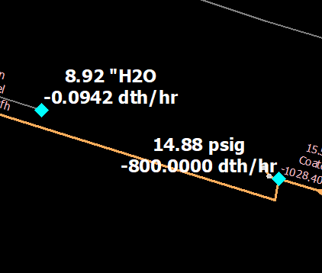
Model Development – Customer Load Profile
Extracting Customer Data
Customer usage from company billing system (2-3 years historical)
Weather Effector- Corresponding Temperature data for the local area (daily avg)
Load Factors
Base Factor: non-temperature dependent (Cooking, Hot Water, Drying, etc)
Heat Factor: Heating load which increases as temperature drops
Customer Loads = Base Factor + (Heat Factor x HDD)
Custom Loaded Customers – Large Commercial & Industrial / Special Contract
Large-Use trends >5dth/hr (typical resi/small commercial is .1 to 1 dth/hr)
Dual Fuel Capabilities, Interruptible customers (Non-firm curtailment at x HDD)
Seasonal Usage (like Asphalt Plants), Special contracts
Customer Load Profiles
”Flow Categories” are created set up Synergy model where load profiles are allocated to the assigned nodes
Can develop seasonal models or HDD specific models to specify analysis criteria
Notes:
Talk about uses of temperature models; may add forecasting/adjustment factors?

Slide 10
Model Development – Daily Usage Pattern
  Daily Usage Pattern
Example:
System Sendout 350,000 dth/d
National Grid assumes 5% peak hour
17,500 dth/hr
Typically, 1/24 supply contract to a city-gate (14,583 dth/hr, 4.2%)
Design Day Supply Requirements:
Calculate minimum LNG
Review Gas Supply Portfolio (Supply/Demand balance between pipelines)
Review Max Daily Quantities/Max Hourly Quantities (MDQ/MHQ) at City-Gates

Slide 11
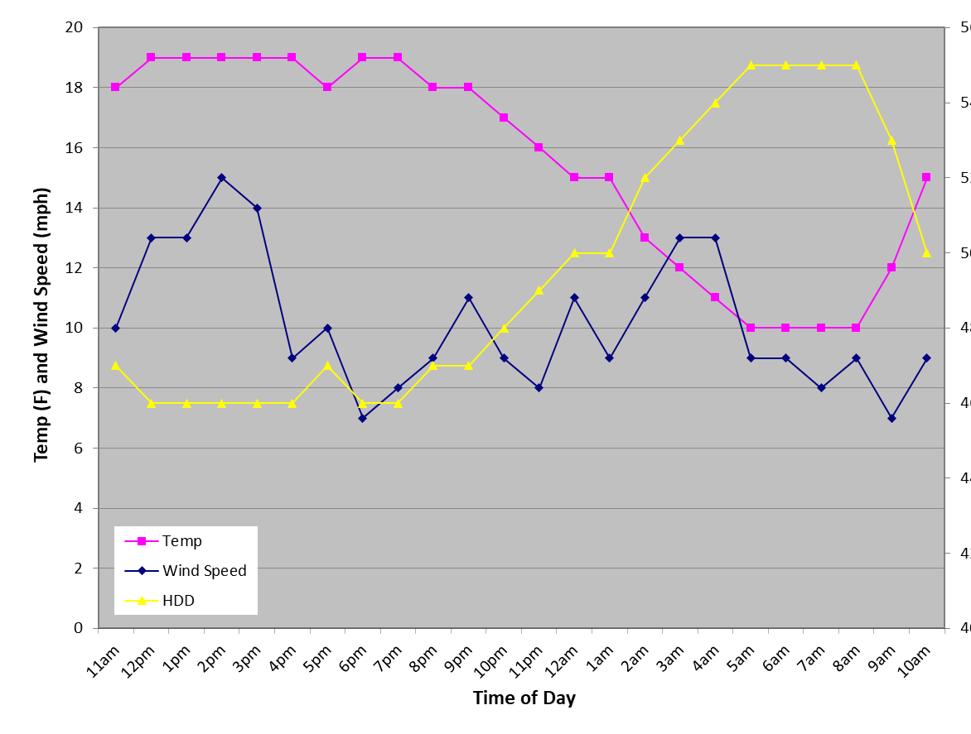
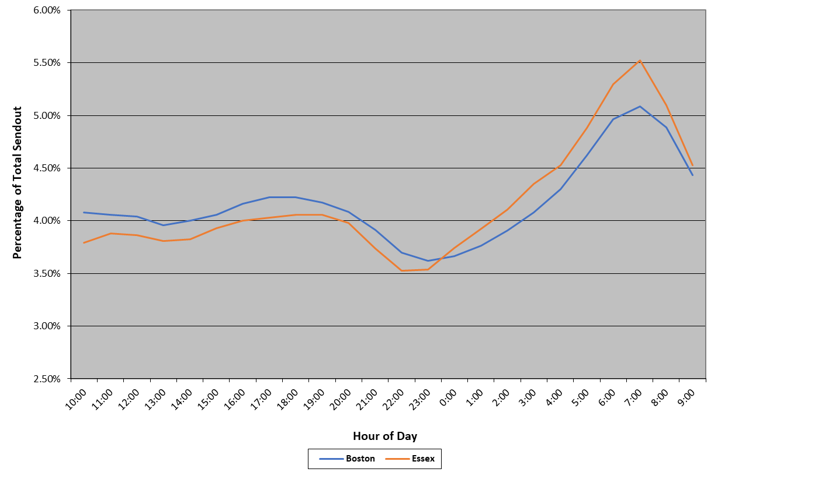
Model Development – Daily Usage Pattern
Temp / HDD
Sendout (% of total day sendout)
Typical Load Curve - Dinner load (5pm – 9pm) and morning load peaks (5am – 9am)
Synergi Steady State Application is a screenshot in time, typically modeled to prepare for the peak hour of an anticipated daily sendout
Notes:
Top line on right is dth sendout, can delete, focus on % of total sendout

Slide 12
Model Verification – How Accurate Are Model Predictions?
Select Verification Day (Coldest observed gas day, highest sendout gas day, or operational discrepancy)
SCADA Extract, large customer meter/usage data
Review & update model - Completed or in progress work, reg station upgrades
Match Observed System Sendout peak hour to Model
Match Observed Operational set points (reg settings, LNG output, BTU value, etc)
Compare Model Data Vs Observed SCADA Data:
Investigation triggered when a point is out of acceptable tolerances
(ex: LP 1” wc variation, HP 10% MAOP)
Gate Station flow rate comparison
Regulator Station Performance – review utilization, unable to maintain set point (drooping outlet)
Compile findings in a report & determine % accuracy of the model prediction to the observed field conditions
Notes:
Important to help justify decisions

Slide 13
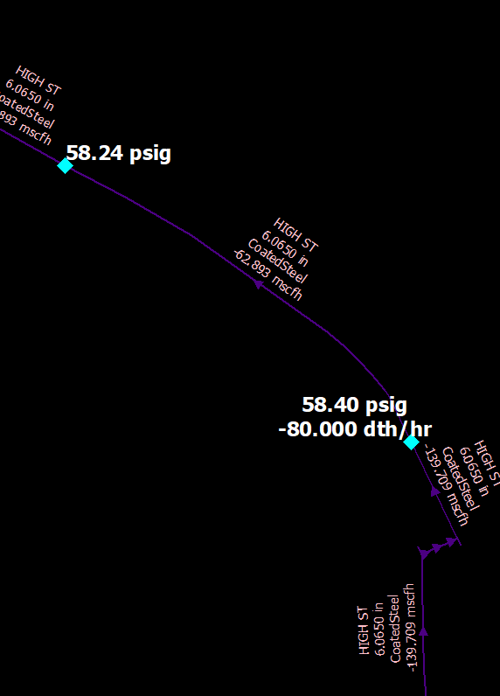
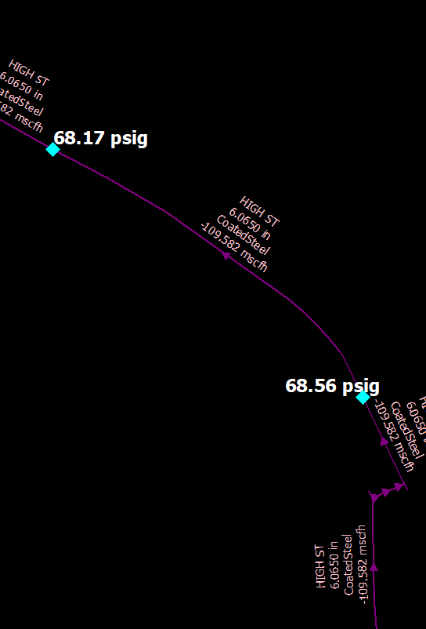
Model Verification – How Accurate Are Model Predictions?
Field Issues:
Pressure worse at SCADA point in field compared to model
Root Causes: closed valve, unknown obstruction, GIS or records error, restrictive fittings, leak concentration (pipe efficiency)
Actions: Field coordination to inspect valves, camera mains, add SCADA points, etc.
Model Issues:
Pressure worse in model compared to SCADA
Root Causes: projects completed in field not updated in model; reg station facilities incorrect; pipes not connected in the model; customer loading issues
  Model Issues Example:
SCADA Pressure: 72.7 psig
SCADA Pressure: 72.7 psig
Special Contract Powerplant Load
Notes:
Look at recently completed work, fire department closed a valve, etc. Add woburn example,

Slide 14
Part 2: Modeling Applications

Slide 15
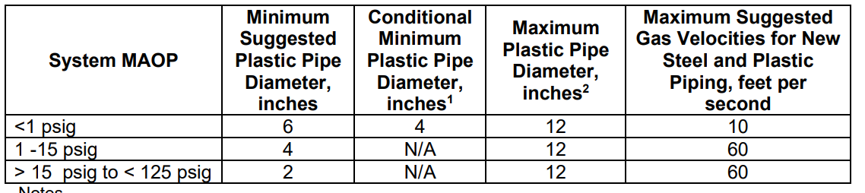
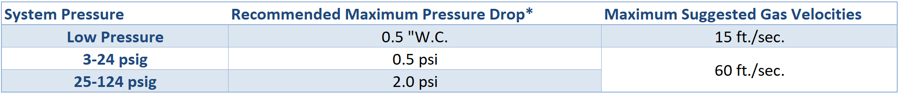
Part 2: System Planning – Design Parameters
Maximum Allowable Operating Pressure (MAOP)
Determine MOP based on regulator set points
Material and fitting requirements
Excess Flow Valves
Minimum Design Pressure (MinOP)
Customer Requirements, etc
Velocity and Pressure Drop
New vs Existing parameters, mains, services, different MAOPs, etc.
Reg Station Utilization %
Multi Run Redundancy
MOP set points
Minimum inlet pressure requirements
Other Parameters
Minimum new main or service sizing for a range of MAOP subsystems (Tables shown)
Allowable number of customers on a single feed system?
SCADA Alarm parameters, operational limitations
Isolation zones & critical valve criteria

Slide 16
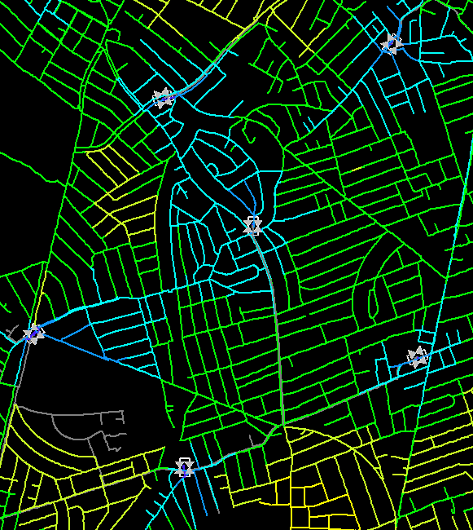
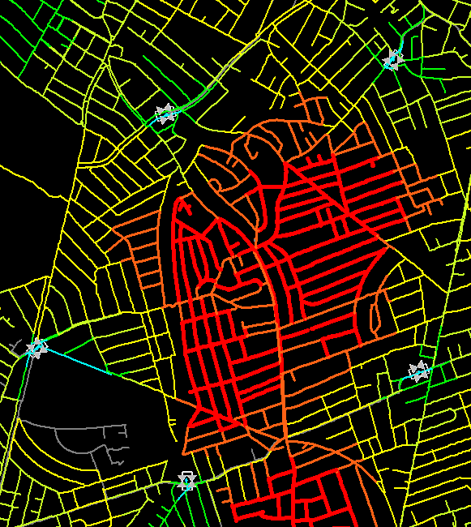
Part 2: Model Application - Overview
Utilizing Synergi Models for various business requirements:
Developing a Capital Work Plan
Justification of capital project needs
Reinforcement projects for projected low points, reg station utilization
Supply Constraints, LNG Ops, Portable LNG needs
Winter Operation Recommendations
Reg Settings, Anticipated Low Points, Special Operations
Field Ops troubleshooting (poor pressure investigation)
Asset Management
Main sizing, regulator station work (new/replace/abandon)
Low pressure system elimination strategy
Critical valves, sectionalizing, area isolation
Risk assessments of critical infrastructure
Gas Segment Decommissioning Feasibility (NPAs)
Load Shed Planning, Contingency Planning
Gas Capacity Request (New Customers, Growth Analysis)
Reviewing Planned work (SOP)
Tie-ins, cut offs, bypass requirements
Reg station shutdowns, set point adjustments
Temperature/HDD restrictions
Emergency Response
  System Reinforcement Example:
Notes:
NPA reviews/justifications

Slide 17
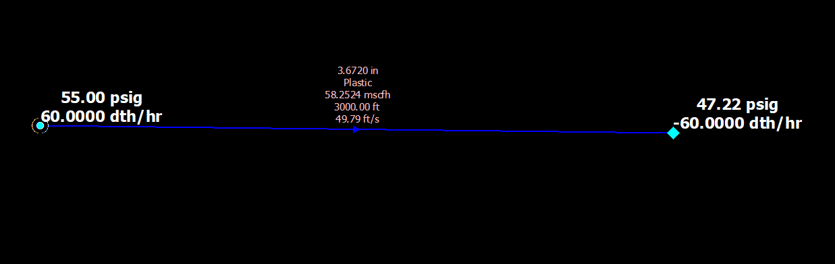
Model Application – Basic Concept
Example:
From Node – Pressure Set to 55 PSIG (KNOWN pressure)
Facility (pipe) – 4” PL 3,000 ft (Known Facility components such as ID, Length, material etc)
To Node – Flow set demand to 60 Dth/hr (KNOWN flow rate)
Solving For → To Node Pressure
Supply equals Demand for a model to balance in the steady state application. Requires Known parameters to solve for unknown parameters
Model settings have different equations to solve for the parameters provided within a steady state application and are commonly used equations in the industry.
Known From Node Pressure
SOLVED To Node Pressure
Also solves for velocity based on the From & To Node data
Known

Slide 18
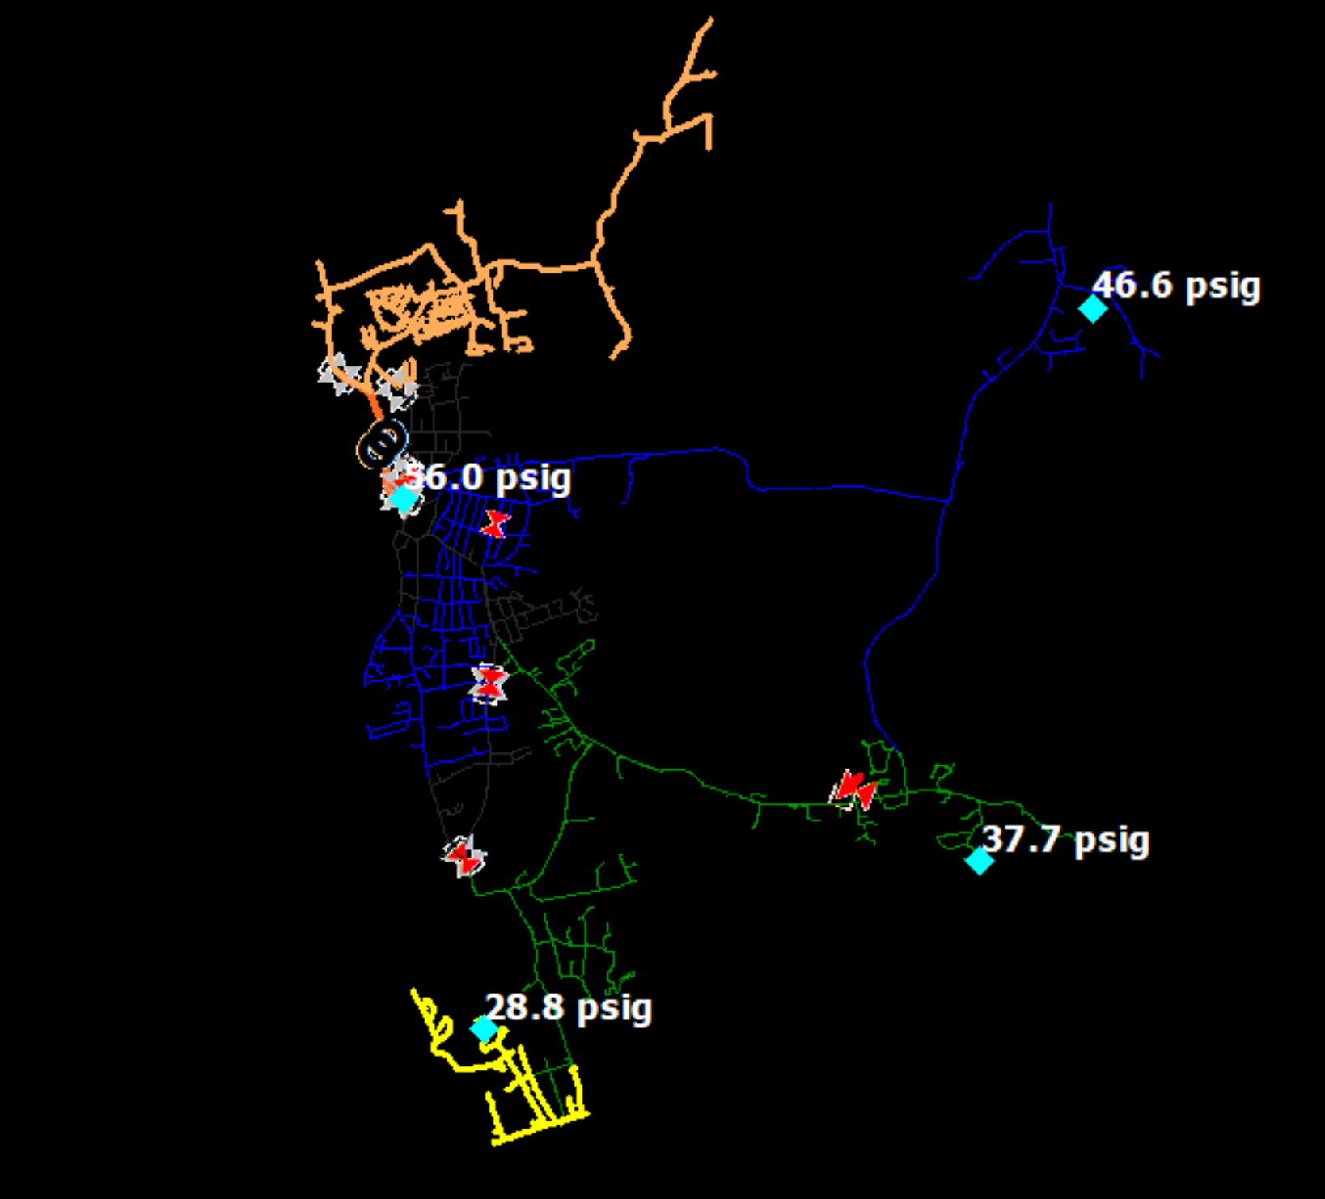
Model Application – Basic Concept
Synergi solves for downstream node pressures based on customer demand (demands rather than supplies are known flows, exception might be LNG)
Known material/infrastructure based on GIS
Set reg station pressures
Sum of supply point flow rates = customer demand
Supply Points
Solving for pressure throughout system

Slide 19
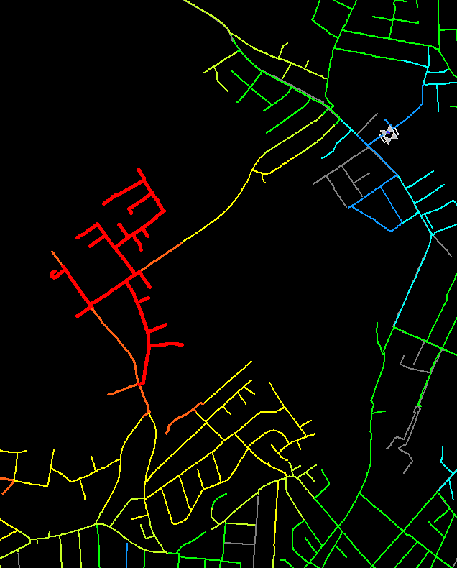
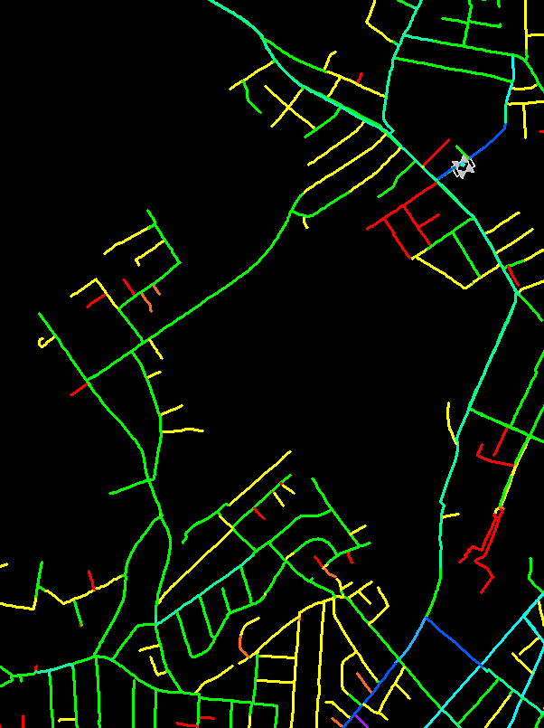
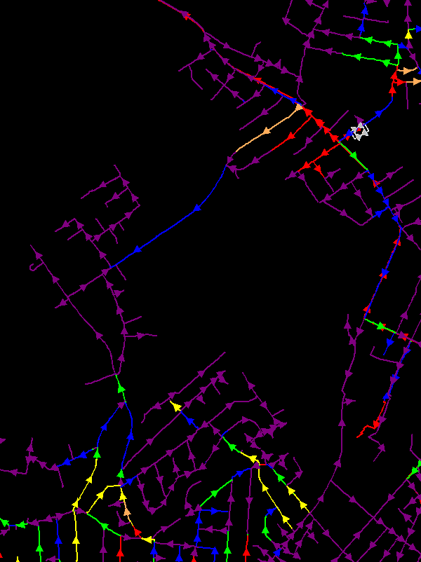
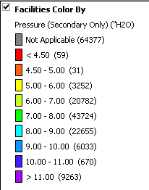
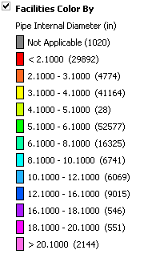
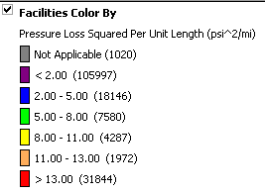
Model Application – Basic Concept
Visual Representation for Analysis
Bottlenecks

Slide 20
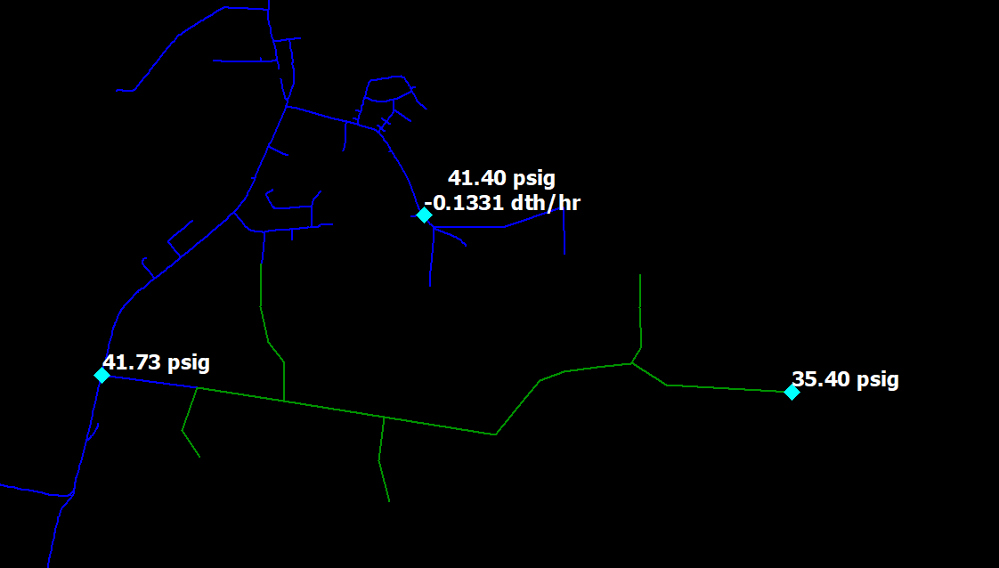
Part 2: Model Application – New Customer
There is a new residential development for 32 homes requesting gas.
Total requested load: 8 dth/hr (.25 per home), load diversifies to 5 dth/hr
What is the most cost effective way to serve this customer & maintain system integrity?
New Customer Location
Existing main: 2” 60 psig
Notes:
Replace with reg shutdown

Slide 21
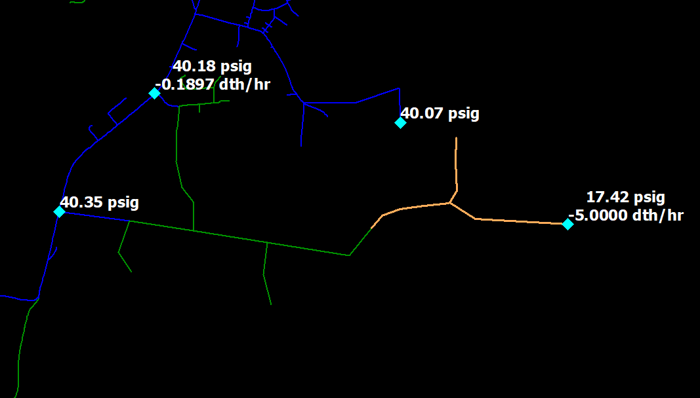
Part 2: Model Application – New Customer
Existing pressure: 35.4 psig
Pressure with load: 17.4 psig
Not acceptable! > 50% change
The 2” main serving the customer location is undersized
Two key ways to reinforce a system
Increase pipe size
Integrate more supply points

Slide 22
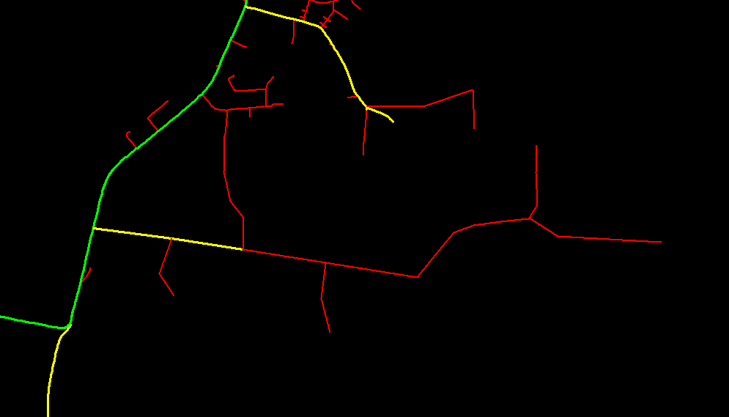
Part 2: Model Application – New Customer
Pipe Diameter View:
Green – 6”
Yellow – 4”
Red – 2”
Looping Option?
Relay Option?
Compare lengths & size
Option 0: Electrification (NPA)

Slide 23
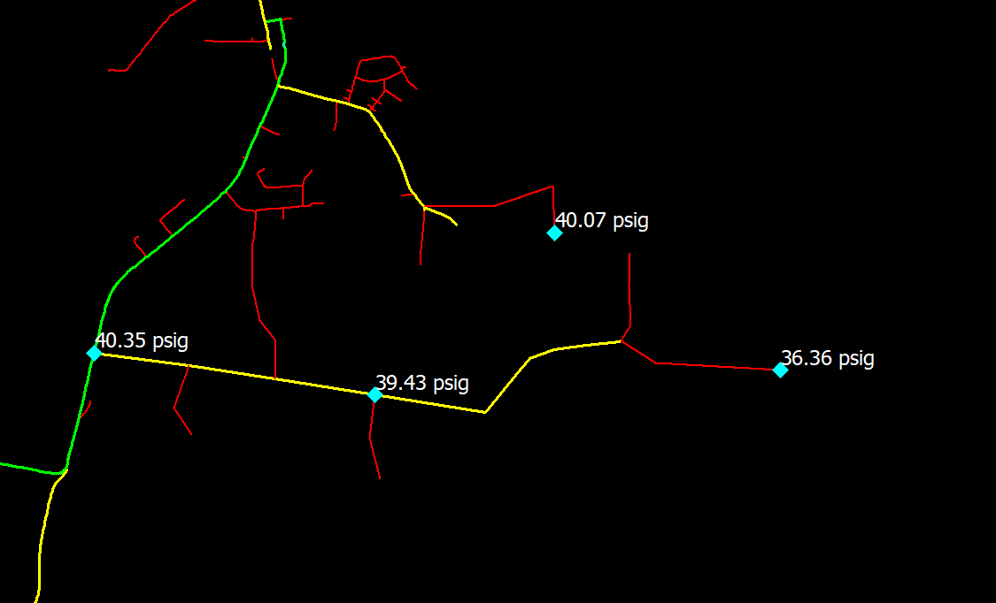
Part 2: Model Application – New Customer
Option 1:
Relaying 2” with 4”
$$$
RECAP
Before: 35.4 psig
No reinf: 17.4 psig
w/ 4” relay: 36.4 psig
Acceptable (better result)
Green – 6”
Yellow – 4”
Red – 2”

Slide 24
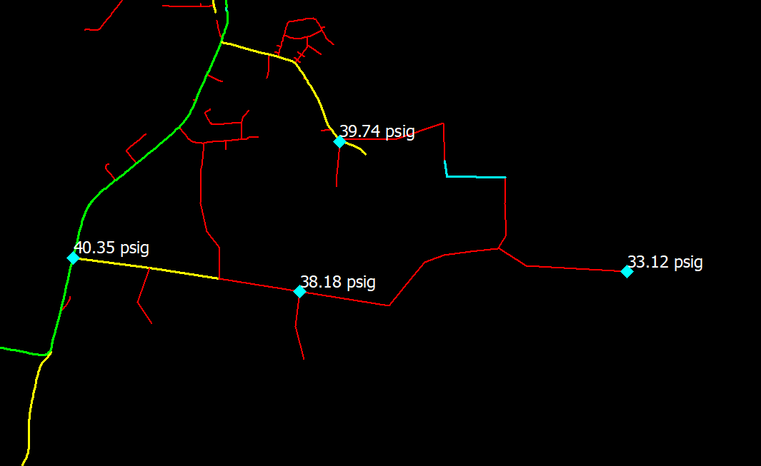
Part 2: Model Application – New Customer
Option 2A: Looping section of 2”
Cheapest option $
Constraints still exist and pressure drop still too high
RECAP:
Before: 35.4 psig
No reinf: 17.4 psig
w/ 4” relay: 36.4 psig
2” Loop: 33.1 psig

Slide 25
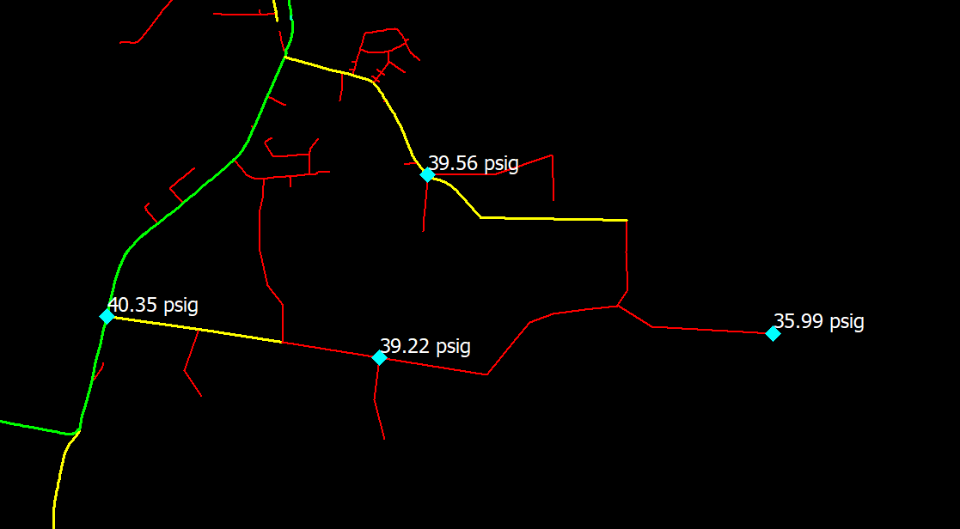
Part 2: Model Application – New Customer
Option 2B: Looping with 4”
Improves pressure
Two-way feed
$$ cheaper than Option 1
RECAP
Before: 35.4 psig
No reinf: 17.4 psig
w/ 4” relay: 36.4 psig
2” Loop: 33.1 psig
4” loop: 36.0 psig
Design Criteria:
Allowable pressure drop = 2 psig
Min design pressure = 10 psig

Slide 26
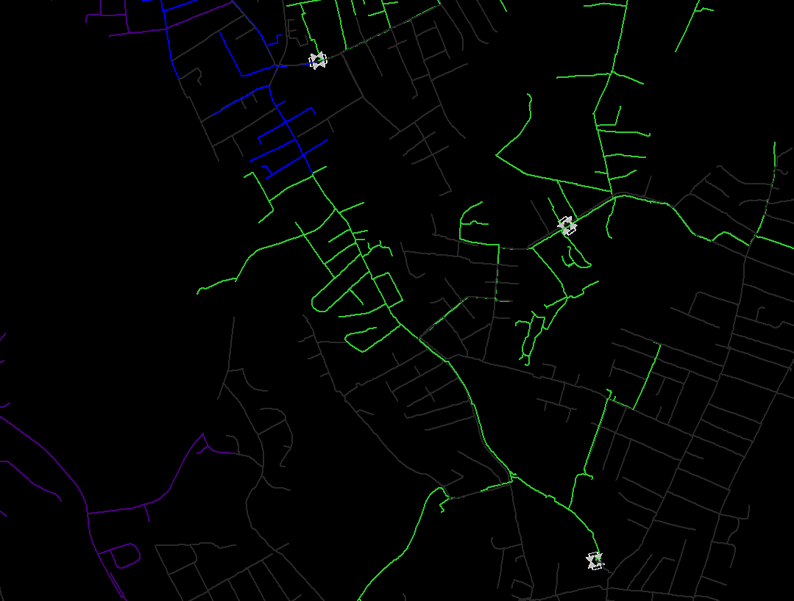
Part 2: Model Application – Troubleshooting
Inlet to R384
SCADA Pressure: 20.2 psig
Synergi Model Pressure: 22.5 psig
Under design conditions on gas day 2/3/23, actual SCADA pressures at the inlet to station R364 differed by nearly 11 psig from predicted Synergi model pressures.
Actual versus predicted inlet pressures at upstream station R384 differed by only 2 psig
Follow flow path….
Restriction in lateral?
Inaccurate loading in model?
Any recent in progress or completed work in GIS?
SCADA:
50 psig
Inlet to R364
SCADA Pressure: 9.0 psig
Synergi Model Pressure: 19.6 psig
SCADA:
26 psig

Slide 27
Part 2: Model Application – Troubleshooting
Inlet to R384
SCADA Pressure: 20.2 psig
Synergi Model Pressure: 22.5 psig
Narrowed area of concern:
8in PL bottleneck between two 12in PL segments with several valves and 90-deg elbows.
Valve checks were requested for the three valves in this cluster and all were thought to be in the open position.
SCADA:
50 psig
Inlet to R364
SCADA Pressure: 9.0 psig
Synergi Model Pressure: 19.6 psig
SCADA:
26 psig

Slide 28
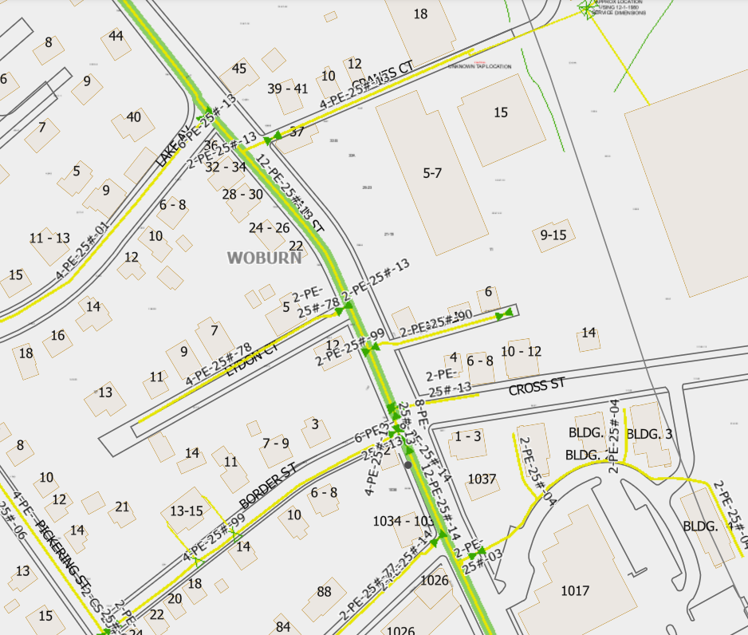
Part 2: Model Application – Troubleshooting
WTS 1a
Expected pressure
Requested I&R install Winter Telescada points on the north and south sides of the suspected problem area
Due to main configuration, camera inspection would not be feasible through all valves and fittings
Relocated northern point several times during the winter to narrow the area of concern
WTS 1b
Expected pressure
Area of concern
WTS 1c
Expected pressure
WTS 2
Much lower pressure

Slide 29
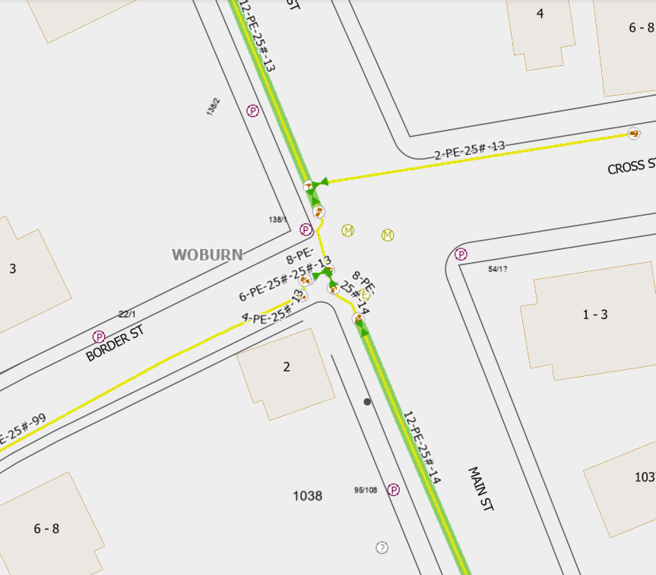
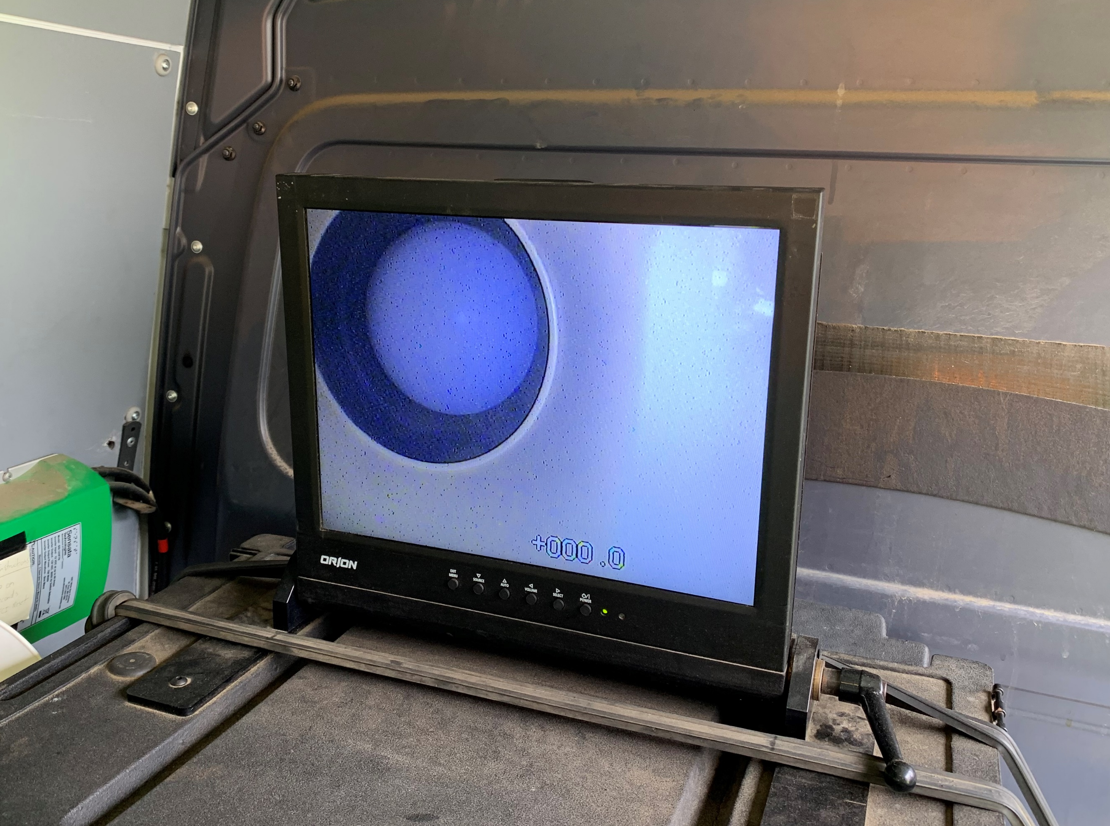
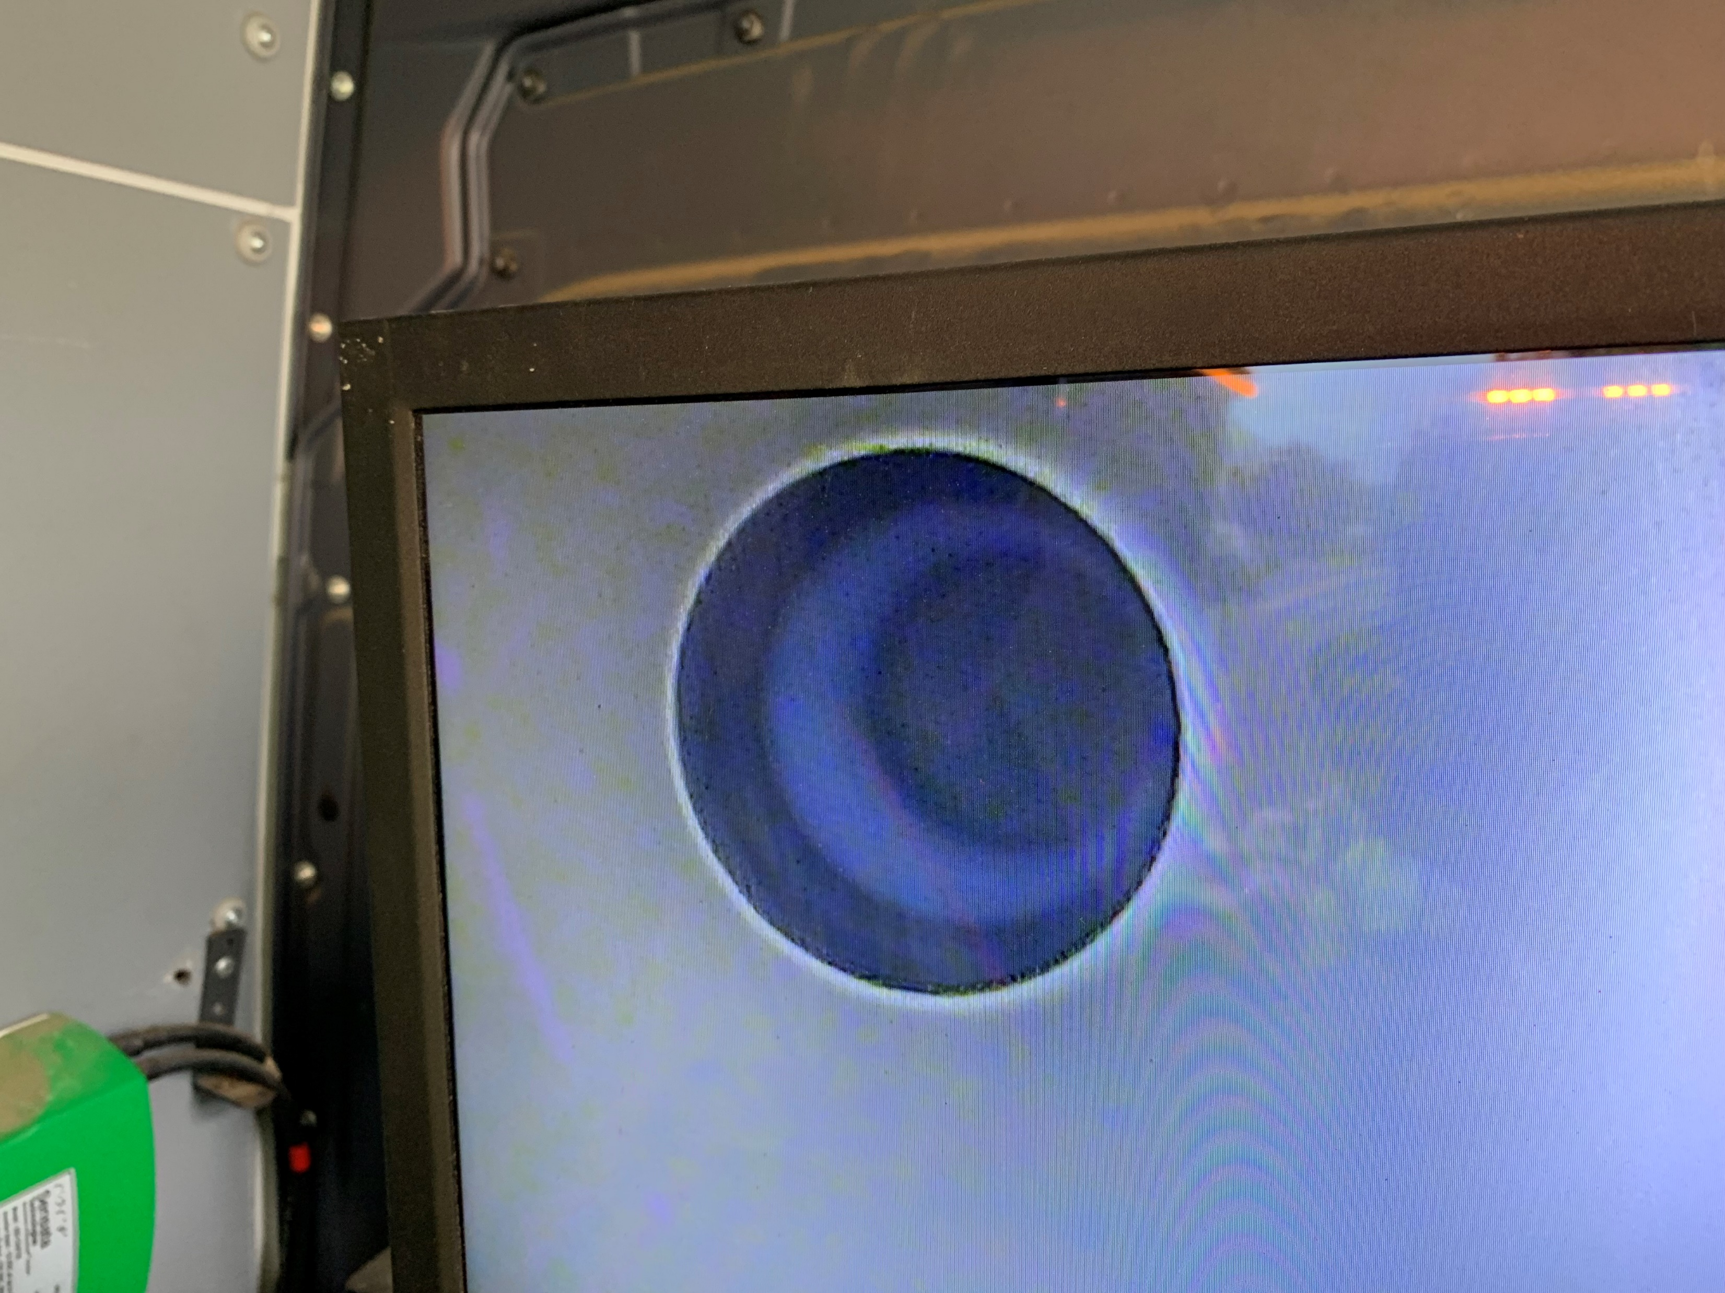
Part 2: Model Application – Troubleshooting
Camera inspection scheduled in the spring
Main clear north of insertion point
Camera located a fully closed 12in PL 25 psig valve south of insertion point
Crew contacted Gas Control and reopened
Root causes?
May have been left open since main installation was completed in 2014, issue exacerbated by extreme cold
Could have been closed during maintenance
Inaccurate records/mapping
Camera inserted here
12in PL valve found closed here!!!

Slide 30
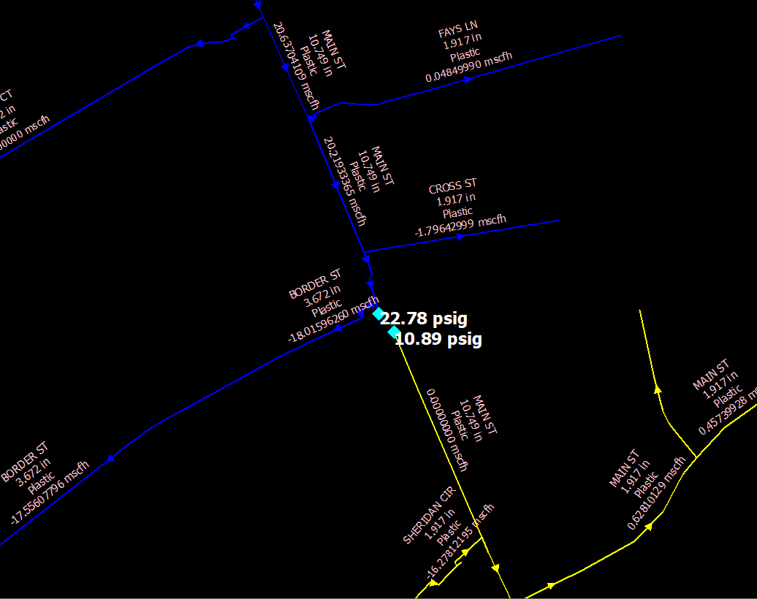
Part 2: Model Application – Troubleshooting
Modeled closed valve in Synergi once condition was field-verified.
Difference between SCADA and Synergi predicted pressures is now only 1 psig.
Inlet to R384
SCADA Pressure: 20.2 psig
Synergi Model Pressure: 21.3 psig
Inlet to R364
SCADA Pressure: 9.0 psig
Synergi Model Pressure: 10.2 psig

Slide 31
Synergi’s Relationship with Gas Departments
Coordination, communication, & support with other all parts of the gas business:
Gas Control
I & R
Field Ops
LNG
Gas Supply & Procurement
Load Forecasting (data & analytics)
Asset Management & Design Engineering (Sizing, scoping, future planning, risk assessments, prioritization)
Resource Planning, Work Coordination
Public Works
Compliance & Safety (Critical Valves, mandated programs)
Jurisdiction (Communication to customers on need for certain projects, etc)
Sales (growth project review)
Dispatch – (Emergency Response)
Meter Data Services (customer usage review)
Mapping (Corrections, GIS extracts)
Finance/Budgeting (Asset Management)
Electric Utility – (Power Gen supply, growth, electrification studies, rolling blackout issues on LP gas systems)
Future of Heat/ Act on Climate (hydrogen blending, RNG, segment decommissioning, etc)

Slide 32
Summary
Other Synergy Gas Modules
Steady State (Typical LDC application)
Compressor Stations
Unsteady State (Transient) (Typical Transmission application)
Regulator Station Module (relief valves, reg failure, overpressure protection)
Area Isolation Module (AIM) – critical valve program
External Training – DNV GL Synergy Training classes (basic, advanced, module-specific, etc.)
Common Issues for Awareness:
Complacency/inattention to detail
Lack of communication across departments
Lack of understanding system operations
Lack of knowledge in standards, policy, code & procedure document
System Design Criteria with gray areas
Poor data!!! (our models are only as good as the data we get)
Notes:
Complacency can lead to IAs (not modeling, or lack of attention to detail)

