Slide 1
LEADING THROUGH COMPLEXITY
PREPARING FOR CYBER RESILIENCE
Ben Miller
bmiller@dragos.com
CISO

Slide 2
The Resilient Leader
The Over Confident
Low engagement but high preparedness.
“Lots of tools, no ownership”
The Resilience Leader
High Engagement and High Preparedness.
“highly coordinated and integrated”
Leadership
Engagement
The Complacent
Low engagement and low preparedness.
“IT has it handled”
The Alarmist
High engagement but low preparedness.
“paper tiger”
Organizational Preparedness

Slide 3
The Resilience Leader
The big rocks
Know the Adversary
01
Know the Stakes
02
Know the Plan
03
Build the Culture
04

Slide 4
Why This Matters

Slide 5
Michael P Fischerkeller et al, Cyber Persistence Theory,
Redefining National Security in Cyberspace
(Oxford University Press, 2022)
“[…] cyber activity of consequence should be understood primarily as campaigns, not incidents, intrusions, or hacks. [...] one of competitive interaction, not escalation, and that initiative rather than restraint is necessitated.”

Slide 6
“Here's a phrase that apparently the airlines simply made up: near miss. They say that if 2 planes almost collide, it's a near miss. BS, my friend. It's a near hit! A collision is a near miss. ”
George Carlin

Slide 7
We are riddled with near misses
Report A
Not within electric/energy
Ransomware
Exploited IT / Corporate
Gained access to OT
Left a ‘calling card’ only

Slide 8
We are riddled with near misses
Report B
Electric
Ransomware (unconfirmed)
Exploited remote access
Gained access to OATI market enclave
Was detected / contained before escalation

Slide 9
We are riddled with near misses
Report C
Electric
Ransomware
Exploited remote access
Solar facility (still being commissioned)
OT Environment rebuilt during commissioning

Slide 10
The ”hits” are happen but are still rare
2015 Ukraine distribution-level attacks, sporadic outages 1-6hrs, ~230k customers
2016 Ukraine transmission attack, ~1hr outage (de-energized 330kv substation)
2019 Safety Instrumentation System (SIS) malware attack. Mideast refinery trip
2021 Colonial pipeline ransomware attack, halting pipeline operations
2024 OT malware takes down Moscow municipality meter infrastructure
2024 OT malware disables HVAC for 600 Ukrainian apartment buildings

Slide 11
The Why
The Three Key Takeaways
Increasing level of “Competition” within cyber
  electric and energy are key players in both market competition and national security policy context
Industry Near Hits only increasing
Industry Actual Hits also increasing

Slide 12
Know the Adversary

Slide 13
Robert M Lee, CEO & Cofounder, Dragos
Testimony To House
Homeland Security Committee
July 2025
“Let me be blunt. We are not prepared for a major attack on our critical infrastructure. We know that such an attack would be part of any major conflict with an adversary, but we are not doing enough to prepare, and the results of continued failure could be catastrophic, including the loss of life.”
Notes:
Industry has many things going for it.

Slide 14



















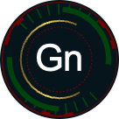














2024
Tracking threat groups
2017
2018
2019
2020
2021
2022
2023
2024
Notes:
We’ve seen a consistent increase in threat activity over the years. 23
We are focused on the threat groups targeting OT networks and ICS systems
A cyber attack in OT requires an understanding of the OT environment
OT adversaries need knowledge devices and systems and how they communicate
They need to be able to use that knowledge to manipulate physical processes and create an impact
That takes time, we also need to know who is working to develop capabilities to product an effect in OT
2024 saw a record number of OT attacks, especially in energy, manufacturing, and water sectors.
This year we added 2 new Dragos Threat Groups to the fold – BAUXITE and GRAPHITE.
We’re also going to talk about the activity of several other known threat groups that have been active in the previous year – VOLTZITE, ELECTRUM, and KAMACITE.

Slide 15
ELECTRUM
ADVERSARY
Associations with Sandworm
INFRASTRUCTURE
CAPABILITY
Compromised Infrastructure
TOR
CRASHOVERRIDE
  IEC 104
  IEC 101
  IEC 61850
  OPC DA
  SIPROTEC DoS
Industroyer2
Various wipers
VICTIM
Ukraine
European electric

Slide 16
KAMACITE
ADVERSARY
Russian-aligned objectives
Linked to Sandworm
INFRASTRUCTURE
CAPABILITY
Compromised 3rd party
TOR nodes
Adversary-owned
BlackEnergy2
BlackEnergy3
GreyEnergy
Exaramel
Kapeka
VICTIM
North America, Europe
Energy, Manufacturing

Slide 17
ELECTRUM and KAMACITE Activities*
* Subset of activities
BlackEnergy2 exploits HMIs
Information Gathering
CRASHOVERRIDE
Impacts substation in Ukraine
ABB PCM600 wiper
AcidRain wiper impacts German wind turbines
AcidPour wiper found in public repository
2014
2016
2022
2024
2015
2022
2023
2024
BlackEnergy3
Manual SCADA operations impacted 225k people for 6 hours
KillDiskWiper
Industroyer2 found in Ukrainian Energy provider
CaddyWiper associated
Unknown wiper impacts Kyivstar telecom
Kapeka backdoor found in European Oil and Gas
Notes:
Talking points:​
2007 BlackEnergy was only used by criminals and in IT​
2014 added exploitation capabilities for Siemens SIMATIC, GE CIMPLICITY, and Advantech WebAccess HMIs -> used for information gathering and did not cause disruption. These were accessible from the Internet​
2015 – BlackEnergy3 has no ICS capability but was used to gain access to the business network, pivoting to ICS and manually manipulating SCADA operations, followed by wiping Windows systems with KillDisk. Though folks were able to manually repair, the wiping capabilities made them lose automation for almost a year in some places.​
2016 – CRASHOVERRIDE used to impact a single substation​
​
​
Key takeaways:​
* We can learn a lot by studying what happened in Ukraine over the last 15+ years. ​
* Initial attacks compromised systems available on the internet, but as they matured, their capabilities allowed them to pivot from business networks into OT networks.​
* The ICS malware abuses trust between OT systems ​
* At some point, they ditched the need for ICS malware and relied on the power of wiper capabilities.

Slide 18
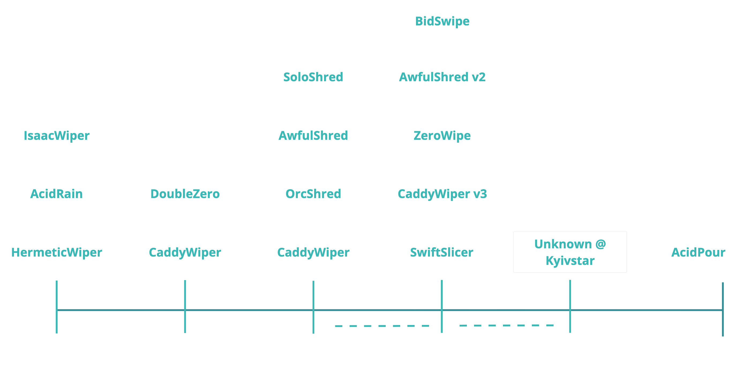
ELECTRUM Wipers 2022-2024
December
2023
March
2024
February
2022
March
2022
April
2022
January
2023

Slide 19







2024
Convergence of hacktivism and state-sponsored threats
KillNet
Shared Infrastructure
CARR
Solntsepek
Intelligence Sharing
Victim
Overlaps
XakNet
Confirmed
Suspected
Notes:
Convergence of hacktivism and TGs
Don't fall for the hacktivism hype, though dangerous they aren’t as skilled as they claim.
The key issue is that loud hacktivist attacks were observed coinciding with more skilled TG activity, concealing what was going on.
We’ve observed these groups sharing infrastructure, targeting the same victims, with the potential for sharing intelligence.
CARR – CyberArmyofRussia_Reborn

Slide 20




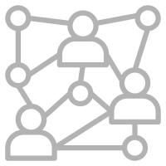






2024
Ransomware attacks increased by 87% with 1693 total incidents
1171Manufacturing
177 Industrial Control Systems
176 Transportation
44 Oil & Gas
41 Communications
30 Electric
20 Government
12 Water
11Mining
7 Renewables
4 Data Centers
Notes:
Solar

Slide 21
VOLTZITE
ADVERSARY
Overlaps with Volt Typhoon
ICS data collection
  GIS, manuals, diagrams
INFRASTRUCTURE
CAPABILITY
Compromised SOHO equipment
ORB networks
Living off the land techniques
Exploitation of externally facing network devices
Proxy tools
ICS reconnaissance
VICTIM
Electric sector in US (including Guam)

Slide 22
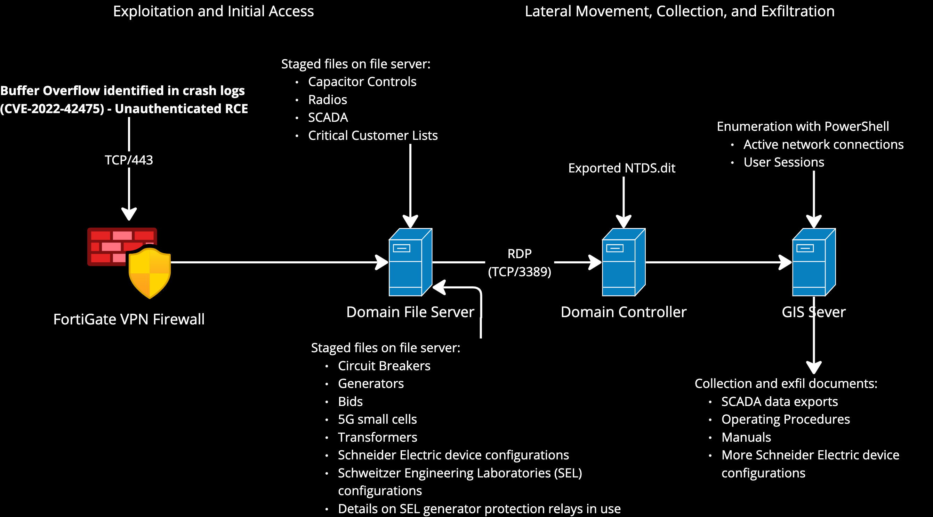
VOLTZITE
24 January
11 January
10 January
7 February
9 February
Notes:
Dates and durations
VPN exploitation
Remote access and LoTL

Slide 23
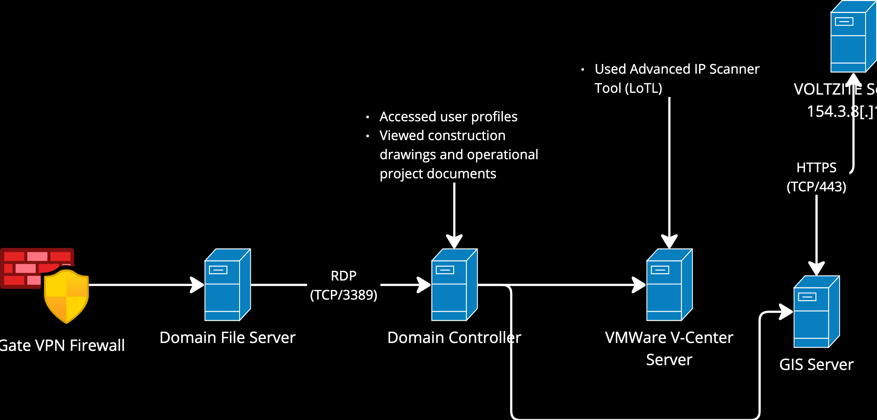
VOLTZITE Activity Continued
VOLTZITE Server
154.3.8[.]157
21 September
FortiGate VPN Firewall
7 October

Slide 24


Chinese Gas Pipeline Intrusion Campaign, 2011 to 2013 – AA-21-201A
NOTE:
“there was a significant number of cases where log data was not available, and the depth of intrusion and persistent impacts were unable to be determined; at least 8 of 23 cases (35%) identified in the campaign were assessed as having an unknown depth of intrusion due to the lack of log data.”

Slide 25
Know the Adversary
The Three Key Takeaways
The adversary adapts, when needed
  Unfortunately, defenders are slower to adapt
The OT threat landscape is getting more diverse and complicated
There is no “eureka moment”

Slide 26
Three 3 Adversary Takeaways
3 Key Takeaways
Utilities are the least blind into OT, compared to other industries
  I would still consider most asset owners “legally blind”
We we riddled with attacks affecting OT
  15 years ago it was science fiction.
  Probably going to get worse before it gets better
There is no “eureka moment”
  Use threat briefings to apply context in security and business operations

Slide 27
Know the Stakes

Slide 28
Know the Stakes
Does your security team have visibility?
  Technical Visibility (OT security tools, e.g. Dragos Platform)
  Business visibility (key priorities, access to business leaders, operations, acquisitions)
Do the right people on your team have the right visibility?
  In 2-3 sentences, do you understand your government affairs security policy?
  Do your leaders agree with security team’s playbook for your really bad day?

Slide 29
Know the Plan

Slide 30
Know the Plan
The Two Takeaways
Make sure both Operations and Security know what a bad day looks like
“train like you fight”

Slide 31
Build the Culture

Slide 32
Ben Horowitz
What You Do is Who you Are
(Harper Business, 2019)
“Your culture is how your company makes decisions when you’re not there.”

Slide 33
Do our teams work with security or against it? Are they engaged?

Slide 34
Do your security leaders understand our business strategy?

Slide 35
Where do you [the security leader] need the most funding?

Slide 36
Do you ever read or receive intel briefings?

Slide 37
I’m concerned about a functional area. How can you help me make a better decision on it?

Slide 38
We’re looking to invest in [asset/technology/company]. What’s the security angle and how should security be involved?

Slide 39
How can we expose more day-to-day operations to your security teams?

Slide 40
Build the Culture
The Three Takeaways
Be Inconvenient. Ask the hard questions
Teach. Probe for the most-correct answer
Be the champion. Consider security/risks in business decisions

Slide 41
In Conclusion

Slide 42
The Resilience Leader
The big rocks
Know the Adversary
01
Know the Stakes
02
Know the Plan
03
Build the Culture
04
Understand the art of the possible.
You know the business the best.
Train as one team.
Be the champion we will need.

Slide 43

Thank you
Ben Miller
bmiller@dragos.com

