Slide 1
Networked
Geothermal Systems
Eric Bosworth- Principal, Thermal Energy Insights
Eric@TEInsights.com

Slide 2
Agenda
Background
What are geothermal networks?
Why the gas utility?
Project Planning
Construction
Operations
Value Proposition

Slide 3
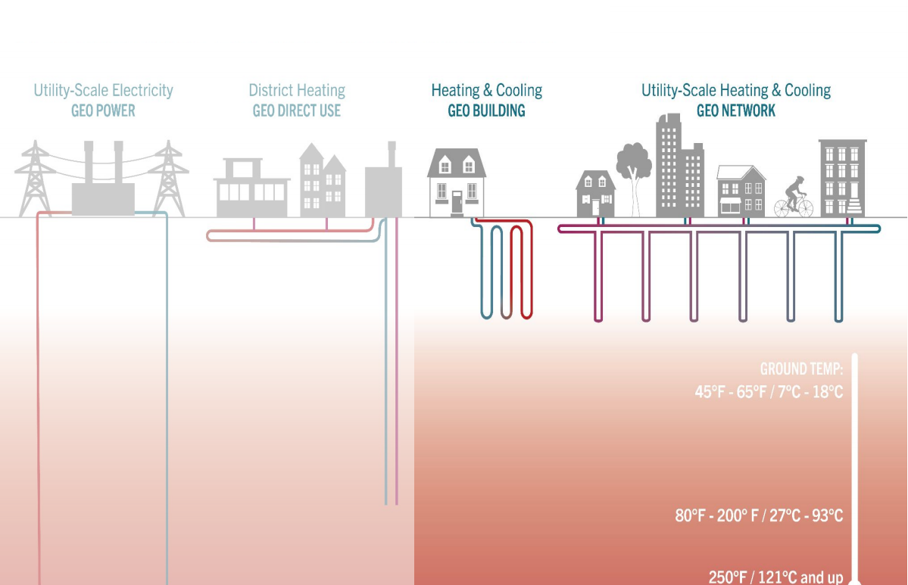
Types of Geothermal
*Image credit HEET

Slide 4
Generations of District Heating
1st Generation
High temperature steam distribution
Coal and industrial heat sources
2nd Generation
Pressurized water distribution at 100 degC
3rd Generation
Ambient temperature loops (10-35 degC)
5th Generation
4th Generation
Coal and industrial heat sources
~1880s
~1930s
Water distribution at <100 degC
Coal, industrial heat, biomass, and some geothermal sources
~1970s
Water distribution for direct use <70 degC
Renewable energy sources, high temperature geothermal, some energy recycling
~2010s
Renewable sources including geothermal, waste heat, and solar PV
Current state of the art
Bi-directional energy transfer for heating and cooling loads on the same system

Slide 5
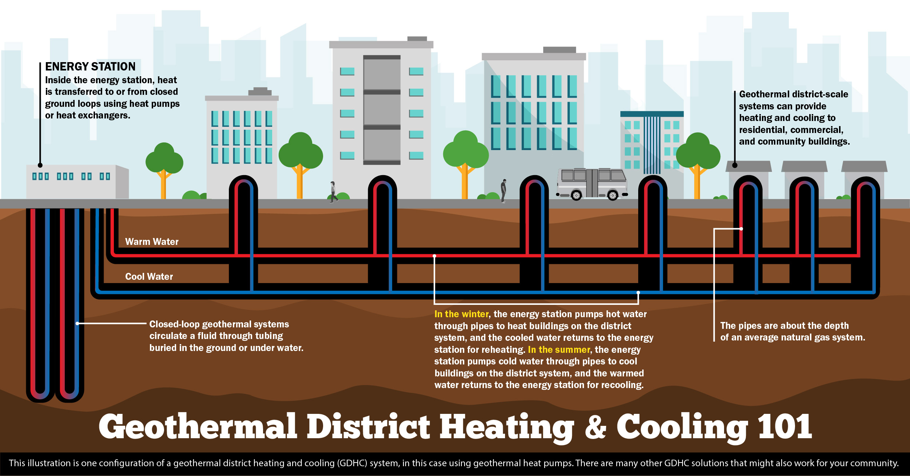
Networked Geothermal Overview
*https://www.nrel.gov/news/features/2023/full-steam-ahead-unearthing-the-power-of-geothermal.html

Slide 6
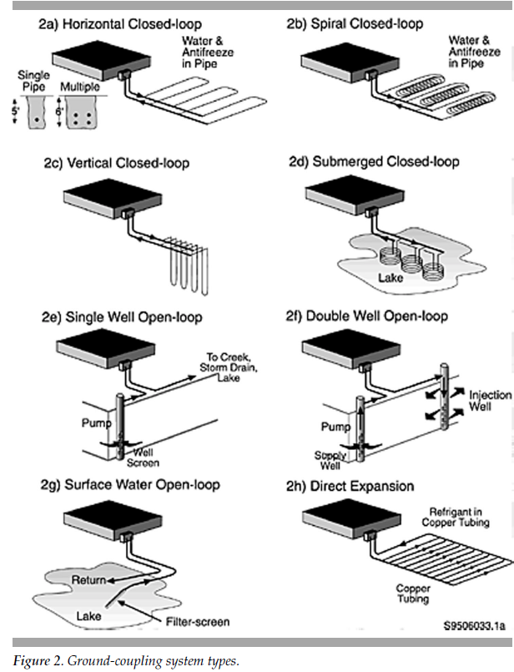
Borefield Types
Thermal transfer is a key component to networked geothermal systems
The ground (or body of water) acts as a thermal source and sink for the network
There are many configurations that can be used depending on location
In a networked system, different thermal exchanges can be connected to various parts of the system

Slide 7
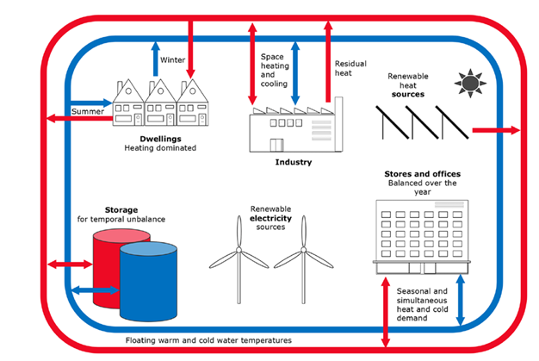
Other Thermal Assets
*5th generation district heating and cooling systems as a solution for renewable urban thermal energy supply, 2019
Networks can take advantage of other sources / sinks of thermal energy
Solar heat recovery, waste water systems, data centers, industry, irrigation, etc
These can be used to balance a network or provide low cost energy sources that supplement borefields

Slide 8
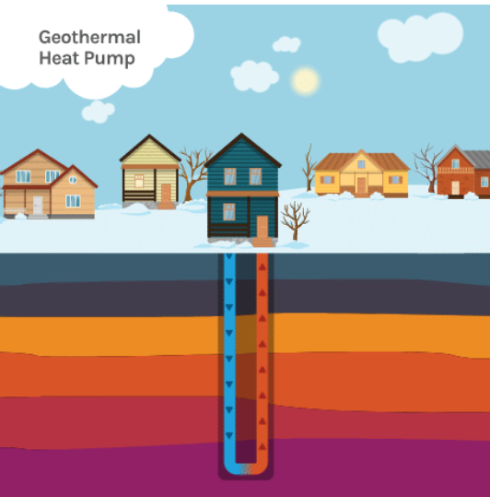
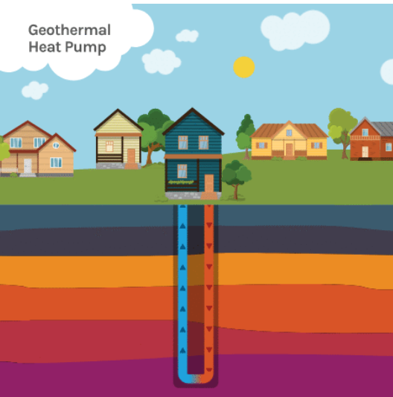
Heat Pumps 101
Heat pumps are electrically driven and move thermal energy from one place to another
They are extremely efficient within the range of approx. 40-70 deg F
Ground source heat pumps generally operate within this range. Air source are exposed to external conditions, so may operate outside the ideal range
*Source: DOE GTO Website

Slide 9

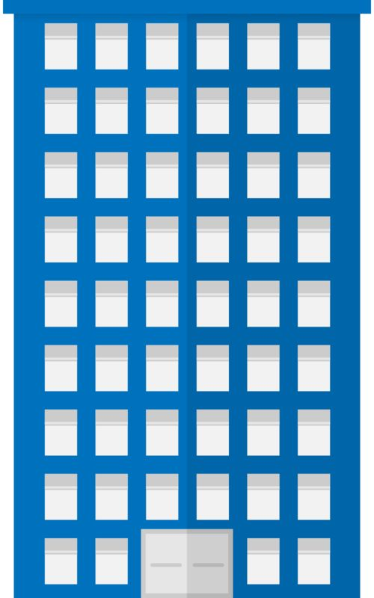

Building Conversion Types
Single Family Home
Forced air with ducting
Apartment Buildings
Corner / console units
Commercial Buildings
Water to water commercial system
VRF with split heads (similar to air source mini-splits)
Combination of forced air and splits
Stacked forced air units
Hydronic / hot water only units (no cooling)
VRF with split heads
Rooftop water to air units

Slide 10

Why the Gas Utility?
From a big picture perspective, geothermal and natural gas businesses share many common aspects
Capital Intensive
Buried/Underground Infrastructure
Long Lived Assets
Regulated Service
Monitoring System Conditions
Similar Customer Barriers
Similar Point of Common Coupling

Slide 11
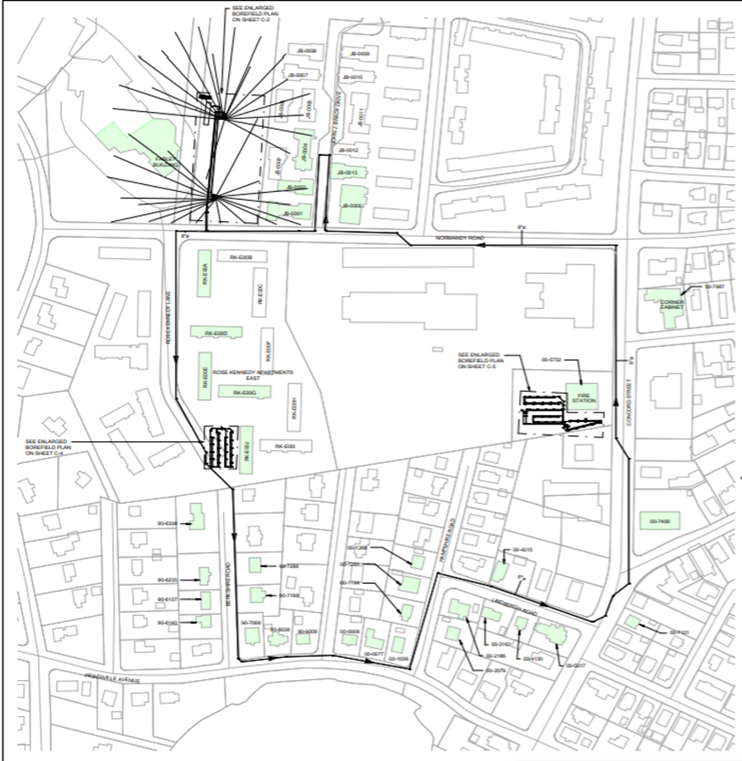
Example System Layout
Ongoing Pilot loop
1-mile single pipe system
Support approximately 140 customers
36 connected buildings
Main borefield with 2x satellite borefields
Main temperature should stay within about 2 deg F (1 deg C) throughout the loop
Peak load of 375 tons (~1,300 kW)

Slide 12
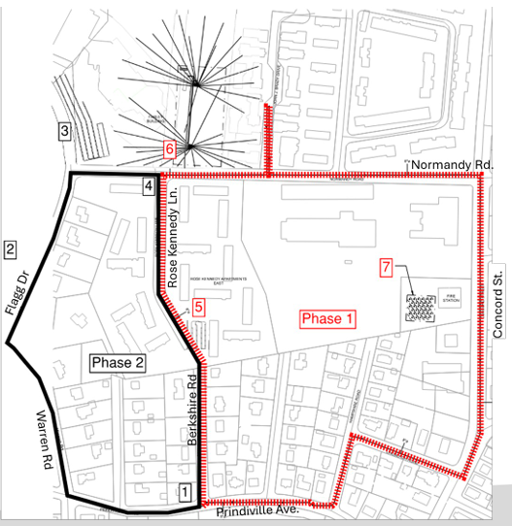
System Expansion
Original system was installed for 375 tons (1,300 kW)
Block by block buildout of a neighborhood
Original pump house and system can be leveraged to reduce cost
Engineering, site work, and permitting simplified

Slide 13
Cost Reduction with Scale
Phase 1
Phase 2
Phase 3
As networks grow, unit costs drop on a per customer or per ton basis
Fixed assets such as pump house and monitoring system are required for a 30 customer loop and a 3,000 customer loop
Larger networks have more thermal stability and reduce both operating energy and peak load requirements

Slide 14
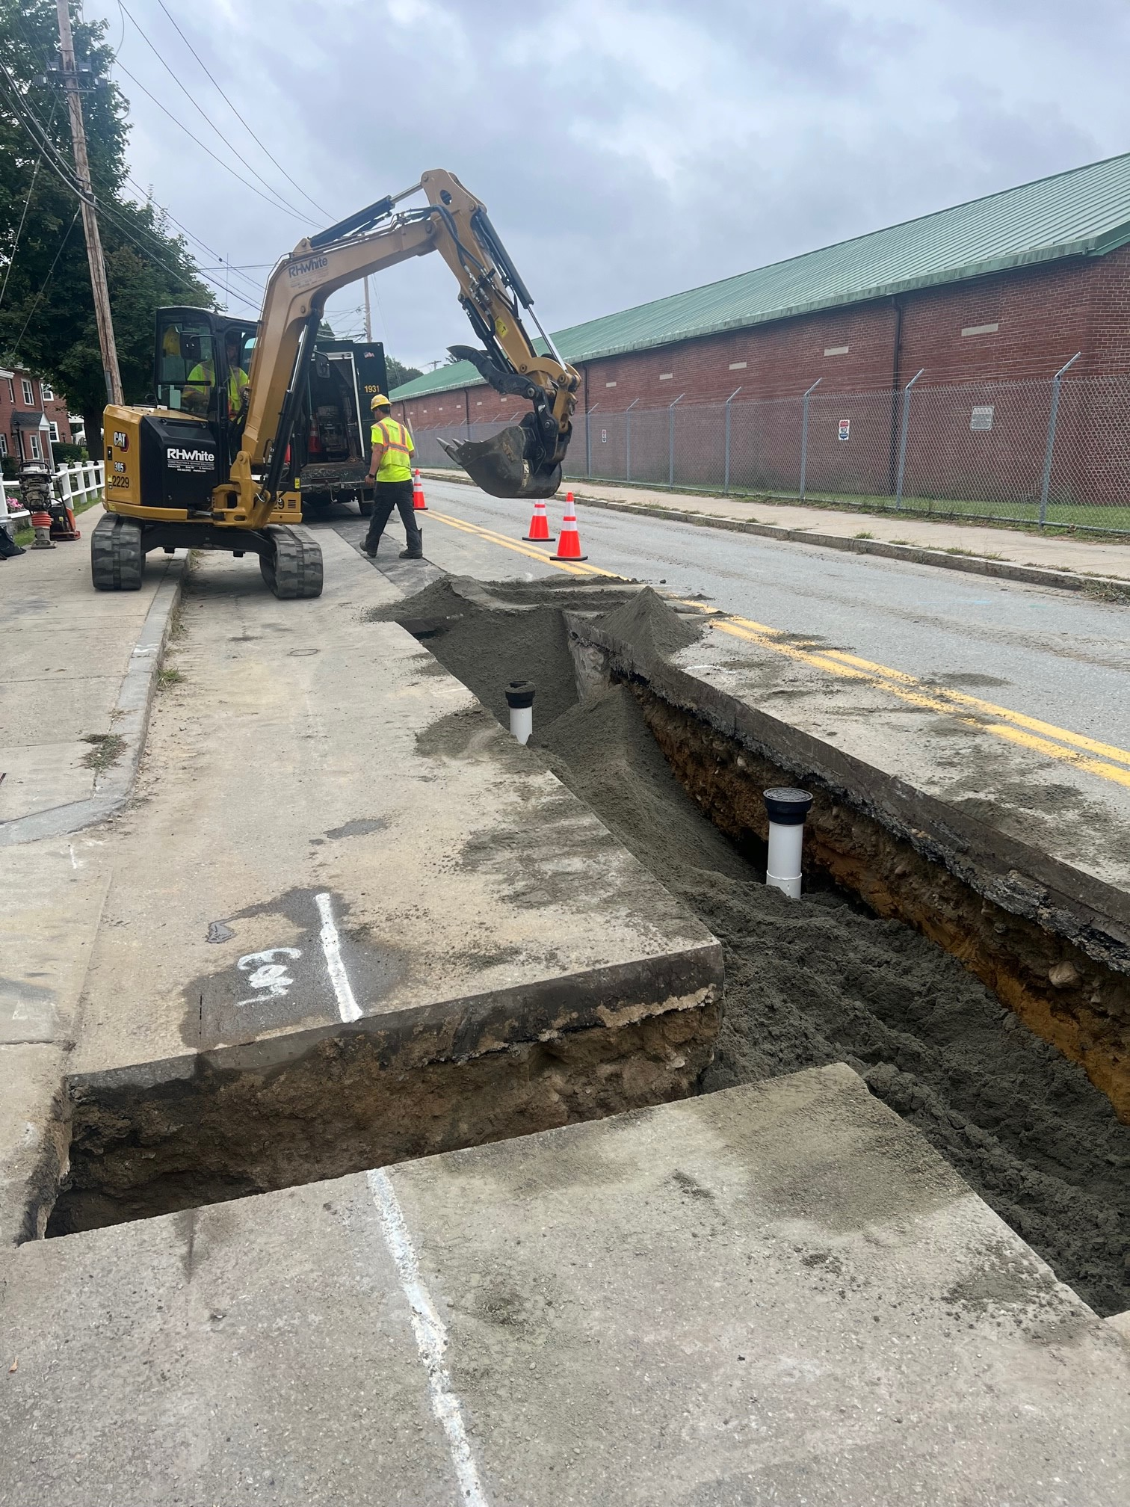
Utility Cost Model
Blending rate bases helps to prevent increasing costs for a smaller group of customers
Thermal networks can be deployed in areas without access to pipelines
Work force can be cross trained for majority of the installation and operations
Existing groups and systems can be leveraged such as billing, mapping, sales, etc
Fixed pricing contracts can be leveraged with large deployments

Slide 15
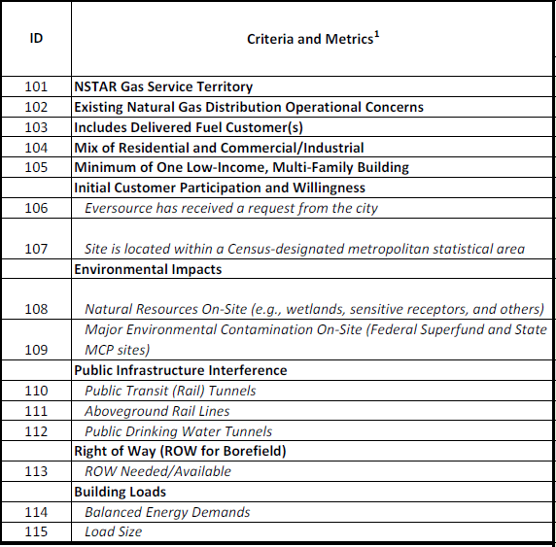
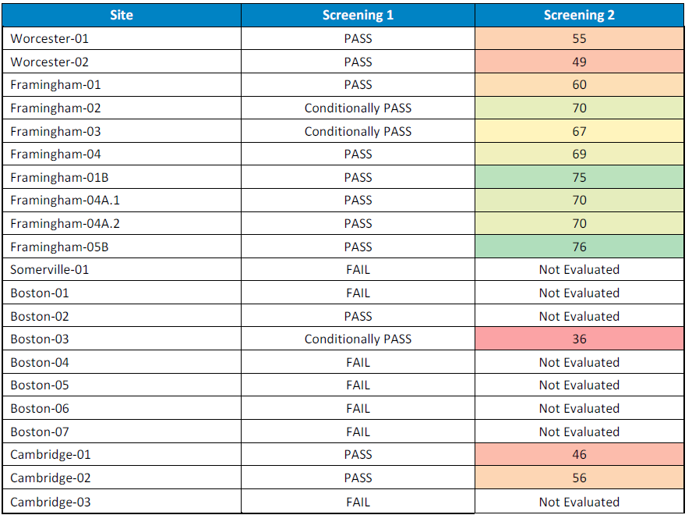
Site Screening
Documented criteria and process are important
Initial go / no go with critical site attributes as a screening
Second level is more quantitative with scoring assigned to a set of 24 criteria
System planning considerations will be important going forward

Slide 16
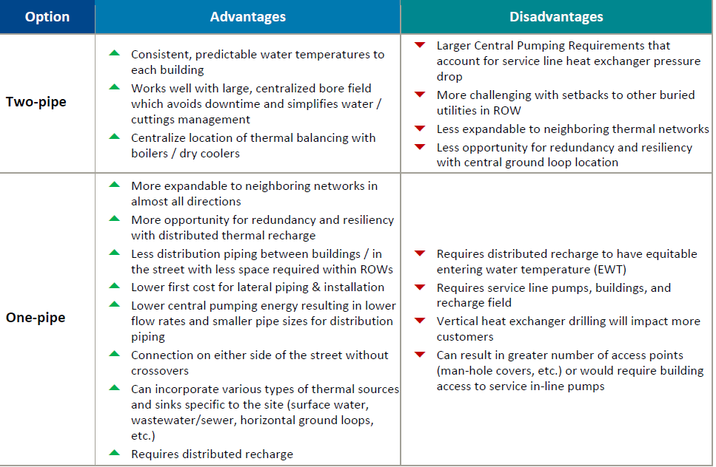
System Design
Loop designs were considered with a number of criteria in mind:
  One Pipe vs Two
  Pumping Energy
  Overall Efficiency
  Temperature Variation
  Ease of Expansion
  Cost and Construction Scope

Slide 17
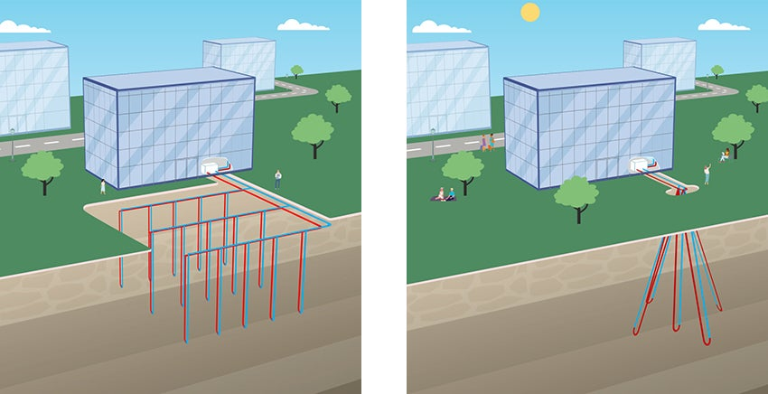
Ground Exchanger Design
Borehole layout can be designed to meet required system capacity
Thermal response is tested in a test borehole
Layout and spacing affect borefield performance
Options for things like deviated boreholes in space constrained areas

Slide 18
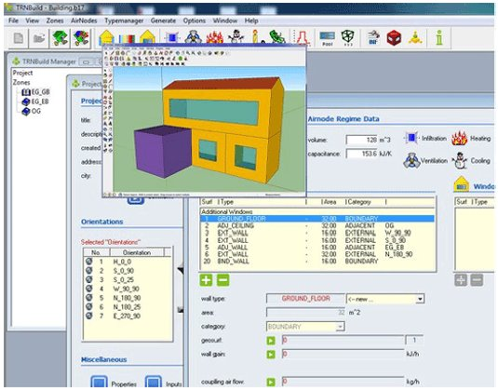
Building Modeling
Manual J calculations for connected buildings
Insulation work or envelope improvements
Confirmation of required loads, not matching what is existing
Information rolls up into thermal model to ensure sufficient thermal capacity on the network
Allows for load cancellation estimates and waste heat to be captured appropriately

Slide 19
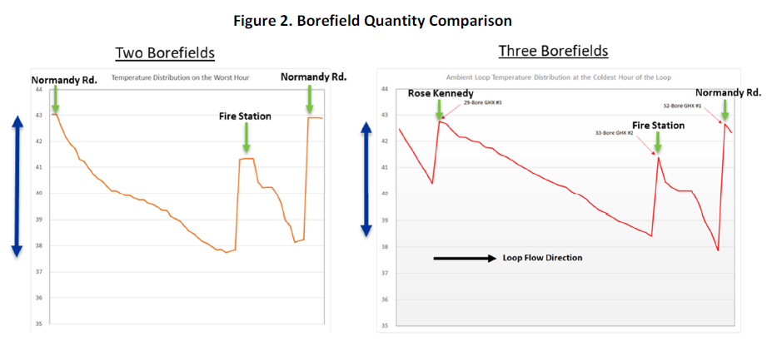
Alternatives Analysis
Sensitivity analysis is important for design critical factors
Used to ensure proper sizing and operation of the loop
Informs the design team on how robust the system will be on
the coldest and hottest days of the year
Opportunity for cost savings if initial design is over sized

Slide 20
System Construction
Thermal Source
Heat Exchanger Installation
Thermal Source Pumps
Horizontal Loop
Weatherization
Heat Pump Installation
Customer Installations
Main Installation
Laterals and Headers
Service Installations
Pump Center and Controls
Ducting and Electrical

Slide 21
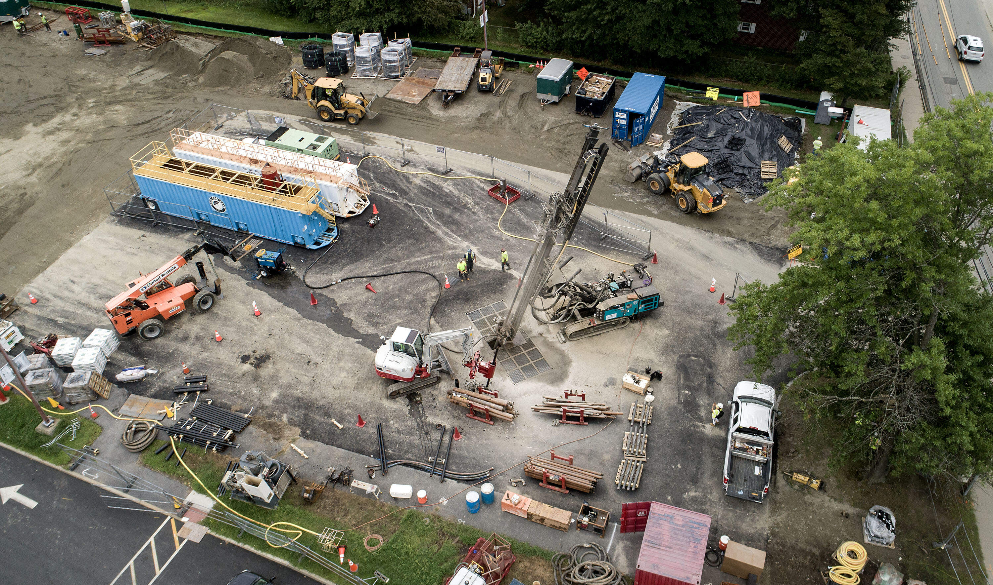
Borefield Drilling
500-1,000 ft bores with u-bend of HDPE pipe
Centralized drilling locations to connect to the network
Water and site management are critical
Typically, 1-2 days per borehole

Slide 22
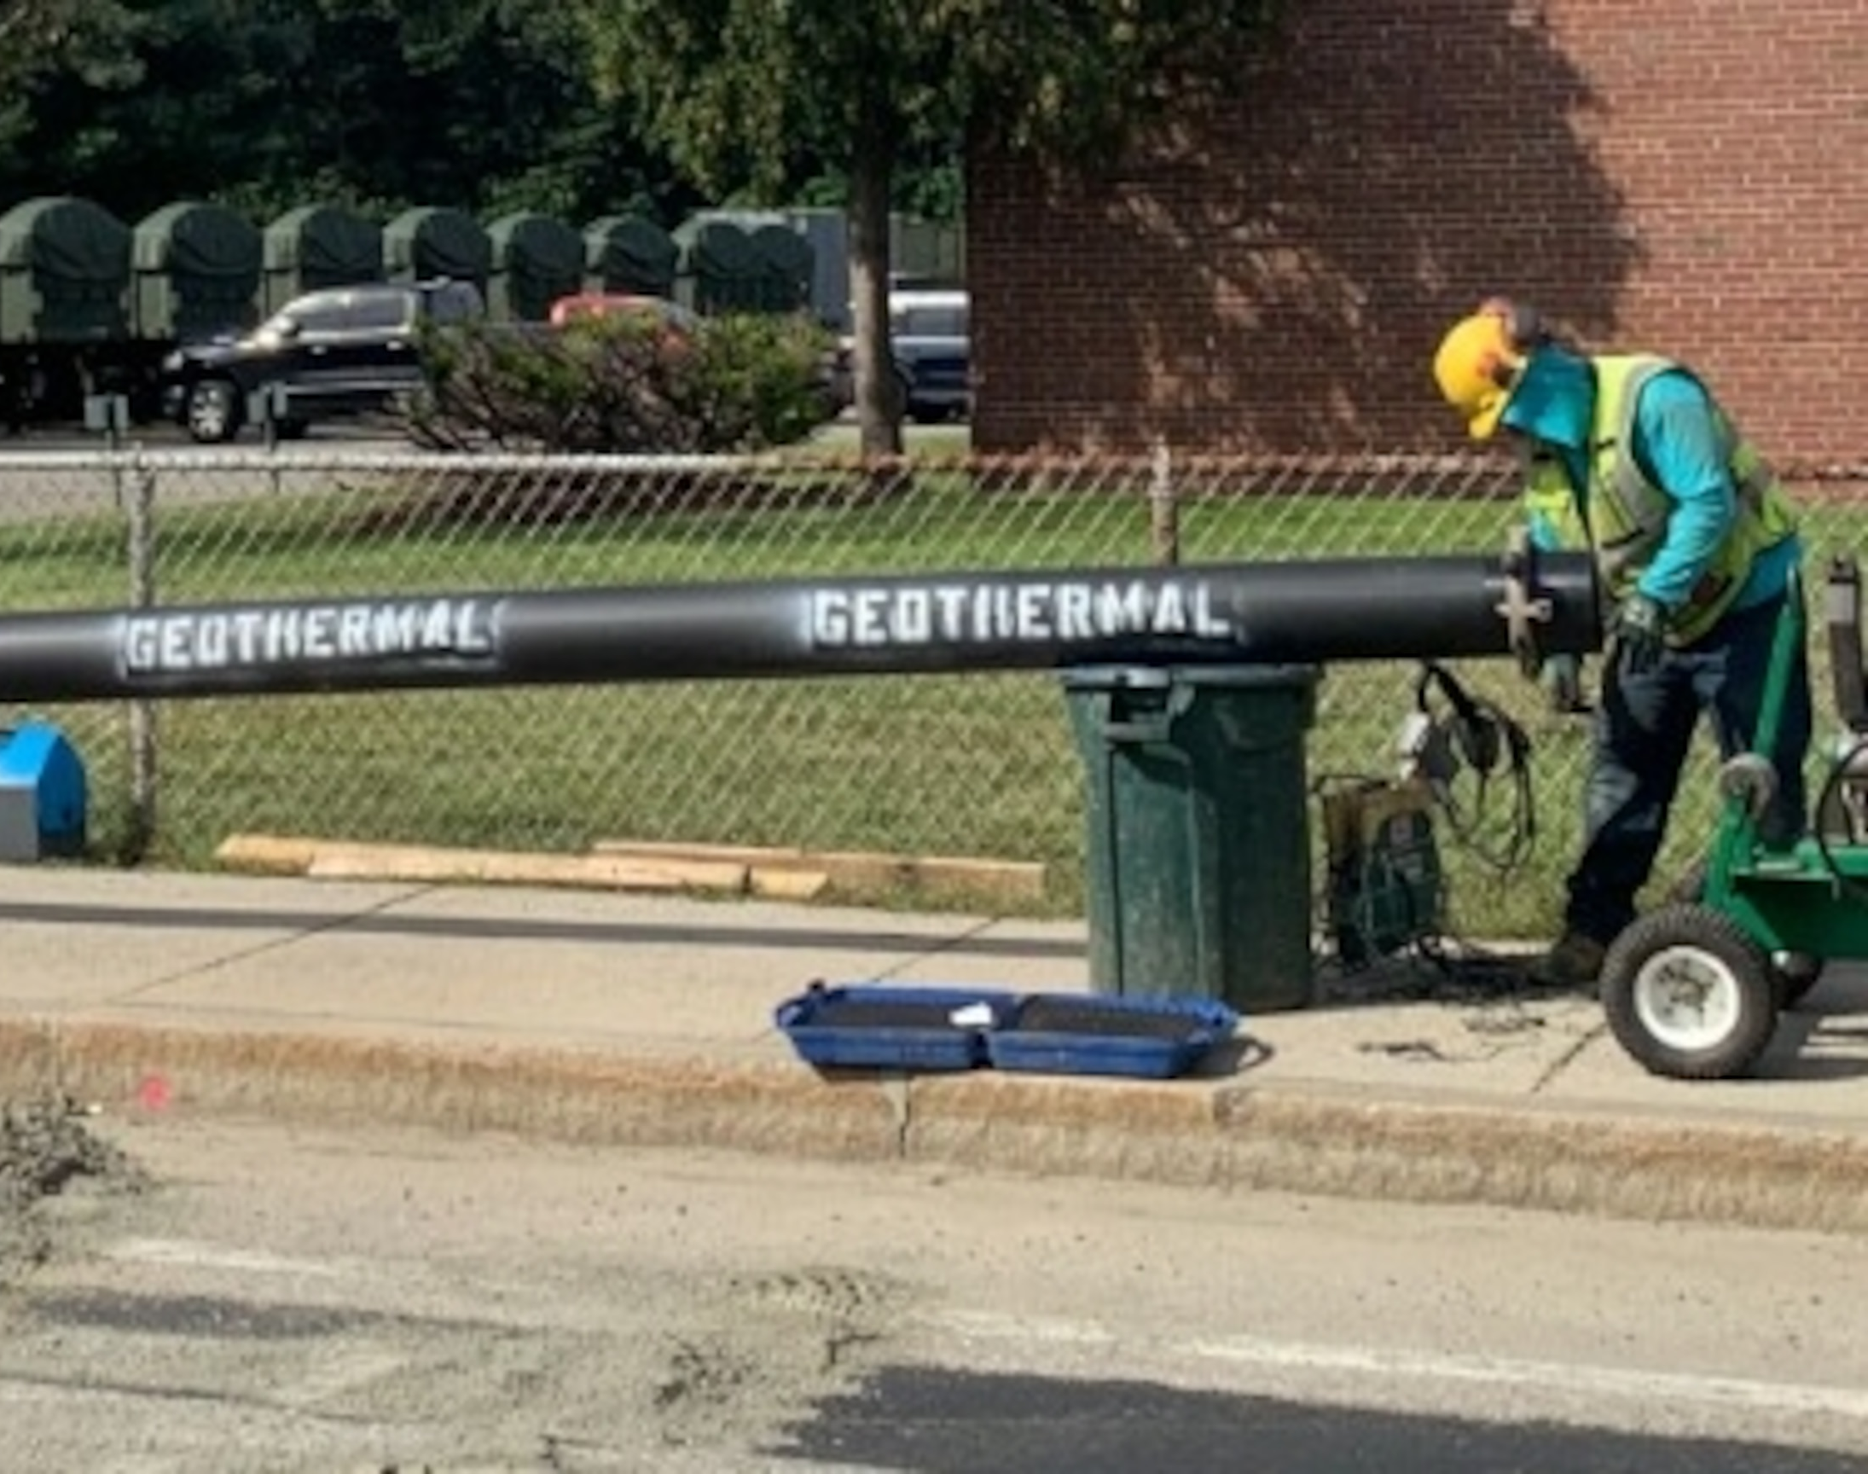
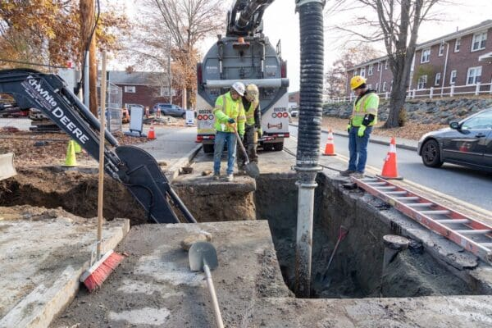
Loop Installation
Mains and services are nearly identical to traditional gas work
Trenching, fusion, backfilling, and pressure testing are all similar
Piping is HDPE marked with “Geothermal” or another identifier
Bury depth in Framingham is 5 ft vs 3 ft for gas. This is a trade off on thermal performance vs cost
Fill and document pressure test with water prior to adding glycol to the system

Slide 23
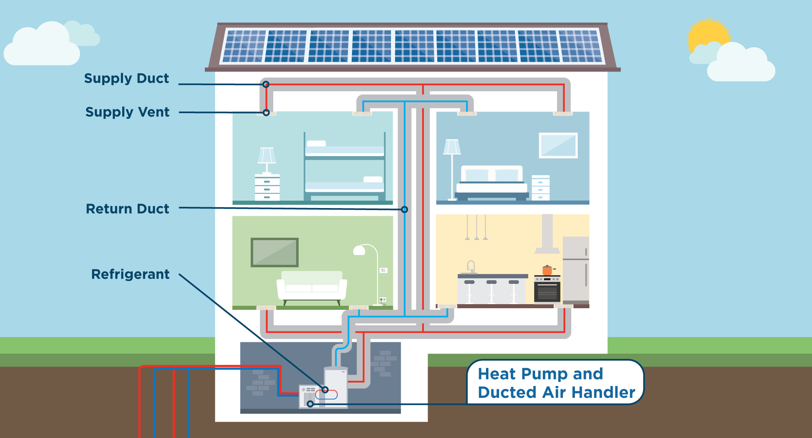
Building Conversions
Conversions are a critical portion of installing a geothermal system
Depending on the existing HVAC, it can be challenging for older buildings
Domestic water and appliances can be converted or left on original fuel
Dual systems can be installed for reliability, especially in critical buildings

Slide 24
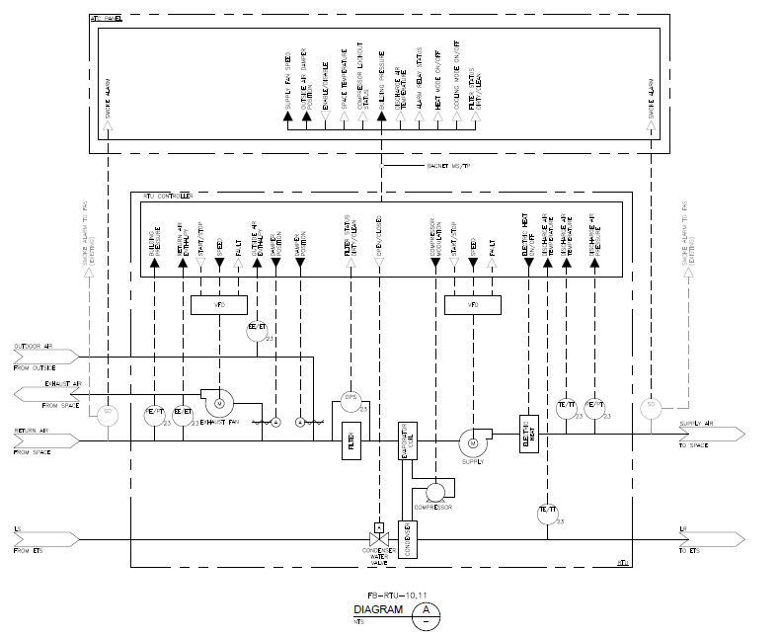
System Instrumentation
Primary instrumentation will be RTU with controls for pumping
Temperature, flow, and pressure monitors will be installed through the system
Basic control program will be used to adjust pump speed and keep temperatures in range

Slide 25
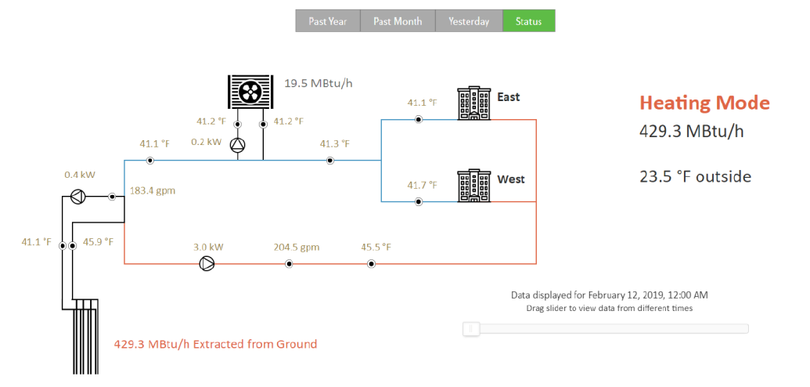
System Operations
Real time operations and monitoring with a dedicated SCADA system
Primarily loop pumps controlling on return temperature
Thermal source pumps can speed up, slow down, or fully stop depending on demand

Slide 26
Thermal Energy Network Value Proposition
Customer
Lowest cost to operate system
Central cooling included
Operator
Long-life assets with fixed energy supply
Utility model with network in public way
Grid
Constrained gas and electric area targeting
Decarbonization at a neighborhood scale
No external building equipment
Low maintenance
Local workforce skills transfer opportunity
Improved peak reliability
Mitigation of electric system buildout to support
Local energy not reliant on upstream supply chains
Opportunity for cooling revenue

Slide 27
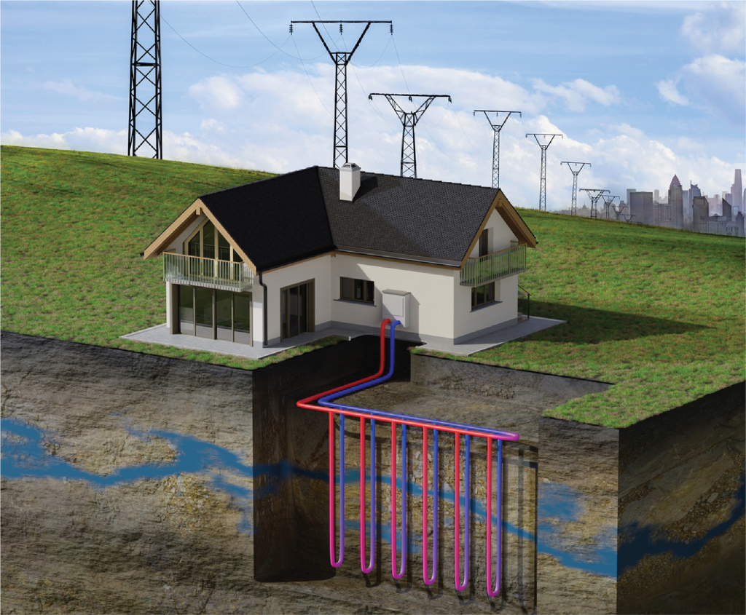
Grid Impacts
DOE funded grid impacts study by ORNL indicated 38% reduction in buildout requirements with GSHP deployment
TENs reduce both peak requirements as well as annual energy consumption
Demand charge savings can be significant and offset project costs in many cases (Oklahoma muni uses them to fund borehole drilling)

Slide 28

Discussion
& Questions

