Slide 1
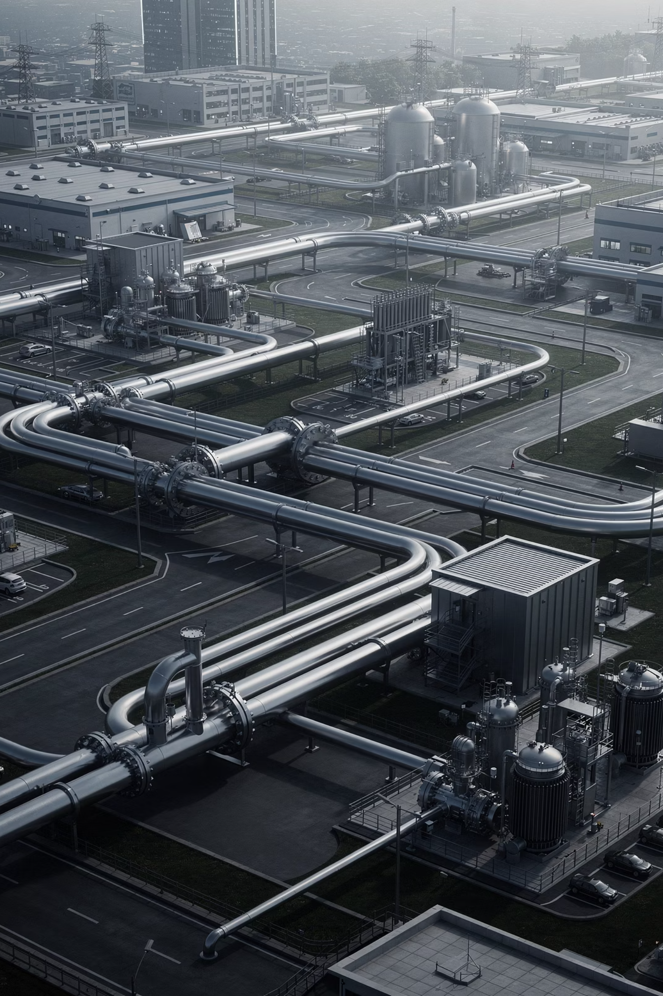
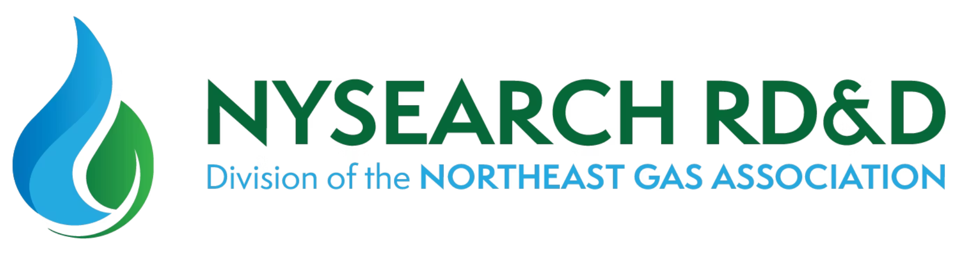
Unlocking RD&D Potential: An Overview of NYSEARCH for Natural Gas Utilities
Presented by Suzy Chaillou | NGA Gas Operations School | June 6, 2026
1

Slide 2
Agenda
This session provides a comprehensive look at NYSEARCH's research, development, and demonstration portfolio — from organizational overview to active programs and real-world commercialization outcomes.
01
02
03
Who is NYSEARCH
Overview of NYSEARCH Portfolio
Program Areas
Organization overview, mission, and membership
Seven core program areas driving innovation
How NYSEARCH works and creates industry value
04
05
Selected NYSEARCH Programs
Commercialized Projects
Low Carbon Fuels, Improved Install, Pipeline Integrity
Technologies that have reached the market
2

Slide 3


Who is NYSEARCH
Our Mission
What Sets Us Apart
A non-profit voluntary sub-organization within the Northeast Gas Association, dedicated to developing innovative products and solutions that serve the natural gas industry.
Small, nimble team focused on high-impact innovation
Ability to attract premier technology providers on a project-by-project basis
Expertise in project management, contract management, intellectual property, and technology transfer
Reputable, high-quality technical project management and program administration
NYSEARCH improves gas safety, reduces costs, enhances worker health and productivity, and drives positive environmental outcomes — all through collaborative R&D.
3

Slide 4
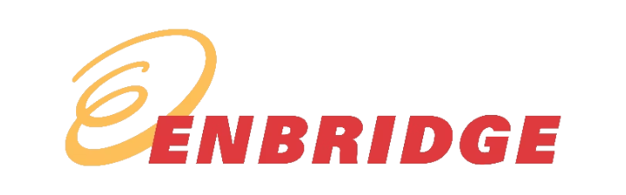

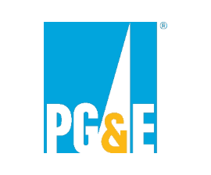



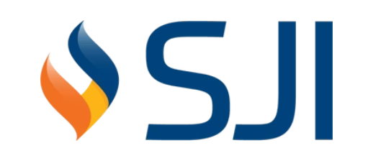
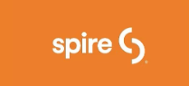
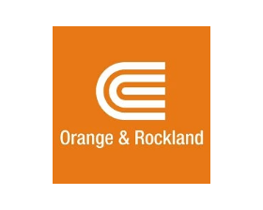
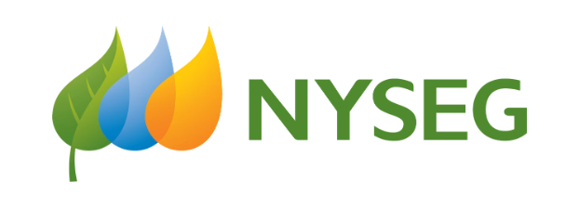
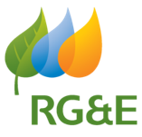



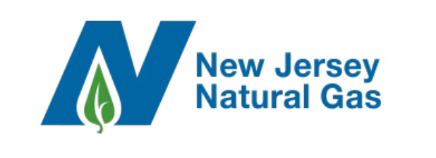

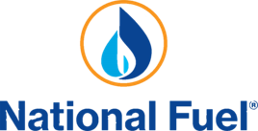
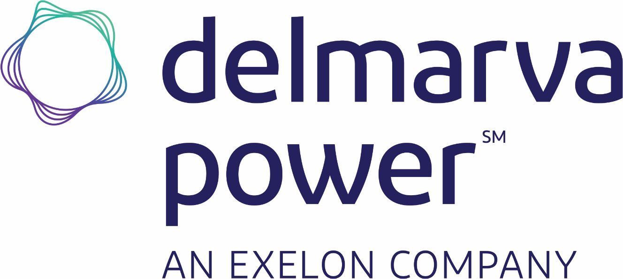
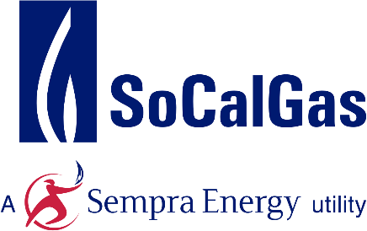
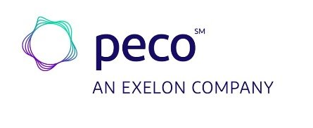
NYSEARCH Member Utilities
NYSEARCH brings together leading natural gas utilities from across North America, pooling resources and expertise to drive industry-wide innovation and benefit the entire sector.
4

Slide 5
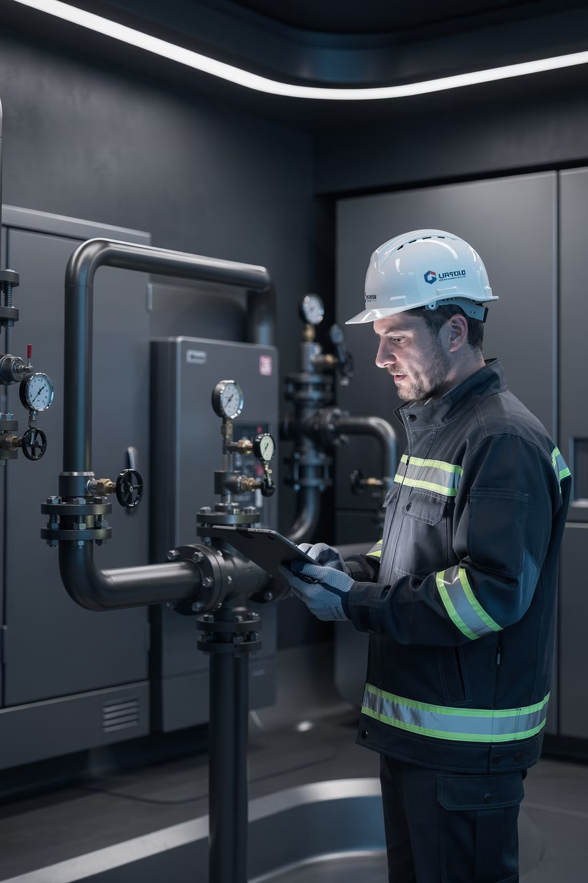
The Value of R&D
Research, development, and demonstration helps utilities stay ahead of operational challenges, regulatory demands, and emerging technologies — rather than reacting after incidents or failures occur.
Safety
Improve safety for workers and the public; respond to regulations proactively
Operational Excellence
Solve challenges not addressed by existing tools; increase productivity and efficiency
Cost Reduction
Reduce long-term O&M costs; evaluate emerging technologies before broad deployment
Environment
Reduce emissions and environmental impacts; improve system reliability and asset integrity
R&D helps utilities proactively solve problems instead of reacting to them after incidents, failures, or regulatory pressure.
5

Slide 6
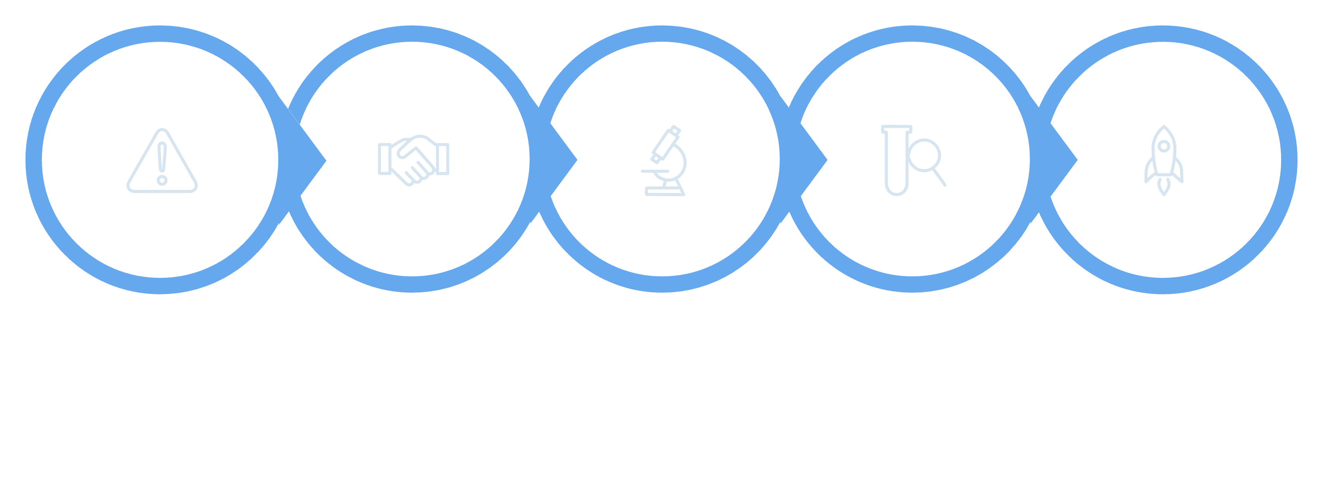

How NYSEARCH Works
Collaborating across the natural gas industry to drive innovation from need to real-world impact
Challenges
Collaboration
Research
Validation
Commercialize
NYSEARCH acts as the connective tissue between utility operational needs and technology providers — managing contracts, IP, and project delivery every step of the way. The result: practical, field-ready innovations that improve safety and efficiency across the industry.
Transforming Energy Powered by Innovation
6

Slide 7
NYSEARCH Program Areas
Seven focused program areas guide NYSEARCH's research portfolio, each targeting a critical challenge faced by natural gas utilities today and into the future.
1
Improved Installation, Maintenance & Repair
Improve operational effectiveness for construction, maintenance, and testing
2
Pipeline Integrity / Direct & Remote Assessment
Expand understanding and assure integrity of gas pipelines
3
Pipe Location
Innovate to assure accurate pipe location and reinvent damage prevention
4
Leak Detection
Reinvent and optimize leak detection capabilities
5
Real-Time Sensing & Inspection
Implement innovative sensing technologies that simplify and continuously improve safe gas operations
6
Low Carbon Fuels
Explore paths to carbon neutrality and conversion of infrastructure
7
Reducing GHG Emissions
Explore paths to abating greenhouse gas emissions across gas systems
7

Slide 8
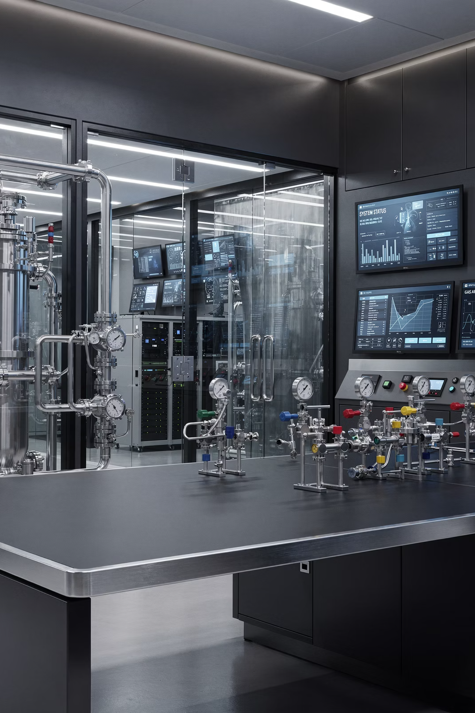
SELECTED PROGRAMS
Sample Studies and Innovations
The following slides highlight a selection of active NYSEARCH programs spanning pipeline inspection, PE joint integrity, low carbon fuels, leak detection, and infrastructure rehabilitation — demonstrating the breadth and depth of our current R&D portfolio.
8

Slide 9

PE Joint Inspection Challenges
Industry Challenge
Why It Matters
PE joint inspection often requires specialized NDE expertise that is not uniformly available in the field
Utilities need more consistent, standardized pass/fail evaluation methods
Existing inspection approaches can be difficult to deploy under real-world field conditions
Fusion joint quality directly impacts system integrity and long-term safety
Utilities continue increasing use of PE pipe across gas distribution systems nationwide
Standardized inspection tools can improve quality assurance, reduce variability, and increase confidence in installed assets
Inconsistent inspection quality creates long-term risk exposure across expanding PE infrastructure portfolios.
9

Slide 10
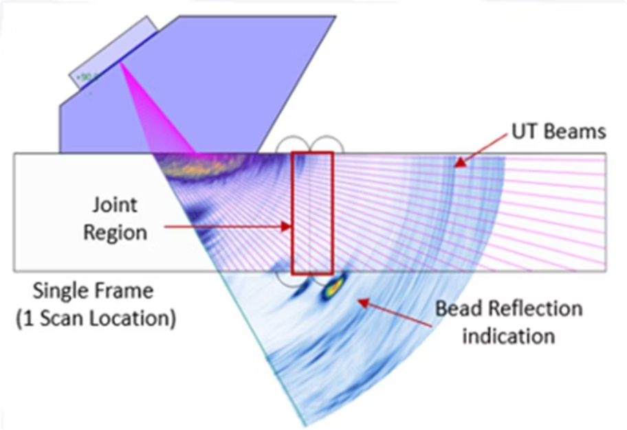

Automated NDE Pass/Fail Tool for PE Joints
R&D APPROACH
Combines ultrasonic inspection (PAUT/ToFD) with AI-based defect recognition for automated analysis
Builds on prior NYSEARCH work defining defect acceptance criteria for PE joints
Designed as a rugged, field-deployable inspection tool suitable for utility crews
INDUSTRY VALUE
More standardized, repeatable inspections across field crews
Reduced dependence on expert interpretation in the field
Improved quality control during PE installation and tie-ins
Status: Advancing toward field-ready validation and utility testing
10

Slide 11
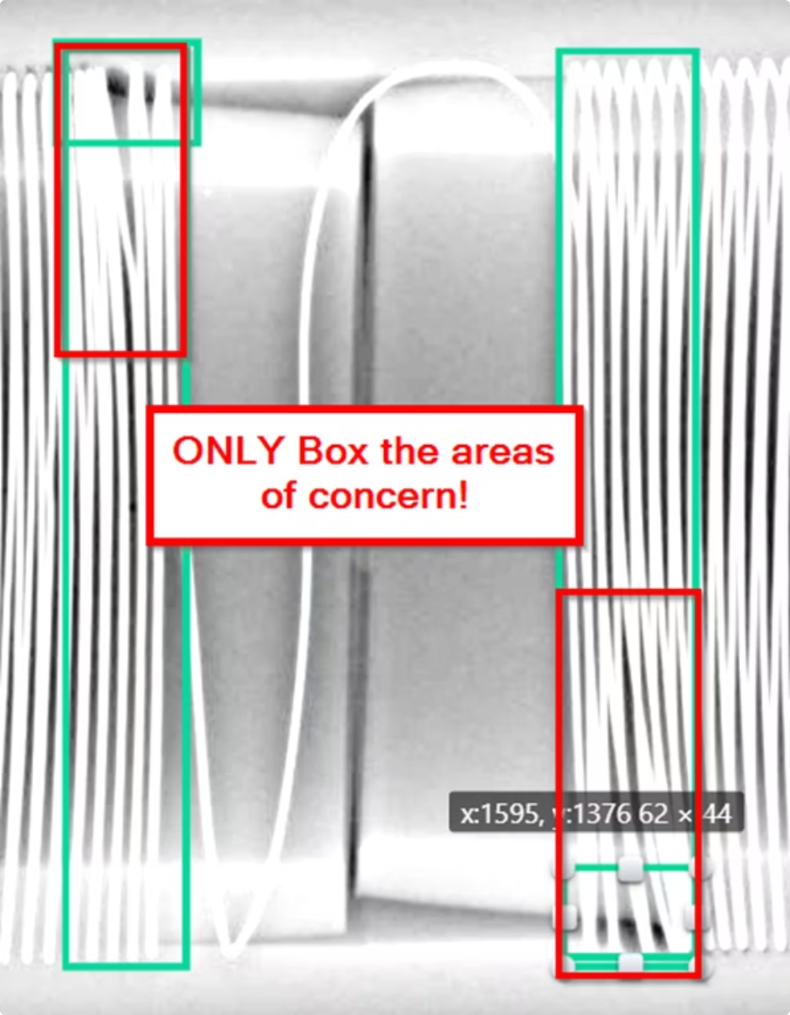

AI-Based Inspection for PE Electrofusion Joints
INDUSTRY CHALLENGE
Electrofusion joint inspection has traditionally relied heavily on manual interpretation, introducing variability and the potential for missed defects. Utilities need more consistent, automated defect identification methods to ensure distribution system integrity.
R&D APPROACH
Uses X-ray imaging combined with AI-based computer vision to identify joint defects
Designed to support automated pass/fail inspection capability for field use
INDUSTRY VALUE
Improved inspection consistency and reduced human error
Potential for real-time field inspection applications
Status: AI model development and validation underway
11

Slide 12
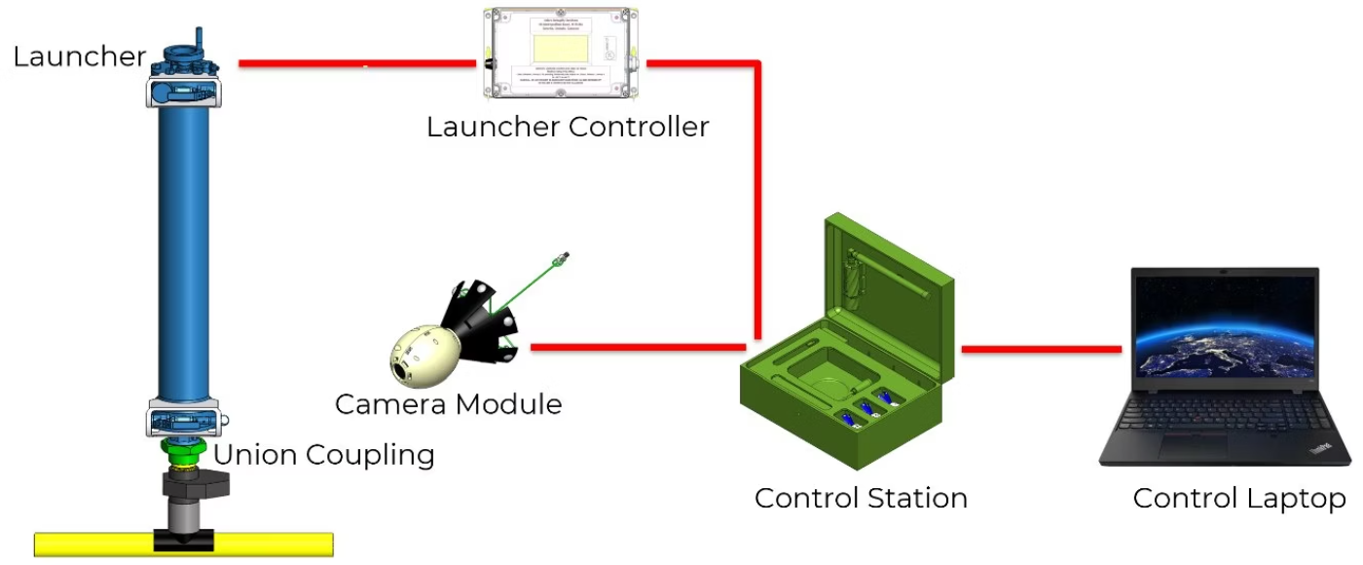
2" Pipe Glider System
Industry Challenge
Small-diameter plastic mains are difficult to inspect internally using conventional tools
Existing methods often require excavation or service interruption
Utilities need better visibility into aging PE infrastructure
NYSEARCH R&D Approach & Value
Developed a live, in-pipe camera inspection system for 2" PE mains
Operates under live gas conditions with minimal flow disruption
Provides video inspection and location tracking capabilities
Supports asset integrity assessment and system mapping
Enables long-range inspection in small-diameter pipe — no excavation required
12

Slide 13
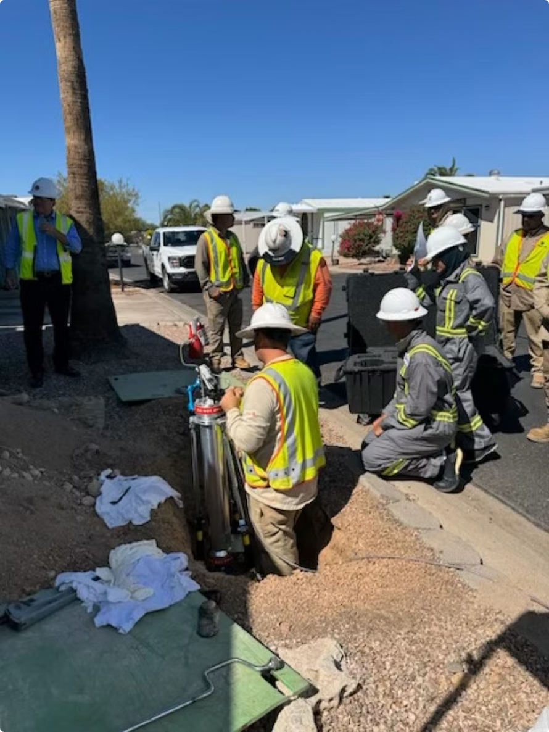

Field Validation: 2" Glider System
SUCCESSFUL FIELD DEPLOYMENT
Field tested with Southwest Gas under live operating conditions. Over 1,000 feet of 2-inch gas main successfully inspected in a single deployment.
Features Successfully Identified
Butt Fusions
Service Taps
Tees
Couplings
Demonstrated readiness for real-world utility deployment — a new non-destructive inspection capability for difficult-to-access PE infrastructure.
13

Slide 14
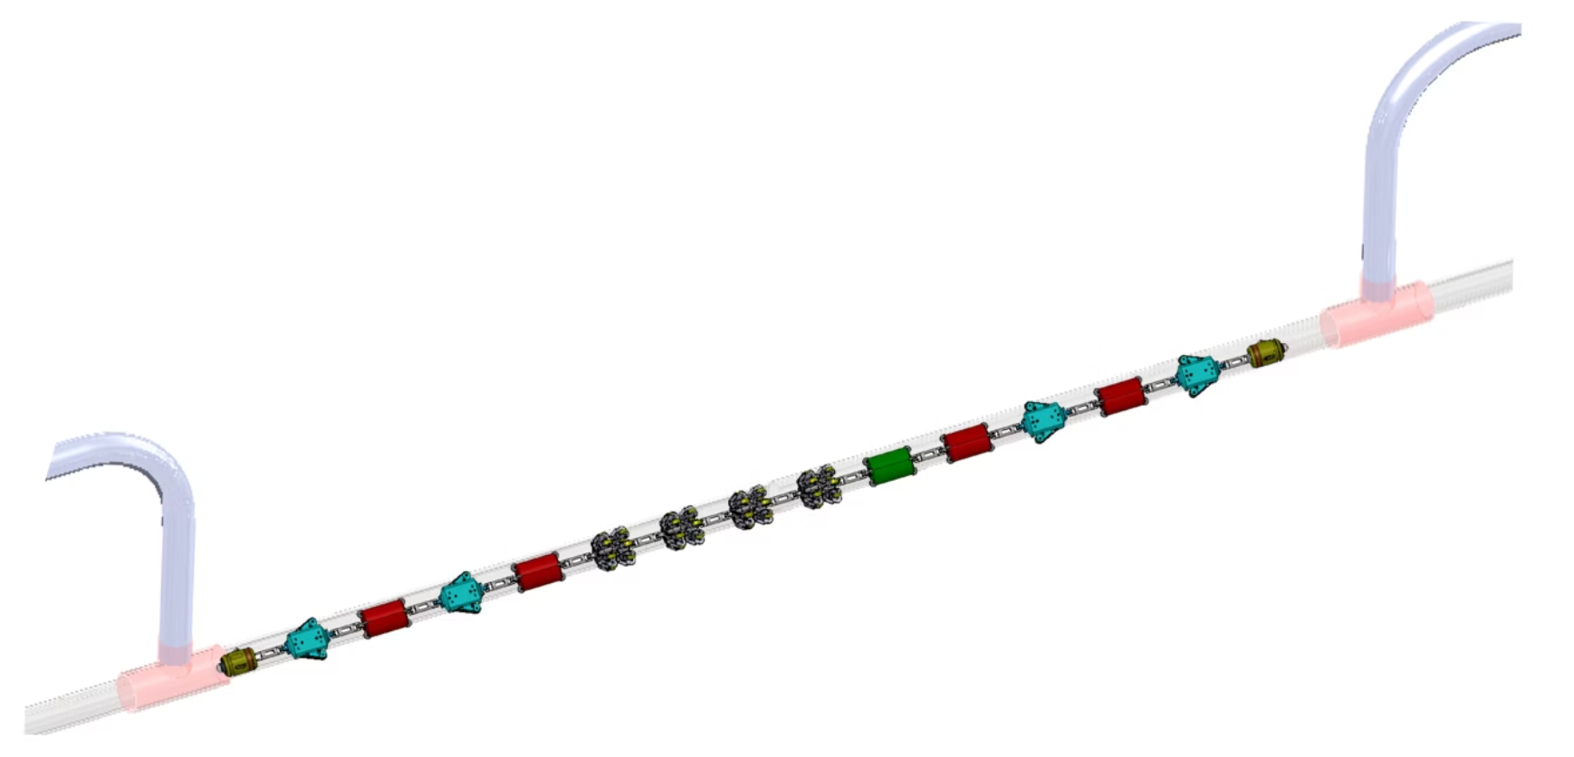

Robotic Inspection Platform for 4" Plastic Pipe
Industry Challenge
Limited options exist for internal inspection of live 4" PE mains
Utilities need better visibility into pipe condition, wall integrity, and defects
R&D Approach & Value
Robotic in-pipe inspection platform for live gas mains
Combines imaging, ultrasonic sensing, and location tracking
Designed for long-range inspection with minimal operational disruption
Improved PE asset integrity assessment and reduced excavation impacts
Status: Phase II design development complete — positioned for future testing and deployment
14

Slide 15
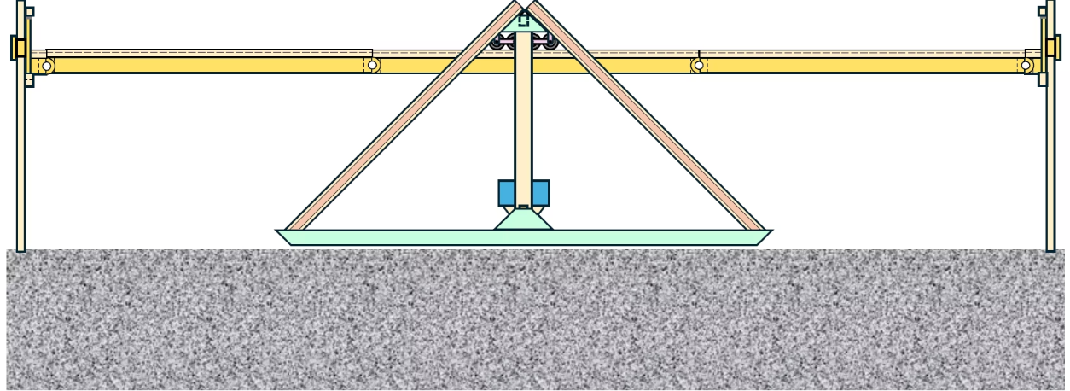
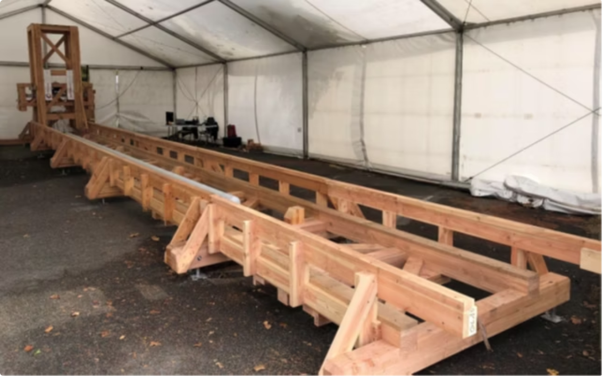

Remote Assessment of Pipe Integrity
PHMSA CO-FUNDED
Industry Challenge
Pipeline integrity assessments often require costly excavation. Utilities need faster, lower-impact screening methods that can identify potential anomalies without digging.
NYSEARCH R&D Approach
Above-ground system for identifying potential steel pipeline anomalies
Uses magnetic sensing, drone surveys, and advanced data analysis tools
Reduces excavation and operational disruption while improving targeting of integrity investigations
Status: Prototype development and validation underway — field-ready system targeted for 2026
15

Slide 16
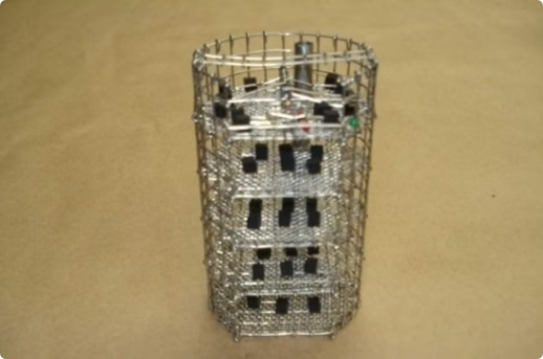
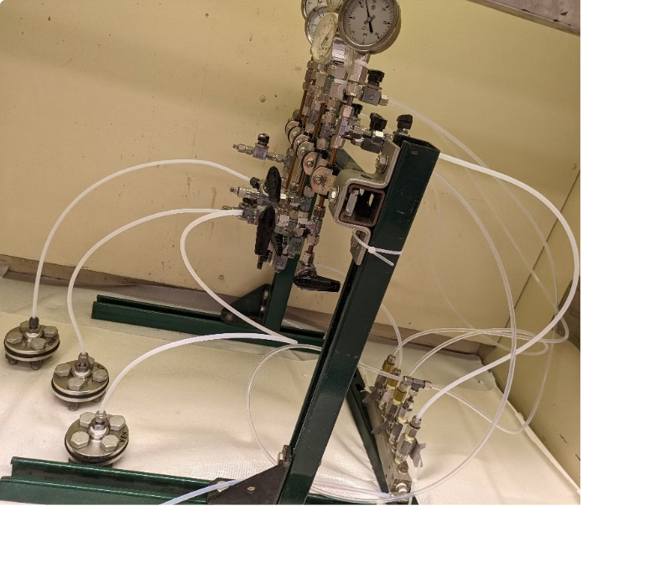

Impact of H2 Blends on Elastomers
LOW CARBON FUELS
Industry Challenge
Elastomers — widely used in seals, gaskets, couplings, and regulators throughout distribution systems — must be assessed for compatibility with hydrogen blending. Material degradation could impact long-term safety and reliability of existing infrastructure.
NYSEARCH R&D Approach
Evaluated common elastomer materials under multiple hydrogen blend conditions
Tested both free-state materials and assembled sealing applications
Assessed changes in material performance and sealing behavior
Provides utilities with actionable data to support hydrogen blending evaluations and reduce uncertainty around material compatibility in existing infrastructure.
16

Slide 17
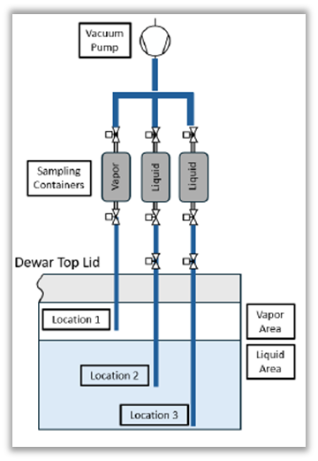
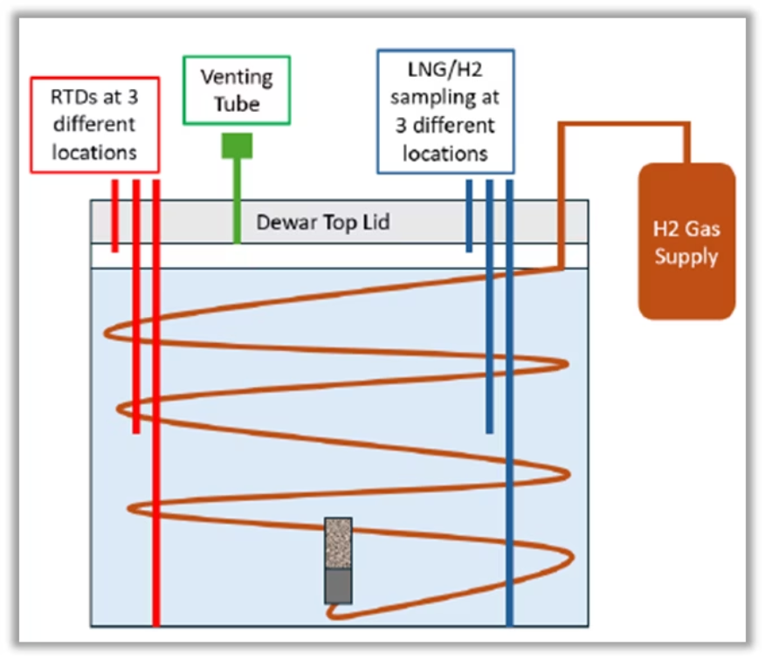

Impact of Hydrogen-Enriched NG on LNG Liquefaction
LOW CARBON FUELS
Industry Challenge
Utilities need to understand how hydrogen blending could impact LNG facilities, liquefaction processes, and critical materials — including 9% nickel steel — before deployment decisions are made.
NYSEARCH R&D Approach
Evaluating how hydrogen affects LNG liquefaction behavior and facility materials
Performing thermodynamic modeling and laboratory testing
Assessing impacts on LNG operations and material compatibility
Industry Value
Helps utilities evaluate LNG system compatibility with hydrogen blending, supporting safer integration of low-carbon fuels into existing infrastructure.
Status: Modeling, material compatibility, and experimental testing completed
17

Slide 18
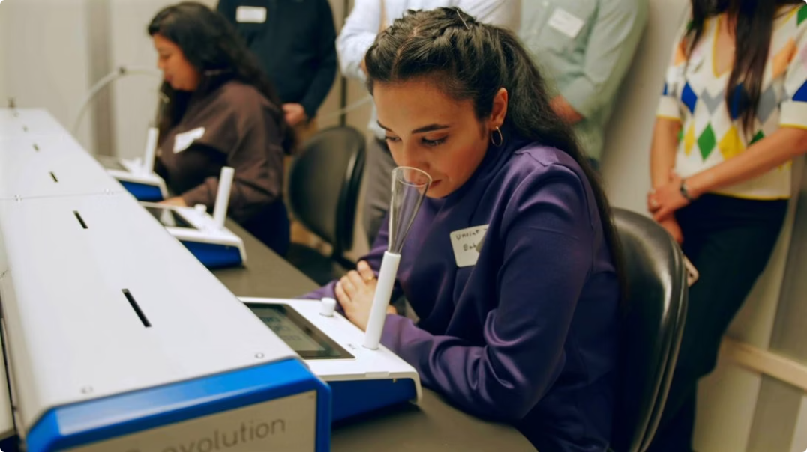

Understanding Hydrogen's Impact on NG Odorization
Industry Challenge
A critical safety question for hydrogen blending: does the introduction of hydrogen affect natural gas odor detection thresholds? Utilities need reliable data before expanding hydrogen blend programs.
Key Finding
R&D Approach
Initial testing at 20% hydrogen showed no observed impact on odor detection thresholds — a positive early indicator for hydrogen blending safety.
Evaluating odor detection across multiple hydrogen blend levels
Testing industry-standard odorants using controlled olfactory studies
Additional testing is underway at higher hydrogen blend levels to further characterize odorization performance across a broader range of blend concentrations.
18

Slide 19
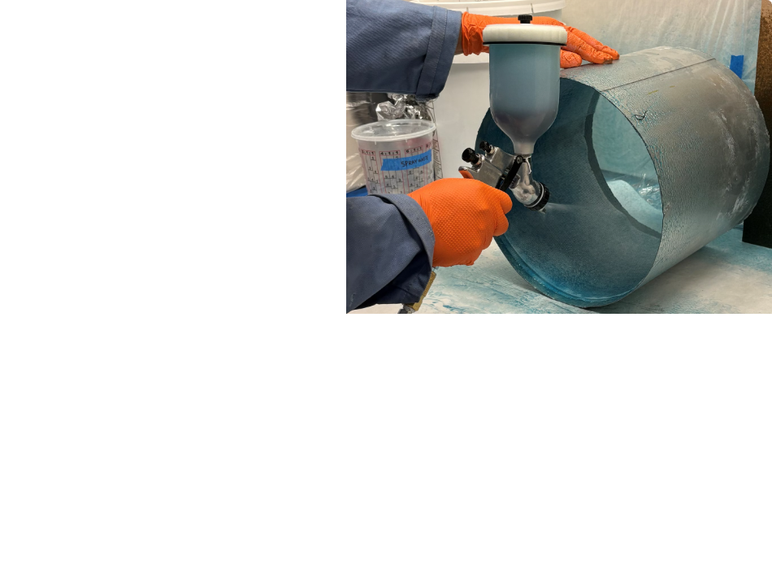
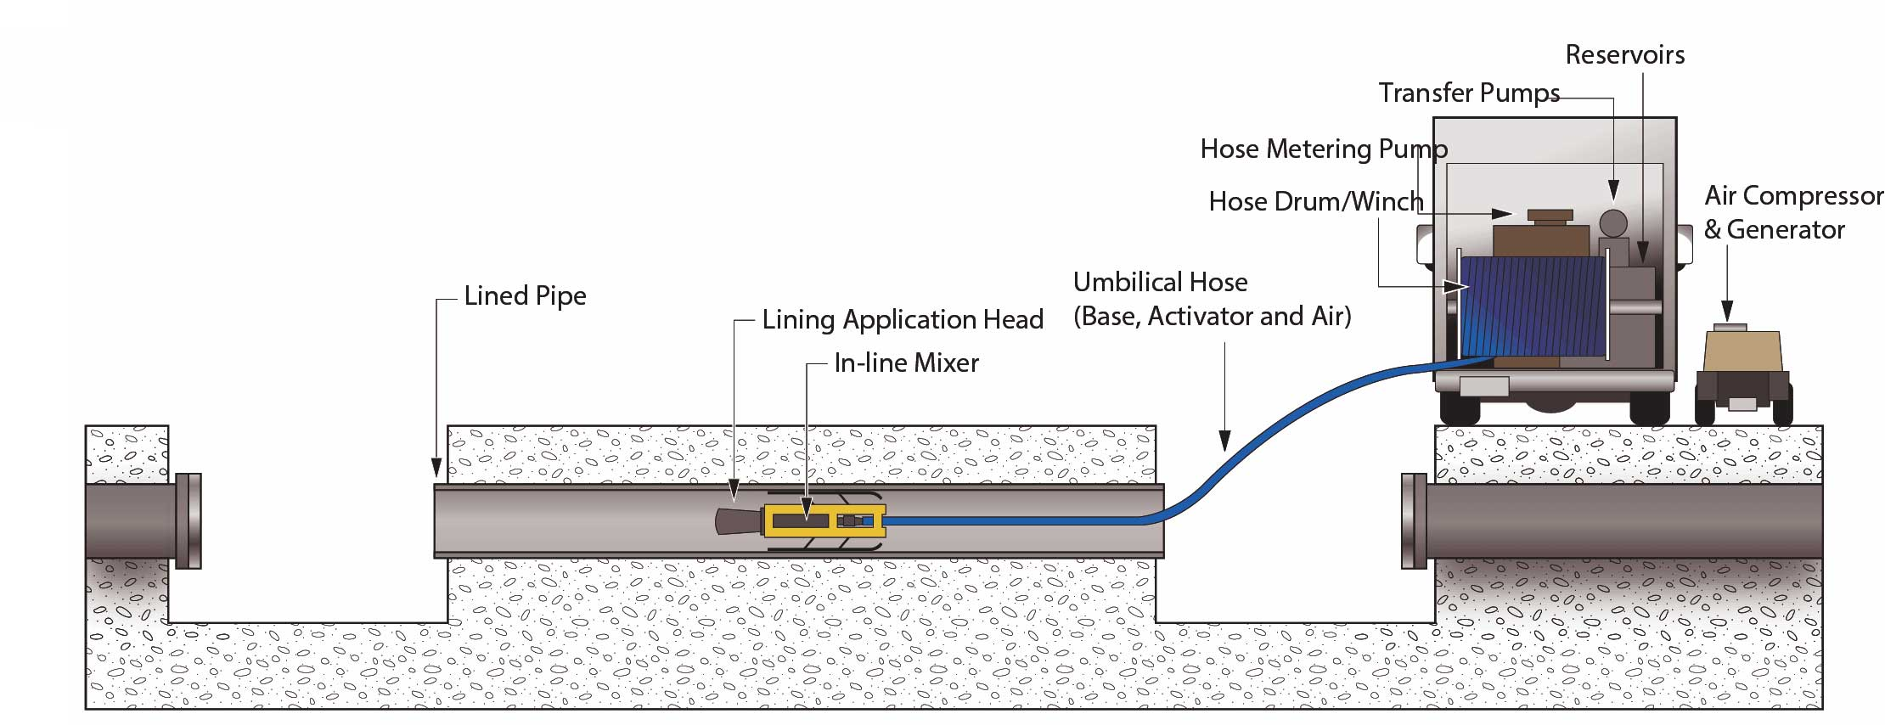

SIPP Feasibility for Gas Pipeline Rehabilitation
IMPROVED INSTALLATION & REPAIR
Industry Challenge
Pipeline replacement can be costly, disruptive, and excavation-intensive. Utilities need lower-impact rehabilitation options for aging infrastructure where full replacement is not the most practical or economical choice.
NYSEARCH R&D Approach
Evaluating spray-in-place pipe (SIPP) as a trenchless rehabilitation method
Assessing structural performance, adhesion, and gas compatibility
Comparing SIPP against traditional repair and replacement approaches
Industry Value
Potential to reduce excavation, restoration, and operational disruption
Could lower rehabilitation costs for select pipeline applications
Status: Feasibility study and utility evaluation underway; results to support future pilot decisions
19

Slide 20
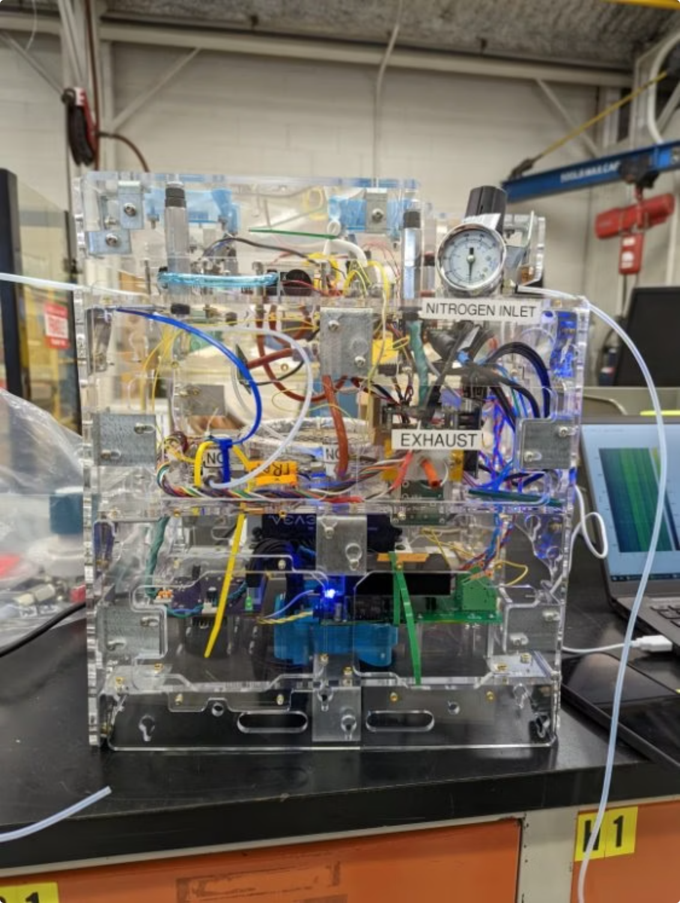

Quantifying the "Sniff" Test
LEAK DETECTION
Industry Challenge
Odor assessment has traditionally relied on subjective human detection — the "sniff test." This introduces variability in emergency response and compliance activities, and limits the ability to document and repeat measurements objectively.
NYSEARCH R&D Approach
Developing a portable mercaptan detection system for field applications
Uses Gas Chromatography (GC) and Differential Mobility Spectroscopy (DMS) for precise odorant measurement
Industry Value
More objective and repeatable odorant measurements in the field
Improved support for emergency response, regulatory compliance, and odorization program management
Status: Prototype fabrication and laboratory testing underway
20

Slide 21
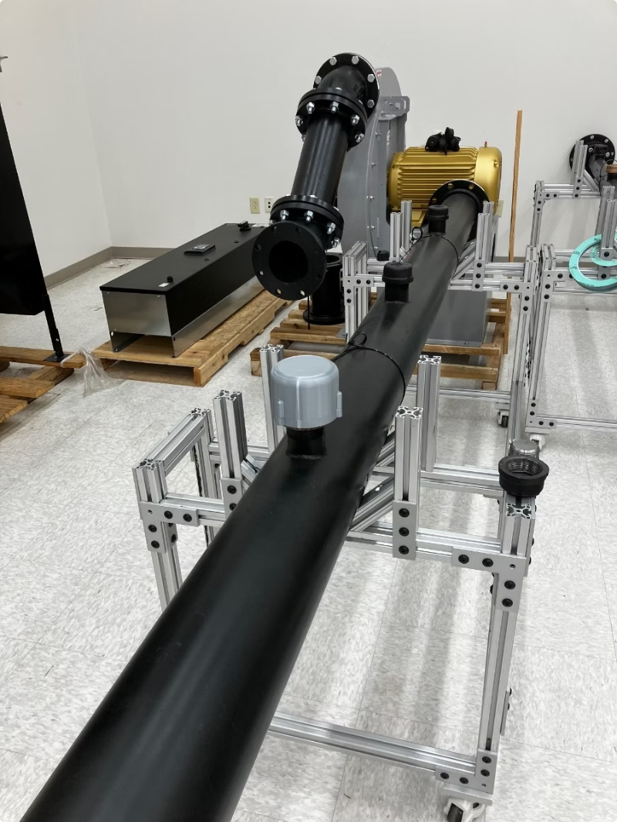
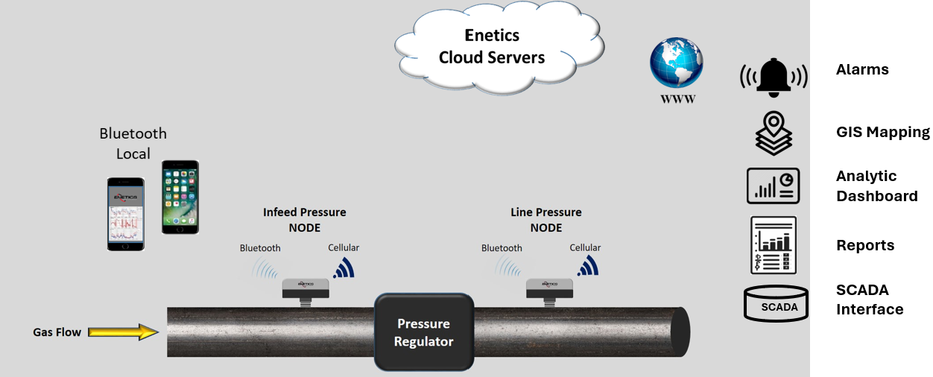


Wireless Natural Gas Pressure Alarm Monitor
Industry Challenge
Utilities need simpler, lower-cost real-time pipeline monitoring solutions that can be rapidly deployed without complex infrastructure. Current monitoring options can be expensive and difficult to install in remote or hard-to-access locations.
NYSEARCH R&D Approach
Developing a wireless pressure and temperature monitoring NODE
Uses Bluetooth and cellular communication for remote alarm notification
Designed for easy installation with minimal infrastructure requirements
Industry Value: Improves visibility into pipeline operating conditions and supports faster response to abnormal pressure events — at a lower cost than conventional monitoring solutions.
Status: Prototype development and enclosure design underway
21

Slide 22
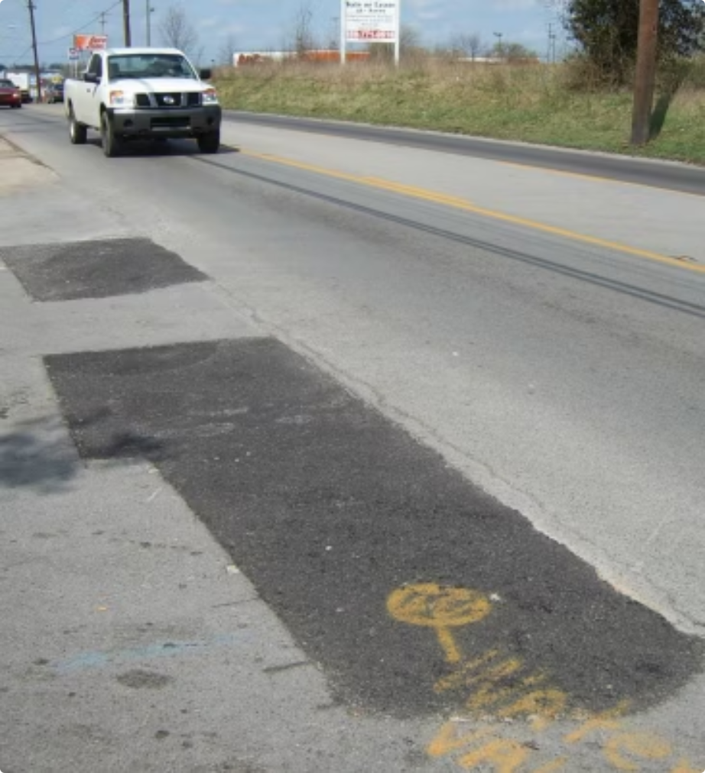
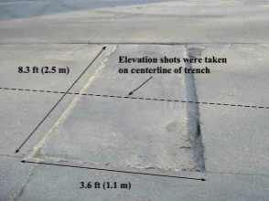

Best Practices for Pavement Restoration
IMPROVED INSTALLATION & REPAIR
Industry Challenge
Poor pavement restoration following gas main work can reduce roadway life, increase long-term maintenance costs, and create friction with municipalities. Utilities face increasing pressure to minimize roadway disruption and improve restoration quality across all project types.
NYSEARCH R&D Approach
Evaluating best practices for compaction, materials, and restoration methods
Combining literature review, DOT surveys, economic analysis, and field/laboratory testing
Industry Value
Improved pavement performance and reduced repeat repair costs
Better coordination with municipalities and transportation agencies
Status: Literature review and stakeholder survey development underway; lab and field testing planned
22

Slide 23
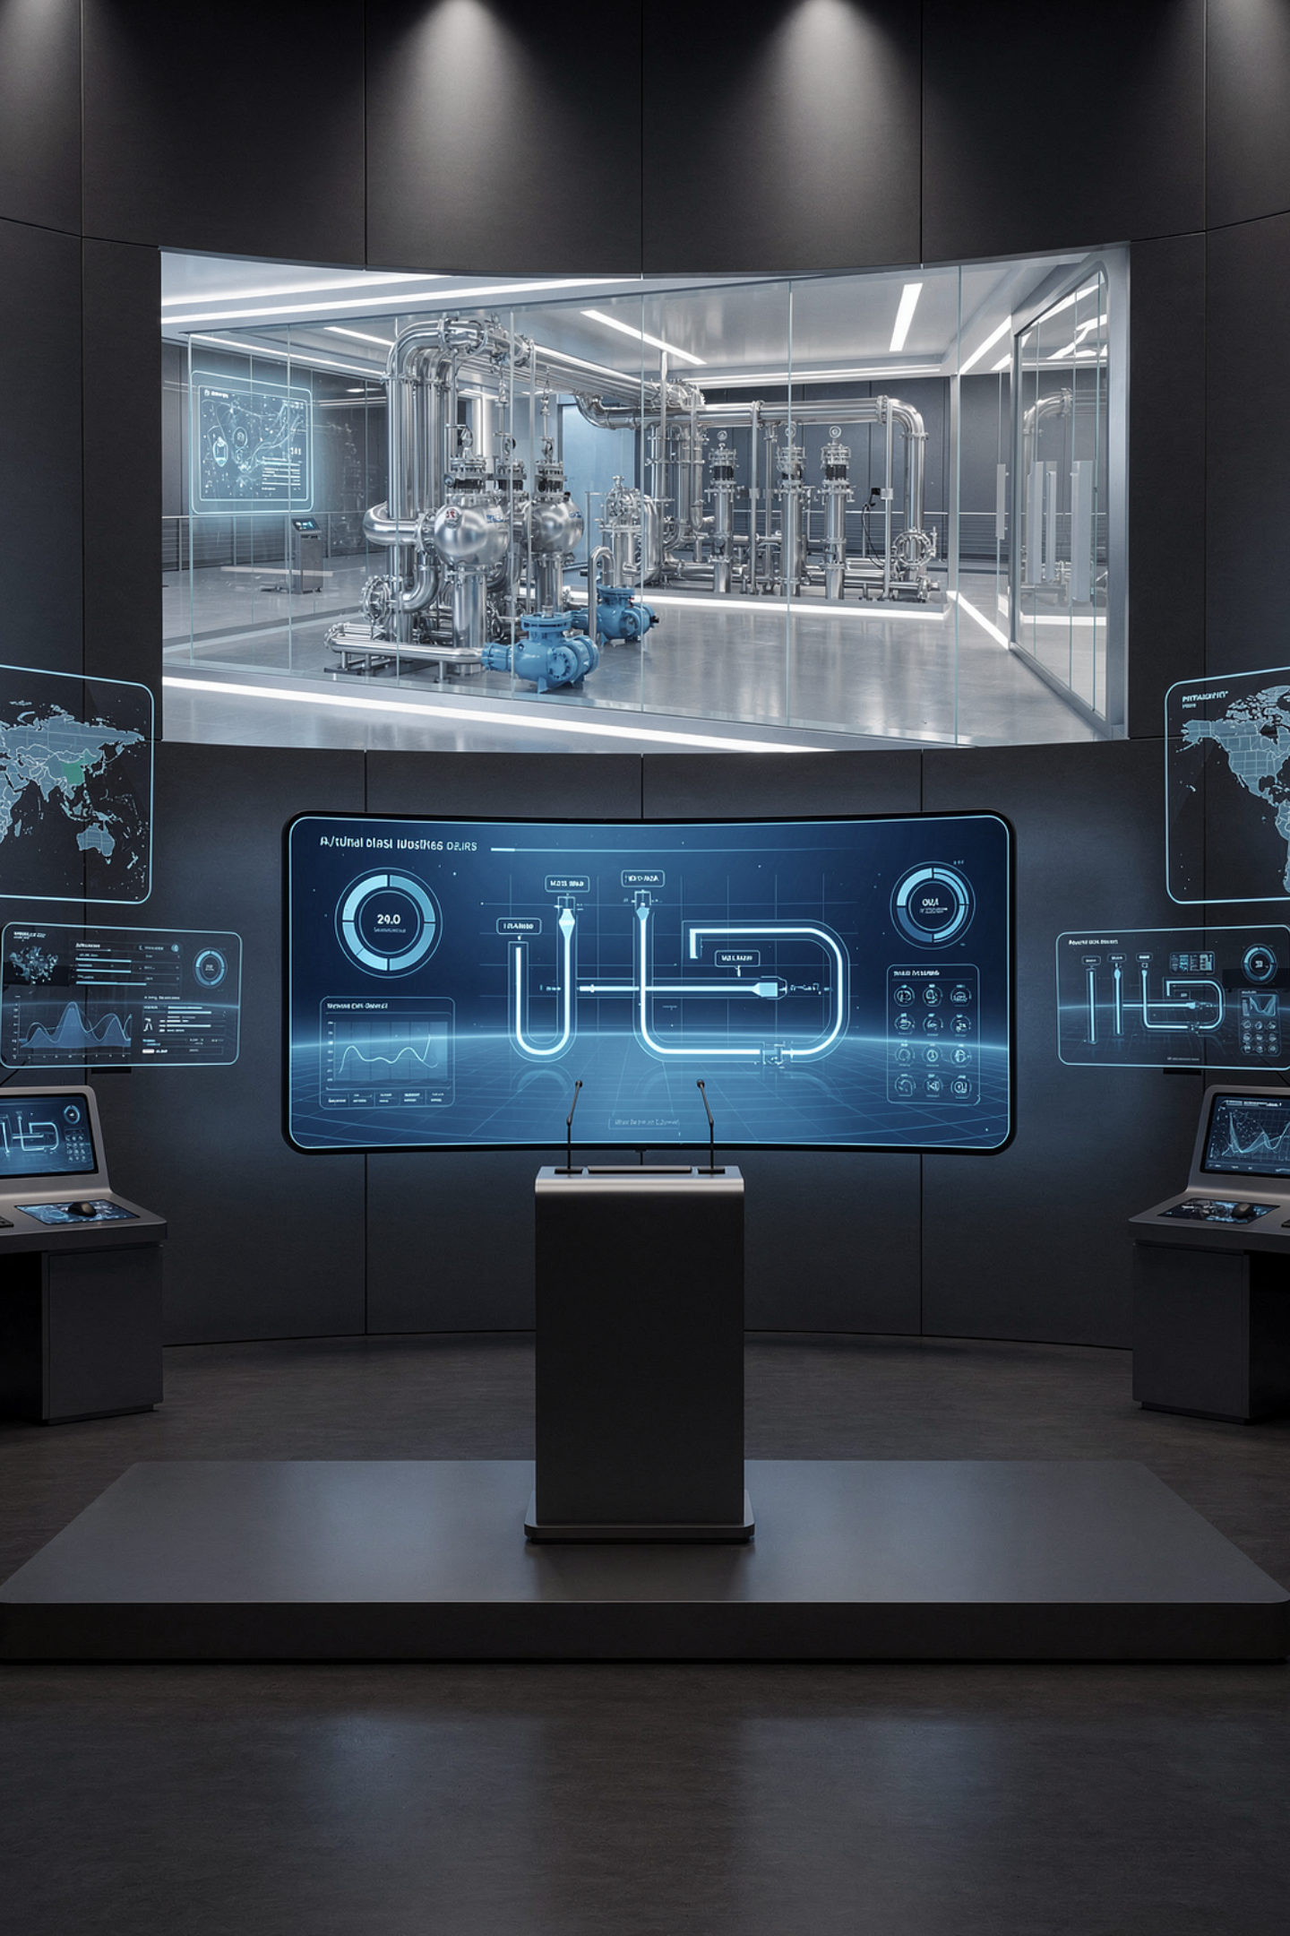
FROM LAB TO FIELD
Commercialization
NYSEARCH's ultimate measure of success is not research output — it is real-world deployment. This section highlights technologies that have moved from R&D through field validation to full commercialization, delivering lasting value to the gas industry.
23

Slide 24
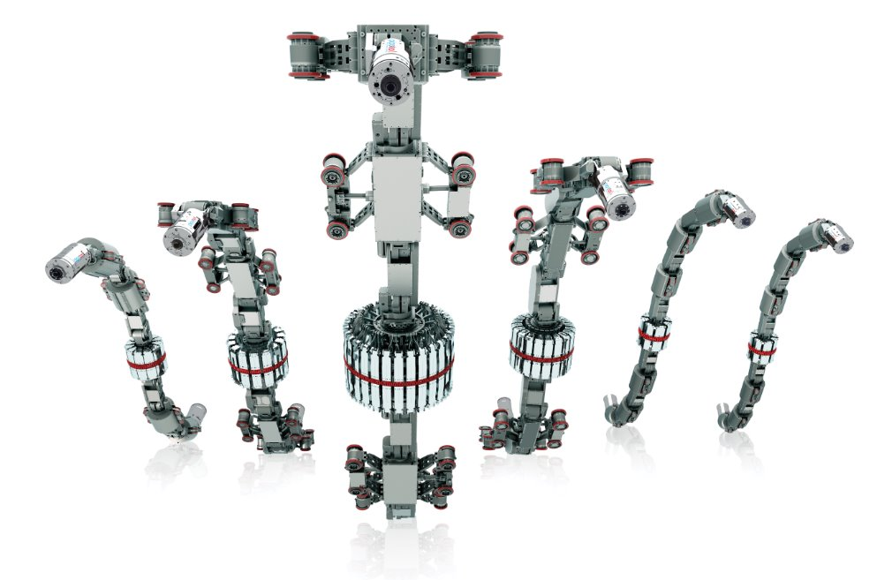
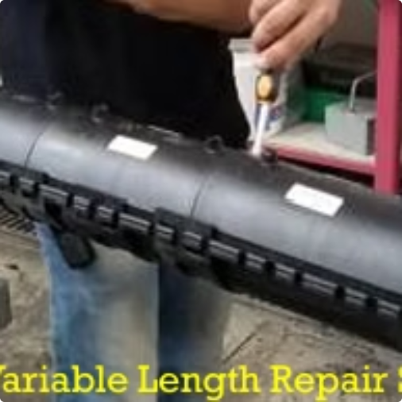
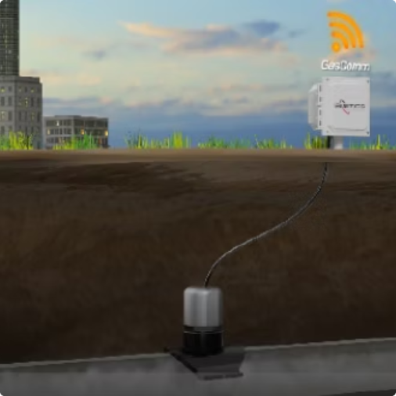
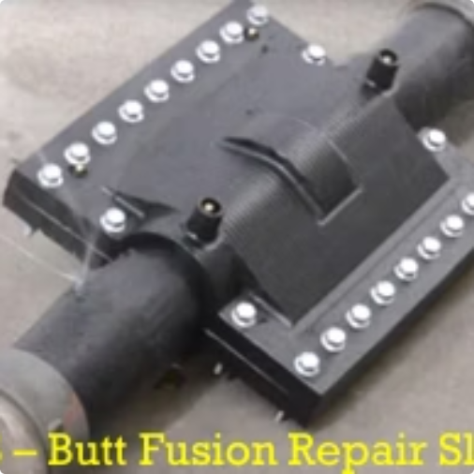
NYSEARCH Project Outcomes and Commercialization
These technologies are commercialized tools that improve safety, reduce costs, and boost performance.
Variable Length Repair Sleeve
Explorer Robotics for Unpiggable Pipe
Flexible repair capability for varying joint configurations.
Robotic inspection for pipelines inaccessible to conventional tools.
GasComm Sensor & Control Module
Real-time monitoring and communication for better operational control.
Butt Fusion Repair Sleeve
Reliable, field-deployable repair for PE butt fusion joints.
24

Slide 25
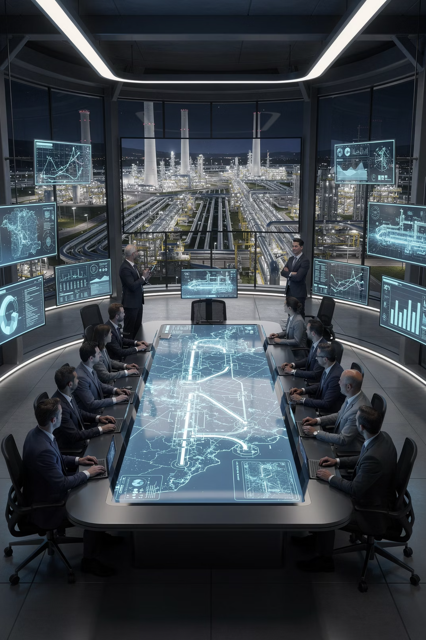

Thank You
Questions? Let's continue the conversation.
Suzy Chaillou
Director, RD&D Program Management
NYSEARCH | Division of the Northeast Gas Association
Learn More
Visit nysearch.org to explore the full NYSEARCH portfolio and learn how to participate in collaborative R&D programs
25

