Slide 1
2026 NGA Gas School
Exploring Practical Aspects of How, Where & When MOC is Applied
Eversource Management of Change
Katie Muroski – Backup MOC Coordinator
kathleen.muroski@eversource.com
Tyler Azure – MOC Coordinator
tyler.azure@eversource.com
MOCCoordinator@eversource.com

Slide 2
Introduction to MOC

Slide 3

What is Management of Change?
Management of Change (MOC) is a systematic approach to dealing with change.
  Changes in equipment, procedures, and workflows can cause issues and contribute to process breakdowns.
  The goal is to manage that change and safeguard the public, ourselves, and our infrastructure during a period of transition.

Slide 4
Why is MOC important?
The Government requires it:
  The Federal PIPES Act of 2020 Section 204 mandates we have an MOC Process
  NTSB specifically requires it of Eversource, stemming from Merrimack Valley
It helps ensure work continues smoothly and safely:
  The MOC program ensures that all impacted stakeholders are aware and provide feedback prior to any large-scale changes occurring
  Ensures that all risks associated with a change are discussed and adjudicated prior to implementation of the change

Slide 5
Eversource MOC Program
MOC vs. moc

Slide 6
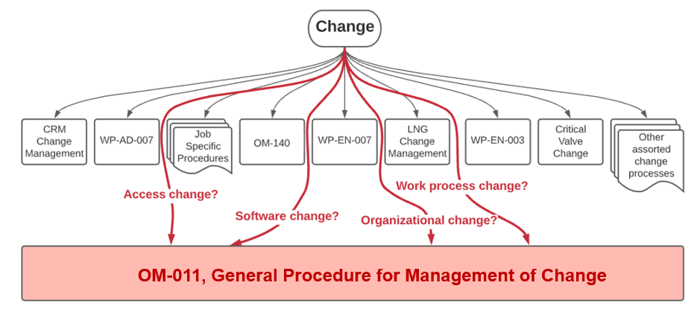
Eversource MOC Program
Most changes at Eversource are managed. Typically, repeated changes are managed through a procedure, work practice, or OM (moc).
Eversource uses the formal MOC process (MOC) to cover changes not adequately covered by other standards and processes.

Slide 7
MOC→moc Example
In some scenarios the formal MOC process can result in creating a standardized managed process.
Eversource piloted Drawdown Compressors (DDCs) and used the MOC process to track the non-standard work.
7 MOCs opened for DDCs from 2022-2025.
WP-OP-113 published in 2026 to standardize the process of using a DDC on Eversource system, eliminating the need for MOC for each project.

Slide 8
How does the Eversource MOC procedure work?
There are 6 main steps:
  Identify a change that needs to enter the MOC program
  Determine stakeholders (Who is implementing the change? Who is affected by the change?)
  Meet with stakeholders to assess risks associated with a change
  Determine actions needed to mitigate identified risks
  Track completion of risk mitigation actions
  Following MOC completion, review with stakeholders to ensure no issues have arisen with the incorporated change

Slide 9
Activity: Identifying Risks

Slide 10
Example Eversource MOC
Example: | MOC-2025-101, Intron Intelis 250 Meter
Change: | Eversource is switching from the current Honeywell NX 250 meters to the new Itron Intelis 250 Meters, with a planned rollout period by Area Work Center.
Why it should Follow MOC: | Bringing in a new meter will have a lot of impacts to ensure the meters are properly updated in all applicable standards, we have procurement set up to meet the demand of the meters, and all personnel are trained for the installation and maintenance of the meters during regular business use and emergency situations.
Task: Discuss amongst your groups/tables what risks should be identified in the MOC to be mitigated prior to implementing the change.

Slide 11
Example Eversource MOC-Risks
Standards/Training
  Training and OQs do not reflect new Itron meters.
  Current standards do not reflect the new Itron meters.
  The new meters are not reflected in Eversource Emergency Response Plans.
Customer Awareness
  Customers are not aware of the new features of the valves/meter.
Procurement
  Meter is a sole source agreement meter, could lead to disruptions in the supply.
  Eversource does not have a contract with Itron for the new meters.
System Updates
  New meter and supporting instrumentation are not in inventory tracker.
  Codes for the new meters are not in customer systems or field mobile software.

Slide 12
Eversource MOC Outreach to Operations

Slide 13
MOC Point People
Worked with Directors and Managers across the entire Gas Business Unit as well as the Clean Technologies Unit.
Produced “MOC Point People” who operate as “Eyes and Ears” of the MOC Program.
Provided them with detailed training on our MOC Program and what we are asking of them.

Slide 14
PSMS Monthly Safety Topic
A presentation on MOC was given at each All Hands Safety Meeting in February.
Gave background and the importance of MOC to the field.
Gave them details on who to reach out to if they had questions on the MOC process or wanted to talk about a potential change.

Slide 15
Questions/Comments?

