Slide 1
Northeast Gas Association
Liz Bowman, Vice President of Government Affairs and Outreach
September 2025

Slide 2
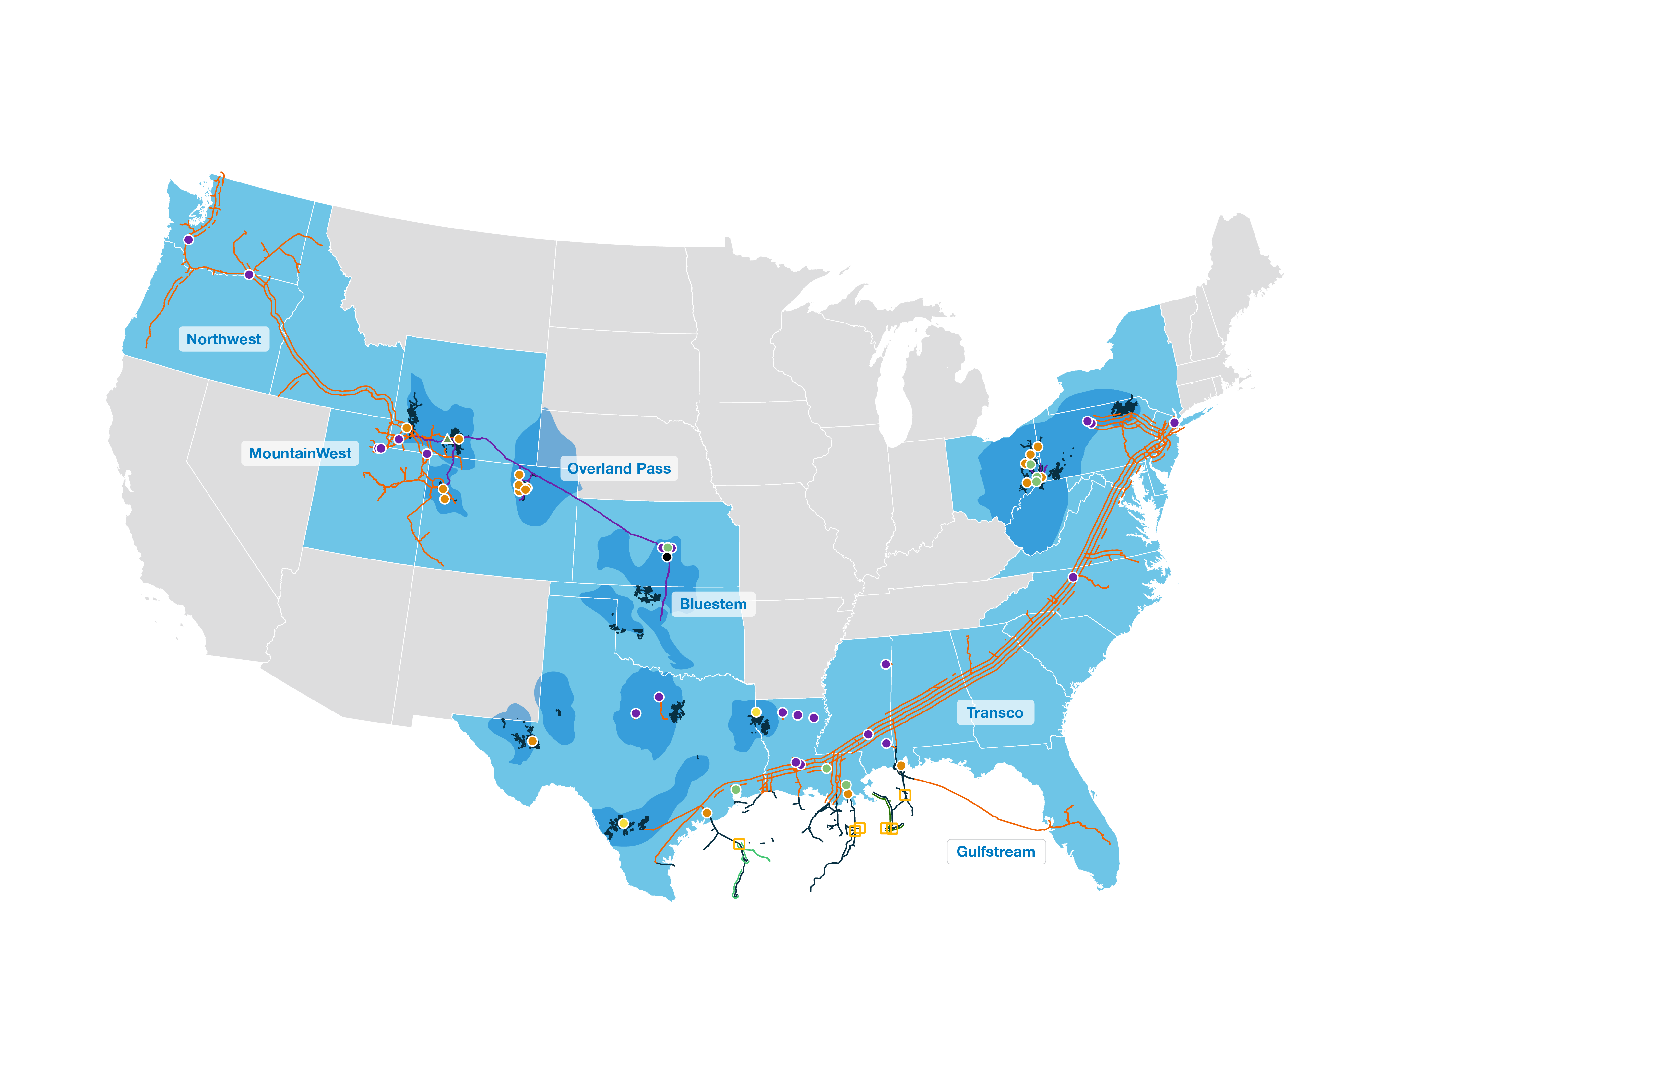

Increasing peak demand on Williams’ Transco system
Transco Winter Natural Gas Peak Day Volumes (Bcf) vs. Renewables Capacity Growth in the Same Markets
ALL OF TRANSCO’S TOP 10 PEAK
DAYS HAVE OCCURRED THIS WINTER
103
GW
37
GW
Wind + solar capacity in GW
Williams’ contracted gas capacity continually needed to supply grid reliability on days of peak demand alongside ongoing renewable capacity buildouts and coal retirements in our pipeline markets
Map as of February 2025. Source: U.S. Energy Information Administration (EIA). ¹Dekatherms converted to cubic feet at 1,000 cubic feet = 1 dekatherm. .

Slide 3

Natural gas generation continues to climb even as solar and wind capacity grows across the Lower 48
As intermittent solar and wind capacity increased, reliable natural gas generation also increased by 30%
Natural gas is now stronger than ever in the U.S. power sector
Source: U.S. Energy Information Administration (EIA). Note: wind capacity consists of onshore and offshore wind.

Slide 4

More natural gas is required to feed growing electricity demand
Electrification of heating and transport, data centers and AI-driven future
will create growth in power demand not seen in past two decades
U.S. Net On-Grid Power Demand
RAPID INCREASE IN ELECTRICITY DEMAND
5%
2010-2024
with majority of growth captured in 2024
32%
2025-2040
driven by emergence of large load data centers and EV growth
Source: S&P Global Commodity Insights, ©2024 by S&P Global Inc. December 2024 Planning Case.

Slide 5
Using natural gas cuts fuel costs by ~50% for Northeast households
The typical Northeast household using natural gas had ~50% lower fuel costs than a home using propane or fuel oil
Natural gas fuel costs
~ $1,200 to $1,450
lower for Northeast
residential consumers²
Source: U.S. Energy Information Administration’s Annual Energy Outlook 2023 & Short-Term Energy Outlook Winter Fuels Outlook 2024–25
¹ Northeast defined as the U.S. Census Division consisting of New England plus Middle Atlantic regions
² Average annual fuel costs for 2024

Slide 6


Winter natural gas prices in New York remain high due to less pipeline access to natural gas supplies
Average Price of Natural Gas Delivered to Residential Consumers
The price of natural gas delivered to residential consumers in New York up to 26% higher than the price to residential consumers in Pennsylvania due in part to less pipeline access to natural gas supplies
, driven by rising demand and access to low-cost supplies
Source: U.S. Energy Information Administration (EIA)
Notes:
More pipelines can help stabilize natural gas prices in winter by improving supply and reducing transportation bottlenecks.
During winter 24/25, the price of natural gas delivered to residential consumers in New York was 20% higher than the cost to residential consumers in Pennsylvania.

Slide 7




Insights on Progressive Policy Institute’s Energy
Affordability Report

Slide 8
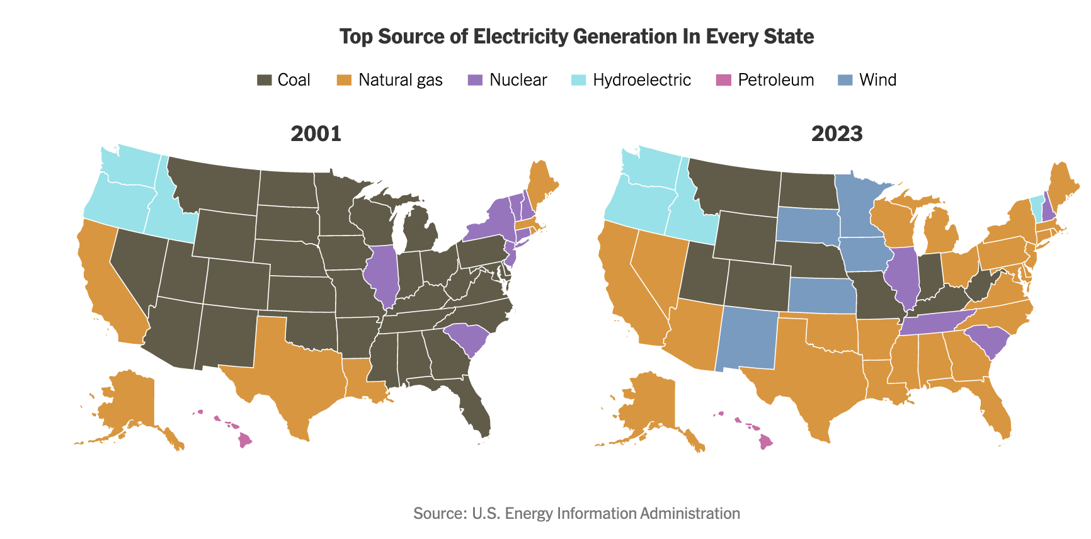

Notes:
Progressive Policy Institute’s latest energy report, Energy Costs Come First: A New Approach to Environmental Justice, authored by Elan Sykes of PPI, who is in the room here with us today.
This report examines the disproportionate energy burdens faced by low-income households, particularly Black and Brown communities. The report provides a critical analysis of how current climate and energy policies exacerbate economic hardship for these communities and outlines a pragmatic path forward — one that prioritizes affordability, clean energy deployment, and regulatory reforms to enable rapid progress for all Americans in the energy transition.
We hope you will walk away from this conversation thinking about the issue of reliability and affordability a little differently, and what some of the consequences of these policy decisions have had on our most vulnerable communities, particularly the adverse impact that advocating AGAINST natural gas has had on many communities across this country, particularly communities of color.
This map shows the magnitude of the change that has occurred over the past 20 years here in America. As I’m sure everyone in this audience knows, just 20 years ago almost every state got most of its electricity from coal. Today natural gas has replaced coal as the top energy source, along with renewables, including solar and wind.
While the energy mix has changed dramatically, one thing that has not changed is the disparity of wealth. I think it’s important to understand the cost of a renewable-only, Green Energy Transition, and how the burden of energy costs falls especially hard on lower-income households.

Slide 9
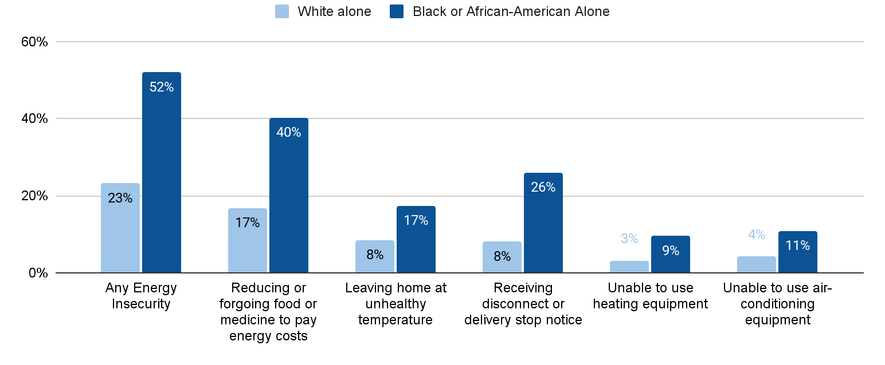
Black Households Face Energy Insecurity at More than
Double the Rate of White Households
Source: EIA’s 2020 Residential Energy Consumption Survey
Notes:
This next chart shows that across the country, more than half of Black households suffer from energy insecurity, and more of their income is going to pay for energy. They are more likely to forgo prescriptions and groceries to instead pay energy bills.
Households of other races are also vulnerable to energy insecurity; however, Black households face the most severe energy security challenges.
People on the left keep talking about buying heat pumps to lower emissions. But what they fail to mention is the cost of buying a central heat pump for a whole house can cost $8,000 - $15,000 and even higher. And that does not include the cost of installation.

Slide 10
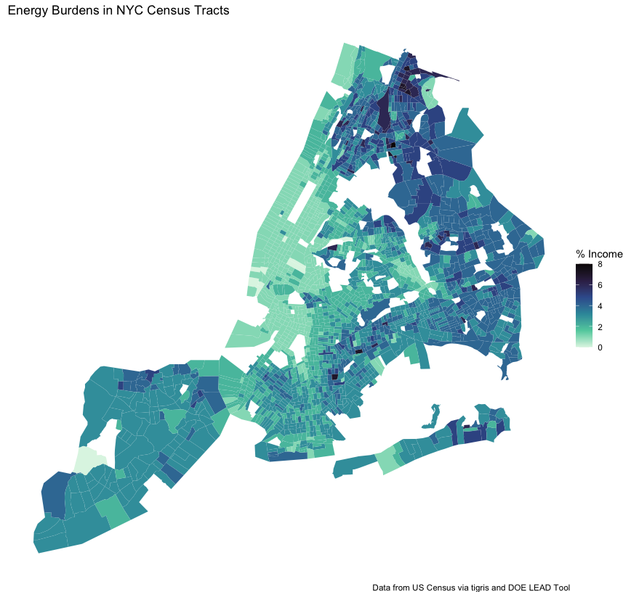
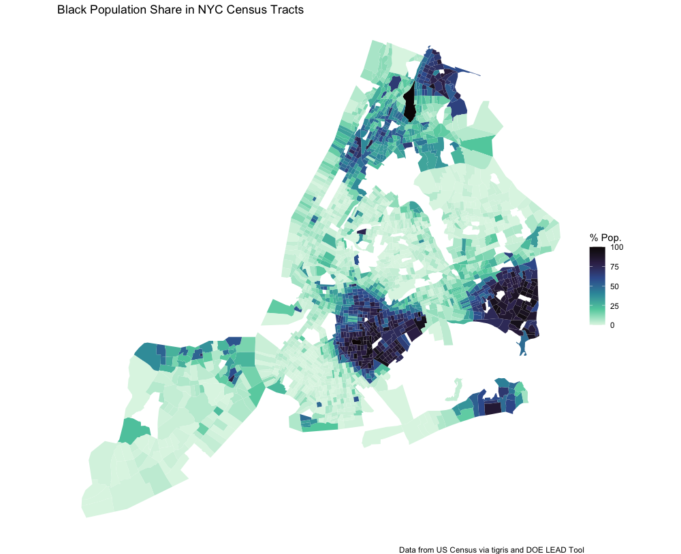

New York City
Black Population Share %
Hispanic Population Share %
Energy Burden (% Income)
Source: Department of Energy’s LEAD tool
Notes:
According to the PPI study, decades of underinvestment and political opposition to new natural gas pipelines and transmission lines have left New England heavily reliant on expensive imported liquefied natural gas (LNG).
When global energy prices spike—as they did after Russia’s invasion of Ukraine—Boston is forced to burn dirtier, pricier fuels to keep the grid running.

Slide 11

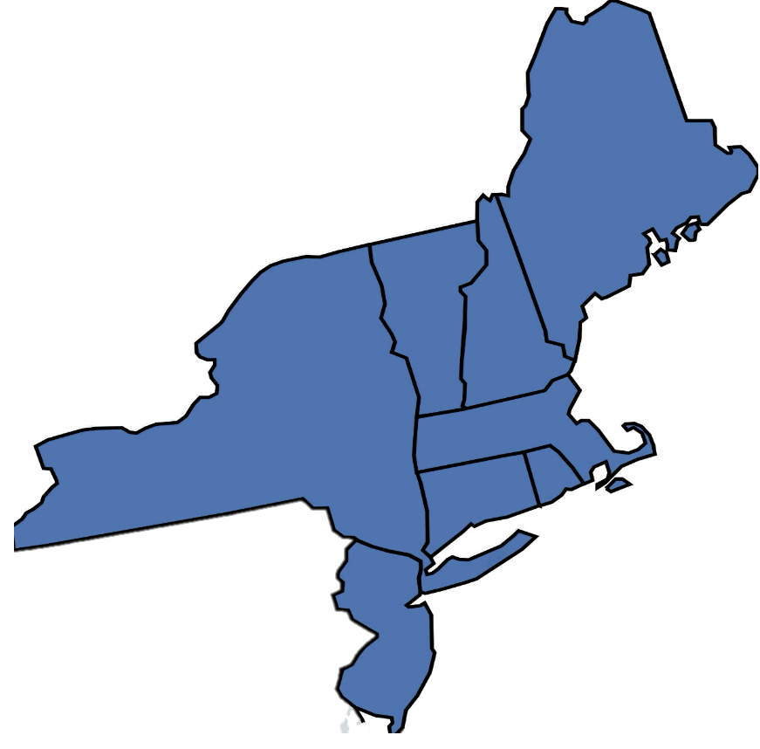

Regional Energy Survey Results:
Northeastern United States
n=4,000 Registered Voters
Margin of Error = +/- 1.55%
Survey Dates: May 14-18, 2025
ME
VT
NH
NY
MA
CT
RI
NJ

Slide 12
Voters in the Northeast Care About Affordability
Voters in 8 northeast states we surveyed are concerned about finances, think their power bills are too high, and prioritize affordability as the most pressing concern over climate.
+58
+67

Slide 13
A Balanced Approach Builds the Most Support
Natural Allies tested six (6) proposed policies for how to address the energy supply and demand problem in the region. A balanced approach that combines natural gas with renewables scored the highest.
+44
+28

Slide 14
CASE STUDY: New Jersey
We asked New Jersey voters if after 7 years of essentially zero carbon-only policies under Gov. Murphy if they want their next Governor to follow his same path. By a 37-point margin voters prefer a candidate with an all-of-the-above approach including natural gas.
2025 GUBERNATORIAL ELECTION: Every electric and gas utility in New Jersey will be raising rates by double digits this summer. The independent power grid operator stated New Jersey’s decisions to cancel natural gas pipelines and instead focus on building zero-carbon energy like windmills off the shore in recent years has played a significant role. Thinking ahead to a new Governor’s election this fall, do you support…
+37

Slide 15
CASE STUDY: Connecticut
The popularity of Gov. Ned Lamont’s position on natural gas in blue Connecticut shows a practical pathway for other states that is good on policy, and popular on the politics
Q: Although Democratic Governor Ned Lamont has advocated for zero-carbon policies in the past, in January he announced that he wants to work in a bipartisan way to increase natural gas supplies, to offset rising electric bills like those from last summer. Do you agree or disagree with Governor Lamont’s goal to work in a bipartisan way to lower bills by increasing the use of clean domestic natural gas?
+67

Slide 16







THANK YOU
Scan the QR Code to Visit Us at naturalalliesforcleanenergy.org
Follow Us On Social Media!

