Slide 1
RP1162 – Pipeline Public Awareness
Karen Sousa Kalil, Lead Specialist, Rhode Island Energy

Slide 2
Course Includes
Purpose and Scope
Key Objectives
Target Audiences
Core Content and Delivery
Regulatory Context
Evolution

Slide 3
Purpose and Scope
Purpose
The primary purpose of RP 1162 is to enhance public awareness of pipelines and their potential hazards, and to promote prevention, recognition, and response to pipeline emergencies.
It aims to:
Educate the public, government agencies, and excavation-related personnel on the risks of unintended pipeline releases.
Encourage behaviors that prevent damage to pipelines (e.g., using 8‑1‑1 before excavation).
Provide clear instructions on recognizing signs of a release and taking appropriate safety actions.
Improve community engagement and trust between pipeline operators and the public.
Scope
RP 1162 applies to pipeline operators of transmission, local distribution, and gathering pipelines, as well as underground storage systems.
It covers:
Active pipeline systems and facilities in the U.S. (including those crossing U.S. borders).
Baseline public awareness program elements such as message content, delivery frequency, and methods.
Enhancements to address local conditions (e.g., population density, development activity, excavation frequency) .
Exclusions:
  Communications about new pipeline construction, offshore operations, abnormal operations, and emergencies.
  Operator-specific performance measures covered by other regulatory reporting requirements.

Slide 4
Key Objectives
API Recommended Practice 1162, Public Awareness Programs for Pipeline Operators, sets out the core goals for pipeline operators to ensure communities and stakeholders are informed, engaged, and prepared regarding pipeline safety.
Enhance Stakeholder Awareness of Pipeline Presence and Hazards
The primary objective is to ensure that the public, public officials, emergency responders, and other relevant groups understand the location of pipelines and the potential hazards from unintended releases. This includes communicating risks, hazards, and possible impacts in a clear, consistent manner.
Promote Prevention of Pipeline Emergencies
Public awareness programs should educate stakeholders on their role in preventing incidents, such as avoiding excavation without proper notification (e.g., calling 8‑1‑1) and recognizing warning signs.
Enable Recognition and Response to Potential Damage or Emergencies
The programs should help audiences identify signs of pipeline damage and know how to respond appropriately, including contacting the right authorities or operators in an emergency.
Provide a Baseline and Flexible Program Framework
RP 1162 offers a recommended baseline public awareness program with elements for message content, delivery frequency, and methods. Operators can adapt and enhance the program to meet local conditions, population density, and development activity.
Support Continuous Improvement and Evaluation
The RP emphasizes establishing, implementing, and evaluating public awareness programs to ensure they remain effective, relevant, and aligned with operational changes.
In summary, the key objectives of RP 1162 are to raise awareness, prevent incidents, enable quick and correct responses, and maintain a flexible, evidence-based program that adapts to local needs while meeting safety and regulatory expectations.

Slide 5
Target Audiences
API Recommended Practice 1162, Public Awareness Programs for Pipeline Operators, identifies several key stakeholder groups that pipeline operators should engage in their public awareness programs. These audiences are selected to ensure that communities, workers, and emergency responders understand pipeline presence, hazards, and safety measures.
Primary target audiences include :
General public – Residents living or working near pipeline rights‑of‑way, including homeowners, renters, and community members.
Commercial excavators – Contractors and businesses that may dig in areas where pipelines are located, including, but not limited to, landscapers, sewage companies and tent rental companies.
Agricultural excavators – Farmers and agricultural contractors who may work in or near pipeline corridors.
Public officials – Local, state, and federal government representatives who can help coordinate safety messaging and enforcement.
Local and state emergency response agencies – Fire departments, EMS, and other emergency services that may respond to pipeline incidents.
Why these groups?
The RP emphasizes that public awareness programs should:
  Increase awareness of pipeline presence and potential hazards from unintended releases.
  Encourage preventive actions (e.g., calling 8‑1‑1 before digging).
  Provide clear guidance on recognizing and responding to pipeline damage or emergencies.

Slide 6
Core Content and Delivery
Core Content Requirements
The RP defines a baseline public awareness program that must cover:
Use of one-call systems (e.g., 8‑1‑1) before excavation.
Hazards of unintended gas releases and physical indicators of such releases.
Public safety steps in the event of a release.
Reporting procedures for pipeline incidents.
Facility location awareness for municipalities, schools, businesses, and residents.
Multilingual communication where significant non‑English populations exist.
Operators must also assess their pipeline’s unique characteristics (population density, development activity, hazard severity) and may enhance the program with supplemental messages, delivery methods, or coverage areas.
Delivery Methods and Frequencies
Delivery frequency by stakeholder type and pipeline category (e.g., transmission, distribution, gathering).
Baseline delivery methods must be identified and supported by program objectives.
Common methods include direct mail, public education events, social media, text messaging, apps, virtual meetings, and collaborative outreach .
Operators may use multiple methods to reach audiences effectively.
Liaison roles (e.g., with local governments, excavation contractors) are encouraged to ensure message reach.

Slide 7
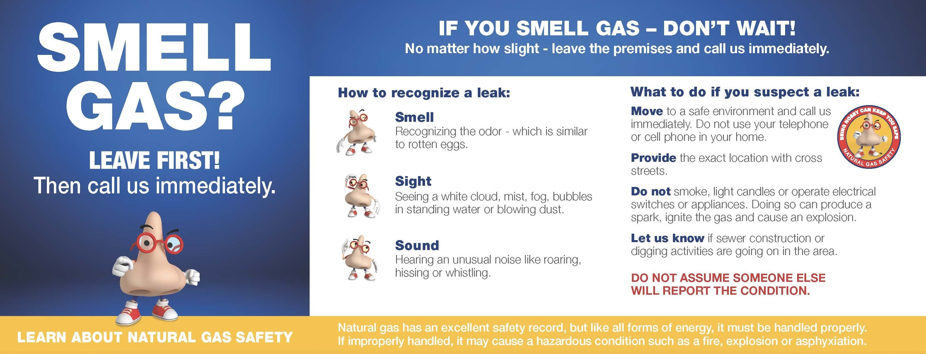

Various Campaigns
2024 Public Awareness Campaign - Call Before You Dig - YouTube

Slide 8
Regulatory Context
Regulatory Context:
Under 49 CFR 192.616, pipeline operators must:
Develop and implement a written continuing public education program following RP 1162 guidance.
Tailor the program to their pipeline’s unique attributes.
Use media and methods as comprehensive as needed to reach all areas served.
Provide materials in English and in other languages for significant non‑English populations.
Key Takeaways:
Core content focuses on damage prevention, hazard awareness, safety actions, and facility location.
Delivery must be systematic, frequency‑based, and method‑appropriate, with flexibility to adapt to local needs.
Regulatory compliance requires written programs, multilingual outreach, and use of both traditional and modern communication tools.

Slide 9
Evolution
1st Edition (2003) - adopted
Published in 2003 and incorporated into federal pipeline safety regulations in 2005, the 1st Edition provided broad guidance for establishing public awareness programs.
It covered transmission, distribution, and gathering pipelines, but early implementations were criticized for:
  Overly complex and redundant messaging
  Poor focus on core safety information
  Inadequate stakeholder coverage and clarity of audience needs
  Weak program evaluation and behavioral impact measurement
2nd Edition (2007) – not adopted
Developed in response to the first four years of regulatory inspections (PHMSA Form 21-), the 2nd Edition:
  Reduced the number of baseline messages to improve retention
  Streamlined delivery frequencies and methods
  Clarified stakeholder identification and coverage areas
  Addressed duplication and information overload
3rd Edition (2022–2026….) – currently being looked at again
The 3rd Edition, adopted in August 2022 and was expected in early 2023, but is still ongoing, builds on these improvements with:
  A clearer scope for active pipeline systems and associated facilities in the U.S. (including cross-border operations)
  Enhanced structure for baseline and supplemental messaging for four key audiences:
    Affected Public (AP)
    Excavators (EX)
    Public Officials (PO)
    Emergency Officials (EO)
  Updated message counts:
    Baseline: AP10, EX8, PO10, EO10
    Supplemental: AP6, EX5, PO6, EO9
  Emphasis on tailored enhancements for high-risk areas, excavation activity, and population density
  Stronger program evaluation requirements, including behavioral intent measurement and annual audits (internal or external, but not the audit
  from the Commission)

Slide 10
Messaging

Slide 11
Risk to Companies for Non-Compliance
Non‑compliance with API RP 1162, Public Awareness Programs for Pipeline Operators can expose a business to a range of financial, legal, operational, and reputational risks. Possibilities:
Regulatory and Legal Penalties
API RP 1162 is incorporated by reference into U.S. federal pipeline safety regulations (49 CFR 192.616 and 49 CFR 195.440). Failure to meet its requirements can result in fines, enforcement actions, or operational restrictions from PHMSA or state regulators. In extreme cases, criminal penalties may apply.
2. Financial Costs
  Fines and penalties: Regulatory bodies can impose significant monetary sanctions for non‑compliance.
  Litigation and settlements: If incidents occur due to inadequate public awareness, the company may face lawsuits and compensatory payments .
  Compliance remediation: Corrective measures such as hiring compliance staff, conducting audits, and updating programs can be costly
  Insurance premium increases: Non‑compliance can raise insurance costs as insurers view the business as higher risk .
3. Operational Disruptions
Non‑compliance can lead to license cancellation or suspension, halting pipeline operations until requirements are met. This can cause service interruptions, loss of contracts, and revenue decline.
4. Reputational Damage
Public perception of safety is critical in the energy sector. Failure to meet RP 1162’s public awareness obligations can erode stakeholder trust, damage community relations, and harm the company’s brand.
5. Increased Liability in Incidents
If a pipeline incident occurs and public awareness programs are found lacking, the company may be held liable for injuries, fatalities, or property damage. Effective RP 1162 compliance is a key defense in such cases.
6. Loss of Business Opportunities
Regulatory or reputational fallout from non‑compliance can make it harder to secure new contracts, partnerships, or government work.
In summary:
Non‑compliance with RP 1162 is not just a procedural issue—it can trigger fines, legal action, operational shutdowns, higher insurance costs, and reputational harm. Given its regulatory status, strict adherence is essential to avoid these risks and to demonstrate a commitment to public safety.

Slide 12
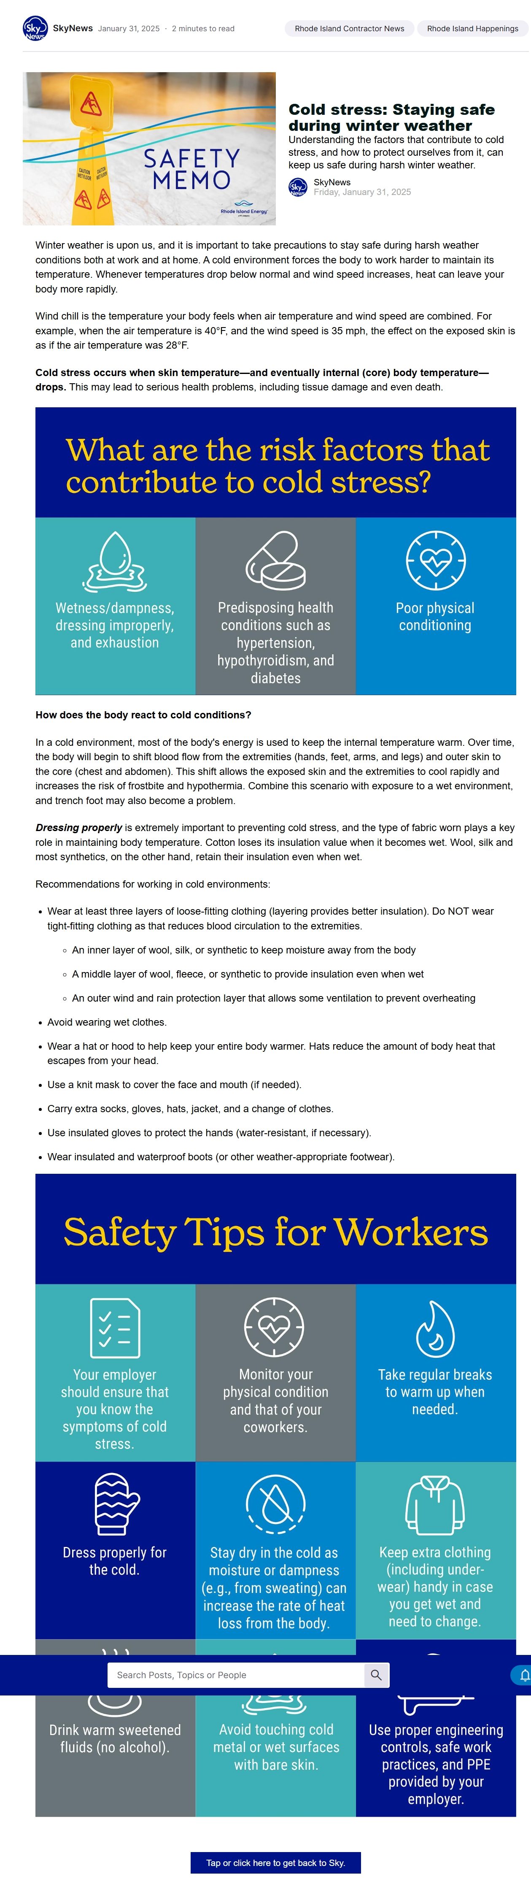
Messaging

Slide 13
Why Employees are Needed to Help with RP1162
Because RP1162 is not a technical engineering standard but a public engagement and communication program, it relies heavily on human interaction to be effective. Employees are essential because they:
  Translate technical guidance into clear, accessible messages
  RP1162 provides detailed content, frequency, and delivery methods for public outreach. Employees must interpret these into language and formats that resonate with diverse audiences, including local officials, excavators, property owners, and the general public.
  Deliver outreach through multiple channels
  Effective RP1162 programs use a mix of methods — public meetings, workshops, social media, digital platforms, and direct contact with stakeholders . Employees handle logistics, scheduling, and on‑the‑ground execution of these activities.
  Measure and adapt programs
  The third edition emphasizes measuring behavioral intent — the percentage of stakeholders who say they will act in alignment with safety guidance. Employees collect feedback, track engagement, and help operators adjust messaging or delivery methods based on results.
  Build trust and community relationships
  Pipeline safety is about more than compliance; it’s about trust. Employees act as the face of the operator, engaging with communities, addressing concerns, and reinforcing the operator’s commitment to safety.
  Ensure regulatory compliance
  Federal regulations (49 CFR 192.616 and 49 CFR 195.440) require operators to follow RP1162. Employees help ensure that all program elements — from planning to evaluation — meet legal and industry standards.
In short, employees are needed to implement, communicate, and evaluate RP1162’s public awareness goals, making the standard effective in protecting communities and meeting regulatory requirements. Without their involvement, the program’s reach, accuracy, and impact would be severely limited.

Slide 14
What can be done
  Align all communications
  Consistent messaging throughout
  Effectiveness studies – more often
  Use several methods of communications
    Web /digital
    Text
    Email
    Print
    Advertising

Slide 15
Some Organizations – All Working Together
  Northeast Gas Association (NGA)
  American Gas Association (AGA)
  Pipeline Association for Public Awareness (PAPA)
  Distribution Public Awareness Council (DPAC)
  Dig Safe (811 centers)
  Common Ground Alliance (CGA)
  Pipeline and Hazardous Materials Safety Administration (PHMSA)

Slide 16
Acknowledgements
Some materials and references supplied by:
Northeast Gas Association (NGA)
Culver Company
PHMSA
American Petroleum Institute (API) Law Resource

Slide 17
Thank You!!
QUESTIONS????

