Slide 1


Holyoke Gas & Electric
Innovative, municipal utility at the crossroads of New England
Pipeline Safety Management System (PSMS)
Scalability - NGA Small Operator
Gas Operation School
June 3, 2026

Slide 2


Company Background
Municipal Light Plant established in 1902
Provide electricity, natural gas and telecommunications services to 18,000 customers (12,000 gas customers)
  18 MW of installed solar capacity
  26MW / 76MWh battery storage (includes 15MW/45MWh with 2026 in-service date)
  50 MW hydro electric generation
Natural gas franchise area includes Holyoke and Southampton, MA
  184 miles of gas main
  8,325 gas services
Company has ~150 employees, with roughly 40 performing gas tasks.

Slide 3




Awards & Recognitions
2021 & 2023 Utility Transformation Leaderboard from the Smart Electric Power Alliance
2023 Business of the Year, Holyoke Veterans Services
System Operational Achievement Recognition from the American Public Gas Association (APGA)
Reliable Public Power Provider from the American Public Power Association
Smart Energy Award from the American Public Power Association
Certificate of Excellence in Reliability from the American Public Power Association
Smart Electric Power Alliance ranked HG&E third nationally in energy storage per capita
Safety Achievement Award from the American Gas Association

Slide 4

PSMS Introduction
Pipeline Safety Management System (PSMS)
  Provides flexible and scalable framework to identify, manage and reduce risks through a systems lifecycle
  Covers design, construction, operation and maintenance
  Makes compliance and risk mitigation routine through intentional actions
Why SMS?
  RP-1173 developed by API following oil spill in Michigan in 2010 (840,000+ gal)
  SMS across other industries shown to reduce risk and incidents
  Adopted by State of MA following Merrimack Valley incident in 2018 (recommended by NTSB)
HG&E and SMS
  Implemented a formalized plan based on customized roadmap created with industry peers (NGA and Blacksmith)
  Many systems were already in place, just required formalization and establishing documentation requirements

Slide 5
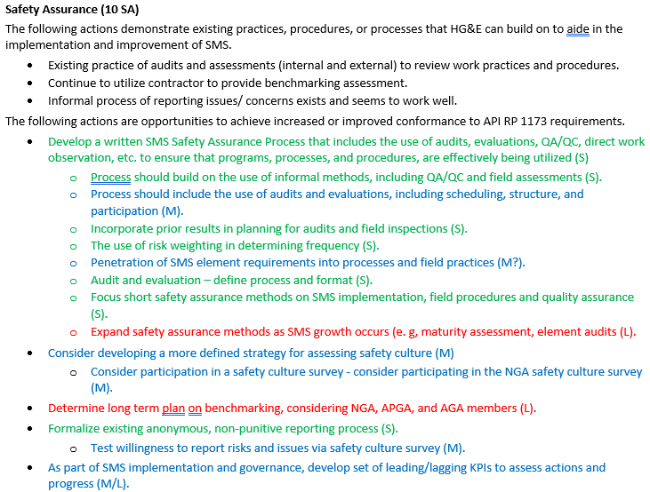
PSMS Implementation Planning
Gap Analysis
  Reviewed Existing Processes
    What were we doing? What needed to be formalized? What opportunities existed to build upon? What was missing?
    Establish timelines for implementation (Short-Term, Medium-Term, and Long-Term) based on each of the 10 elements
Gap Analysis Ex.

Slide 6
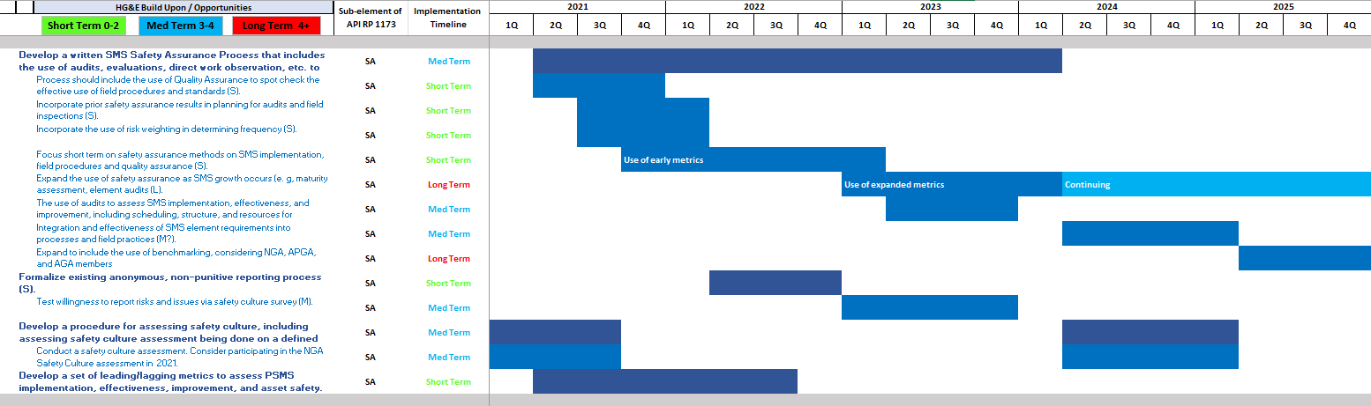

PSMS Implementation Planning
Gap Analysis
  Translated gap analysis to GANTT Chart
  Established manageable multi-year implementation schedule

Slide 7
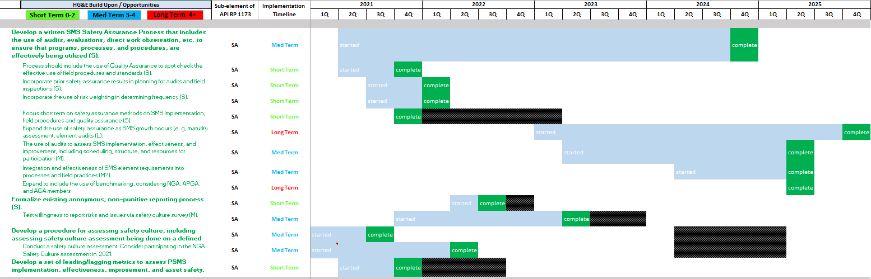
PSMS Implementation Progress
Gap Analysis Update
  Completed initial implementation roadmap in 2025
  New and/or Formalized Processes
    Job specific procedures with crew sign-offs
    Documented MOC and Audit Programs
    ICS Training for Emergency Response
    Sharing of lessons learned

Slide 8
PSMS Implementation Progress
Metrics
  In addition to developing the framework and written program, wanted to establish metrics to track progress.
  Started small
    Number of leadership engagement activities vs. plan
    Infrastructure replaced vs. plan
    Emergency drills held vs. plan
  As program matured, so did metrics
    Mapping QA/QC (errors from as-builts)
    Average number of days to update records (MA requires 60 days)
    Safety and Reliability metrics
      Average number days known leak on file before elimination (3.5 days in 2025)
      Incident Rate
      Emergency response time
    Continue to work with NGA on additional metrics for peer evaluations.

Slide 9
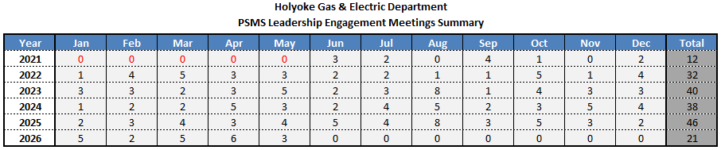
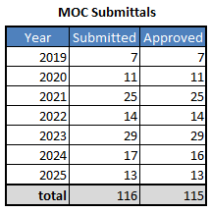
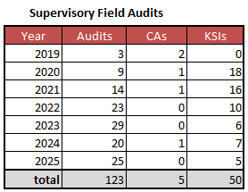
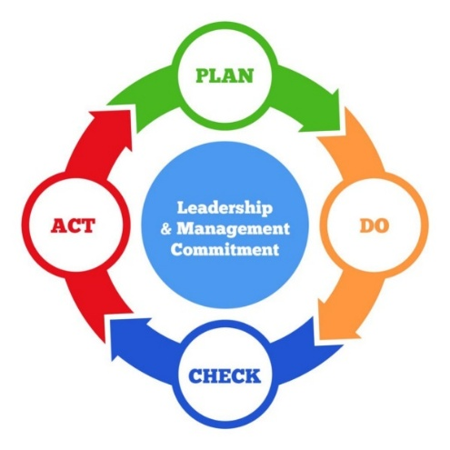
PSMS Implementation Progress

Slide 10
PSMS Scalability – Small Operator Summary
Customized road map/GANTT chart was helpful in setting annual program implementation targets
  Challenge of not knowing where to start
  Focus on single elements to incrementally build program
  Our initial framework was built upon over 5 years
Attempt to keep tracking as simple as possible
  Currently using spreadsheets to document MOCs, LE meetings, Audits, etc.
  Simple but effective for our system
Leadership engagement meetings promote two-way communication and foster healthy culture
  Collaborative vs. Directive
  Continue to repeat the message
PSMS is truly scalable to size of organization

Slide 11

PSMS Scalability – Small Operator
Questions?

