Slide 1
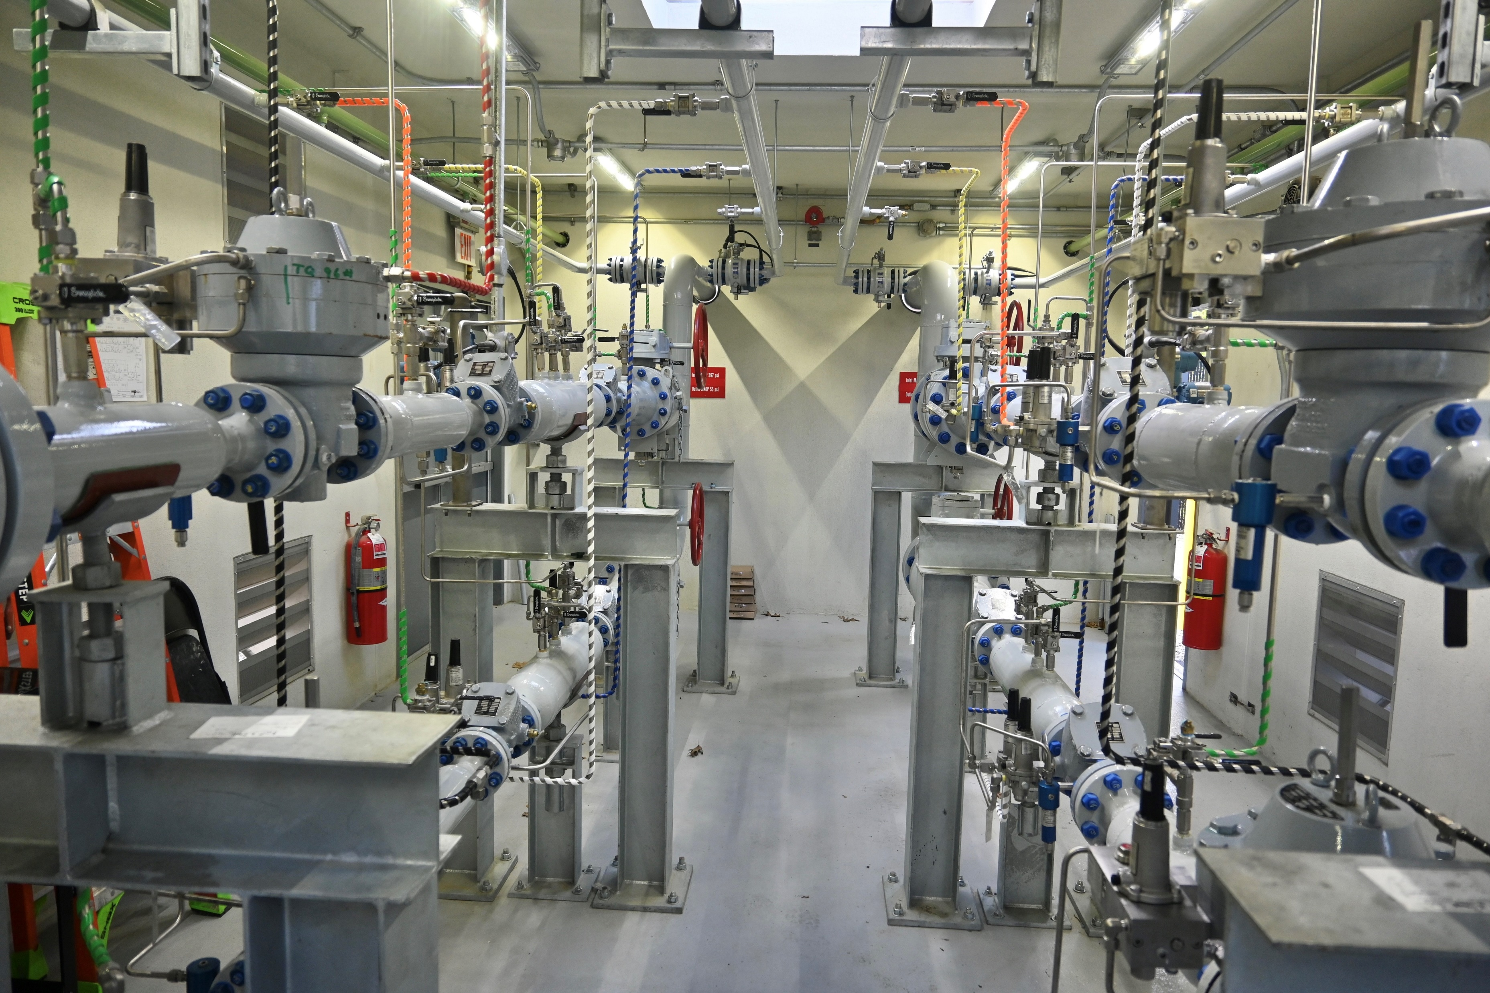

Over-Pressurization Mitigation Strategy-UNITIL
Gas System Operations
Mark Dupuis- Director, Gas System and Transmission Operations

Slide 2
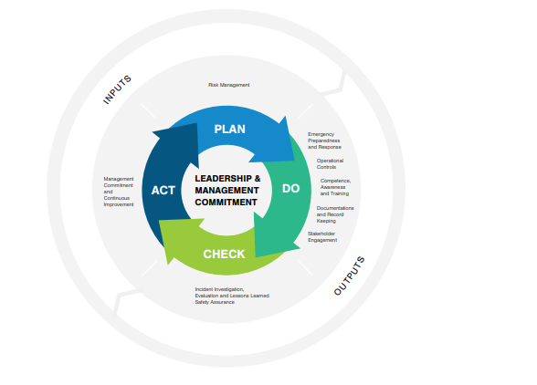
Advancing System Safety- Built on the Principles of PSMS

Slide 3

API RP1173
Pipeline Safety Management Systems and Operational Integrity
Advancement of system safety build upon the foundation of 10 elements that promote engagement at all levels & drive continuous assessment & improvements
  Leadership and management committee*
  Stakeholder engagement*
  Risk management*
  Operational controls*
  Incident evaluation- Lessons learned*
  Safety assurance*
  Management review & continuous improvement*
  Emergency preparedness & response
  Competence/awareness/training
  Documentation & record keeping *

Slide 4

API RP1185
Application of the 6 key-element framework to Enhance Stakeholder Engagement in Support of:
Commit and Align
  More community involvement via increased dialogue
Identify, Understand and Confirm
  Moving away from “Siloed” communication and focusing more on two-way engagement
Plan and Prepare
  Develop an approach based on stakeholder input
Share Information
  Continued stakeholder reengagement to develop buy-in for solutions to critical issues
Ask, Listen and Respond
  Emphasis on thorough evaluation of stakeholder input
Monitor, Evaluate and Adjust
  Demonstrating commitment through actions

Slide 5
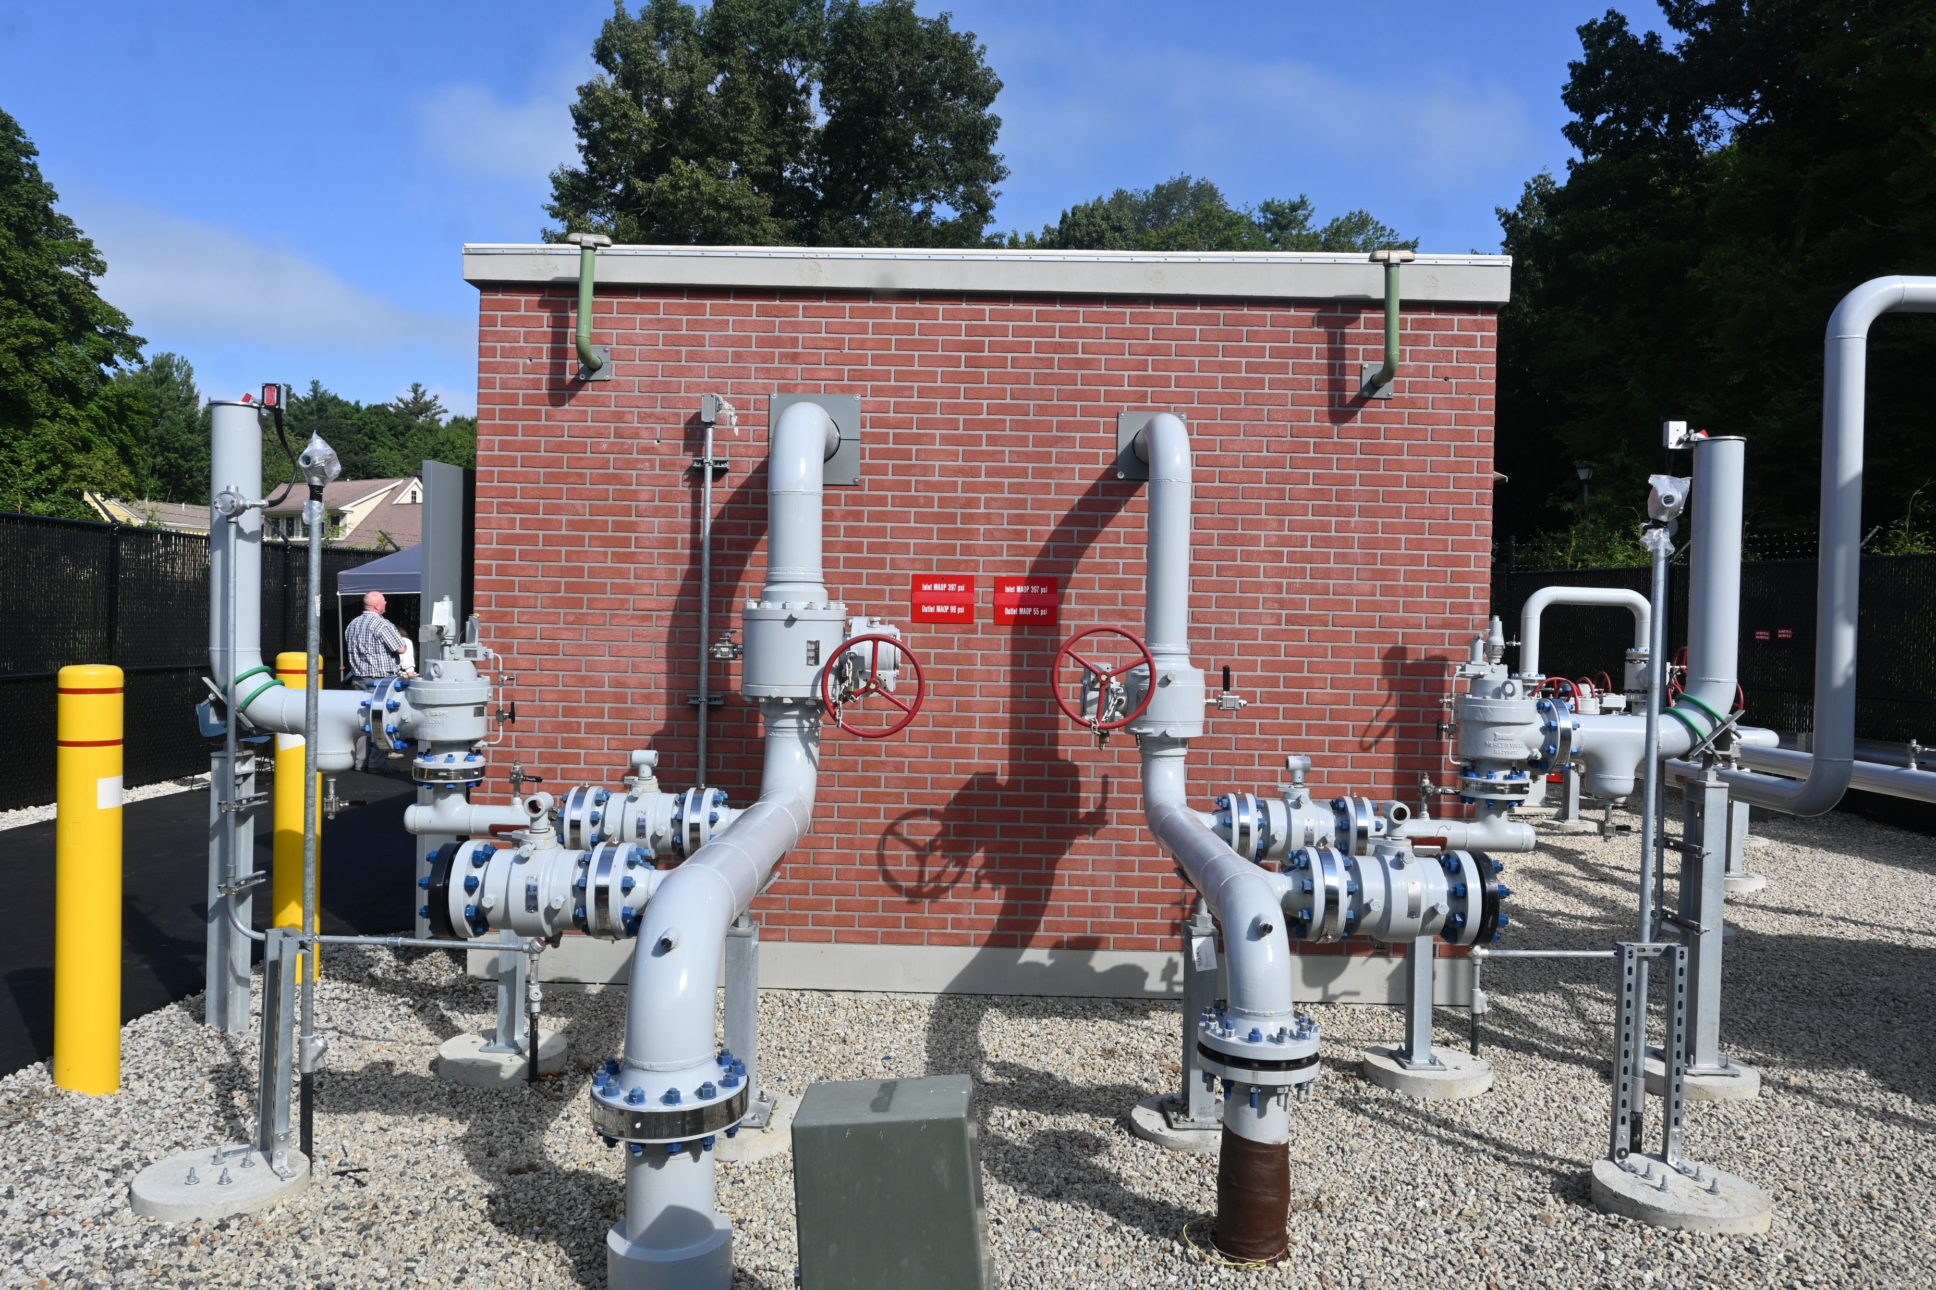
Application of RP1173 & RP1185 in the Design/Construction/Commissioning of pressure regulating facilities
Five Step Approach:
Plan (1173)
  Redundant/advanced levels of OPP
  Sense line awareness and controls
Do (1173)
  Sense line design/placement & location confirmation
  Effective application of OPP layering
Check (1173)
  Enhanced system monitoring via Gas Control
  Tied to advanced OPP
Act (1173)
  Employ advanced technology for OPP
  Progressive equipment inspection, maintenance, and testing program
  Employ advanced sense line demarcation initiative
  Immediately address stakeholder concerns
Engagement (1185)
  Enhanced stakeholder engagement
  Community outreach through design/construction/commissioning
  Continuous community follow-up/periodic check-ins

Slide 6
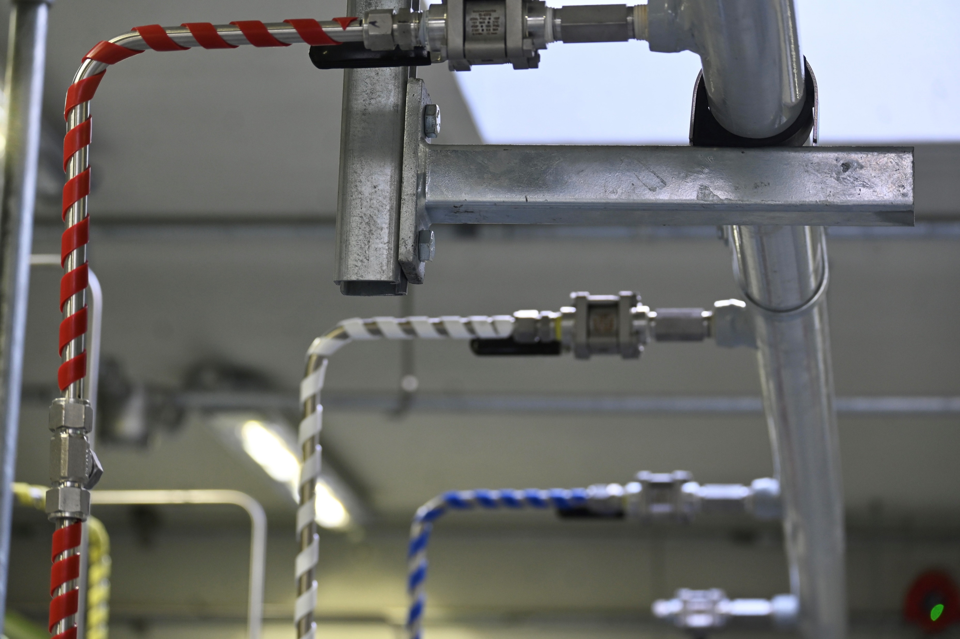
Unitil’s Comprehensive OPP strategy

Slide 7
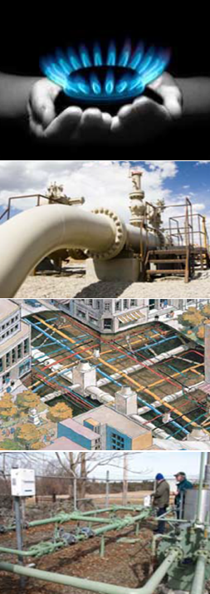
Over-Pressurization Mitigation Strategy
Gas Control- First Line of Defense
Utilization of Slam Shut Regulators for LP System Over-Pressure Protection
  Considerations & Concerns
Advanced Layering of Over Pressure Protection Technology
  System Equipment Configuration & Operation

Slide 8
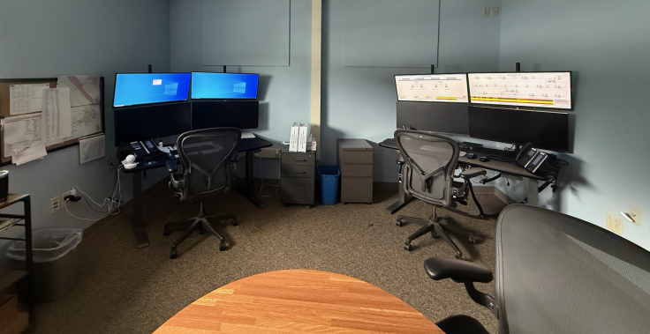
GAS CONTROL CENTER & SYSTEM MONITORING
(Monitor, Detection & Control)
Unitil’s Gas Control Rooms are staffed 24/7 & 365, and located in Portsmouth, NH, Exeter, NH and Portland, ME
Monitors system operations for all gas service areas (MA; ME; NH)
Responsibilities of Gas Control:
  Final approver in all facility shut in requests
  Direct coordination w/ field crews
  Continuously monitor pressures and flows
  Initiates internal notifications for emergency’s
  Dispatches emergency crews to the field
  Direct line of contact for Police/Fire
  Conservative alarm settings below MAOP to allow for expedited response

Slide 9
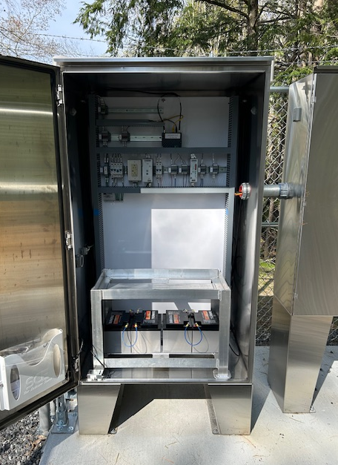
SCADA ALARMS & SETPOINTS
Regulator Set points Points:
  Worker – Below MAOP
  Monitor – Below MAOP
  Super Monitor – At MAOP
SCADA Alarms :
  High Alarm – Before Monitor Regulator Set point
  High - High Alarm – At Monitor Regulator Set Point
  Technicians Dispatched at High Alarm Notification
    Example:
    System MAOP – 60 PSIG
    Worker Regulator – 55 psig
    Monitor Regulator – 58 psig
    Super Monitor – 60 PSIG
    (Conservative & Industry Leading)

Slide 10
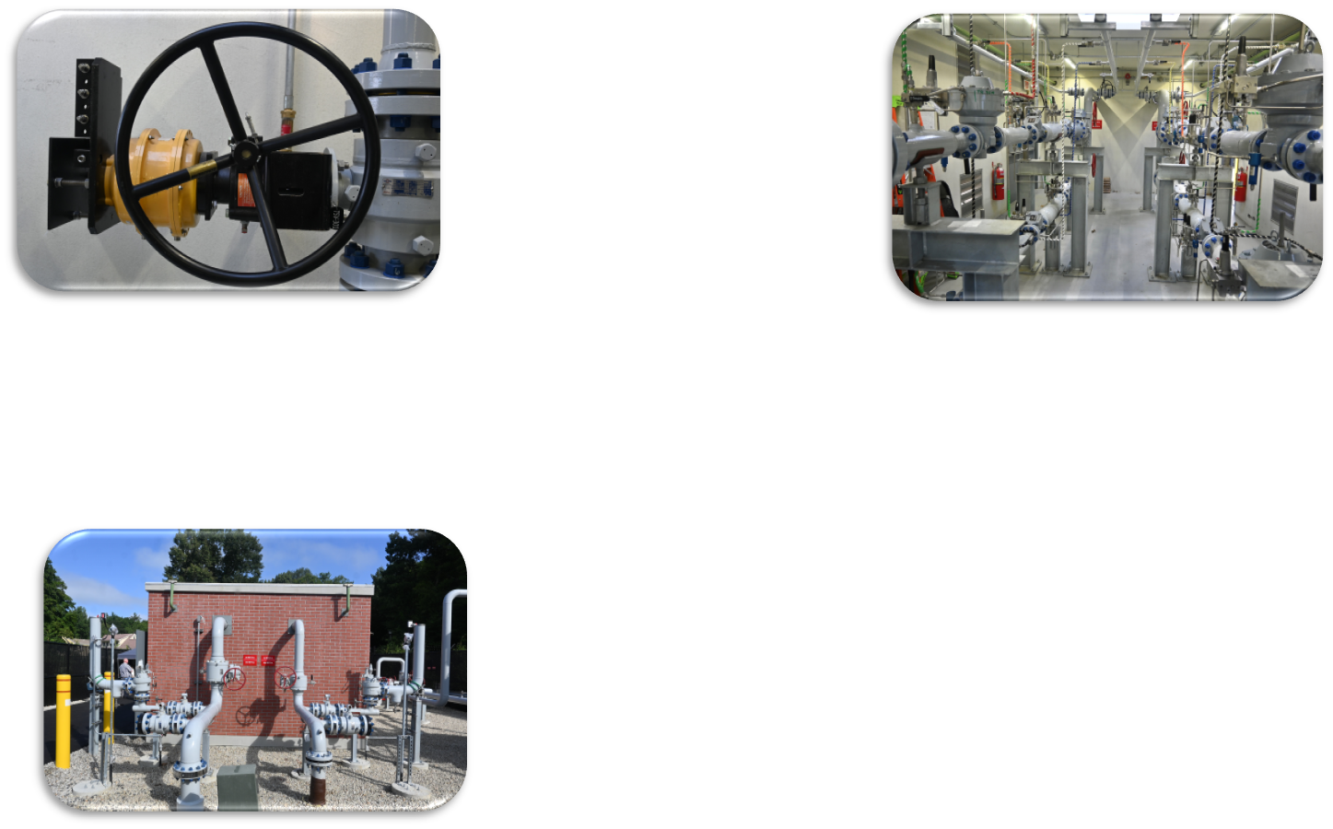
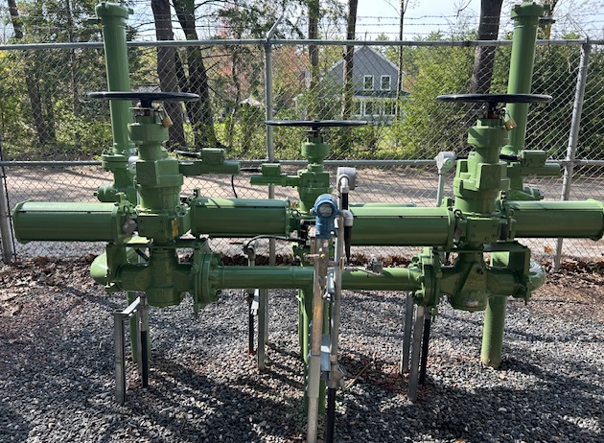
Consideration for and Application of OPP Technology
NGA SPRING OPERATIONS SCHOOL
June 2rd-June 5^{th,} 2026

Slide 11
Slam-Shut Regulators-Are they the Answer?
Single system supply
  Immediate stopping of the flow of gas
  Protection for end-user
  Customer impacts
    Relights required for all end-users
    Effect on business & critical care constituents
    Maintaining System Continuity
Multi-system supply
  SCADA monitoring an absolute must
  Inherent risk associated with pressure loss to parts of the system
    Customer Appliance Pilots
    Management of shut-offs/relights
    Maintaining System Continuity

Slide 12
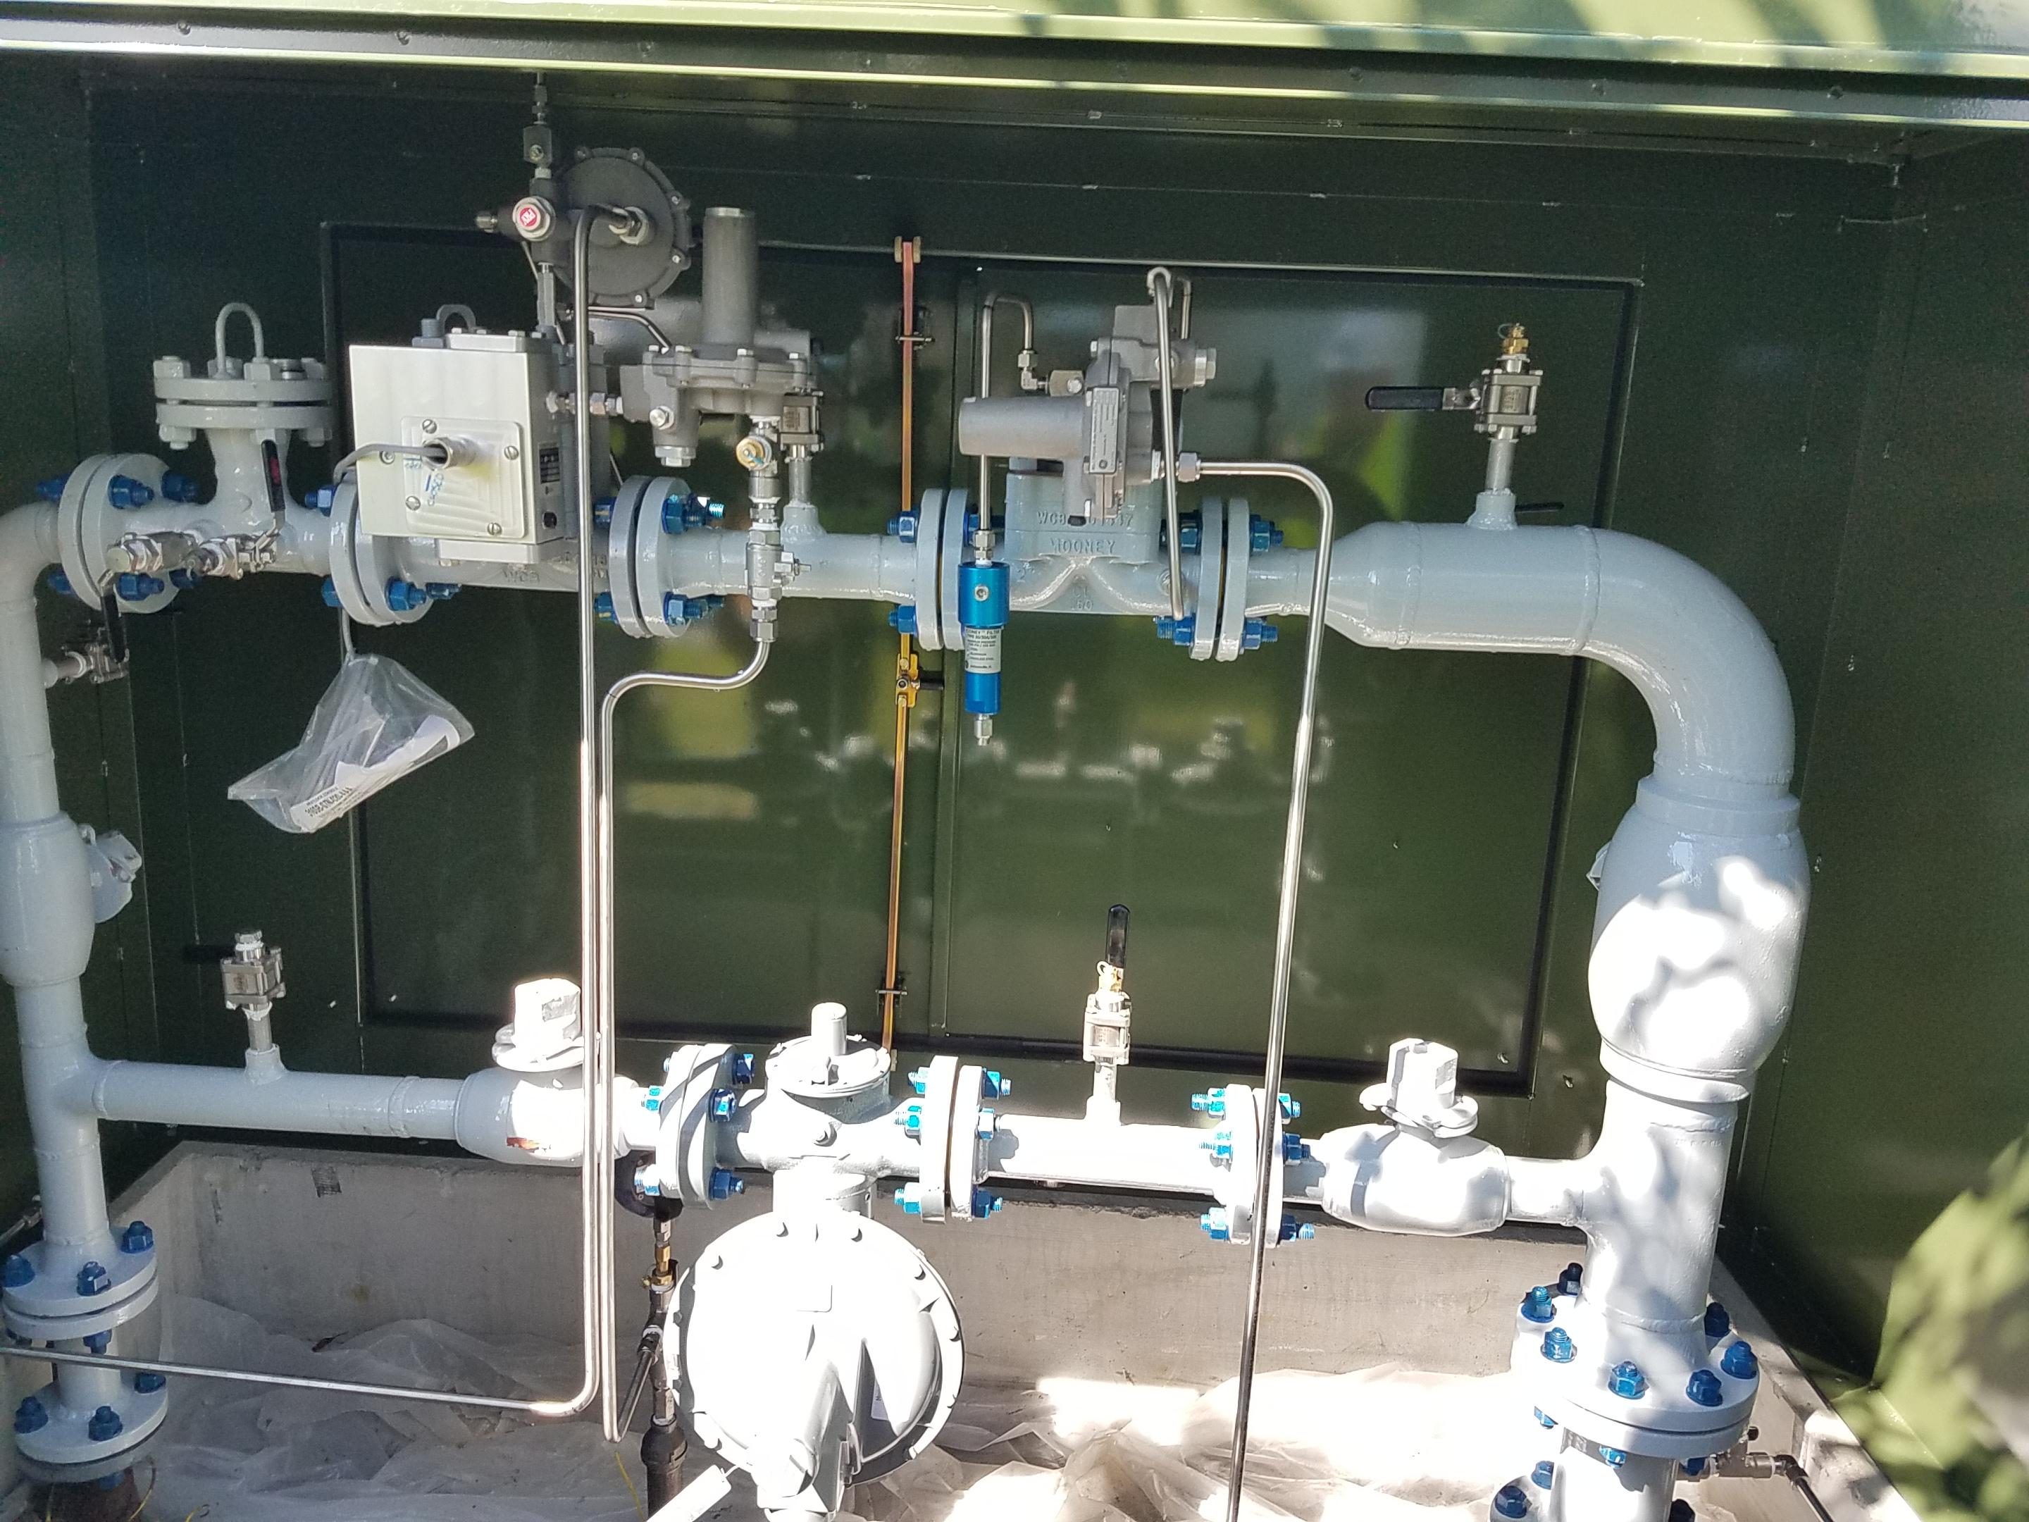

Slide 13
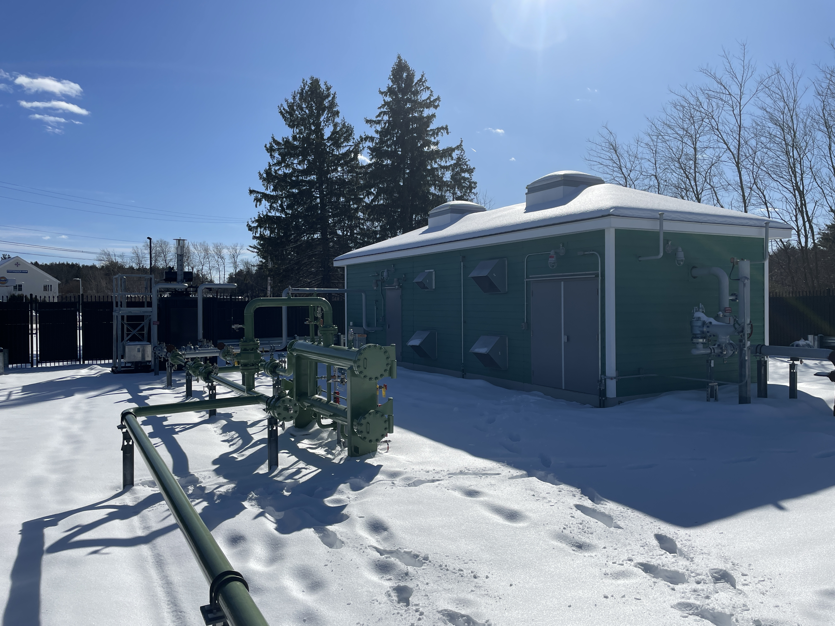
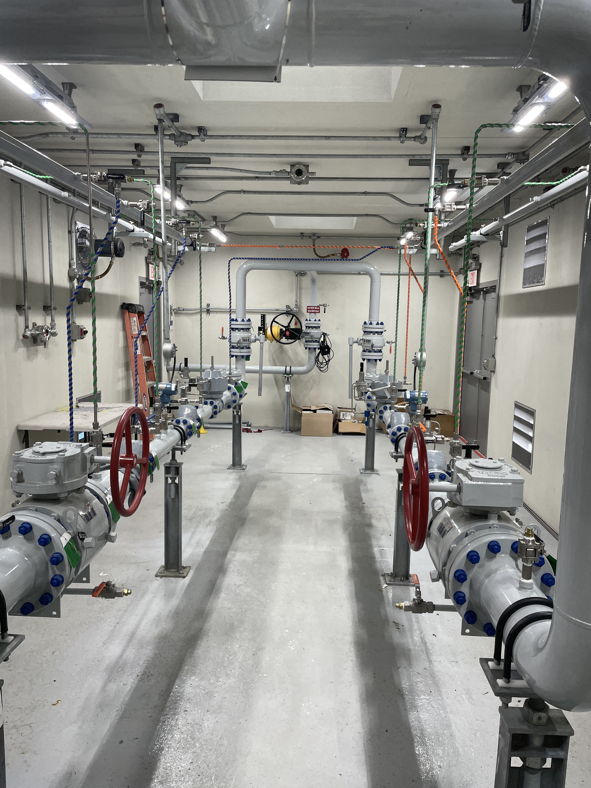
Advanced OPP Technology
What Code Requires vs. Can we do more?

Slide 14
MULTI-LEVEL OPP IMPLEMENTATION-
ADVANTAGES & AREAS OF CONCERN
Advantages
  Minimizing customer Impacts
    Minimizes relights- Gas still flowing
    Minimizes effects on businesses & critical care customer constituants
    Maintains safe operations & operational continuity of system
    Preserves overall system integrity in the event of a catastrophic failure
Areas of concern
  Full relief not suitable for all locations
  Confirmation & management of customer effects
  Balancing act between system safety & overall operational continuity
  Robust SCADA monitoring- an absolute must
  Larger station footprint
  Cost- $$$$$

Slide 15
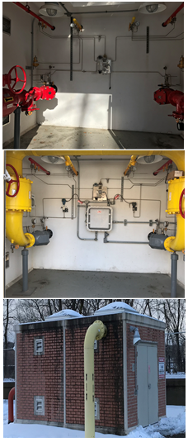
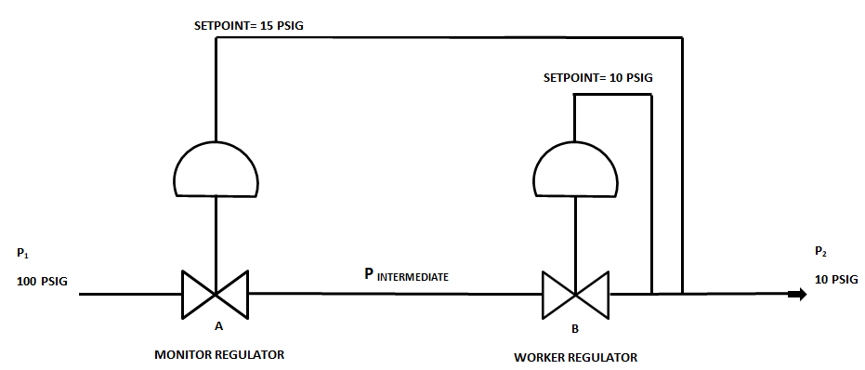
WORKER/ MONITOR CONFIGURATION
    A Worker & Monitor Regulator (Industry Standard)
    Code Minimum (49 CFR §192.195)
    Provides for over pressure protection if the primary regulator fails (failure +1 level of protection)

Slide 16
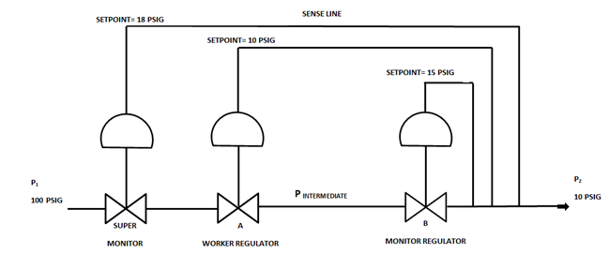
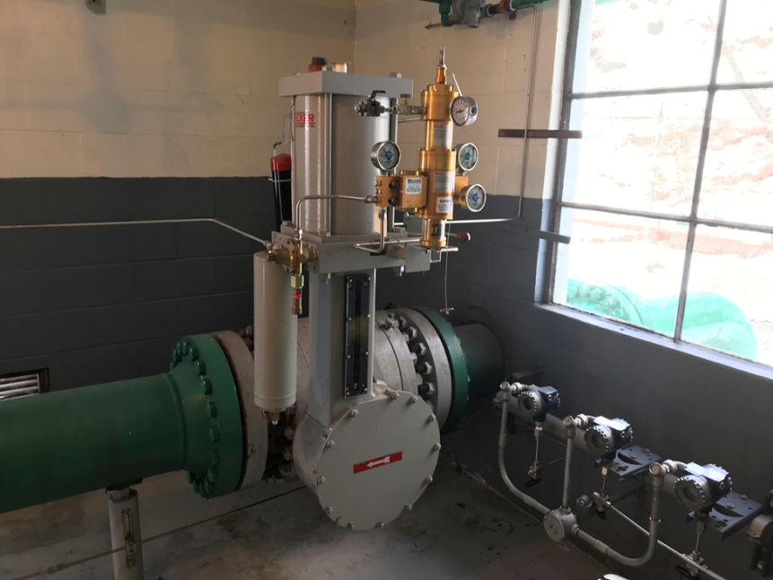
WORKER / MONITOR / SUPER MONITOR
(Station Design & OPP Redundancy)
    A Worker Regulator, Monitor Regulator & A 3rd Regulator (Super Monitor)
    Provides for over pressure protection if the primary regulator fails (failure + 2 levels of protection)
    Unitil Standard Design Since 2010

Slide 17
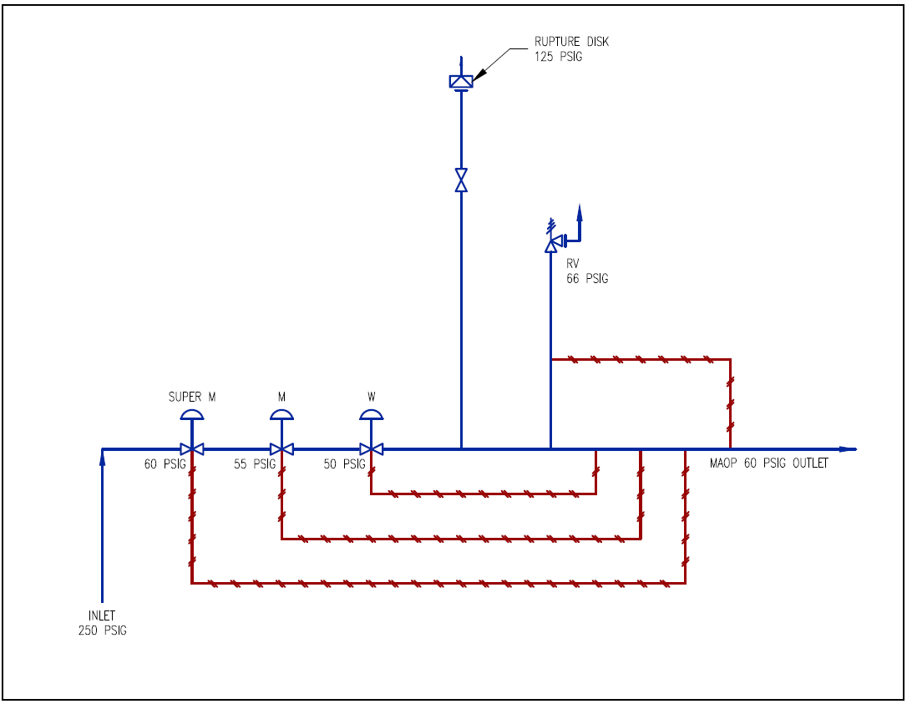
REGULATOR STATION DESIGN STANDARD
SUPER MONITOR WITH RELIEF VALVES
(STATION DESIGN & OPP REDUNDANCY)
    New Design Standard Since Merrimack Valley
    Provides for over pressure protection if the primary regulator fails
    (failure + 4 levels of protection)
    Industry Leading Design
    Note: Not all 4 levels are suitable for all existing locations.
      Gas System Operations and Gas Engineering work closely together to determine which locations are best suited for each level of protection.
Note: Not Suitable for all existing locations

Slide 18
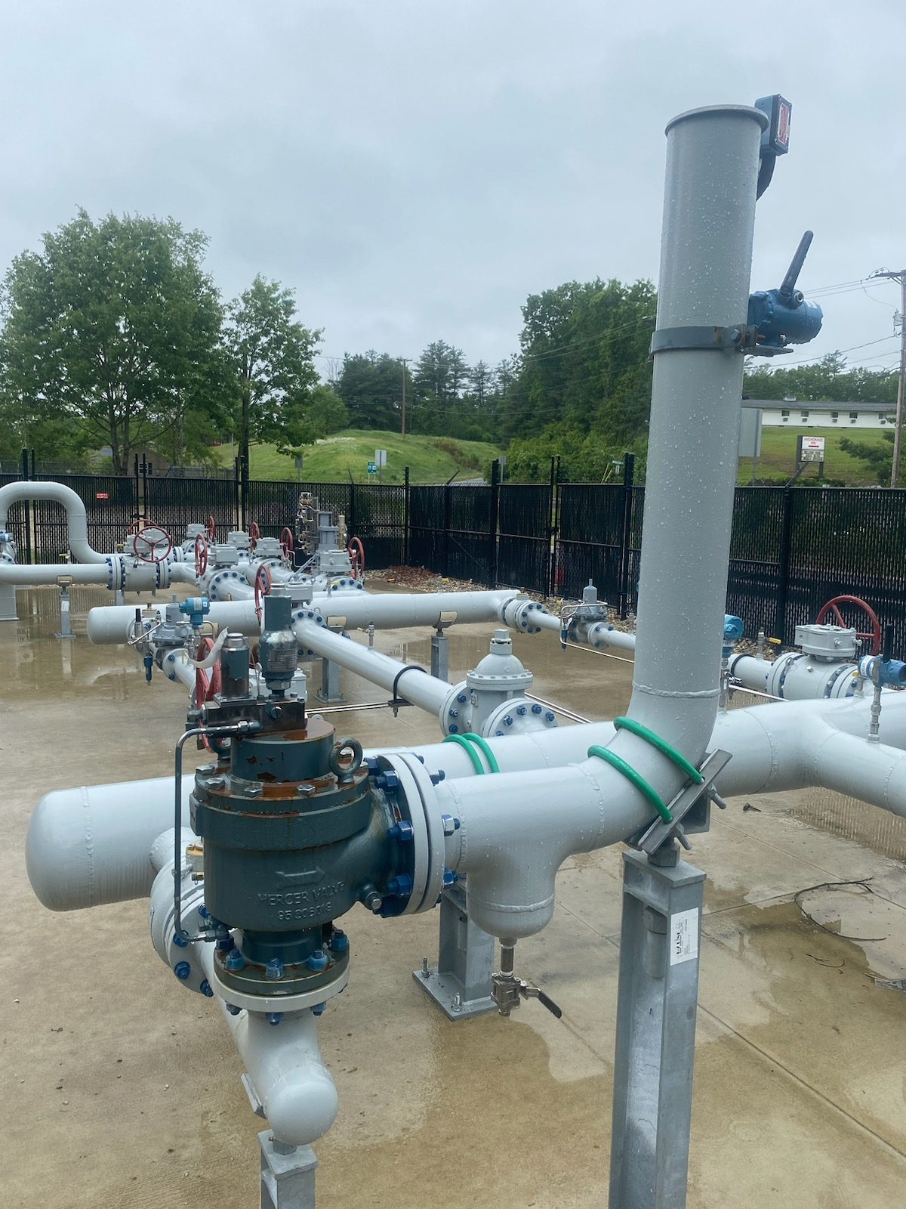

Slide 19
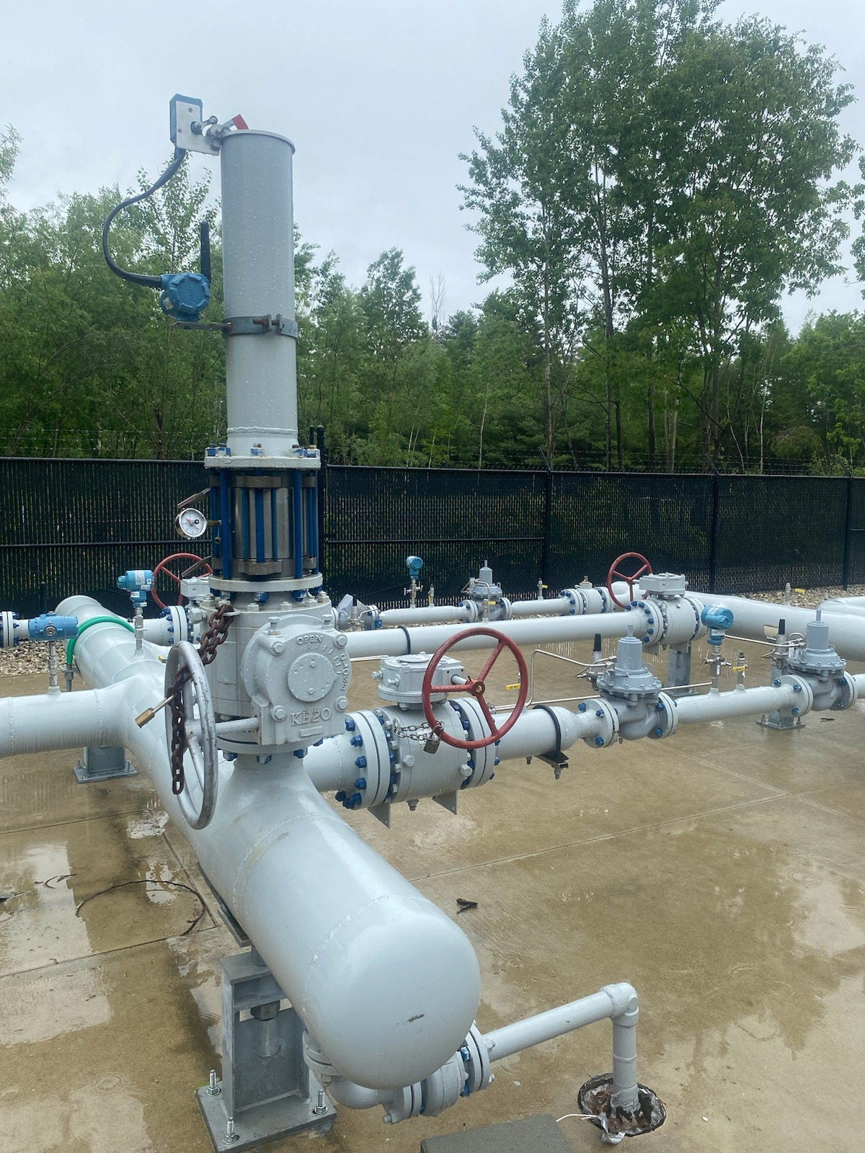

Slide 20
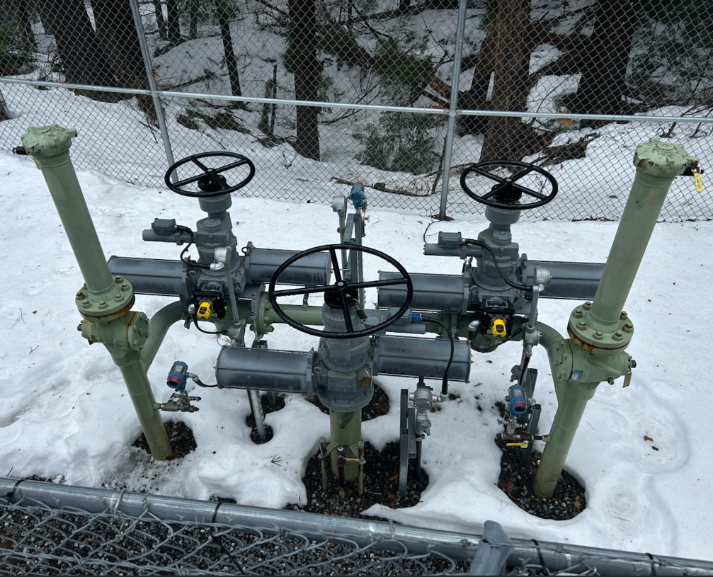
OPP Enhancements for Transmission Operations

Slide 21
Remote Actuator Control Valve Program
On April 8, 2022, PHMSA published the final rule Pipeline Safety: Requirement of Valve Installation and Minimum Rupture Detection Standards.
§192.636 Transmission Lines: Valve Capabilities stipulates that an operator must, after identifying a rupture, close such valves as soon as practicable, but no later than within 30 minutes (measured from rupture identification).

Slide 22
System and Location Considerations:
Remote Actuator Control Valve Program
The purpose of the RACV Program is to provide enhanced rupture detection capability of the Granite State Gas Transmission System AND to enable the rapid isolation of a pipeline segment that has ruptured.
The installation of remote actuators and pressure sensors at Mainline Valve sites, that are controlled by Gas Control through SCADA enable this rapid detection and isolation of pipeline segments.

Slide 23
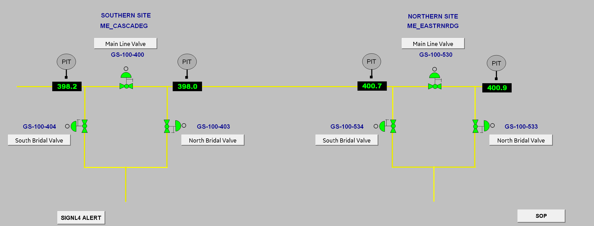
Gas Control and SCADA Considerations:
Remote Actuator Control Valve Program
Cyber Security
  Multi-factor Authentication
  Networking segmentation
  Safe storage of critical information
  Permissions by credentials
  OT Firmware
  Network monitoring
Screen Layouts/configurations
Communications pathways
Operational technology procurement, installation and maintenance
Leak detection philosophy and algorithm development and deployment

Slide 24
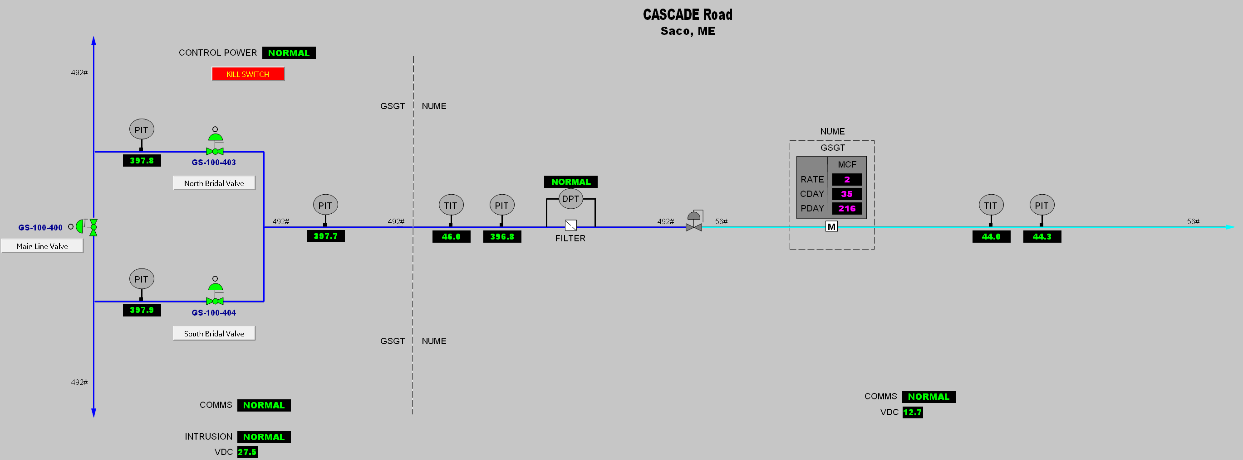
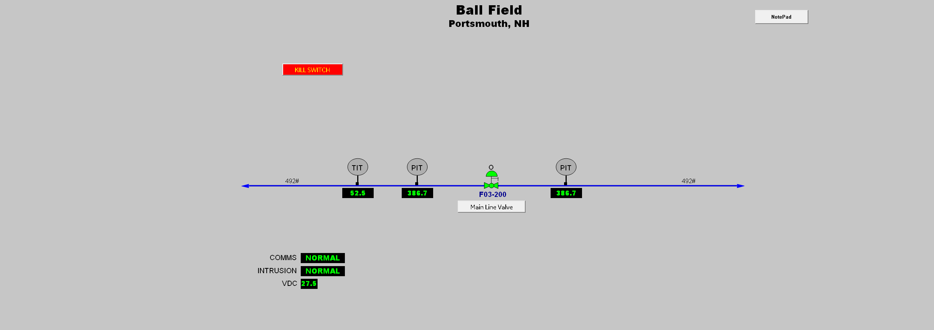
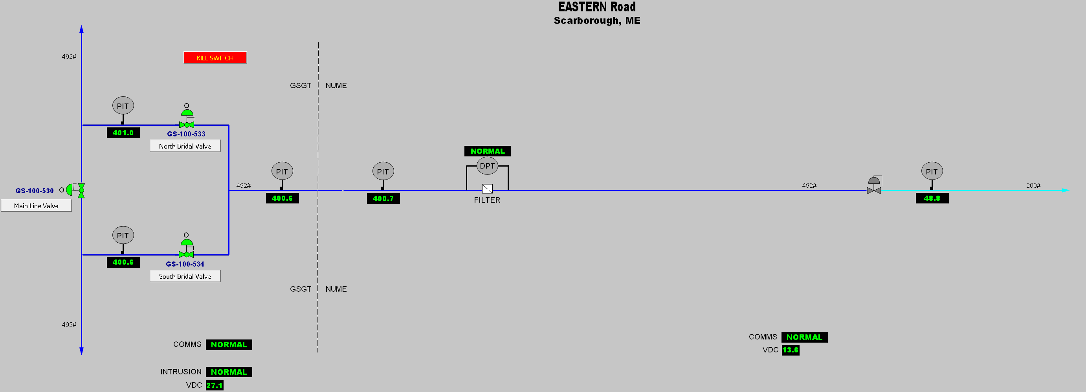
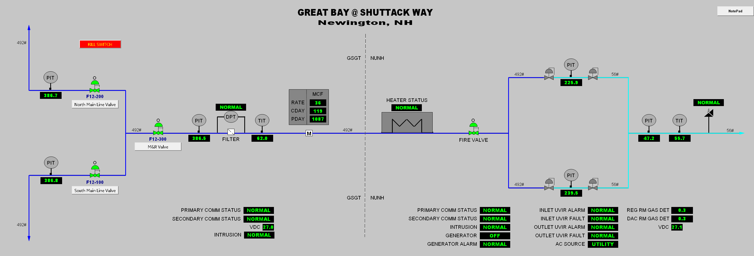

Slide 25
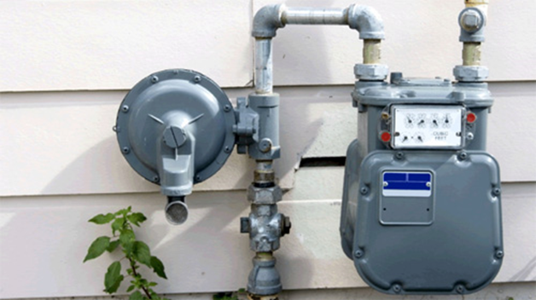
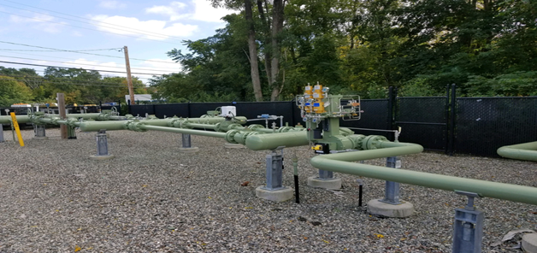
Downstream System and Service OPP Technology
Cast Iron/Bare Steel Replacement Programs
  NH Complete, ME- 2024, MA – 2035
  Elimination of the Majority of the Low Pressure Systems
  Excess Flow Valves
  Service regulators on IP systems
Relocate meters from inside to outside
Evaluating End User Piping Protection Devices (Over-Pressure Shut Offs (“OPSO”) on Risers)

Slide 26
QUESTIONS?

