Slide 1
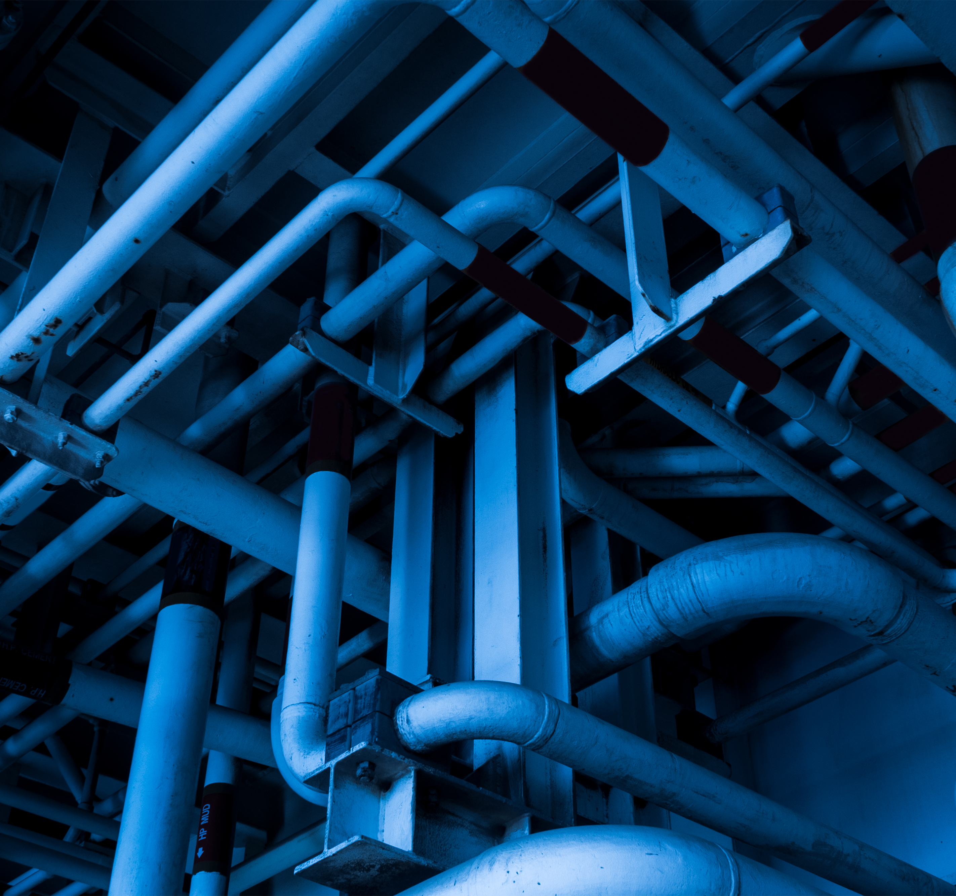
Energy Policy In The Northeast
Gas Operations School
June 2026
Christian Rodrick
Director of Public Affairs & Industry Engagement
Northeast Gas Association
Notes:
Good morning.
My name is Christian Rodrick
Director of Public Affairs and industry engagement for NGA – been here for nearly 3 years
Prior to NGA I worked in Washington, D.C. Most recently as a public affairs consultant working for energy companies and associations.
Before that I worked at the United States EPA as the director of congressional affairs. I also worked for a couple for years in the United States Congress.
Today, we’re going to talk about energy policy in the Northeast
Show of hands – who regularly works on policy issues?

Slide 2
The Plan for Today’s Presentation
Intro to the Northeast Natural Gas System
The Natural Gas Success Story
The Policy Pressures Impacting the Natural Gas Industry
What this means for you?
Notes:
I know some of this will have been covered already in past sessions within this track, so bear with me.

Slide 3
System Dynamics in the Northeast
Northeast Nature Gas Infrastructure,
Supply, and Demand
Notes:
First lets set the table with the current supply and demand dynamics in the Northeast.

Slide 4
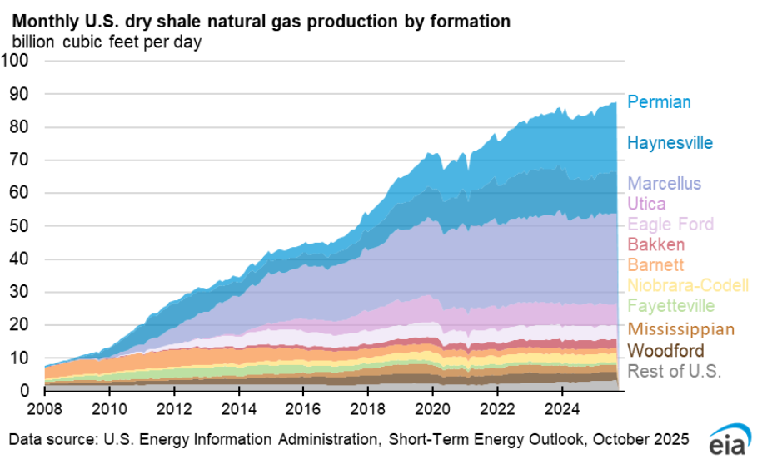
Shale Production Growth
Notes:
Lets start w Natural gas production.
The Appalachian region is the largest natural gas production area in the United States, and the Marcellus Shale basin is the largest source of that regional production. Relatively new, but rapidly exploded in production. Technological advances such as horizontal drilling paired with hydraulic fracturing have allowed energy companies to unlock the energy resources from the Marcellus Shale, while protecting drinking water sources and the environment.
… this is production by the way. The 400-million-year-old rock contains approximately 410 trillion cubic feet of shale gas and could supply U.S. consumers' energy needs for hundreds of years, according to the U.S. Energy Information Administration.

Slide 5
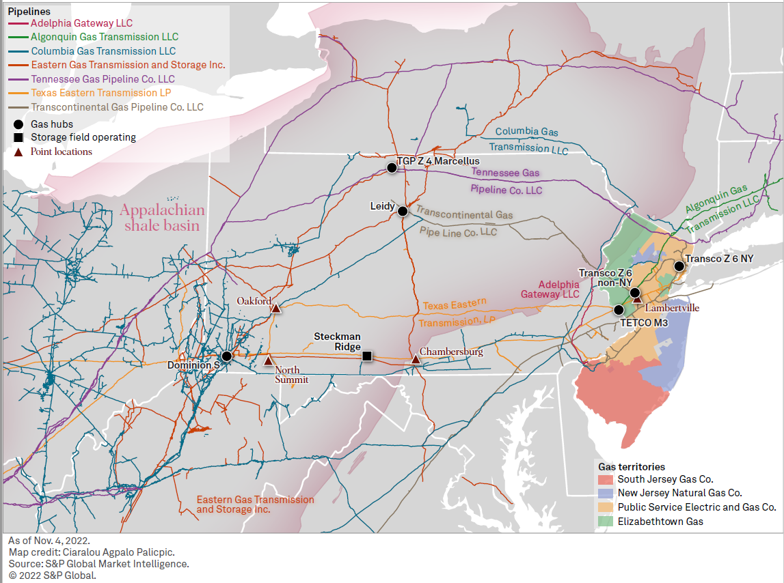
New Jersey, Pennsylvania & New York Regional Map
Notes:
It’s an extensive and vast network. Traditionally we’ve imported gas from Western Canada and the Gulf of Mexico, but Marcellus Shale changed that dynamic.

Slide 6
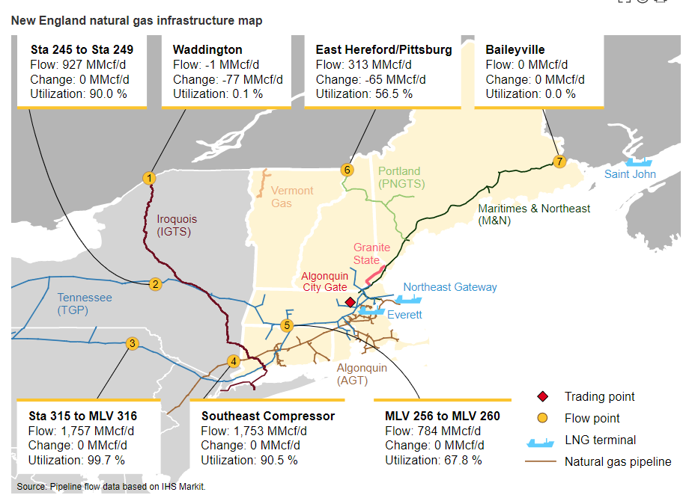
New York & New England Regional Map
Notes:
So here in the Northeast, we’ve got all this transmission infrastructure, and we’ve got all this accessible gas. Yet only a couple hundred miles away there is a world of difference in the amount of infrastructure, and as a result, the price.
New England is the end of the line
Pipeline constraints have resulted in higher prices in New York and New England, but lower prices in producing regions. Fern 17x talking point
These pipeline constraints have also forced the region to Rely on LNG to meet peak demand and for storage

Slide 7
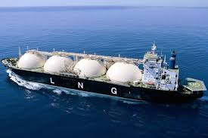
U.S. LNG Imports
LNG imports can be a key marginal source of supply during times of high demand. On peak demand days, imported LNG can contribute up to 35% of New England’s natural gas supply.
-U.S. EIA
Notes:
LNG imports can be a key marginal source of supply during times of high demand. On peak demand days, imported LNG can contribute up to 35% of New England’s natural gas supply. Almost all U.S. LNG imports are delivered into the New England market at import terminals in the Boston, Massachusetts, area—Constellation Energy’s Everett LNG Facility in Boston Harbor and Excelerate Energy’s Northeast Gateway in Massachusetts Bay.
Also highly reliant on imported LNG through Repsol’s St. John terminal in St. John Canada.
Quick moment on Exports:
With the increase in the shale production but constrained Northeast pipeline, producers and transmission companies began reversing the flow down to the south for shipments of LNG to the rest of the world.
The U.S. only began exporting natural gas from the lower 48 states in 2016, when the first LNG export terminal came online, and since then exports have exploded.
In 2022 the U.S. became the world’s largest exporter.
This is important for New England and I think often misunderstood – that if gas prices are higher here, then why are we shipping them to other countries?
touch on the Jones Act and how LNG from US terminals cannot be shipped to the Everett terminal in MA thus we have to pay global pricing
impacted by Jones Act. Passed in 1920, the Jones Act restricts domestic shipping to vessels that are U.S.-flagged, built, owned, and crewed. But such ships are significantly more costly to build and operate than their international counterparts. There are no U.S. LNG ships.

Slide 8
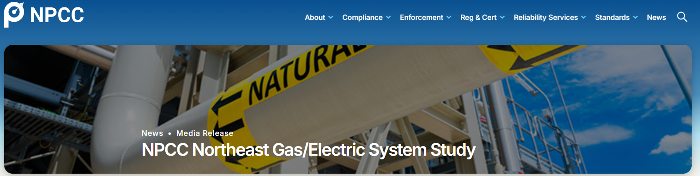
“..For high frequency and/or long duration constraints, one of the most economic mitigation measures, in lieu of adding backup fuel capability, may be the installation of additional pipeline capability…”
Notes:
Everyone familiar with the Northeast power Coordinating Council?
Study came out in January 2025 examining system
NGA was a steering committee member on this study

Slide 9
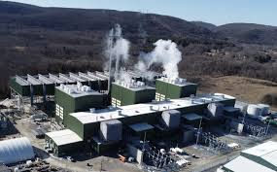

So, what is the end use of all this infrastructure?
Notes:
So we’ve talked about the region from the production and infrastructure side… what is happening with all this energy?
Cricket Valley Energy Center, Dover New York (Began operations April 2020)
And Bobby Flay.

Slide 10
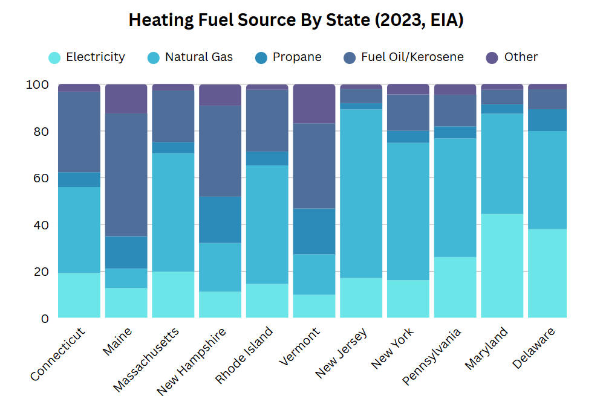
The Northeast Gas Heating Market
Notes:
within The eleven-state region more than 13 million residential natural gas customers, more than 17% of the U.S. total of 72 million. Additionally, the Northeast has more than 1.2 million commercial natural gas customers and more than 32,000 industrial customers. Respectively, these numbers represent 21 percent and 18 percent of the U.S. total.
In many parts of our region, natural gas is the dominant fuel for home heating. In New York and New Jersey, more than 58% and 72% of homes are heated by gas, respectively.
That said, as we move into the northern parts of New England, due to insufficient gas infrastructure and supply, that number drops significantly, with homes relying more on oil/ propane, or other fuels like wood for home heating. in New Hampshire, 20% of homes heat with natural gas, compared to nearly 40% of homes that heat with oil.

Slide 11
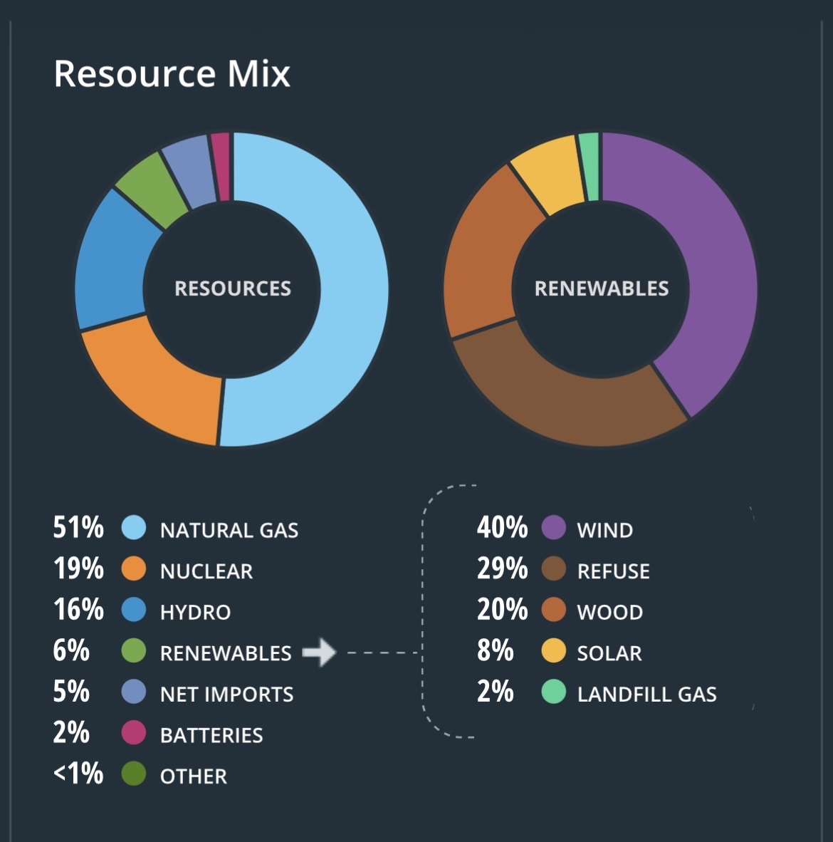
The Northeast Electric Market
New England Electric Generation by Fuel Source, 2023
Natural Gas: 55%
Nuclear: 23%
Renewables: 12%
  Wind: 4%
  Refuse: 3%
  Wood: 2%
  Solar 4%
  Landfill Gas: 0.45%
Hydro: 10%
Other: 5%
Oil: 0.32%
Coal: 0.2%
ISO-NE Resource Mix, June 3, 2026, 7:00PM
Notes:
ISO-NE and NYISO are the most natural gas dependent RTO/ISOs [in the U.S.] with over 50% of their respective electricity generation output forecast tied to natural gas-fired power plants.
With the proliferation of distributed energy resources like wind and solar, we need increasing amounts of dispatchable, baseload generation. The only technology that exists in most Northeast states are quick start gas or oil generators.

Slide 12
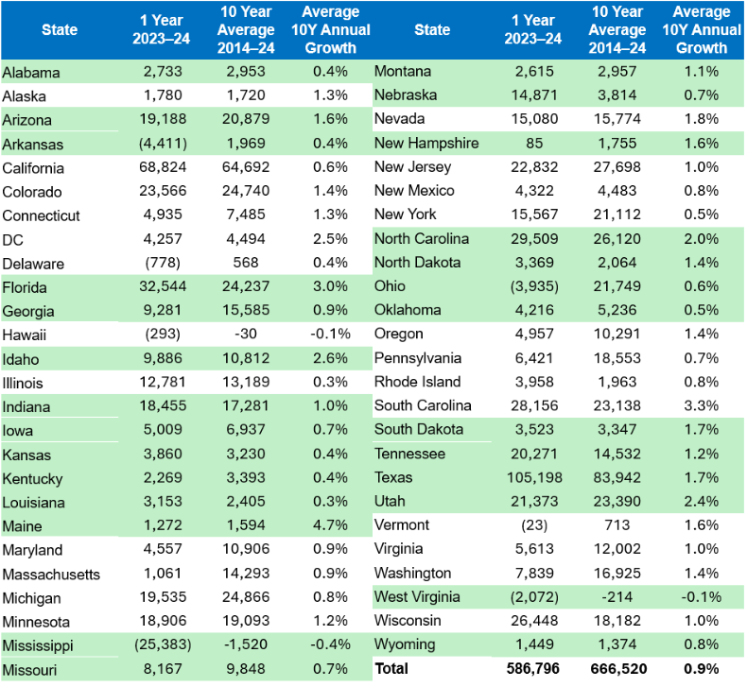
Gas Customer Growth
Notes:
I know you can’t read this. But these slides will be published later. So. The point of this slide is to show that, both nationally, and even here in the Northeast Gas LDCs are still adding customers.

Slide 13
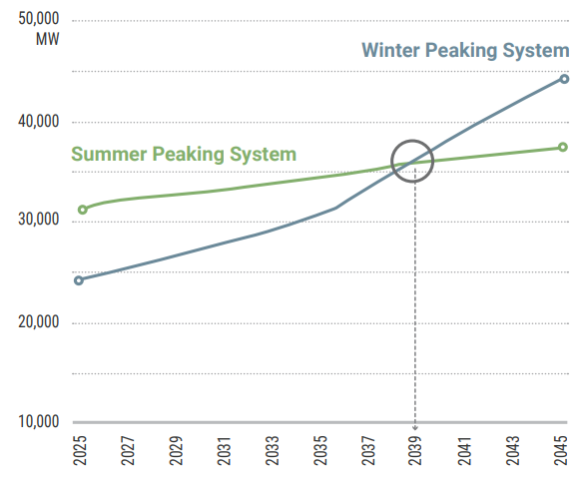
Energy Growth
“Demand Growth is now higher than at any point in the past two decades.”
NERC 2024 Long-Term Reliability Assessment
NY-ISO 2025 Power Trends –
Summer and Winter Peak Demand Forecasts
Notes:
Are we really going to meet this without gas infrastructure?
Initially this growth is based on large load – think AI and Data centers – not electrification.. so even if all these electrify everything plans fall through – they will still be growing.
And should we really be electrifying home heating with these projections?
By the way, as a quick aside, according to EIA more than 60% of energy used in generation is lost in conversion – so until we have a totally clean grid, shifting to electrification isn’t even efficient.
Further, The U.S. Energy Information Administration (EIA) estimates that annual electricity transmission and distribution (T&D) losses averaged about 5% of the electricity transmitted and distributed in the United States in 2018 through 2022.
Its more environmentally friendly to heat or cook with gas at your house, rather than with electricity generated at some power plant.

Slide 14
The Success Story
Emissions, Affordability, Reliability
Notes:
3 key things I want to touch on.

Slide 15
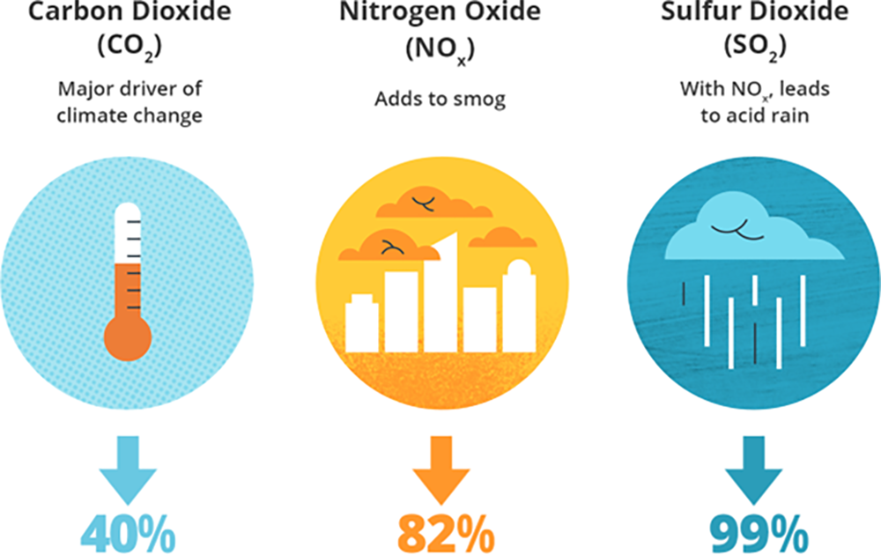
New England Generator Emissions – 2001 vs 2023
“The biggest contributor has been the region’s shift to lower-emitting, highly efficient natural-gas-fired generation.”
-ISO-New England
Notes:
Despite what is often the narrative about natural gas today, for New England, Natural Gas has been a major climate success story. The above data from ISO-NE shows a remarkable story of emissions reductions.
Its worth noting, that these reductions aren’t only a climate success story, but an environmental success story more broadly. Fewer emissions means cleaner air for our communities to breath.
According to ISO-NE, the biggest driver of this success? Natural gas.
However, several factors—including increasing oil-fired generation during winter cold snaps due to natural gas pipeline constraints and the retirement of nuclear generation—have slowed the declines or led to increases in some recent years.

Slide 16
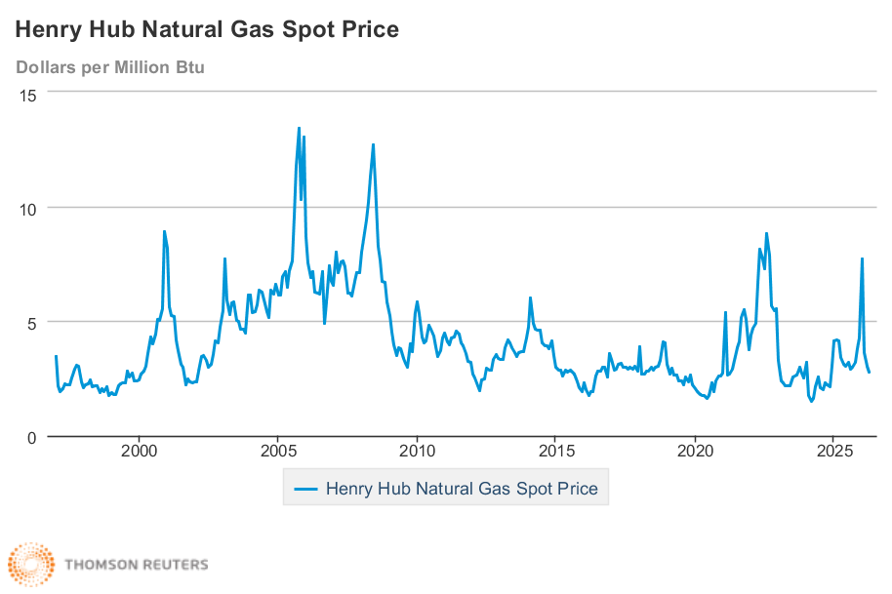
Data Source: Thomson Reuters https://www.eia.gov/dnav/ng/hist/rngwhhdm.htm
Notes:
The graph you see here represents Henry Hub natural gas Spot prices in dollars per million BTU.
As you can see – prices are LOW.
NOTE: The Henry Hub is a distribution hub on the natural gas pipeline system in Erath, Louisiana. Due to its importance, it lends its name to the pricing point for natural gas futures contracts traded on the New York Mercantile Exchange (NYMEX) and the OTC swaps traded on Intercontinental Exchange (ICE).
HOWEVER:
FERC: "Because the [New England] region's supplying pipeline capacity is somewhat limited, consumers of natural gas tend to compete for supply when demand induced by cold weather soars. Due to the high winter demand and limited pipeline capacity, winter natural gas prices often peak during the coldest days of the year.“
In fact New England prices frequently track more closely with Europe than mid-Atlantic. Talked about the Jones Act earlier, which is part of the reason for that

Slide 17
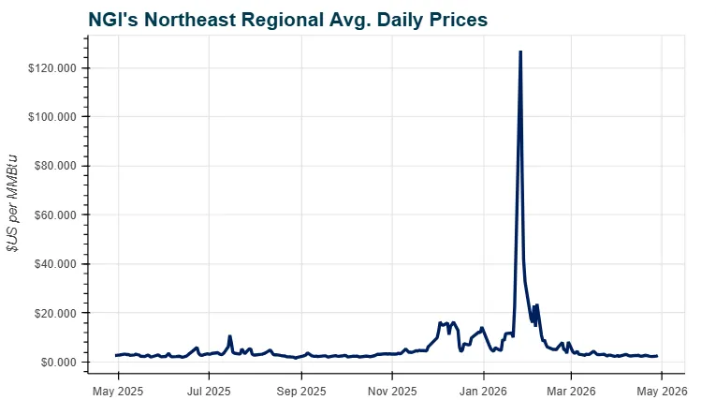
Natural Gas Prices (Northeast)
Notes:
HOWEVER:
As you can see, the Northeast is much more susceptible to generally higher prices, and to price spikes. When you limit our infrastructure, you can often pay the price.
The spike you see one the screen was during the cold snap this winter.
Worth noting: the price of natural gas is not the price that the consumer pays on their utility bill, and a number of other factors contribute to that.

Slide 18
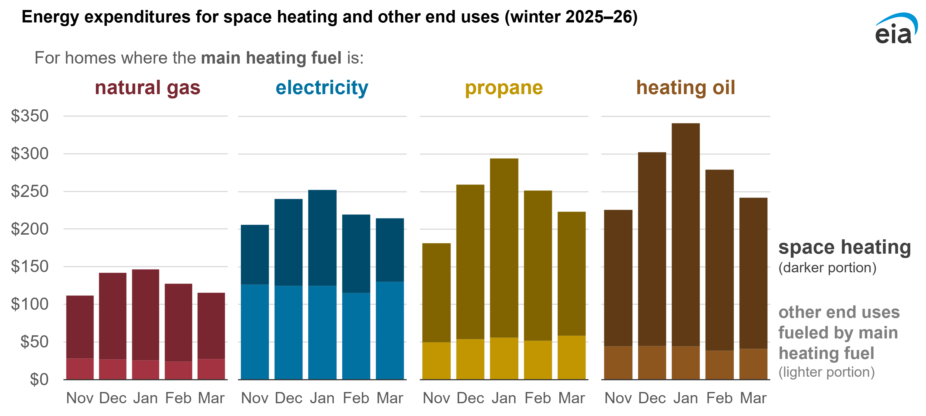
Natural Gas: Affordable Home Heating
Notes:
HOWEVER:
The chart you see above is from EIA… this is national, but, despite the high prices New England, natural gas still tends to be the most affordable fuel for heating.

Slide 19
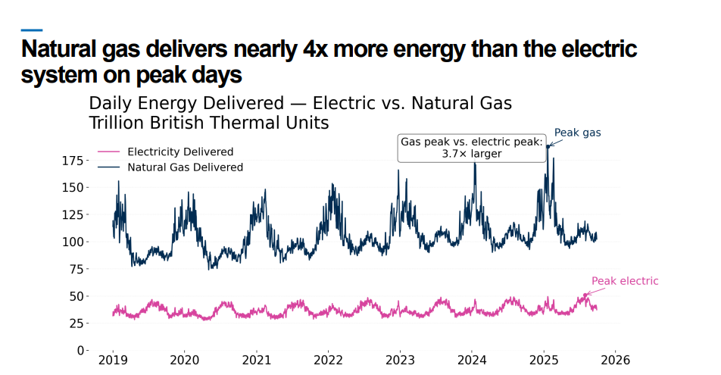
Reliability - Meeting Peak Demand
Source: AGA Winter Heating Outlook
Notes:
So much gas. Near perfect reliability. Gas almost never runs out. Successfully meeting crazy demand
The natural gas system set a record for total daily domestic demand of 162.0 Bcf on 1/16/2024. This was a significant increase over the record previously set on 12/24/2022 when total daily demand reached 158.4 Bcf.
• Domestic demand only includes power generation, residential, commercial, and industrial end users. Additional natural gas demand for feedgas for liquefied natural gas exports and pipeline exports to Mexico were not included.
During the hottest day in the summer when cooling demand will be at its highest, the electric grid set a record of 14,843 GWh in total sales compared to last year’s record of 14,769 GWh. Approximately 45% of electricity supplied on 7/15/2024 was from natural gas power generation.
Converting the two sources of energy to total daily GWh, the record demand day for gas was 49,182 GWh compared to 14,843 GWh for electricity. This demonstrates that the gas distribution system on the coldest days can supply 3.3 times as much energy per 24-hour period as the electric grid on the hottest days. Residential and commercial users accounted for 44% of natural gas delivered on 1/16/2024 or 1.5 times as much energy as the electric grid supplied during the peak summer day.
“NERC has long stated that natural gas is essential to the reliability of the grid during the electricity industry’s unprecedented transformation.”
-North American Electric Reliability Council
9/6/2024

Slide 20
What is the policy landscape today?
Federal and State Divide
Affordability policy
Utility Scrutiny
The Energy “transition” and who pays?
Notes:
So with that background, lets dive into the policy landscape.
First, I am going to quick touch on the Trump Administration and Washington
Then we will look at the northeast states at a high level.
After that we are going to broadly look at some of the issues and concepts really animating the policy debates in the region, including that “Affordability” buzzword, the future of gas, utility scrutiny, and the “energy transition” and who pays for it.

Slide 21
Where are policymakers focused?
Affordability
Reliability
Environment
Notes:
AS we dive into some of policy debates taking place I want you to be thoughtful about this triangle.
Today, these three forces are the defining points impacting energy policy – federally and in the Northeast.
Everyone agrees. We all want affordable energy. We all want reliability. We all want a clean environment. (and please, please remember, the environment is more than just climate change.)
The challenge is… policy debates today are increasingly pitting one against the other.
So… which one do you think policymakers in your state CARE about the most?
Which do they TALK the most about? Is it the same?
Which one do YOU worry about the most in your job?

Slide 22
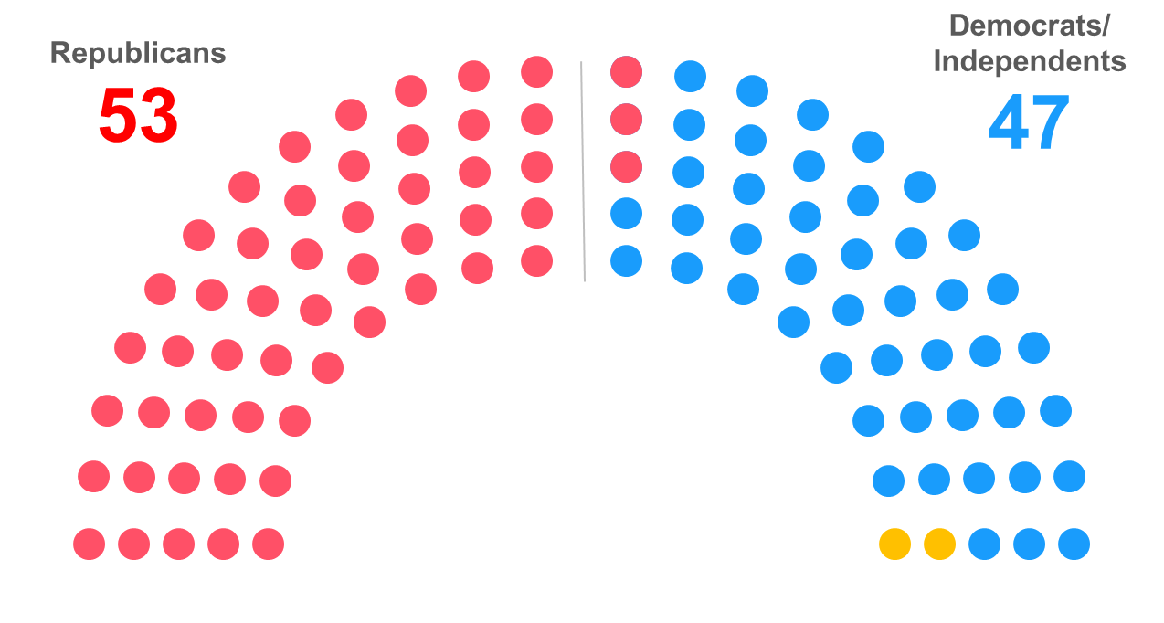

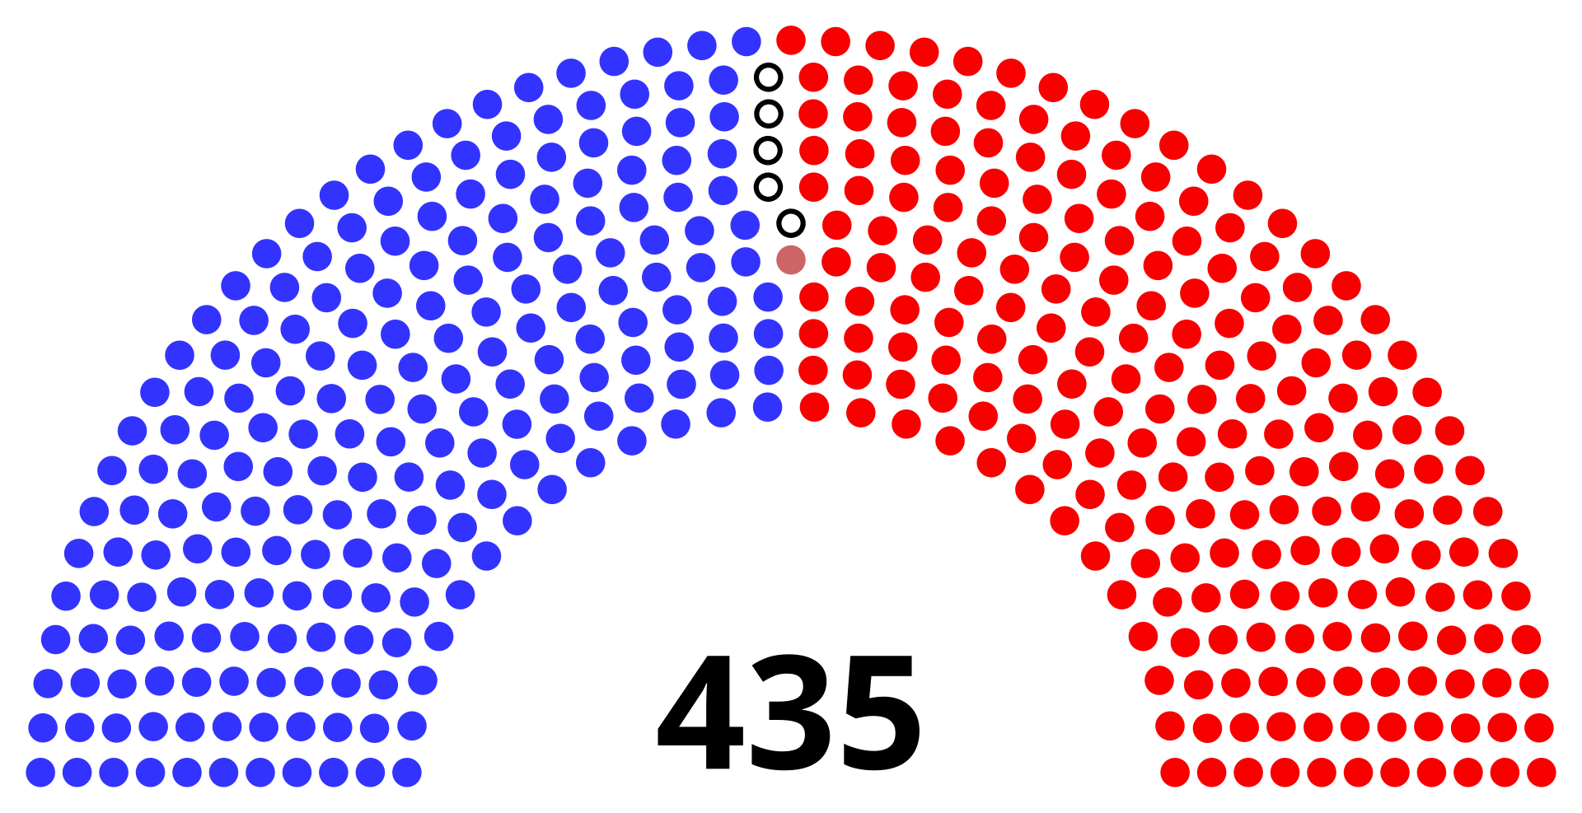
What’s Going on in Washington, DC?
Notes:
So lets look at Washington
President Trump is the President… That is basically the only story that matters in Washington, D.C. in terms of policymaking right now.
Trump is also unique in the ways he goes about trying to achieve his policy goals… I know. Shocker, right?
But, to explain what I mean by this, look at the Constitution pipeline situation.. Most presidents try and create a regulatory atmosphere that supports their goals and hinders things they don’t want. Look at Obama using the EPA and the clean air act to create a regulatory environment that specifically targets the coal industry or Biden creating a positive environment for offshore wind.
Trump on the other hand just tries to revive a specific project he is interested in and goes and meets with governors on that specific project.
That’s not to say that no president has ever put their thumb on the scale of a specific project. But this is the way trump operates.
Wind:
I would be remiss if I didn’t at least mention that President Trump is doing A LOT to make sure offshore wind does not get built. This is important here in the Northeast, where a lot of our green energy targets are tied to developing a lot of offshore wind.
Emerging technologies like Hydrogen
Less funding go out the door.
Cap hill is trying, but not doing much
Nick Langworthy Energy Choice Bill
Interest in Energy reliability… permitting reform…
But. How do you get there? How do you agree? What do you trade?

Slide 23
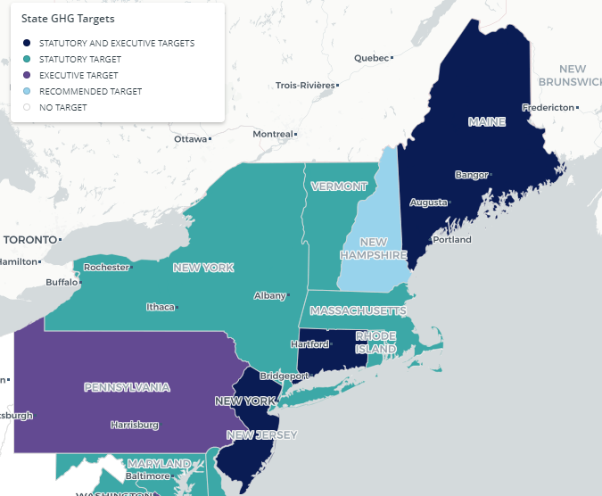
State Climate Goals
All states in the region, except for New Hampshire, have adopted formal economy-wide Net Zero targets that were established through legislation or executive declaration.
Notes:
“One of the most important things to understand about the Northeast energy landscape is that almost every state in our region now has formal climate or emissions reduction goals.”
“Those goals vary in aggressiveness, vary in enforceability, and vary politically — but they are fundamentally shaping the policy conversation, and therefore how utilities operate within each state.”
Important Point #1 — NOT ALL GOALS ARE THE SAME
This is a critical nuance.
“Some states have extremely aggressive statutory mandates. Others have more aspirational executive goals. Some are actively debating whether those goals are achievable or affordable.”
New York and Massachusetts → among the most aggressive – though New York currently reconsidering some of theirs
Pennsylvania → less stringent / executive-oriented
New Jersey → ambitious goals, but political winds are changing
“And one distinction that really matters — especially for utilities — is whether these goals were created by legislation or by executive action.”
If Legislative:
“When goals are written into law by the legislature, utilities and regulators are often legally obligated to work toward them.”
Examples:
CLCPA in New York
Massachusetts climate statutes
Rhode Island Act on Climate
“That creates long-term legal and regulatory pressure that survives changes in governors or administrations.”
If Executive Action:
“Executive actions can still be very influential — but they’re generally easier for future administrations to revise, reinterpret, or reverse.”
“That creates a very different level of certainty and legal exposure for utilities.”

Slide 24





Future of Gas Proceedings
Notes:
When you think about how regulators are implanting these climate goals, ne of the most significant developments in Northeast energy policy over the last several years has been the emergence of so-called 'Future of Gas' proceedings. At a high level, these are regulatory proceedings, where regulators are asking a pretty fundamental question: What role should natural gas utilities play in states’ future energy make up?
Massachusetts
Massachusetts is probably the furthest down this path.
After several years of debate, the DPU issued Order 20-80 a couple of years ago. 20-80 fundamentally changes how gas utilities approach long-term planning.
The order places a strong emphasis on electrification over new gas customers or over replacing older pipe, requires utilities to file climate compliance plans, and creates additional hurdles for traditional gas infrastructure investments.
They acknowledged that in some cases – this would raise costs, including for low income folks.
DPU has also targeted the 100 foot rule and the GSEP
Explain 100 foot rule
Explain mass GSEP
These are very important, fundamental pieces of what we do and how utilities make money.
New York
New York is asking many of the same questions of gas LDCs.
"The state continues to evaluate long-term gas planning, infrastructure investments, customer growth policies, and how utilities align with the Climate Leadership and Community Protection Act.
Issues like the proposed changes to the 100-foot rule are part of a much broader conversation about the future shape of the gas system.
New Jersey / Rhode Island / Maine
New Jersey, Rhode Island, and Maine have all launched similar efforts.
The details differ from state to state, but the underlying question remains the same: How do utilities function while states pursue emissions reduction goals – in some cases with their eyes on – theoretically – not using gas at some point in the future.
And whether you're in engineering, operations, planning, customer service, or public affairs, those decisions will eventually impact how your company operates.
For most of the last century, utilities planned around growing demand. Increasingly, they're being asked to plan around managing decline – despite the fact that, as we discussed earlier, they’re still adding customers. That's a fundamentally different challenge.

Slide 25
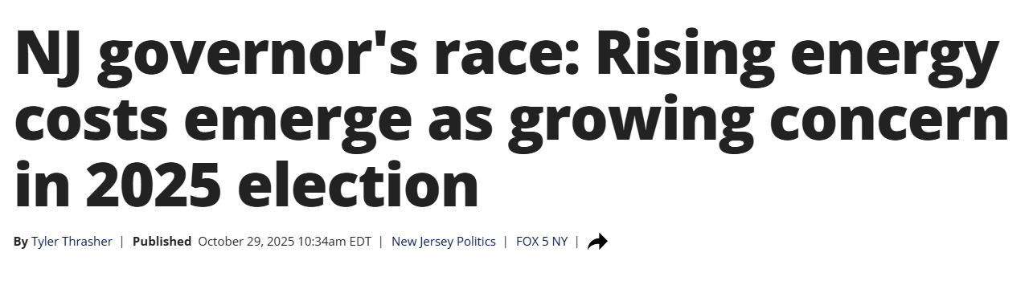
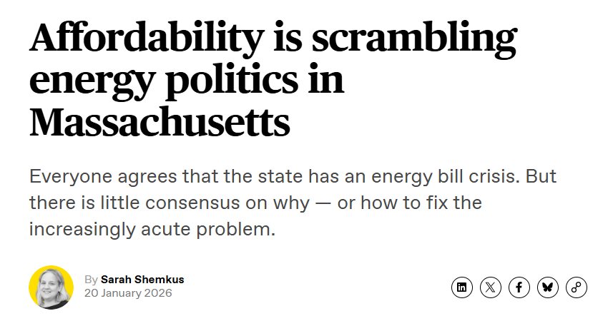
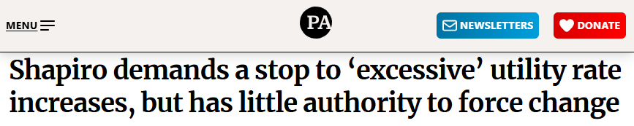
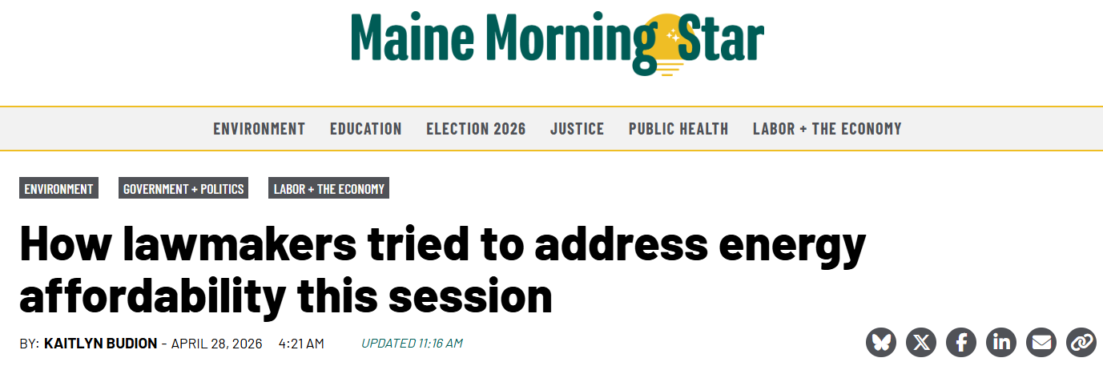
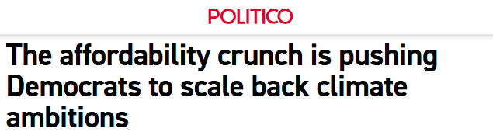
Affordability
Notes:
"Over the last year or two, affordability has become the dominant energy policy issue in the Northeast."
"Not reliability. Not decarbonization. Not even emissions."
"Affordability."
"How many of you have seen energy bills become a political issue in your state?"
Of course. All of us have.
"Energy is unique because almost every resident and every business gets a bill every month."
"Most people don't know what the wholesale gas price is. They don't know what a capacity market is. They don't know what the CLCPA is."
"But they know exactly what their bill says."
And increasingly…Customers vote on energy bills.
Massachusetts
"Last winter, bill increases became a major political issue."
"The state ultimately ordered bill credits and deferred certain charges."
"The bills got smaller, but the underlying costs didn't disappear."
New Jersey
"Affordability became a central issue during the gubernatorial campaign."
"Candidates from both parties spent significant time talking about energy costs."
Mikie Sherrill clearly did a more effective job of it. She promised rate freezes and that became a major point for her campaign.
New York
New York is an interesting example, because they’re really at a crossroads…
On one end, in the budget they just seriously rolled back climate goals…
On the other end, we see things that are long standing climate advocacy goals being reframed as affordability bills.
" policies like the NY HEAT Act are increasingly being framed through an affordability lens.“ They aren’t. But that is now how they’re being pitched
"The challenge is that affordability means different things to different people."
Politician affordability
Monthly bill
Utility affordability
Long-term system cost
Customer affordability
What they pay today and tomorrow
Regulator affordability
Balancing all of the above
Bring Back Future of Gas
"Remember when we talked about the Future of Gas proceedings?"
"One of the debates happening in both Massachusetts and New York is whether policies that historically encouraged new gas customers should continue."
"Supporters argue those changes support climate goals."
"Critics argue they make it more difficult and more expensive for new customers to access natural gas service – which is historically the most affordable way to heat a home.
These things also make it more expensive for everyone else. As fewer people are on the system, or fewer people get added, it means those that don’t transition will spend more money…
"And when bills go up, regardless of why they went up, somebody gets blamed."
"Increasingly, that somebody is the utility."

Slide 26
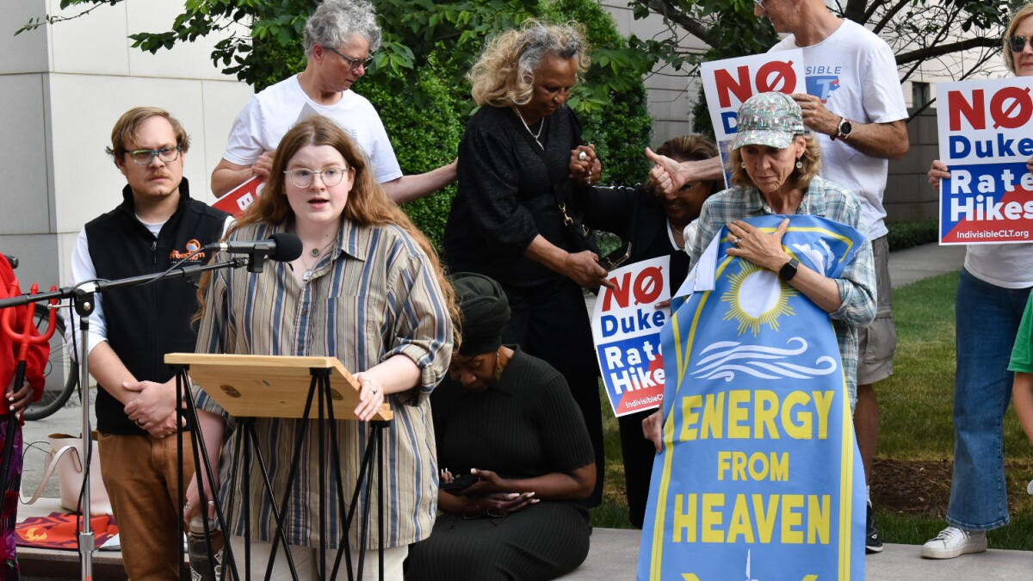
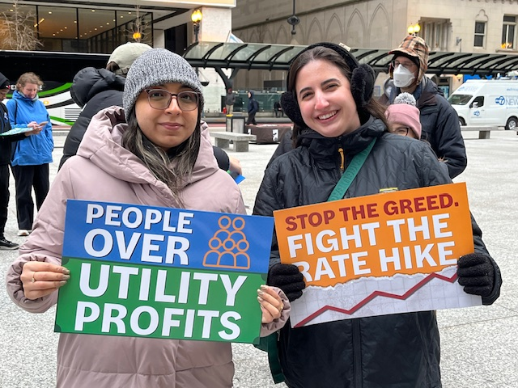
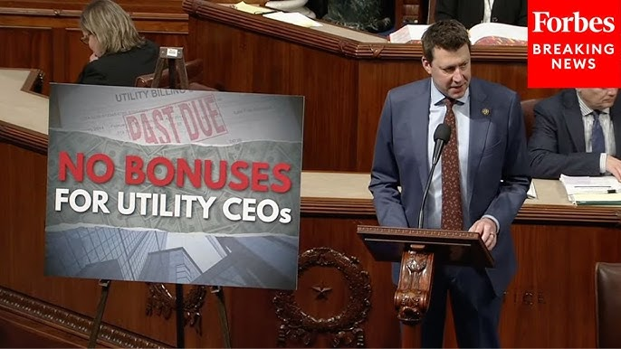
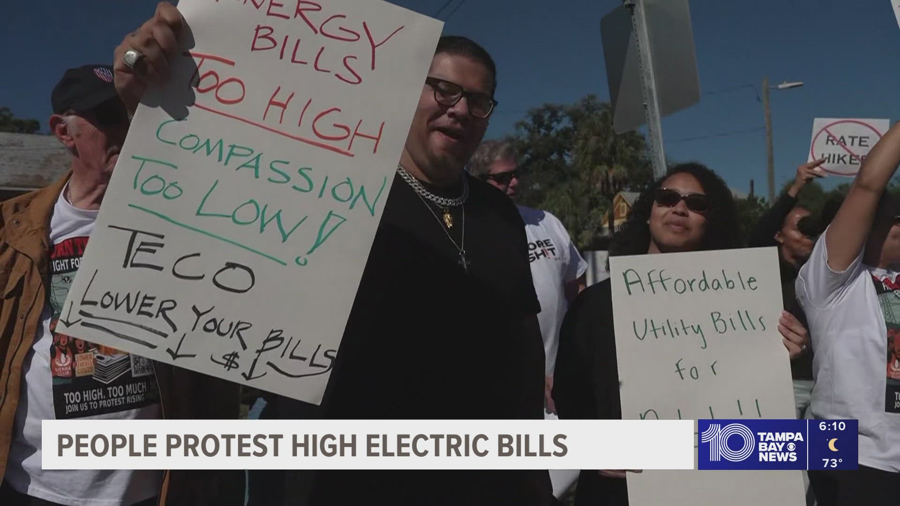
Scrutiny of Utilities
Notes:
I suspect this is an issue you all feel personally.
“Utilities used to largely operate in the background. That’s changing.”
“As energy bills rise and climate policy intensifies, utilities are increasingly becoming easy political targets.”
Then examples:
CEO pay scrutiny
profits scrutiny
infrastructure investment criticism
rate case backlash
even scrutiny of safety/training spending
NGA feels this personally… legislation has targeted your company’s membership in our organization.
“Customers don’t always distinguish between commodity prices, public policy costs, and utility delivery costs. They just see the bill.”
At the same time…
“Utilities are increasingly expected to deliver affordability, reliability, decarbonization, resiliency, workforce development, and equity — all simultaneously.”
Its worth exploring this a little more… why are utilities such easy targets for policymakers? We’re highly regulated. We have to get every dollar we spend and every cent of profit we earned approved by regulators, who are appointed by elected officials. Why are those elected officials targeting us?
Picture: Josh Riley from NY

Slide 27
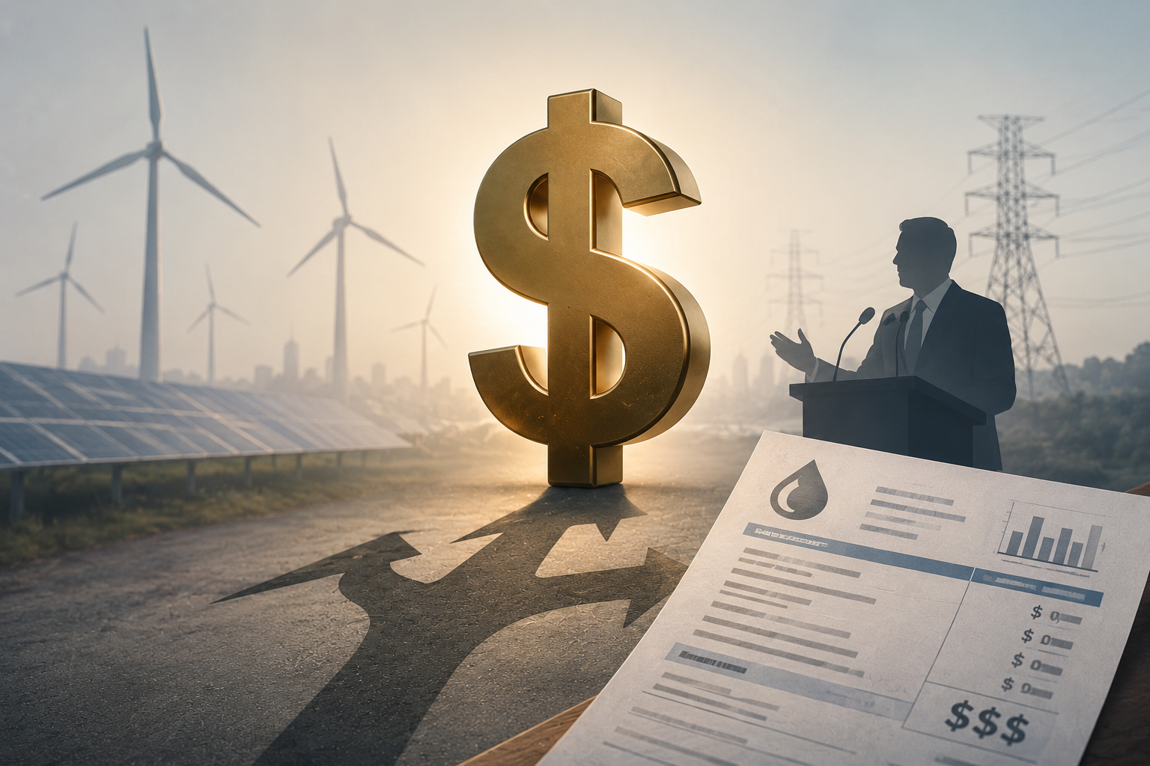
The “Energy Transition” and who pays?
Notes:
PART 1 — The easy part
“In the Northeast - Setting climate goals is politically popular.” you’ll get fundraising from the Sierra Club and other environmental NGOs. People will like that.
PART 2 — The hard part
“Paying for the transition is where things become difficult.”
Climate superfund
moving costs off utility bills
state financing concepts
affordability backlash
Everybody supports the energy transition in theory… they just don’t think they should be the one to pay for it…
And by the way – these questions have huge implications for financing…
I sit on the Massachusetts Financing the Transition Working Group…
PART 3 — Financing reality
This is where your presentation becomes VERY smart.
Talk about:
long asset lives
financing assumptions
investor certainty
future customer uncertainty
VERY STRONG LINE
“Infrastructure financing depends on long-term certainty. But many current policy debates are creating long-term uncertainty.”
That’s excellent.

Slide 28
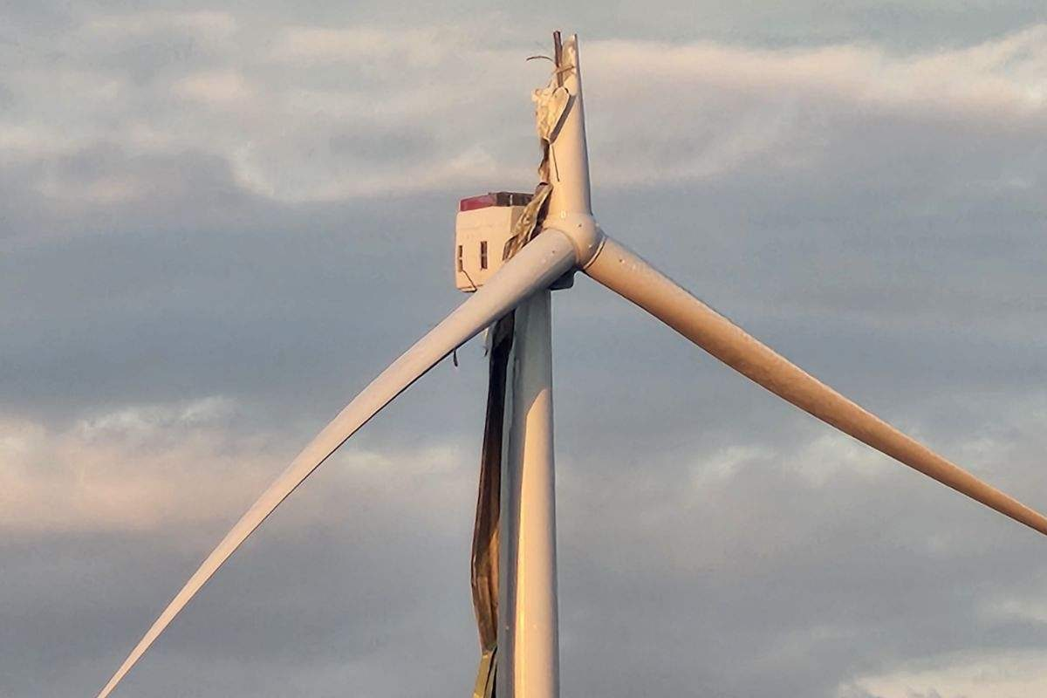
Decarbonization Reality Check
Notes:
So given all of this…
“The Northeast has some of the most aggressive climate goals in the country.”
“But the pathway to achieving them is getting increasingly complicated and increasingly policy dependent.
Examples:
Offshore wind
once centerpiece of transition
now facing federal hostility + cost pressures
Hydrogen
massive excitement 2 years ago
momentum has cooled significantly
Electrification
raises major grid questions
Load growth
AI/data centers changing forecasts
“The challenge isn’t setting goals. The challenge is building systems that can actually achieve them reliably and affordably.”
“Policy ambition and infrastructure reality are not always moving at the same speed.”
.

Slide 29
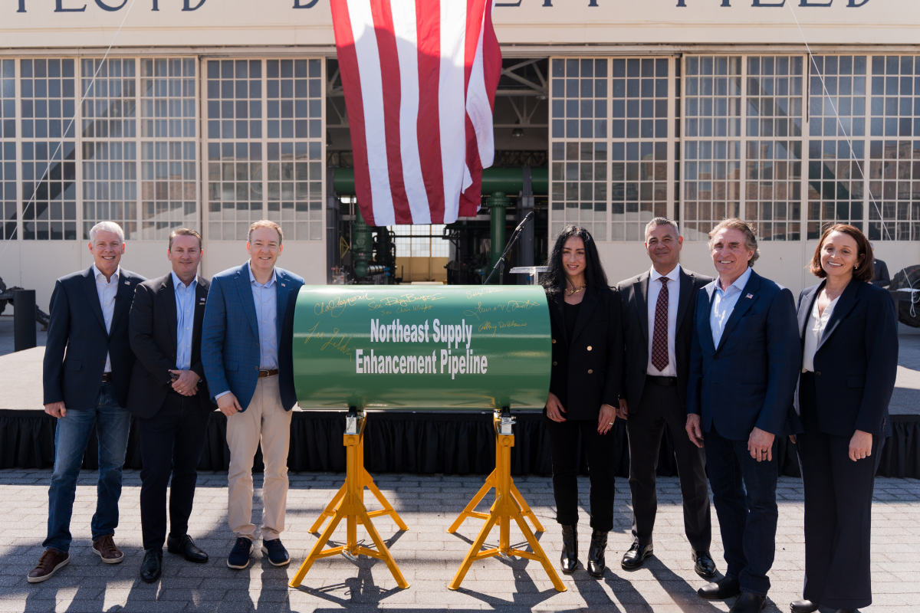
How is the Perspective on Infrastructure Shifting?
Notes:
"For years, the conversation in the Northeast was largely about stopping infrastructure. Increasingly, the conversation is becoming whether we can meet reliability, affordability, and climate goals without building infrastructure.
NESE just broke Ground
Constitution…
Enbridge has Project Beacon and Algonquin Reliability…
Iroquois has EXC…
As electoral politics comes face to face with pricing reality the conversation may be shifting…

Slide 30
What does this all mean for you?
How do we do our job in this landscape?
Notes:
So given the current importance of natural gas to our region, and the current political status, what does the future really look like?

Slide 31
Why should you care?
1. Your job is getting harder
2. The system still depends on you
3. The narrative doesn’t always match reality
4. You are credible messengers
5. The future of our industry can and will be impacting significantly by policy choices being made today
Notes:
5 Points:
1. Your job is getting harder
More scrutiny
More regulation
More expectations
2. The system still depends on you
Winter reliability
Emergency response
Safety
3. The narrative doesn’t always match reality
You’ll hear things that don’t align with what you see
4. You are credible messengers
Local, trusted, real-world experience
5.Future of our industry can and is being dramatically impacted. Insuccifient investment today is a nightmare for the future.

Slide 32
Are we serious about these goals?
Affordability
Reliability
Environment
Notes:
“If we’re serious about affordability, reliability, and emissions — we need solutions that actually work in the real world.”
The future of this industry isn't going to be determined by geology. We have the gas.
It's not going to be determined by engineering. We know how to build and operate these systems safely and reliably.
Increasingly, it's going to be determined by policy choices.
And that's why understanding this landscape matters.
“You can debate policy all day long.
But when it’s 10 degrees in January —
none of that matters if the system doesn’t work.”

Slide 33

So what
Notes:
I believe today, natural gas is absolutely essential for the Northeast’s Energy landscape. I believe that is not going to change anytime soon. I hope you agree.

Slide 34


