Slide 1

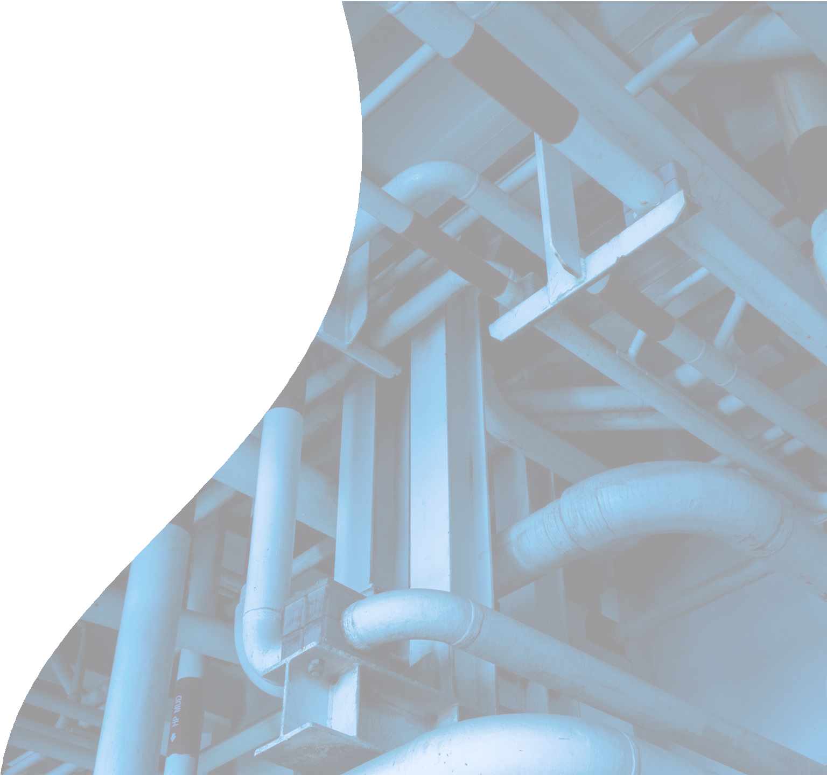
Emergency Management: Planning and Response
June 4, 2026
Glenn Meyers
Director of Operations, NGA

Slide 2
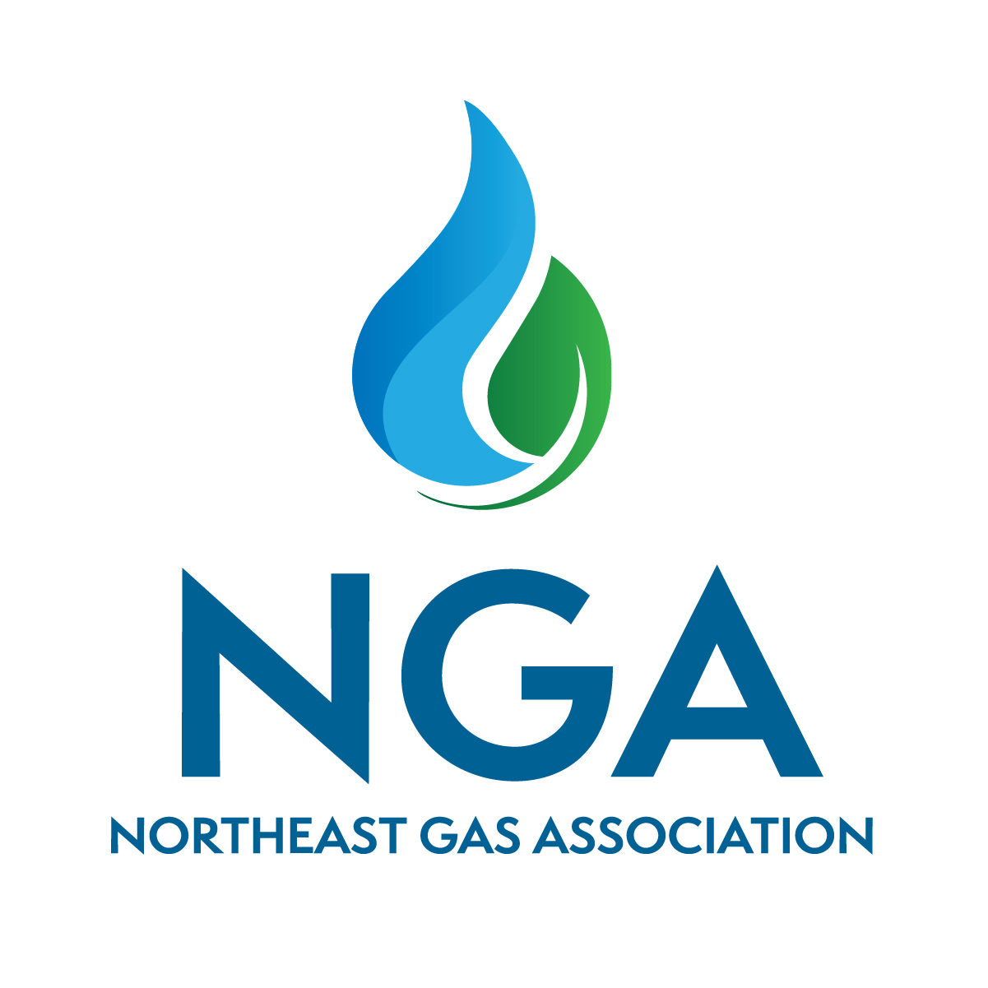
Agenda
Why is Emergency Planning Important?
Who Cares?
Risks
Risk Mitigation
System and Business Impacts
Emergency Planning and Response
Closing and Q&A

Slide 3
Why is Emergency Planning Important?
A robust gas emergency plan is essential because there are many risks and a single failure can rapidly escalate into a public safety crisis, widespread business disruption, major financial losses, and long-term damage to public trust and utility reputation.
“When people ask what I do for living, I tell them I manage risk.”
– Operations Manager
“You are only as good as you last major event.”
– Investor Relations Executive

Slide 4
Who Cares?
Regulators - Federal (e.g., PHMSA, EPA, OSHA), State (e.g., DPS)
Public and communities
Customers
Employees and unions
Local governments and emergency responders
Insurers
Shareholders / investors
Environmental groups

Slide 5
Risks
3rd Party damages
Weak or incomplete integrity management plans
Aging infrastructure
Supply disruptions and power generation impacts
Inadequate training
Earthquakes, floods, wildfires, extreme cold
Interdependency/coordination with electric
Physical and cyber sabotage

Slide 6
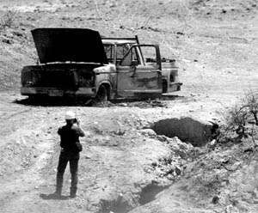
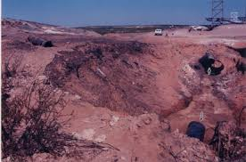
Carlsbad, NM (2000)

Slide 7
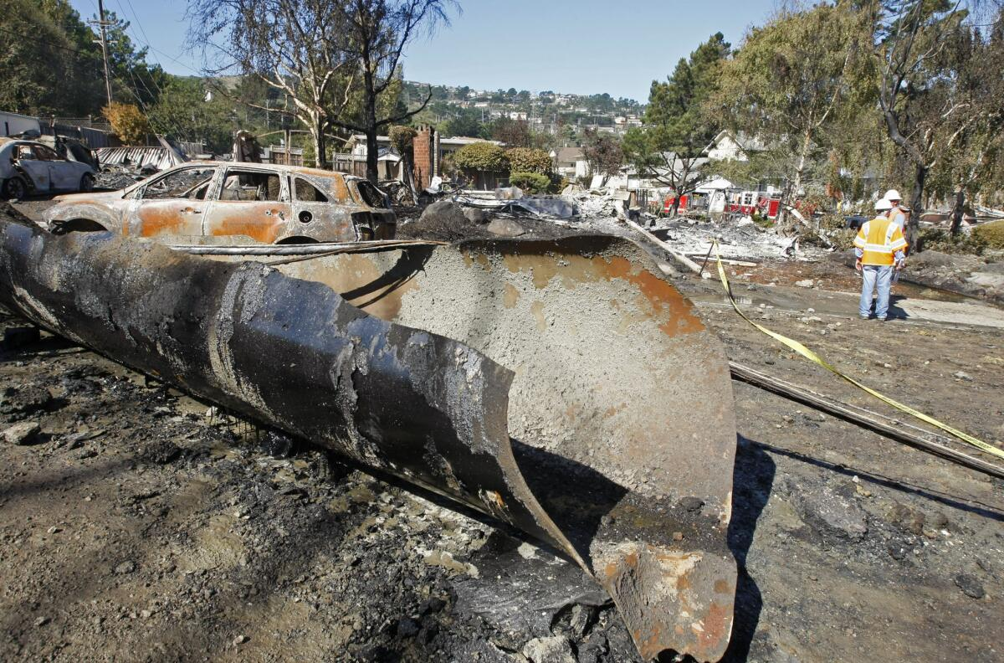
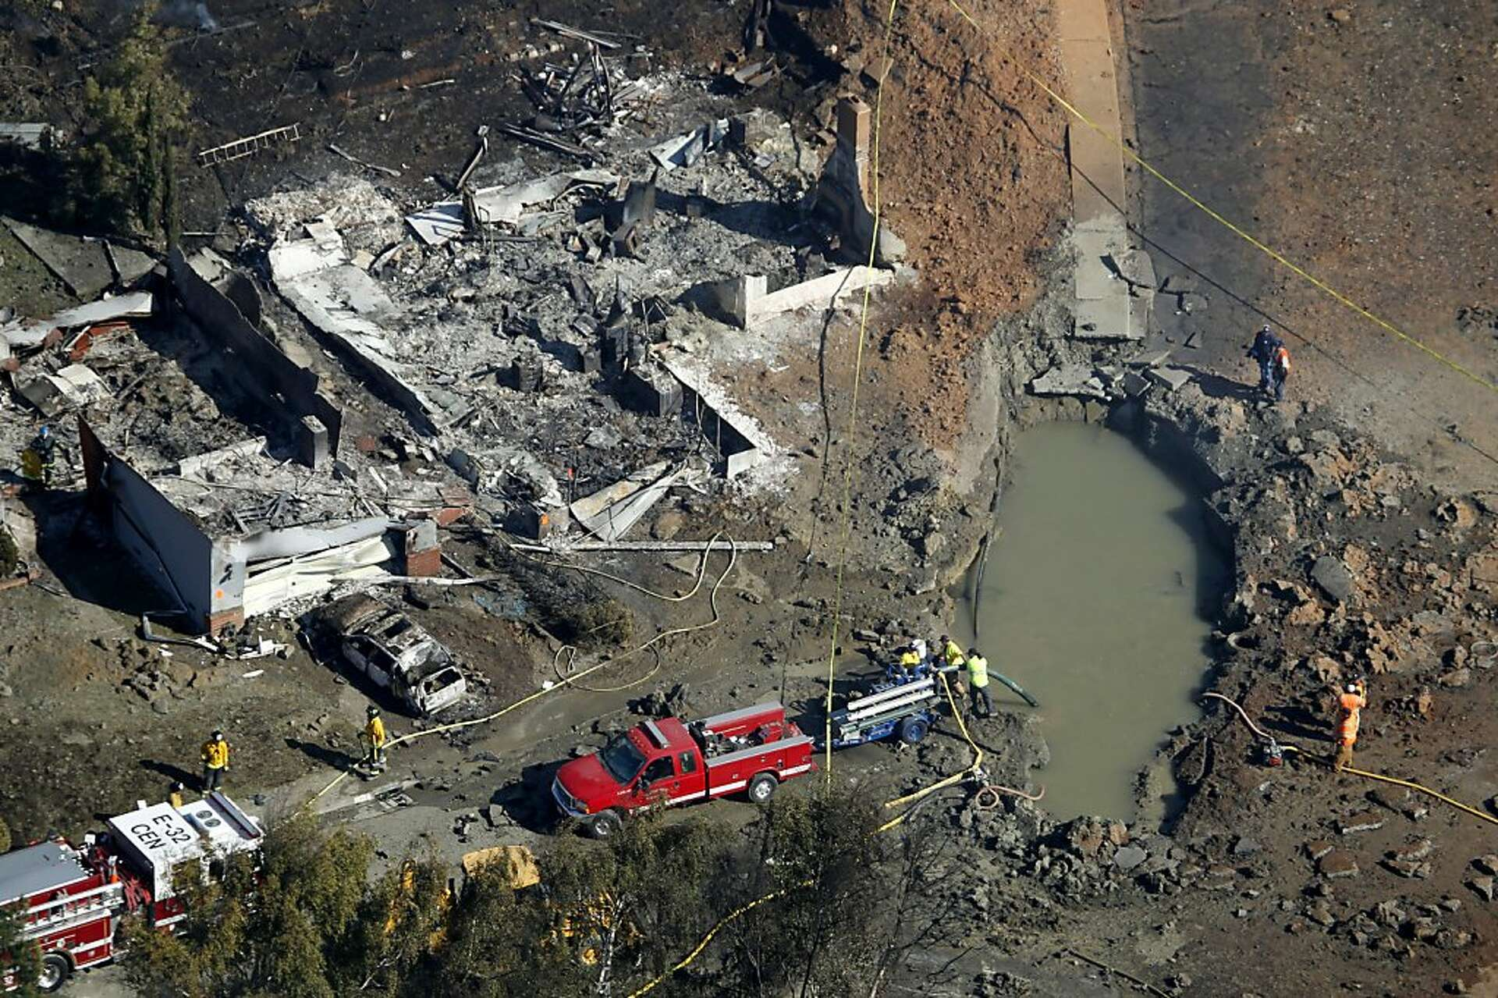
San Bruno, CA (2010)

Slide 8
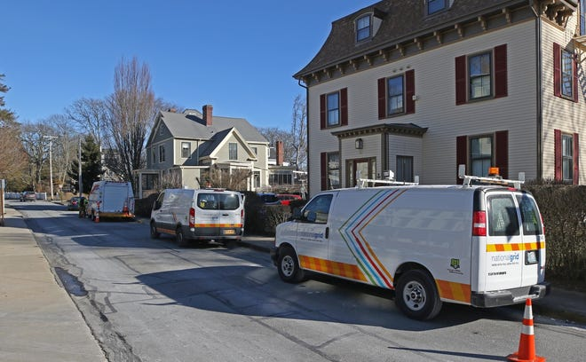
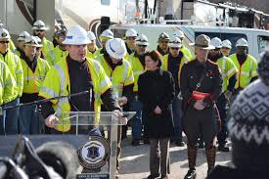
Aquidneck Island, RI (2019)

Slide 9
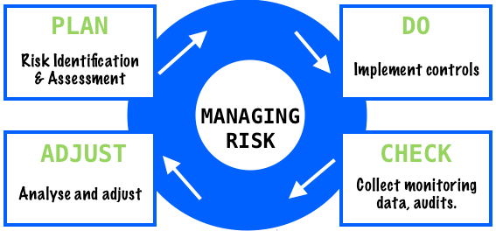
Risk Mitigation
Asset Protection – physical, maps, records
Integrity management
Contingency and redundancy
Emergency Plans / exercises
Risk tracking and mapping
Robust training
Strict compliance with regs/procedures
Communication with Electric
“You don’t rise to the occasion—you fall to your level of training.”

Slide 10
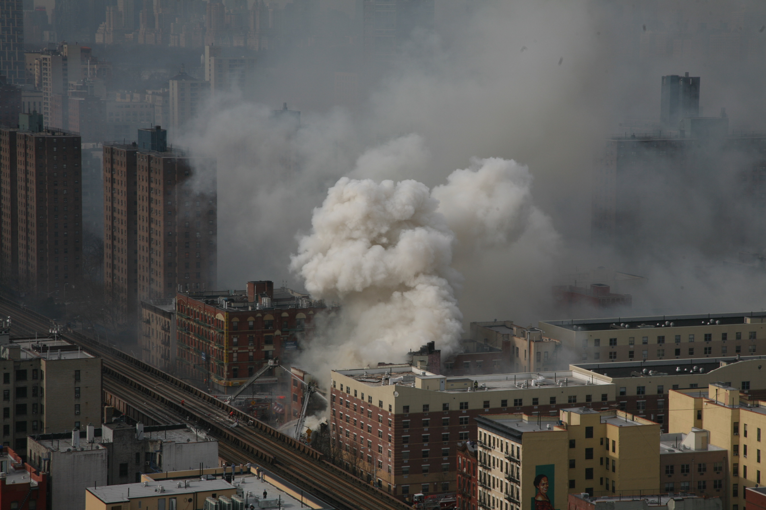
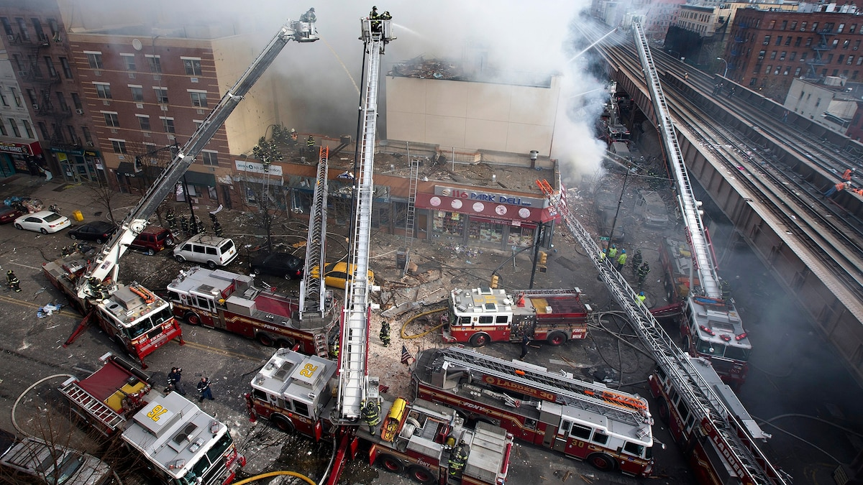
East Harlem, NYC (2014)

Slide 11
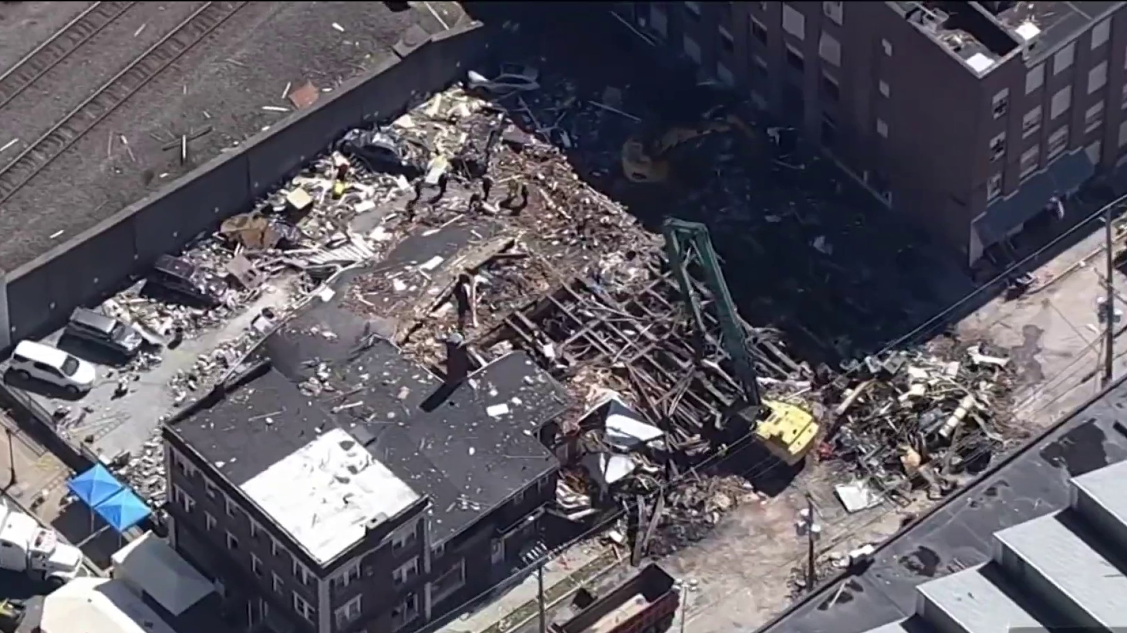

Palmer Chocolate Factory, PA (2023)

Slide 12
Impacts
System:
Major service interruptions and extended customer outages
Infrastructure damage
Loss of pressure control and cascading failures
Business:
Financial – fines, lawsuits, penalties, insurance premiums, debt financing, infrastructure investment, cost recovery, regulation
Reputational – loss of trust by regulators, customers, inventors
Community – business losses, disruption of critical services, deployment of emergency responders, rebuilding costs
Regulation – increased federal and state requirements

Slide 13
Why is Emergency Response Important?
An effective emergency response capability is critical because rapid, coordinated action can mean the difference between a contained operational incident and a catastrophic event involving loss of life, prolonged outages, severe economic disruption, and lasting reputational damage.
  “In emergencies, every second counts.”
  - American Red Cross

Slide 14
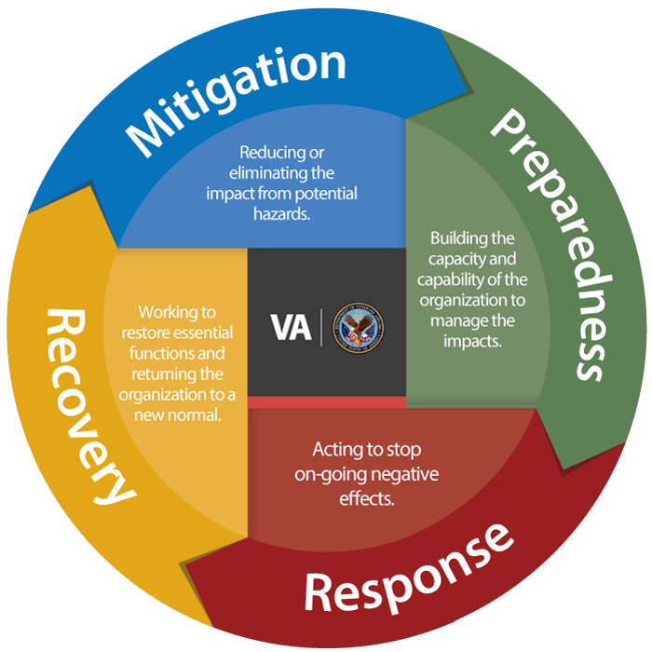
Emergency Planning and Response
Incident Command System (ICS)
Plans – ER, Bus Continuity, Cyber
Mutual aid coordination
  Capability assessment
  Workforce integration and OQ
  Collaboration and support
Drills and exercises
Communication

Slide 15
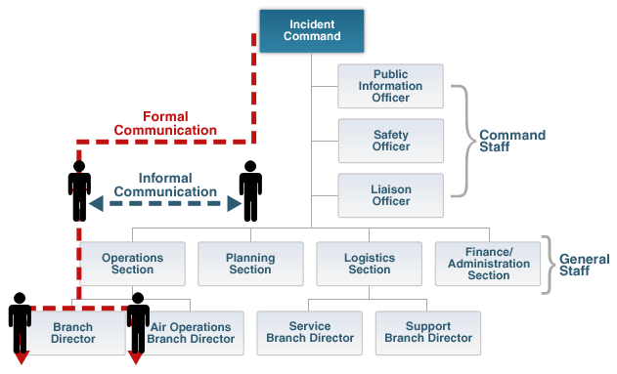
Emergency Response: ICS

Slide 16
Mutual Aid: Control Layers
A. Assess Competency, Compliance, and Eligibility
  Responding Company attests on RFA
  Requesting Company verifies
B. Provide Onboard Briefing
  Event details
  Safety, logistics, reporting requirements, emergency contacts
  Procedure, AOC identification/response review
  Items requiring review from part A
C. Perform Quality Field Checks
OQ Plan complies with federal and jurisdictional state OQ requirements.
Covered Tasks address the core elements required to safely perform the work being requested.
Responding personnel have received training on the applicable Covered Tasks.
Responding personnel have been evaluated and qualified to safely perform the requested Covered Tasks.
Qualifications of responding personnel for requested OQ covered tasks are current.
Responding personnel meet DOT Drug & Alcohol Testing Program requirements.
Mutual Aid Arrival - Crew Briefing Script
Opening Statement: This is your mutual aid arrival briefing. I’m going to walk through the situation, expectations, and safety requirements before we begin work.
Event Overview: We’re responding to [incident type]. The cause is [known/suspected], and here’s where things stand right now: [current system status]. The impacted areas include [locations], affecting approximately [#] customers, including [critical infrastructure if applicable]. From a system standpoint, you’ll be working on a [MAOP] system, primarily [materials], and [meter configuration]. Be aware of [any unique system considerations]. The current restoration plan is: [shutdown/isolation if applicable], followed by [repair sequence], then [re-pressurization plan]. Key safety concerns include [call out specifics].
…

Slide 17
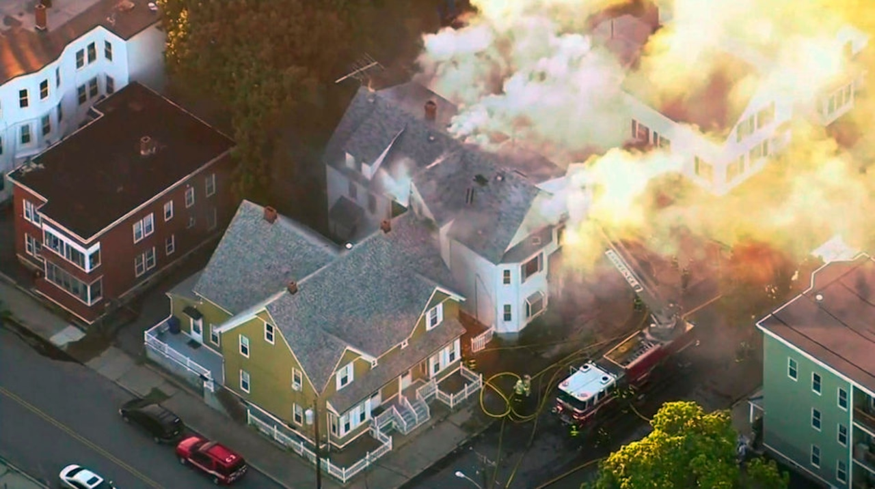
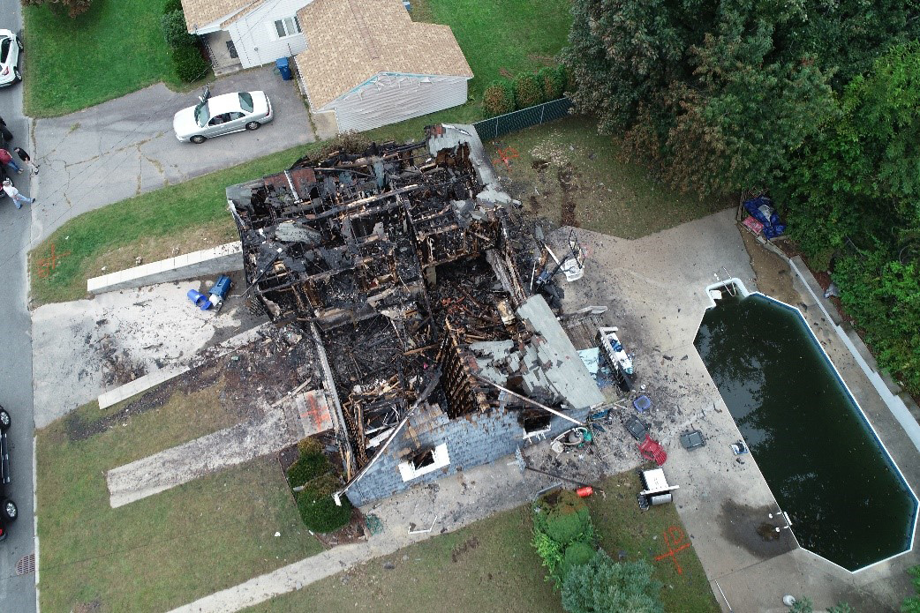
Merrimack Valley, MA (2018)

Slide 18
Merrimack Valley Response
Group Exercise

Slide 19
Closing / Q&A
For gas utility companies, emergency management is not just a safety function — it is an essential and core enterprise resilience and risk management discipline.

