Slide 1
Northeast Gas Association
Cross- Commodity Hazards
Walter Munro
Senior Natural Gas Operations Trainer
Loss Control

Slide 2
Associated
Electric
Gas
Insurance
Services, Inc.
Mutual Insurance Company.
Created by the Natural Gas Industry in the mid 1970s.
Risk Management.
Protect Life
Then Property!

Slide 3
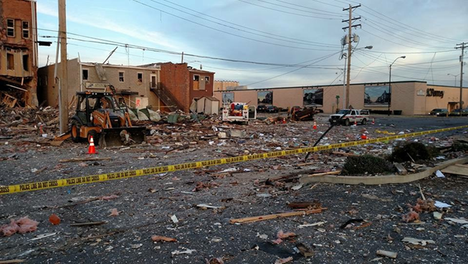
Products & Services
Risk Assessments
Case Studies
Presentations & Workshops
Monthly Webinar Series
Focus Services
Support for Mock Emergencies
Public Safety Awareness Review
Industry Research
Presentations for Industry and Customer events

Slide 4
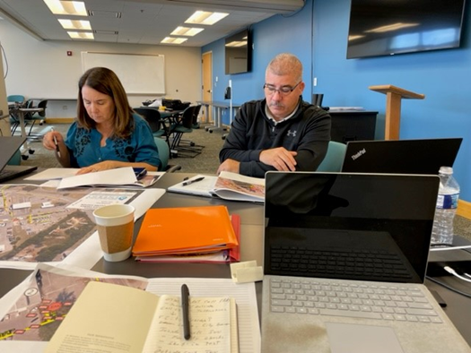
Presentations & Workshops
Free to member companies
Can be virtual or in person
All include discussions of applicable case studies, industry incidents, near misses and lessons learned.
Customized Sessions
Length of session (1 hour – Full Day)
Content – Company policies and procedures, trends and/or concerns of company leadership. All courses can be created to touch upon a variety of topics.

Slide 5
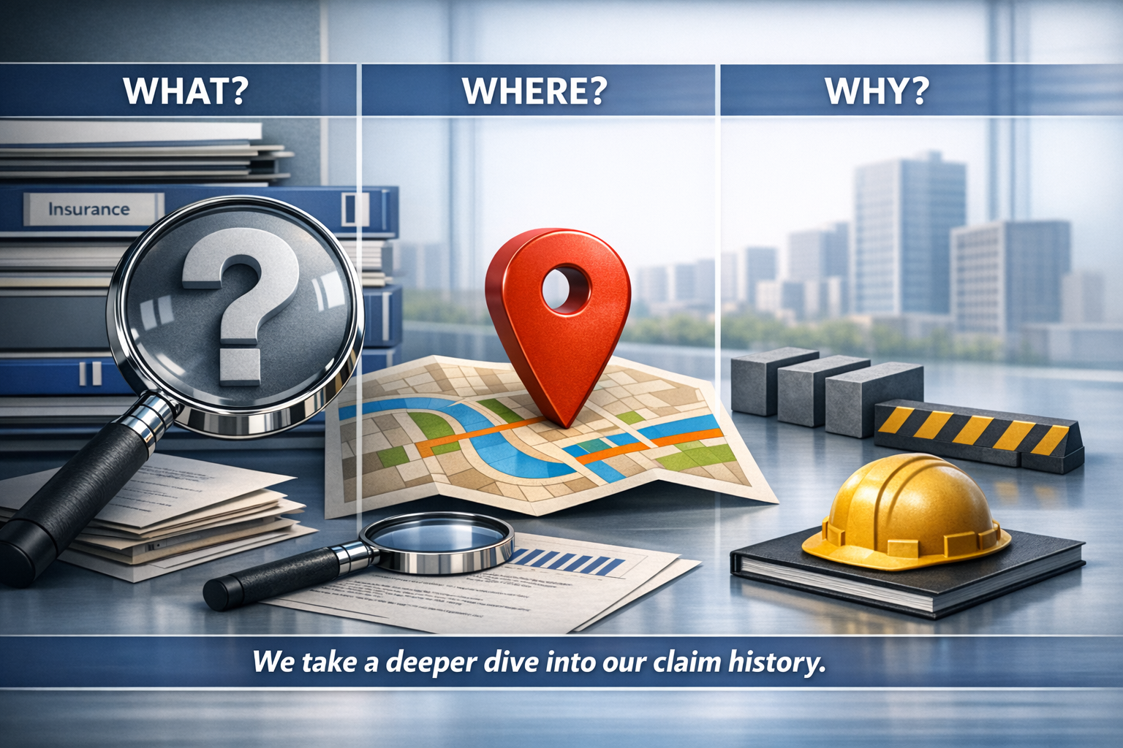

Slide 6
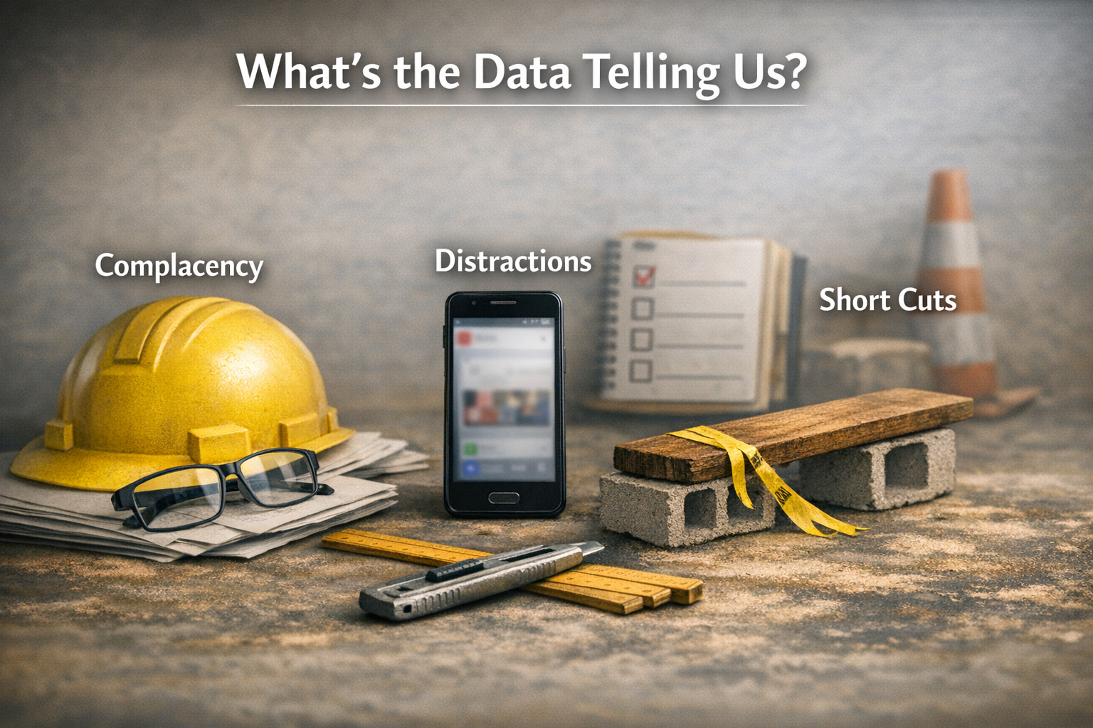

Slide 7
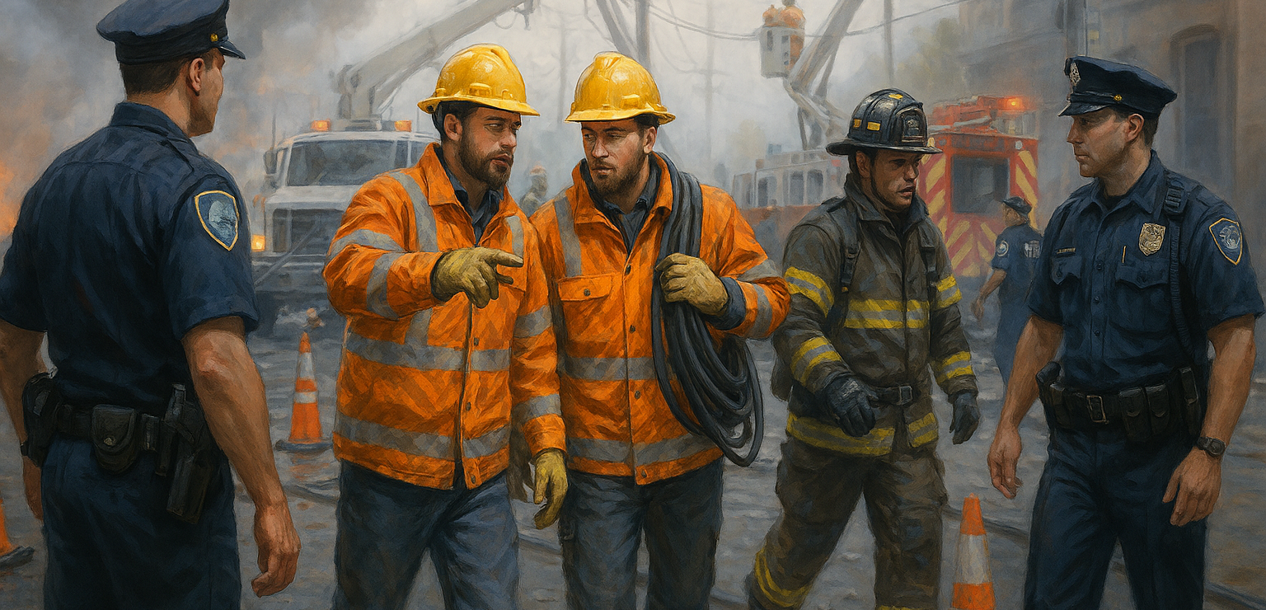
Cross- Commodity Hazards
Different Jobs / Different Hazards
Same Work Zone

Slide 8
Stories From the Field
Storm Response Incidents Involving Both Gas and Electric Hazards
Oklahoma – Tornado Damage with Simultaneous Gas Leaks and Downed Power Lines (2024)
Following a severe storm and tornado, emergency responders dealt with broken gas mains alongside live downed electric lines, creating a high‑risk environment requiring coordination between gas technicians, electric utilities, firefighters, and law enforcement. Crews had to delay certain actions until hazards from the other utility were controlled to avoid ignition or electrocution risks.
Relevance:
Gas technicians could not immediately access leaks due to energized conductors.
Electrical responders faced ignition risks from leaking gas.
Demonstrates the danger of responders acting without understanding the other commodity’s failure modes.

Slide 9
Stories From the Field
Utility Crews Working Outside Primary Roles During Storms
Historic Flooding Storm Response (Wisconsin, August 2025)
During extreme flooding, natural gas crews were required to:
Inspect and rebuild submerged indoor gas meters
Access damaged gas infrastructure using bucket trucks designed for electric work
Operate near compromised electric equipment and water‑energized ground conditions
Relevance:
Gas personnel faced electrocution risk due to energized equipment in floodwater.
Crews performed unfamiliar tasks outside their normal operating environment.

Slide 10
Stories From the Field
Hurricane Irma – Multi‑Utility Mutual Aid Operations (Florida, 2017; analyzed 2025)
Post‑storm investigations found that utility linemen clearing debris frequently encountered damaged gas services, propane tanks, and fuel systems, hazards outside their traditional electric discipline.
Fatigue and unfamiliar conditions increased near‑miss events.
Relevance:
Demonstrates how storm fatigue and cross‑discipline exposure amplify risk.
Shows why relying solely on “trade knowledge” is insufficient during large emergencies.

Slide 11
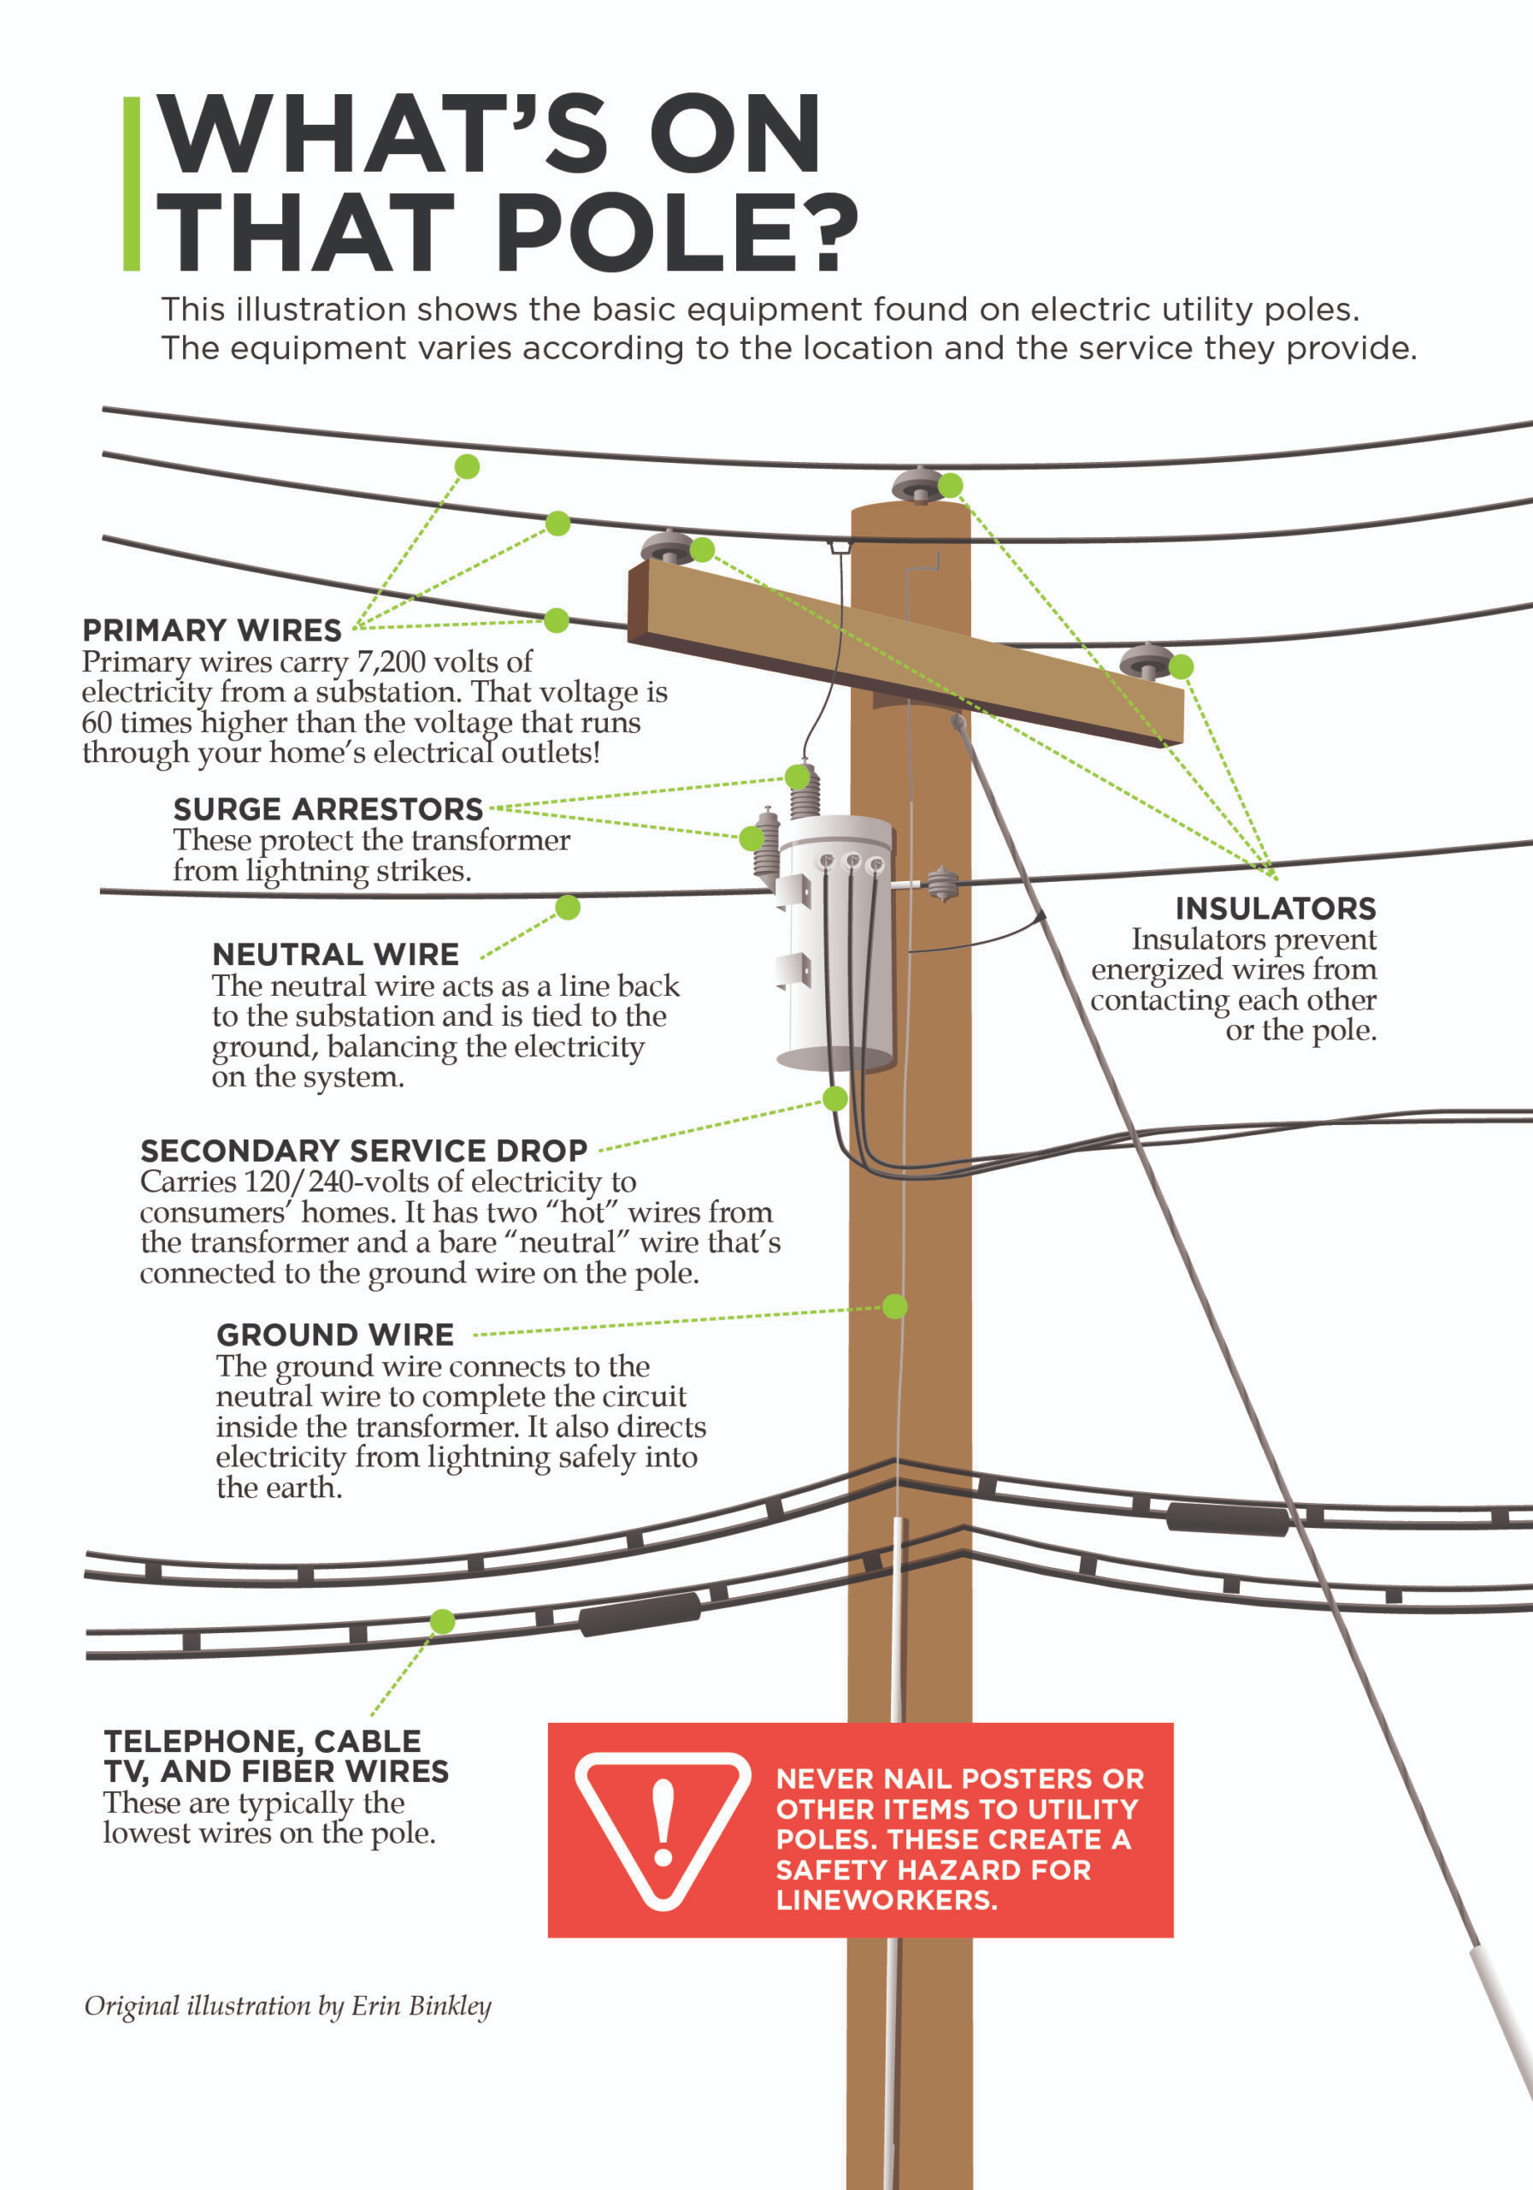
Case Study – Utility Worker Electrocuted
After an MVA damaged multiple poles, a phone company requested an emergency locate; the gas utility locate technician was electrocuted upon contacting a pole truck.
Additional Facts
Pole truck operator in training extended / rotated the boom, the grapple contacted the primary wires.
Boom truck wasn’t grounded.
Crew Foreman was at the crash site awaiting authorization from Incident Command.
Believed the line locate technician was attempting to communicate with the boom truck operator when the grapple contacted the primary wires.
Complacency / Training
Notes:
6

Slide 12
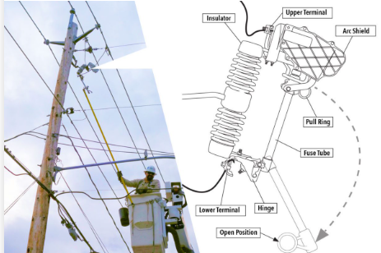
Case Study – Homeowner Electrocuted
Additional Facts
Electric service was repeatedly shutoff for nonpayment, and the homeowner continually bypassed the disconnect. A work order was issued to disconnect at the cutout.
Procedures required removal of the fuse tube when disconnecting at the cutout.
The technician disconnected the electricity at the cutout but left the tube hanging.
The homeowner obtained an aluminum extension ladder; a paint roller was threaded onto a long painter’s extension pole. While attempting to reinstall the electric fuse, the homeowner was electrocuted.
The technician stated that the power would need to be restored at a later time and did not believe the homeowner would attempt to reinstate the fuse.
Procedures
Notes:
6

Slide 13
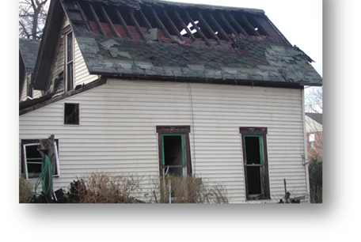
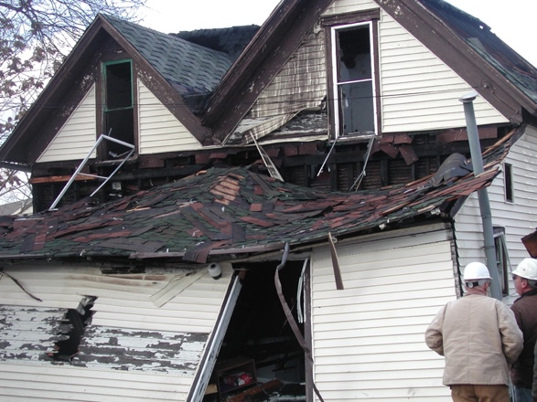
Case Study – Property Damage, Low Order Explosion
Natural gas first responder conducting an inside odor investigation, upon arrival the homeowner informs him the electricity has been off for over an hour. The first responder continues the investigation, while in the basement the CGI is recording 3, 4 & 5% readings in an abandoned bathroom, immediately evacuates and call for help.
Additional Facts
First Responder starts checking surrounding homes, the electric is restored.
Approximately 15 minuets later as other first responders arrive on scene (police & Fire) the home that was evacuated explodes.
The surrounding homes were evacuated.
In the natural gas first responder's statement it was noted that they saw the electric crew working a few houses down the street but never thought to speak to them about the evacuated home.
Find & Fix Syndrome / Distracted
Notes:
6

Slide 14
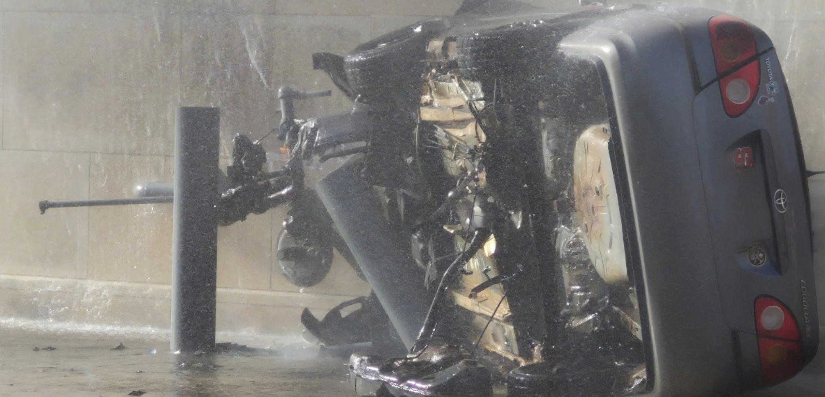
Working with Police & Fire

Slide 15
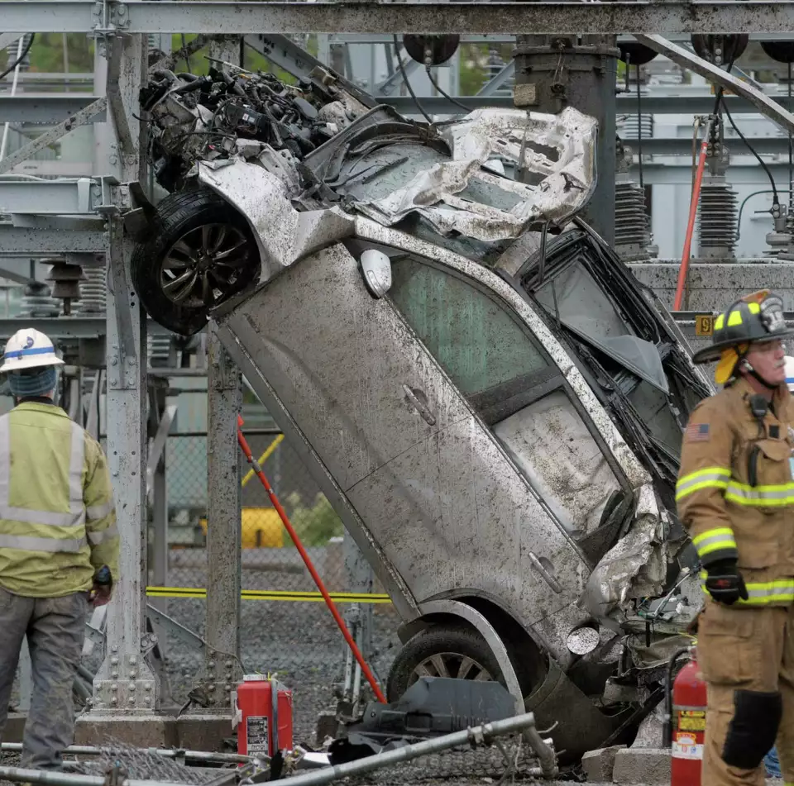
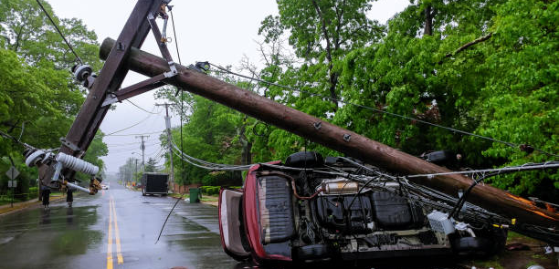
Working with Police & Fire

Slide 16
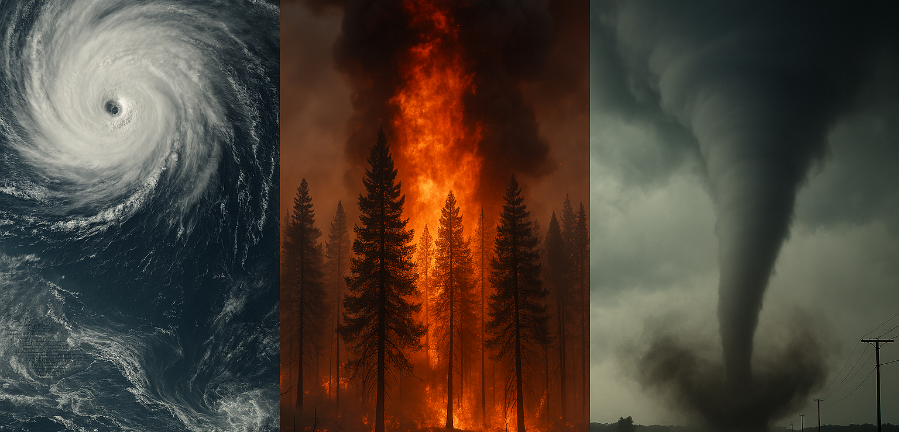
Super Storms
exceptionally large, intense and destructive

Slide 17
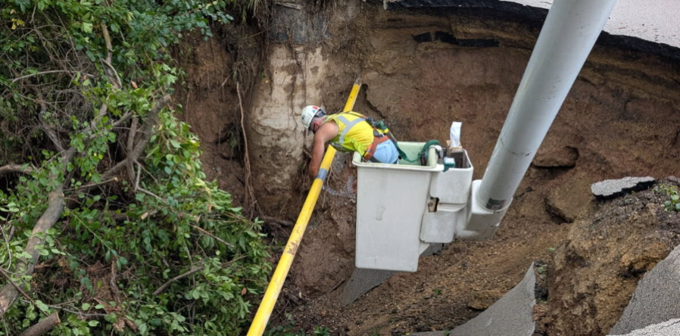
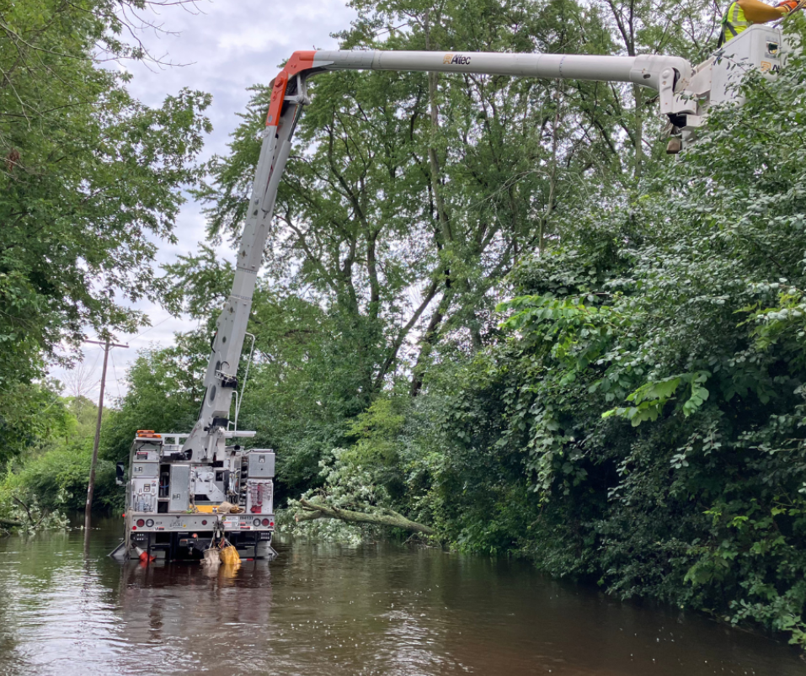
Flooding
Washouts

Slide 18
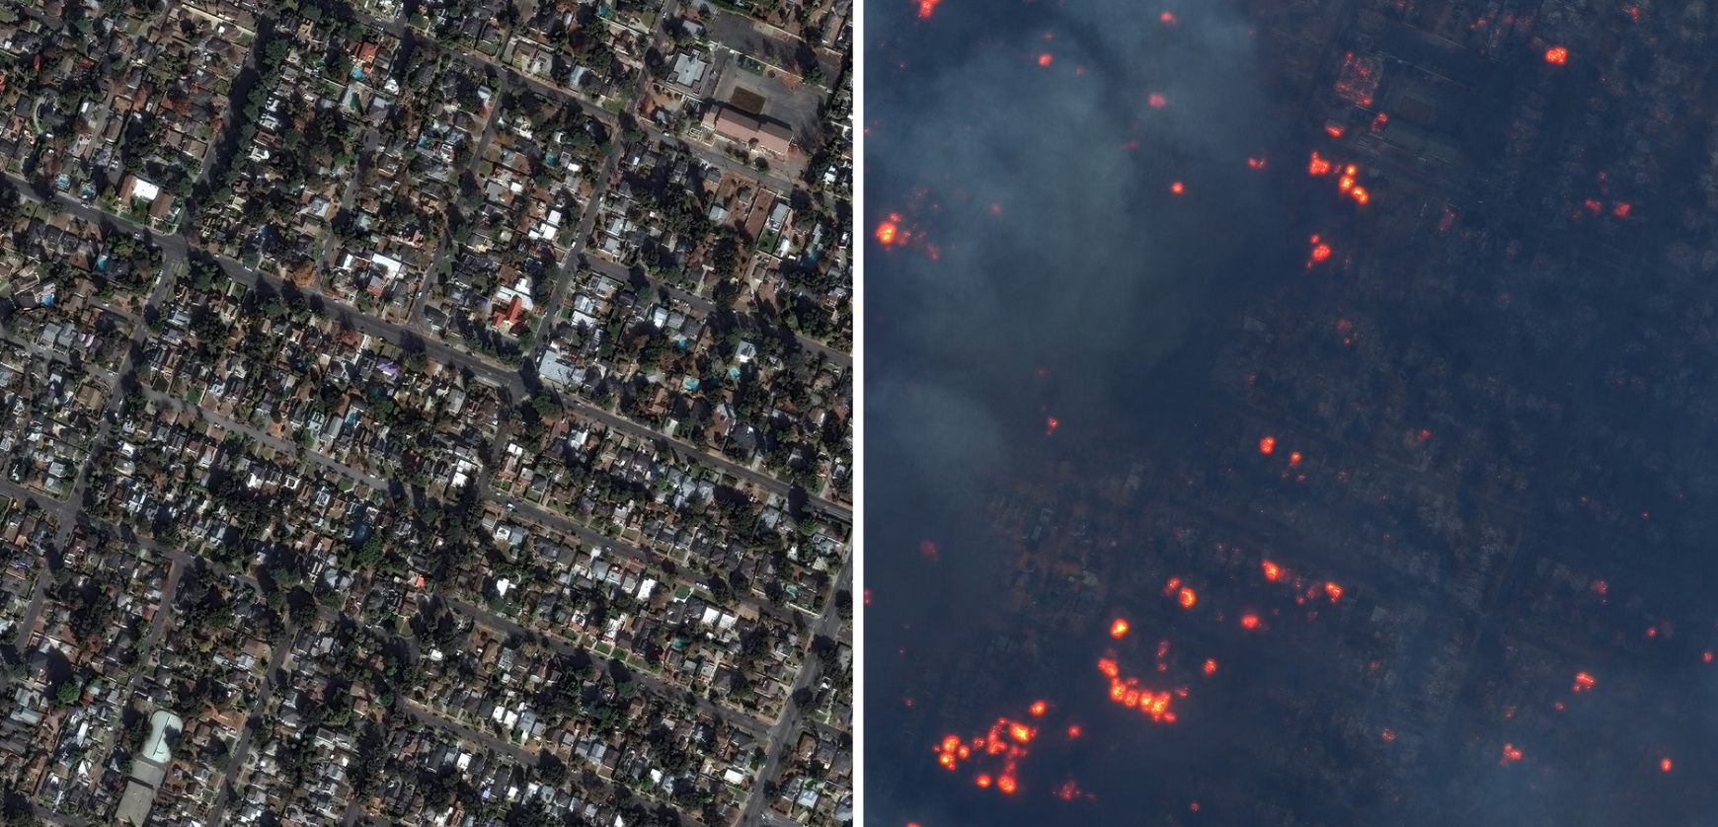
Burnt-out Neighborhoods

Slide 19
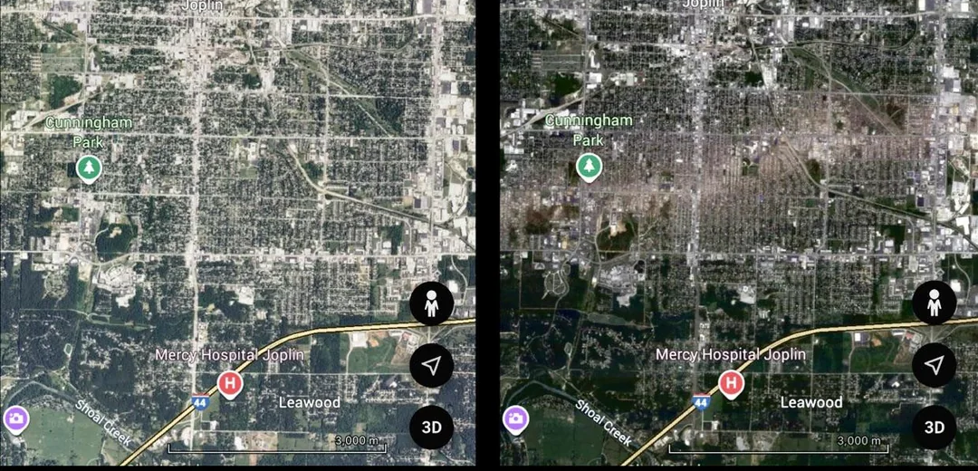
Wiped-Out Neighborhoods

Slide 20
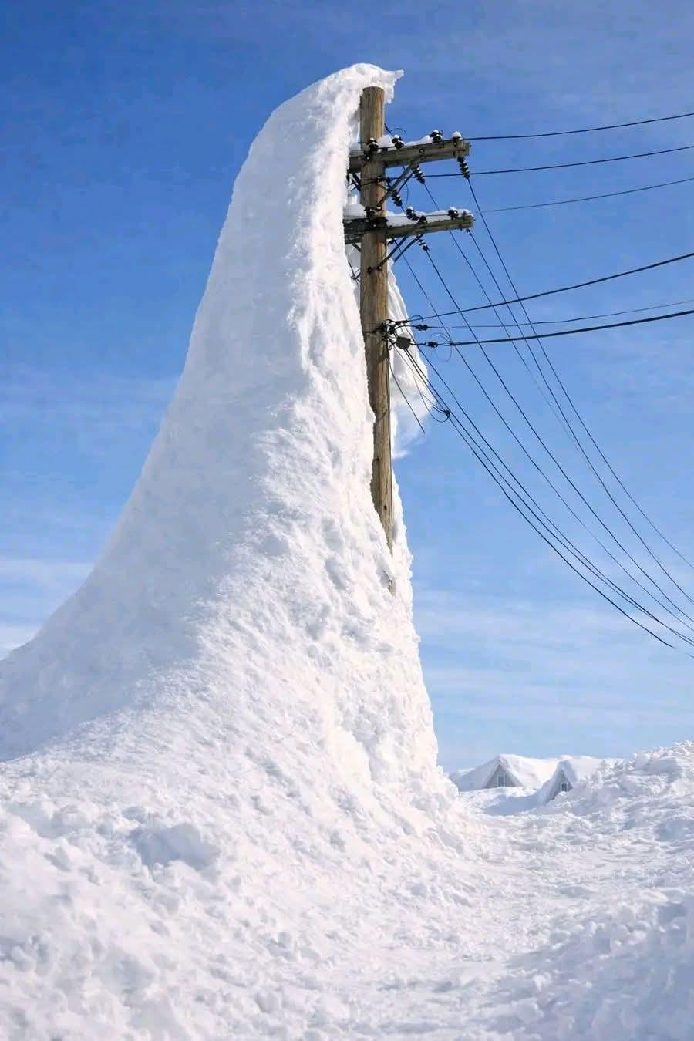
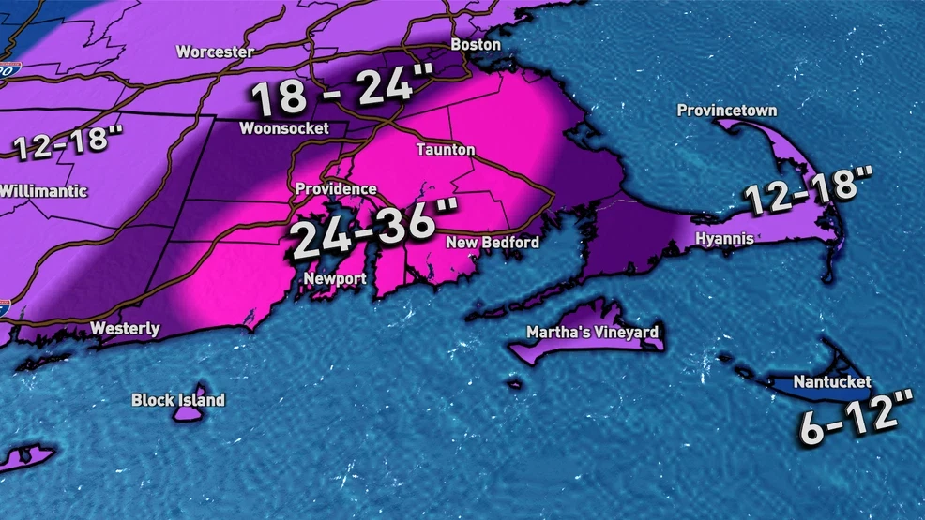
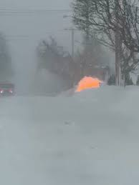
Blizzards

Slide 21
Primary Dangers - Electric
Conductors remain energized despite:
No arcing or sparking
Lines resting on pavement or vegetation
Back feed from customer generators or solar systems
Step and touch potential, especially on wet ground
Re‑energization from automatic reclosing or restoration switching
Energized floodwater
Loss of grounding effectiveness
Electricity igniting escaping gas
Confined spaces with gas accumulation

Slide 22
Key Awareness Points - Electric
Floodwater must be treated as potentially energized
PPE effectiveness may be compromised by water
Pair mutual aid crews with local guides
Establish exclusion zones large enough for worst‑case ground gradients
Never assume “quiet” equals de‑energized
Conduct cross‑commodity briefings before deployment
Wire watchers must focus on scene control, not hazard mitigation
Only qualified electric line crews should approach or touch conductors

Slide 23
Primary Dangers – Natural Gas
Electrocution from:
Contact with energized conductors
Energized fences, piping, or soil
Arc ignition of leaking gas
Coordinate exclusion zones jointly with electric utilities
Public exposure during evacuation efforts
Water‑energized ground during flooding
Ignition of gas by:
Electrical switching
Vehicle engines
Radios or phones
Gas migration into:
Manholes
Basements
Subsurface duct banks
Gas odor may be masked by:
Wind
Rain
Cold temperatures

Slide 24
Key Awareness Points – Natural Gas
Gas piping can become electrically energized
Never assume grounding is intact after storms
Coordinate exclusion zones jointly with electric utilities
Incident command should coordinate both utilities simultaneously
Gas repairs must wait until electrical hazards are verified controlled
Isolation must occur in the correct sequence
Conduct cross‑commodity briefings before deployment
Pair mutual aid crews with local guides

Slide 25
Are You Prepared?
Are Your Decisions Defendable ?

Slide 26
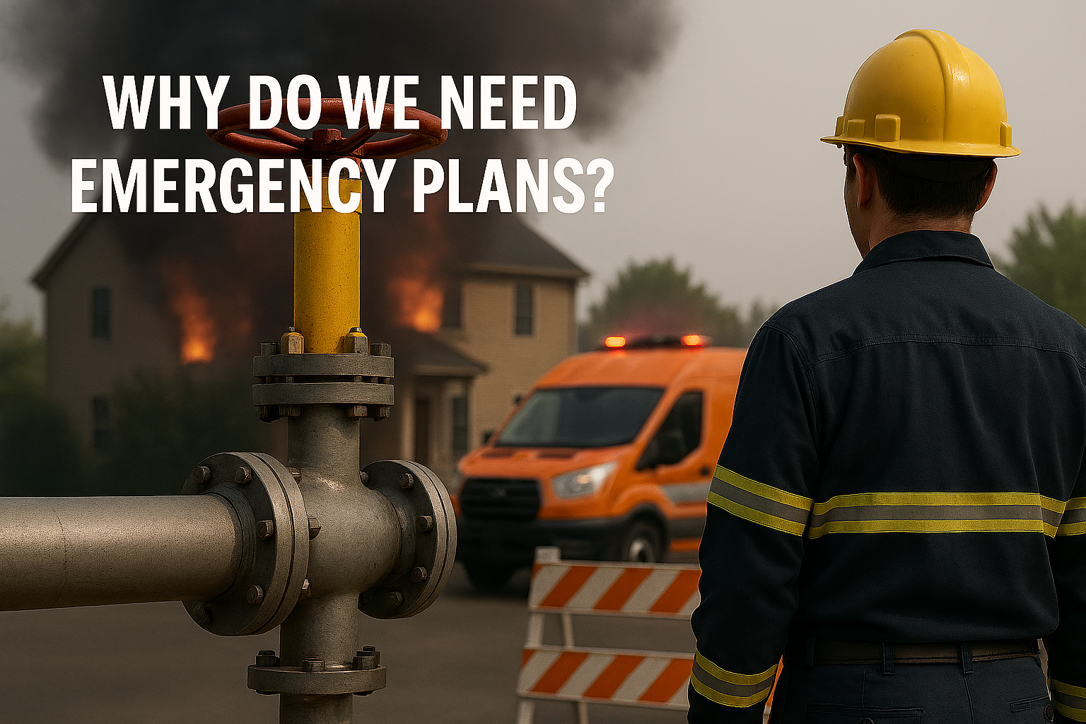
§ 192.615 Emergency plans.
(a) Each operator shall establish written procedures to minimize the hazard resulting from a gas pipeline emergency. At a minimum, the procedures must provide for the following:

Slide 27
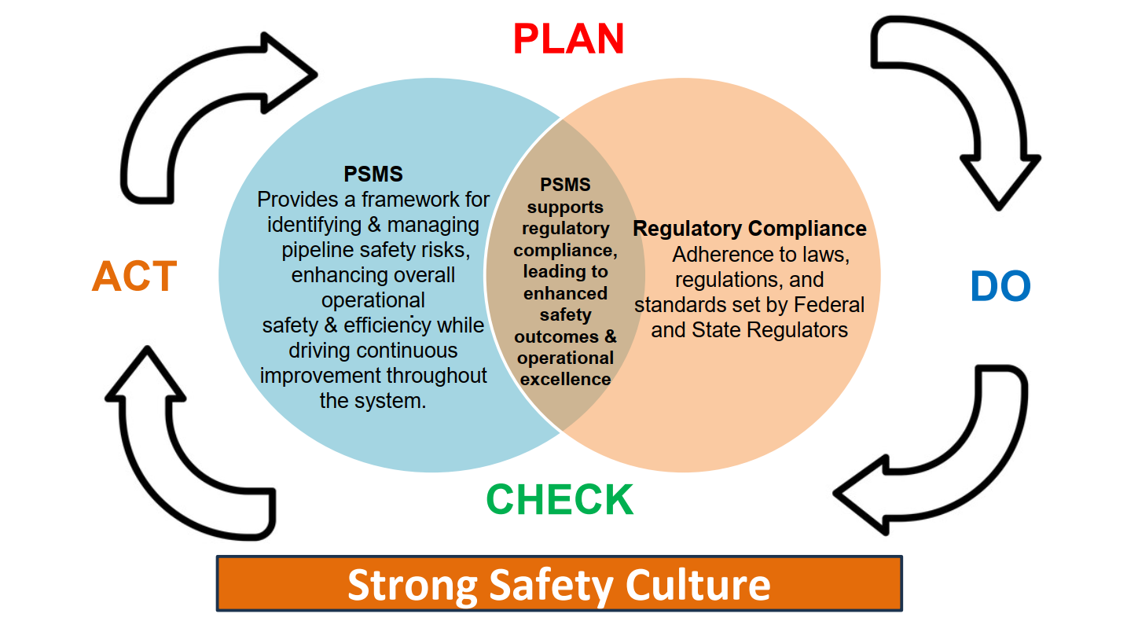

Slide 28
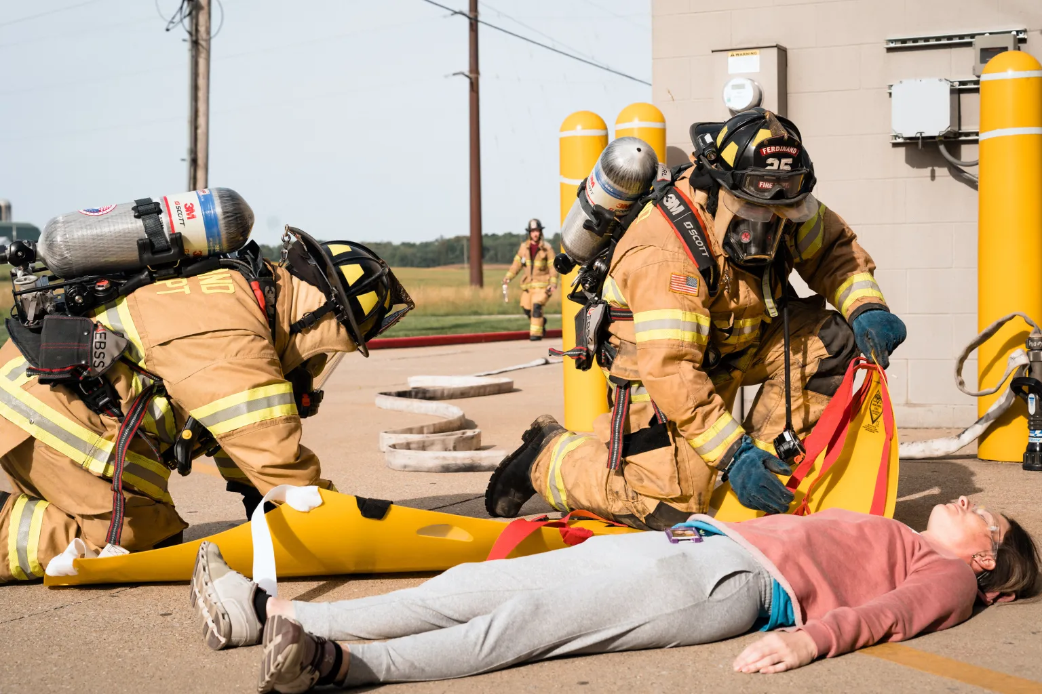
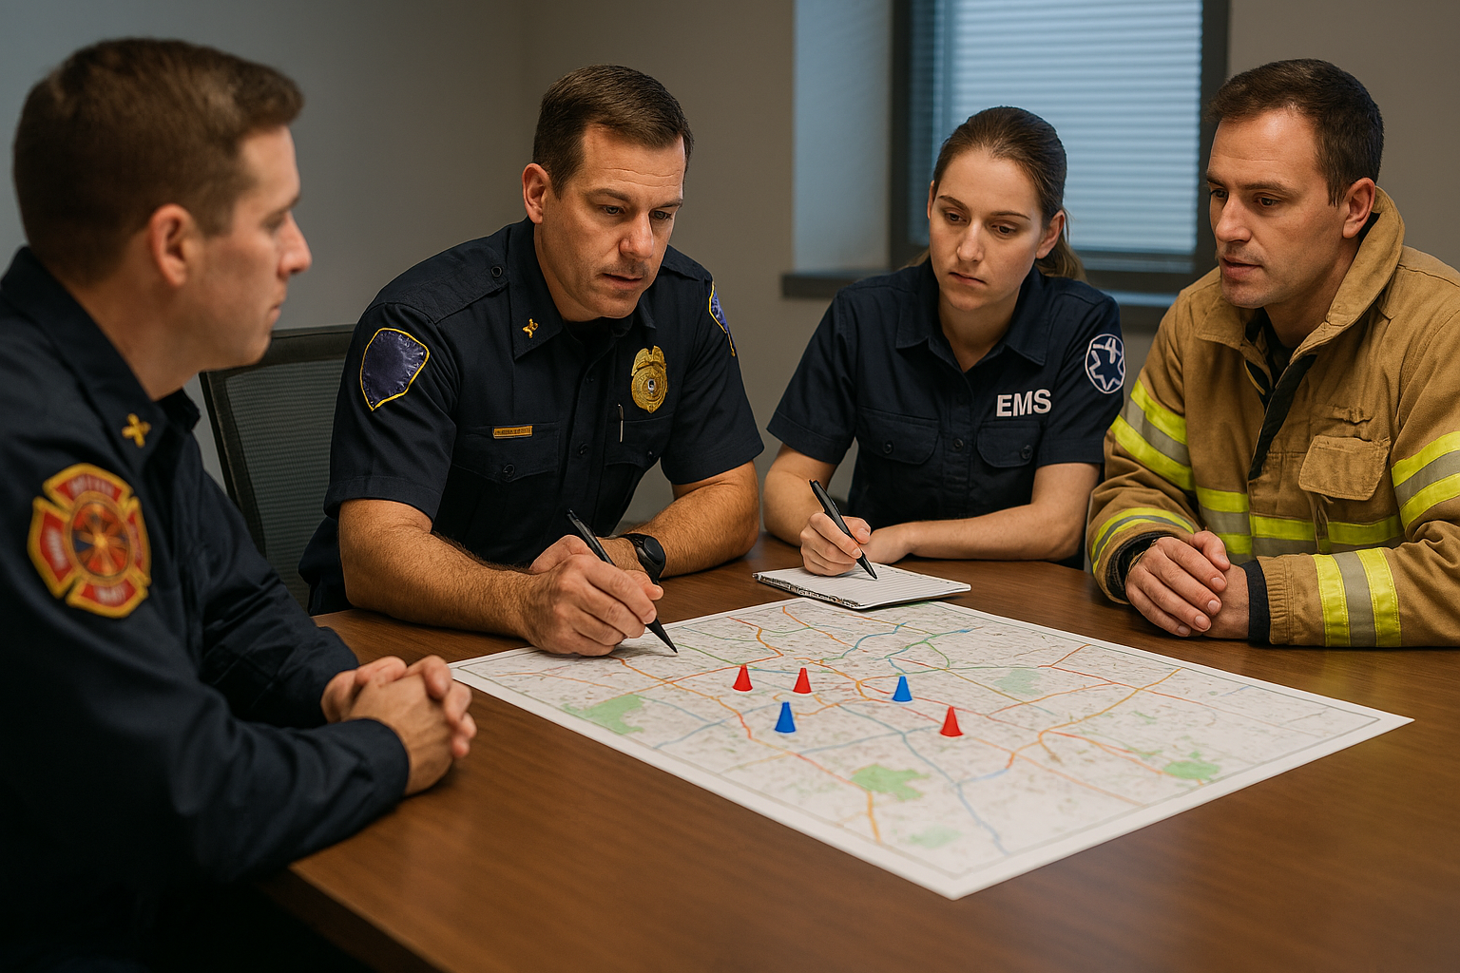
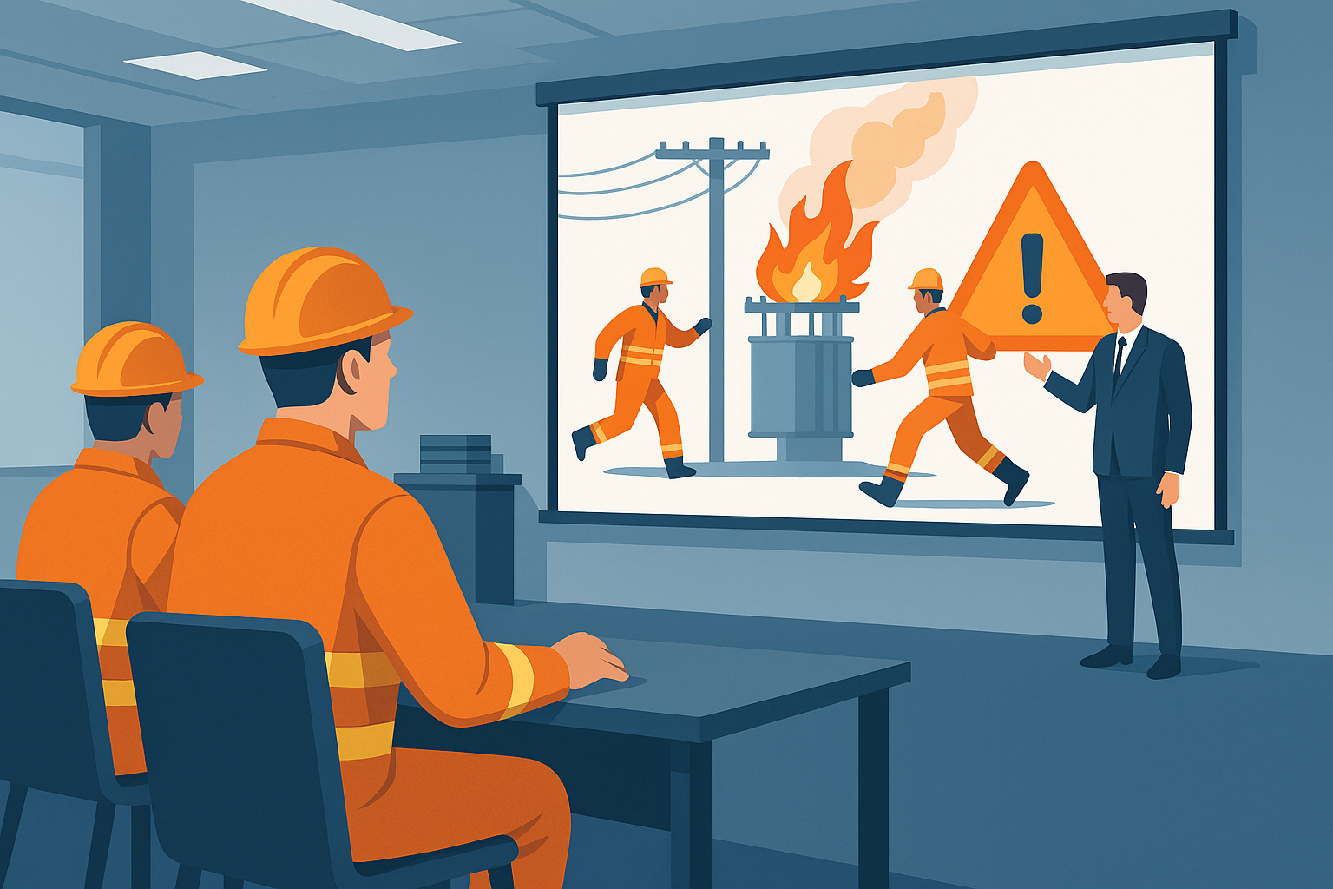
How Do We Plan / Prepare
Field Mocks
Tabletops
Verify that the Training is Effective

Slide 29


Slide 30


Slide 31
Questions
or
Comments

Slide 33
Disclaimer
This presentation is advisory in nature and is offered as a resource to be used together with your professional insurance and loss control advisors in maintaining a loss prevention program. It is intended only as an overview, and is not intended as a definitive statement of the law in any jurisdiction or a substitute for consultation with your insurance broker, or for legal, engineering or other professional advice of any kind. This presentation is provided without any warranties of any kind and no liability is assumed by reason of the information contained herein.
Associated Electric & Gas Insurance Services Limited (“AEGIS”) is a Bermuda insurer and eligible surplus lines insurer in the United States with additional qualifications in other jurisdictions. AEGIS’s operations are conducted through a wholly-owned subsidiary, AEGIS Insurance Services, Inc. (“AISI”), which provides AEGIS and its affiliates with professional staff and services. This presentation is the property of AISI and is not to be shared, published or distributed without the prior written consent of AISI. (Ed. 01/2022)

Slide 34

Be Alert,
Be Prepared &
Be Safe
Walt Munro
AEGIS Insurance Services
waltermunro@aegislimited.com
551-335-2570

