Slide 1
Goodnight Gas Utility?
NGA 2024 Regional Market Trends Forum
Melissa F. Bartos
Senior Vice President
May 9, 2024

Slide 2
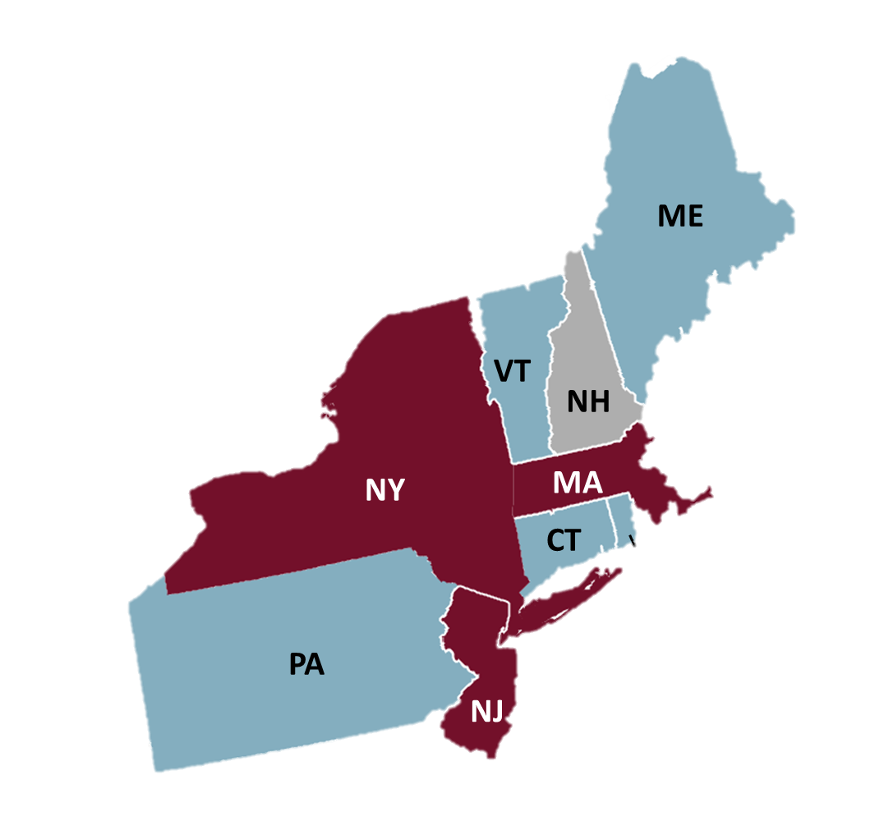
States Are Requiring Gas Utilities to Develop Decarbonization Plans
Staggered Schedule
Started December 2022
Ongoing
All Gas Utilities – April 1, 2025
RI
No Emissions Reduction Target
Emissions Reduction Target, No Gas Utility Plans
All Gas Utilities – 2025Q1?
Emissions Reduction Target, AND Requires Gas Utility Plans

Slide 3
Guiding Principles Establish a Vision of Desired Outcomes
Reliable Service
Safe Operations
Energy Affordability
Guiding Principles
Energy Resilience
GHG Emissions Reductions
Customer Choice

Slide 4
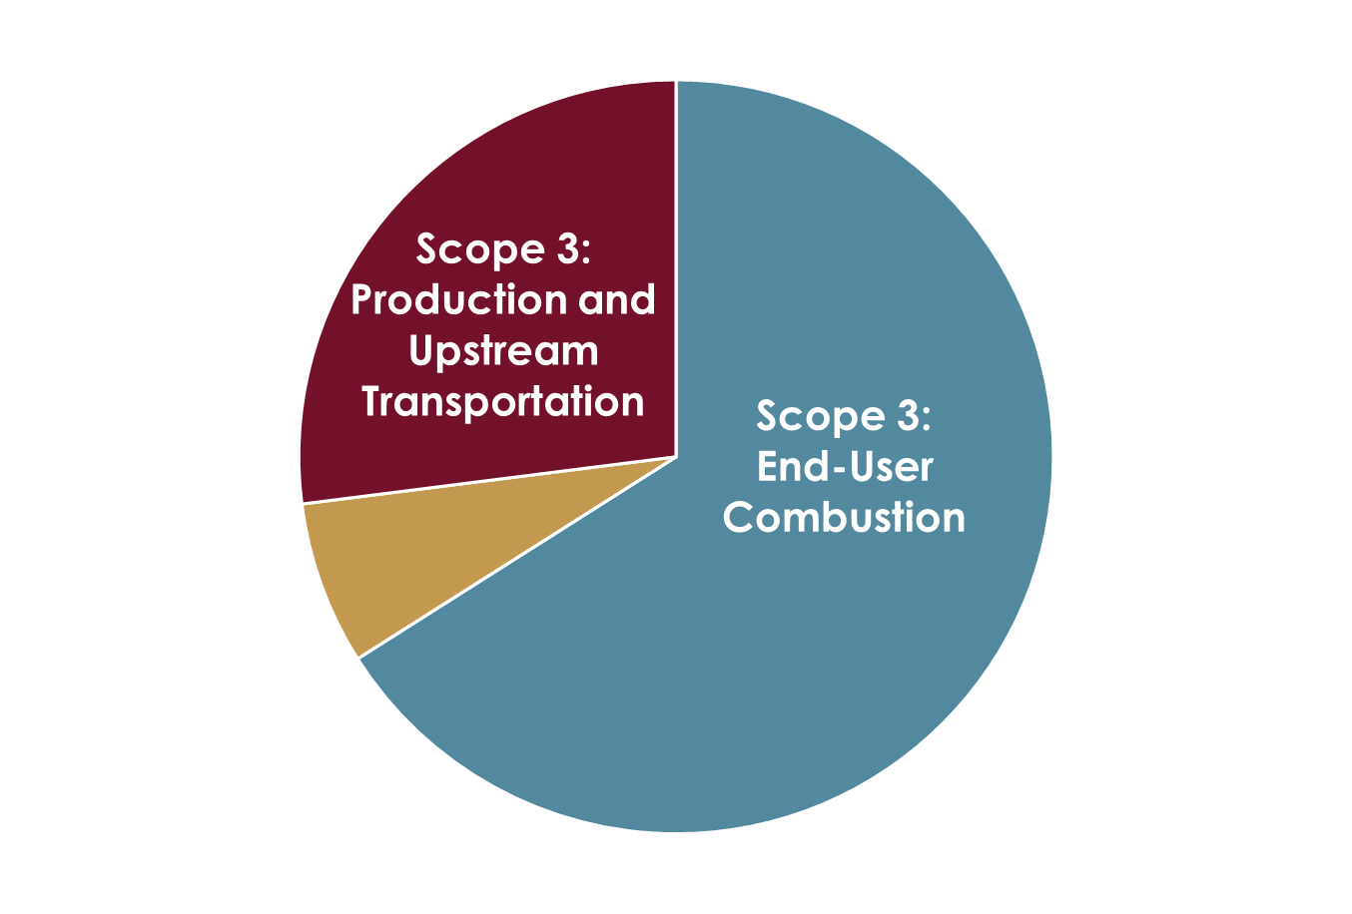
Combustion of Natural Gas Causes the Majority of GHG Emissions Associated with Gas Utility Operations
Sample Gas Utility GHG Emissions (CO₂e)
Scopes 1 & 2 (combined)
Mains
Services
Meters and Regulators
Company Vehicles
Electricity Use (Scope 2)
Major Assumptions:
CO₂e: CO₂, CH₄, N₂O; 20-Year Global Warming Potential
Includes sales and transportation customer load

Slide 5
With Regulatory Approvals, Gas Utilities Can Implement Programs to Address Scope 3 Emissions
Weatherization
Industrial Customer Programs
Electrification
Renewable Natural Gas
Utility Thermal Energy Networks
Green Hydrogen

Slide 6
Practical Considerations Will Limit Adoption of Decarbonization Actions
Changes Needed at Customer Premises
Electric System Buildout and Reliability
Limited Quantities
Cost

Slide 7
Customer Affordability Concerns Are Real
Behind-the-Meter Installation Costs
Gas Bills
Insulation
Heat Pumps
Electric Bills
RNG Cost
Hydrogen Cost
Clean Generation
Transmission Infrastructure
Distribution Infrastructure
Other Upgrades (wiring, ductwork)

Slide 8
Costs Should be Compared on a Dollars per GHG Emissions Reduction Basis
Cost per GHG Emissions Reduction for Gas Utility Decarbonization Actions ($/MT CO₂e)
Major Assumptions:
New York weather
Electricity is relatively clean, and emissions-free in 2040
20-year NPV of costs and GHG emissions reductions
CO₂e: CO₂, CH₄, N₂O; 20-Year Global Warming Potential
Includes sales and transportation customers and load
Existing utility rate design and cost recovery principles

Slide 9
Non-Pipe Alternatives Are Best Suited for Avoiding Expansions
Non-Pipe Alternatives
Expansions to Serve Load Growth
Partial Customer Participation Provides Benefits
All Load Reducing Options Available
Energy Efficiency
Demand Response
Full/Partial Electrification
Local Supplies May Provide Benefits
Extensions to Serve New Customers
100% Customer Participation Required
Full Electrification Only
Replacement to Maintain Safety and Reliability
100% Customer Participation Required
Full Electrification Only
No Downstream Impacts

Slide 10
Decarbonization Plans Must Address Major Uncertainties
Electric Infrastructure Build-out Cost and Timing
Communicate with Electric Industry
Cost, Technology, Market Changes
Monitor Developments
Customer Acceptance
Conduct Integrated Energy Planning
Participate in Industry Studies
Engage Customers
Understand Different Priorities
Keep Options Open
Modify Plans

Slide 11
Thank You!
Melissa F. Bartos
Senior Vice President
508.263.6240
mbartos@ceadvisors.com

