Slide 1
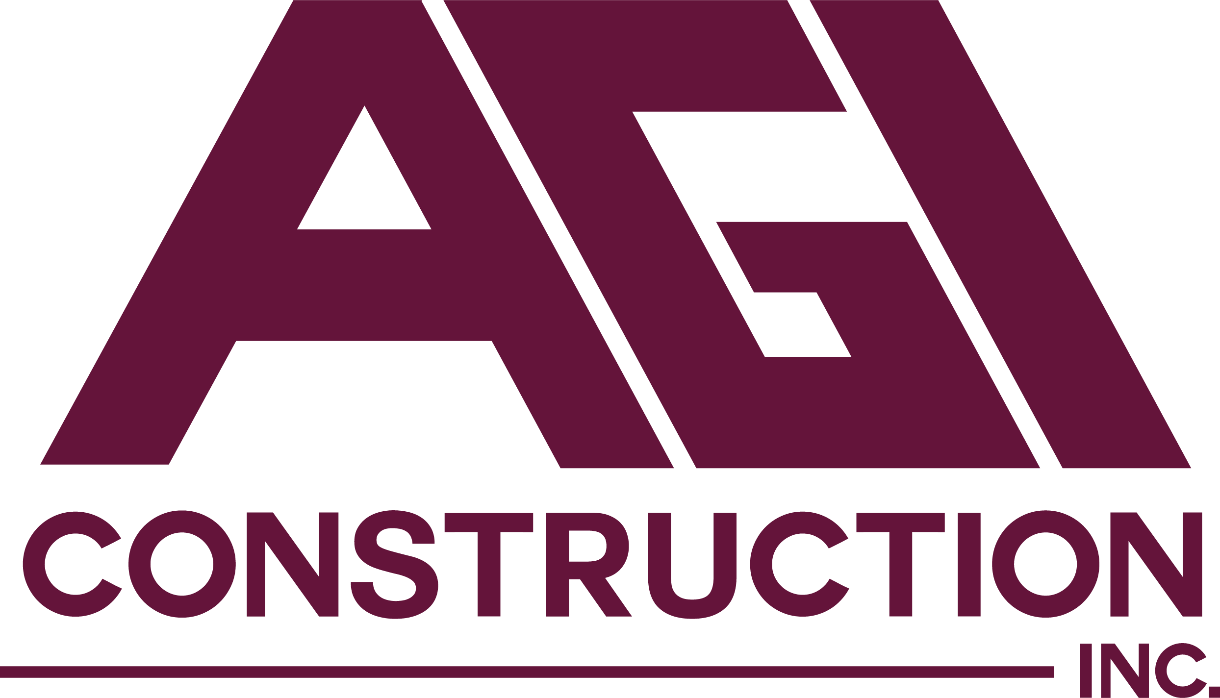
Contractor Relations
Michael F. Smith
Chief Operating Officer • AGI Construction
PREPARED BY AGI CONSTRUCTION, INC.

Slide 2
AGI × NGA • 2026
Agenda
■ Working in multiple states with multiple regulatory requirements
■ Working for multiple LDCs
■ Meeting OQ requirements across multiple states and multiple LDCs
■ Workforce challenges
■ Workload challenges
01
AGENDA
AGI CONSTRUCTION • NGA 2026 PRESENTATION
02 / 08

Slide 3
AGI × NGA • 2026
Multiple States, Multiple Regulatory Requirements
■ Rate case implications
■ Impact to contractors
■ Impact to contractor employees
02
REGULATORY LANDSCAPE
AGI CONSTRUCTION • NGA 2026 PRESENTATION
03 / 08

Slide 4
AGI × NGA • 2026
Serving Many Utilities at Once
■ Maintaining relationships
■ Navigating O&M implications
■ Coordinating crew movement across multiple states
03
MULTIPLE LDCS
AGI CONSTRUCTION • NGA 2026 PRESENTATION
04 / 08

Slide 5
AGI × NGA • 2026
OQ Requirements
■ Training employees across multiple OQ platforms and protocols
■ Testing and re-qualifying on each utility's standards and systems
■ Cost to contractors
■ Impact to contractors
04
OQ REQUIREMENTS
AGI CONSTRUCTION • NGA 2026 PRESENTATION
05 / 08

Slide 6
AGI × NGA • 2026
Workforce Challenges
■ Retaining qualified employees in an increasingly competitive market
■ Impact of training and testing to multiple OQ’s
■ Impact of regulatory decisions on employees and families
05
WORKFORCE
AGI CONSTRUCTION • NGA 2026 PRESENTATION
06 / 08

Slide 7
AGI × NGA • 2026
Workload Challenges
■ Replacement budget decisions in late March
■ Sudden workload reductions
■ Ability to pivot from contractors
■ Contracts with LDCs
06
WORKLOAD
AGI CONSTRUCTION • NGA 2026 PRESENTATION
07 / 08

Slide 8
AGI × NGA • 2026
Questions
AGI CONSTRUCTION • NGA 2026 PRESENTATION
08 / 08

