Slide 1
Emerging Climate Threats to Utility Infrastructure
NGA Spring Operations Conference
April 2025

Slide 2
THIRA Overview – Purpose:
Due increasing frequency of storms, restoration costs and climate driven threats, Eversource has identified the need for a holistic approach to prioritizing efforts related to both Response and Recovery efforts, as well as Prevention and Mitigation efforts related to Natural Hazards.
Establish a formal THIRA (Threat and Hazard Identification and Risk Assessment) process for Natural Hazards (focused on Today thru 5-Years):
What hazards are likely to impact the northeast region of the United States (Probability)?
What impacts would those hazards have on our infrastructure (Vulnerability)?
What effect would those hazards have on our customers / business (Consequences)?
Prioritize efforts related to update of Eversource All Hazard Emergency response Plan (AHERP) and associated hazards / risk specific documentation.
Prioritize efforts related to investments for Prevention/Mitigation efforts as well as Response/Recovery efforts.
* Eversource Natural Hazards include 18 FEMA identified Natural Hazards (https://hazards.fema.gov/nri/natural-hazards) plus Space Weather (https://www.swpc.noaa.gov/)

Slide 3
Comprehensive Risk / Incident Management Program
Enterprise Risk Management
Benefits:
Identify / prioritize threats and hazards against infrastructure
Wholistic approach that synchronizes all aspects of the business:
Asset liability underwriting
Long-Term Capital Program
Gas / Electric Interdependency
Asset Value / Coverage
Liability Analysis
Analyze how resiliency / mitigation options affect asset
Response Process
Response Strategy
Business Unit Emergency Response Plan
Incident Response
Vulnerability Assessment
Prioritized Risk Assessment
All Hazards Emergency Response Plan
Hazard Specific Annex
Emergency Preparedness
Natural Hazard Threat Assessment
Analyze Long-Term Capital Program
System Reliability / System Growth
Long-Term Climate Change
Hazard Mitigation Options
Cost / Benefit
Analysis
Operations / Engineering

Slide 4
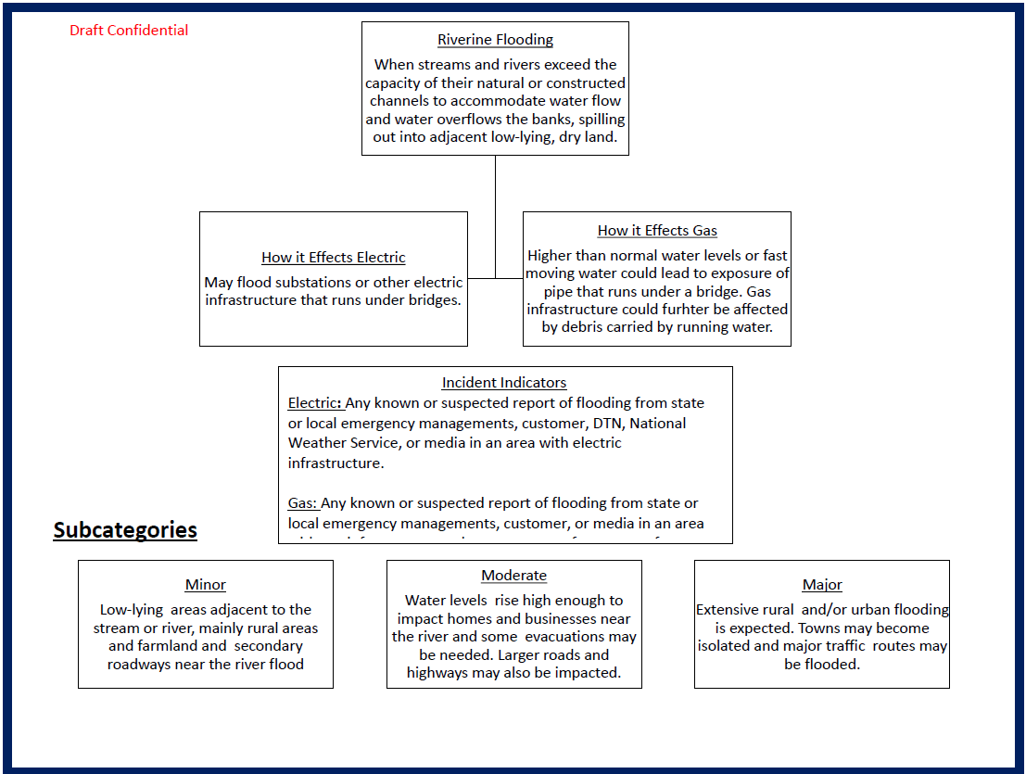
Emergency Preparedness – THIRA Assessment
Step 1: Identification of Threats and Hazards of Concern
Assess the eighteen (18) natural hazards as outlined in the National Risk Index (NRI) which included the following:
Avalanche Coastal Flooding Cold Wave
Drought Earthquake Hail
Heat Wave Hurricane Ice Storm
Landslide Lightning Riverine Flooding
Strong Wind Tornado Tsunami
Volcanic Activity Wildfire Winter Weather
In addition to the NRI’s 18 Natural Hazards, this analysis also included Space Weather (i.e. Solar Flares) for a total of nineteen (19) hazards for assessment
Step 2: Utility Infrastructure Vulnerability Assessment
Assess infrastructure vulnerability by evaluating severity and assigning a numerical value using the existing Business Unit Emergency Response Plan Event Level Matrix.
Step 3: Hazard Impact Assessment
Evaluate the expected consequences of an incident, assuming the hazard occurred at different severity levels. This assessment will utilize the existing Business Unit ERP Event Levels (ERP Level 1-5)
The final hazard risk score, derived from this process, produced a prioritized list of hazards requiring the most urgent attention. Once the risks are ranked, capability priorities will be established to address gaps in preparedness and response.

Slide 5
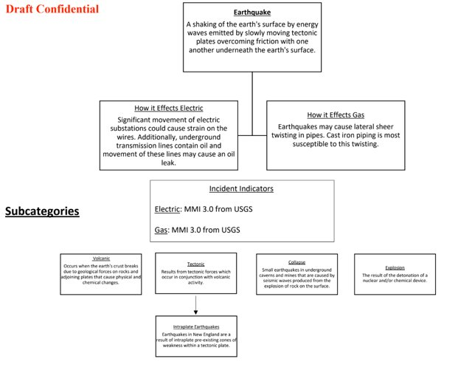
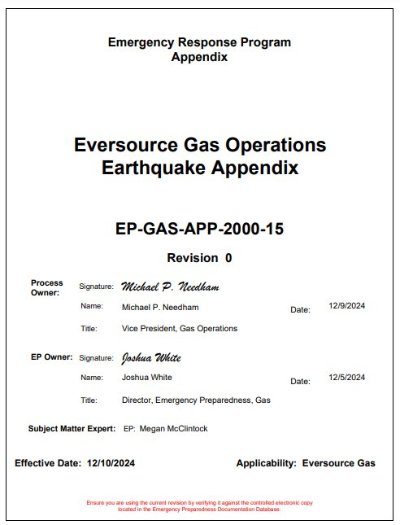
Emergency Preparedness – Hazard Specific Planning
Threat & Hazard Identification
(Natural, Man-Made, Technology)
Risk Assessment
(Threat, Vulnerability & Consequence)
Risk Controls
(Engineering, Mitigation, Prediction, Preparedness, Response)
Risk Control Evaluation
(Internal & External Audit, KPI's, Training & Exercise Program)
Risk Control Validation
(Eversource Risk Committee)
Risk Assessment Validation
(Eversource Risk Committee)

Slide 6
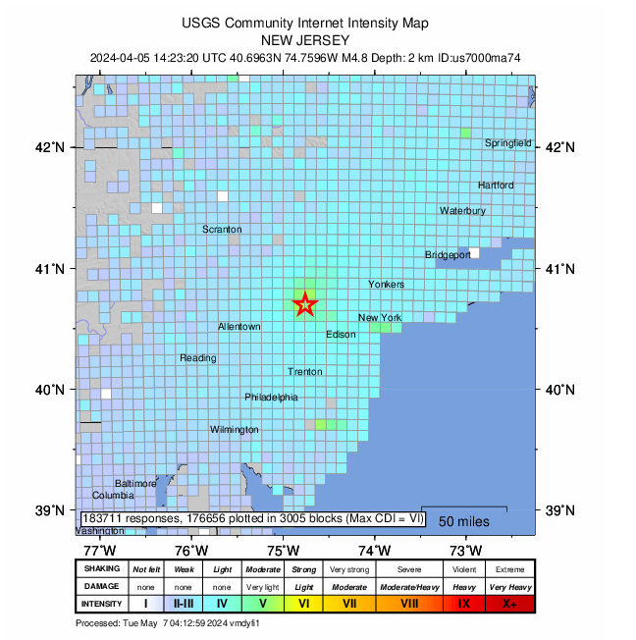
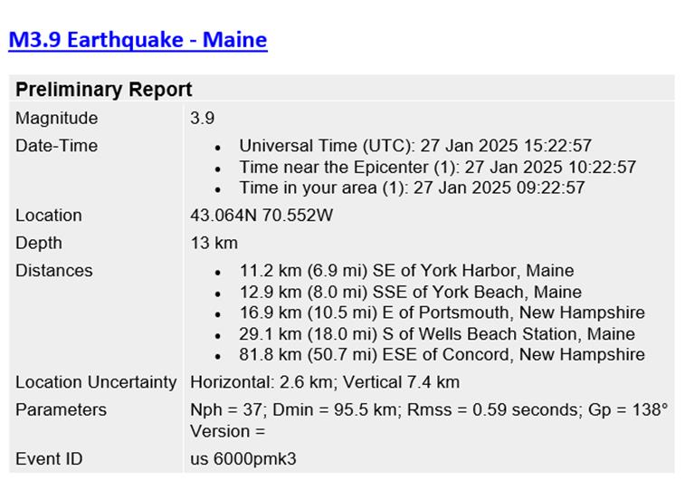
Emergency Preparedness – Earthquake Annex
Notification Process
The IMT activates and investigations begin when the severity of the quakes reach 3.0 magnitude within the service territory.
Tools from the United States Geological Survey (USGS) are used to understand the impact of the earthquake
USGS Earthquake Notification
USGS ShakeMap
USGS “Did You Feel It?” Map

Slide 7
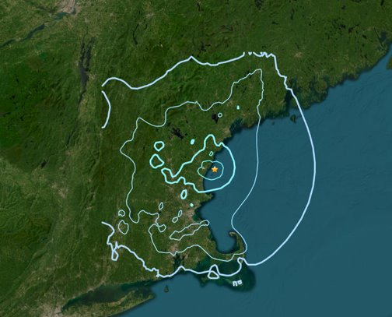
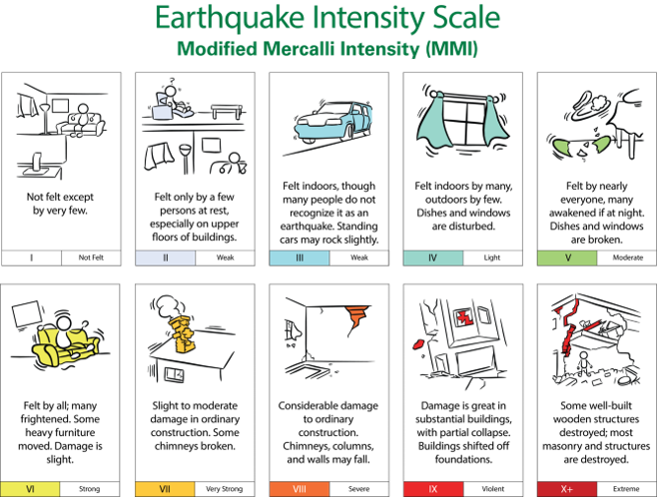
Emergency Preparedness – Earthquake Annex
The Eversource GIS Department will provide mapping to analyze the location and impact of the earthquake in relation to gas infrastructure and facilities.
This will assess what infrastructure may have been impacted and start investigations to that designated area.
Original MMI 3
MMI 3
Damage Assessment Process

Slide 8
Response Considerations
Mobilization
Develop safety messaging, including information about if personnel should respond to a location or shelter in place. (Safety Officer)
Develop earthquake-specific internal communications to keep employees informed of the earthquake effects and the implementation of this Appendix plan. (Communications Officer)
Use Graphic Information System (GIS) mapping to focus on older material types (such as cast iron) pipes in the sections of the distribution system closest to the earthquake’s epicenter. (Planning Branch Director – Engineering)
Identify potential system impacts based on the scope of the mapped impacted areas and publish a predicted impact assessment to include potentially impacted customers. (Planning Section Chief)
Implement engineering survey of LNG/LPG Facilities
Coordinate with the Operations Section Chief to determine whether the mapped impacted area(s) should be isolated and provide that decision to the IC for approval. (Planning Section Chief)
Notify dispatchers of the earthquake and track any customer calls in the impacted area with an emphasis on gas odor or no gas calls in a clustered area, or anything indicative of a main break. (Gas Dispatch Branch Director)
Notes:
Pick 5 or 6 of the phase across the board

Slide 9
Response Considerations
Sustained Actions
Notify and update communities and key stakeholders of any planned isolations being implemented to protect the system after notification of an earthquake event. (Liaison Officer)
Coordinate with the Gas Operations Section Chief to prioritize repair operations and to determine if any additional isolation measures should be taken. (Planning Section Chief)
Identify any Critical Facilities affected by the earthquake and coordinate with Engineering to develop potential temporary restoration solutions. (Planning Section Chief)
Work closely with the Gas Operations Branch Director to determine mapping and list of customers affected by the earthquake. (Planning Branch Director-Tactical)
Ensure that mark outs are still in place or are replaced in a timely manner; notify contractors, highway departments, and others involved in post-earthquake restoration activities of the presence of pipelines and the risks posed by reduced cover. (Technical Services Branch Director)
Contract for LNG Tank Assessment

Slide 10
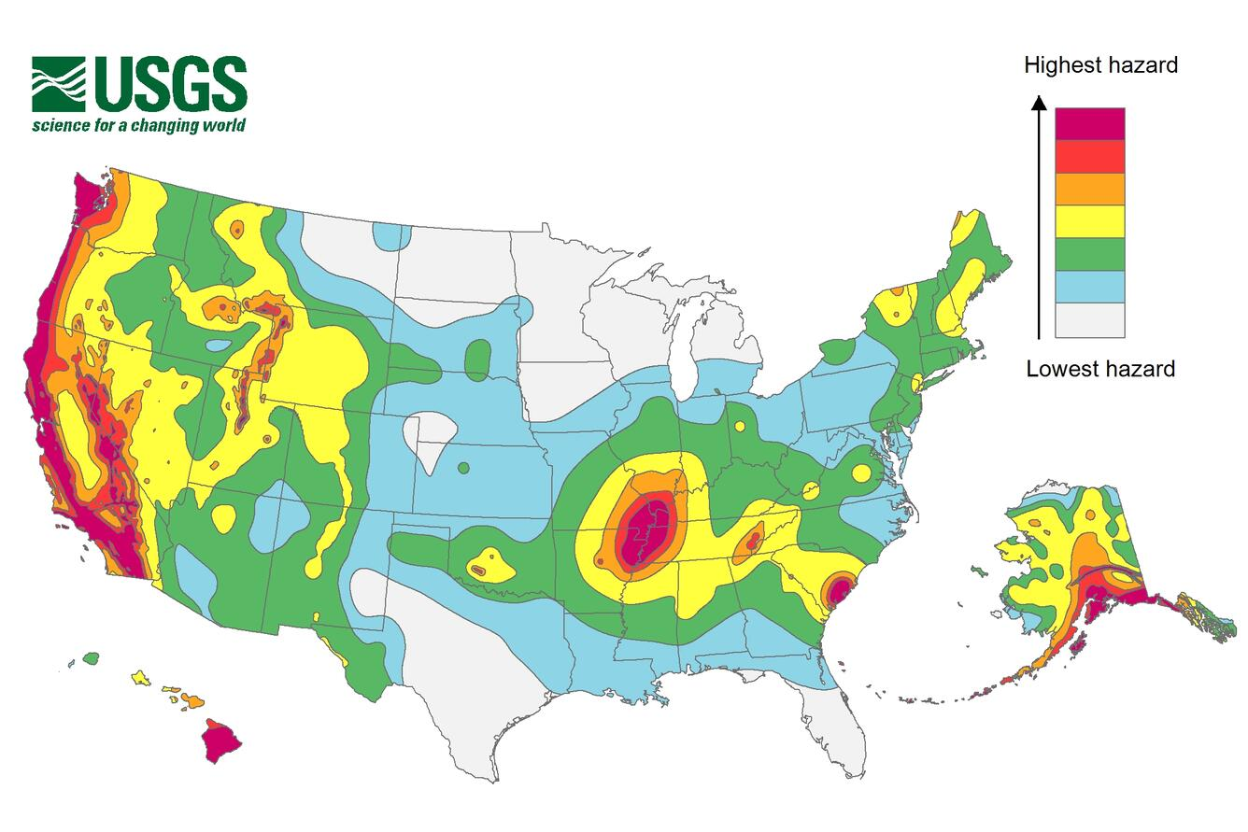
Response Considerations
Demobilization
Occurs after all inspections have been made to all the potentially effected infrastructure.
If damages were found, repairs have been made on the system and there are no area of concerns still pending.
A duration of time should be monitored within the ICC from the time the first earthquake occurred to the deactivation of the ERP to ensure no aftershock wave activity is detected.

Slide 11
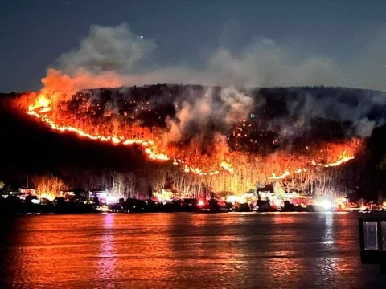
Jennings Creek Wildfire
Geoff Greene – Senior Specialist, O&R Emergency Preparedness

Slide 12
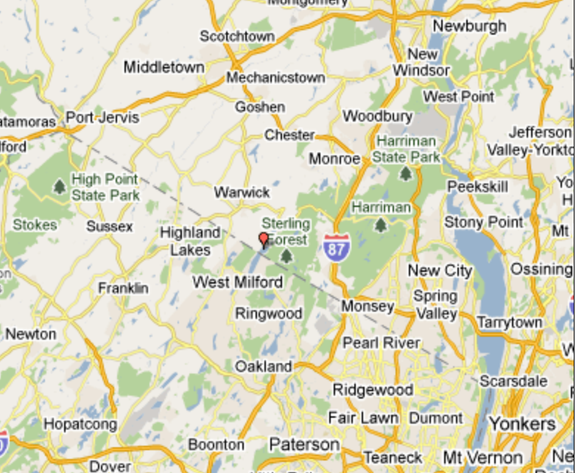
Jennings Creek Wildfire
Nov 8
O&R first aware of Jennings Creek Wildfire activity
Nov 22
100% containment declared
Nov 23
100% controlled
427 fire companies & 1,300 firefighters assisted
Nov 9
Nov 13
Nov 16
O&R began response activities
24-hour support continued through November 19th
Orange County declared State of Emergency
Voluntary evacuations conducted

Slide 13
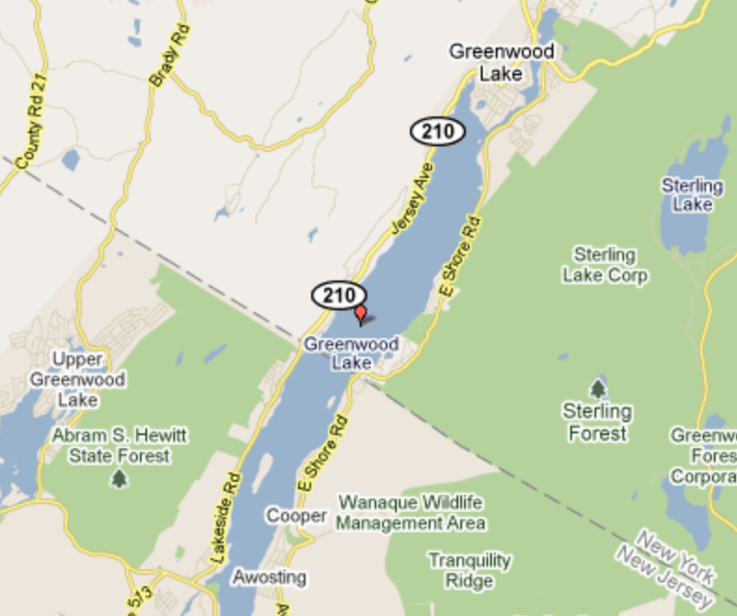
Jennings Creek Wildfire
Nov 8
O&R first aware of Jennings Creek Wildfire activity
Nov 22
100% containment declared
Nov 23
100% controlled
427 fire companies & 1,300 firefighters assisted
Nov 9
Nov 13
Nov 16
O&R began response activities
24-hour support continued through November 19th
Orange County declared State of Emergency
Voluntary evacuations conducted

Slide 14
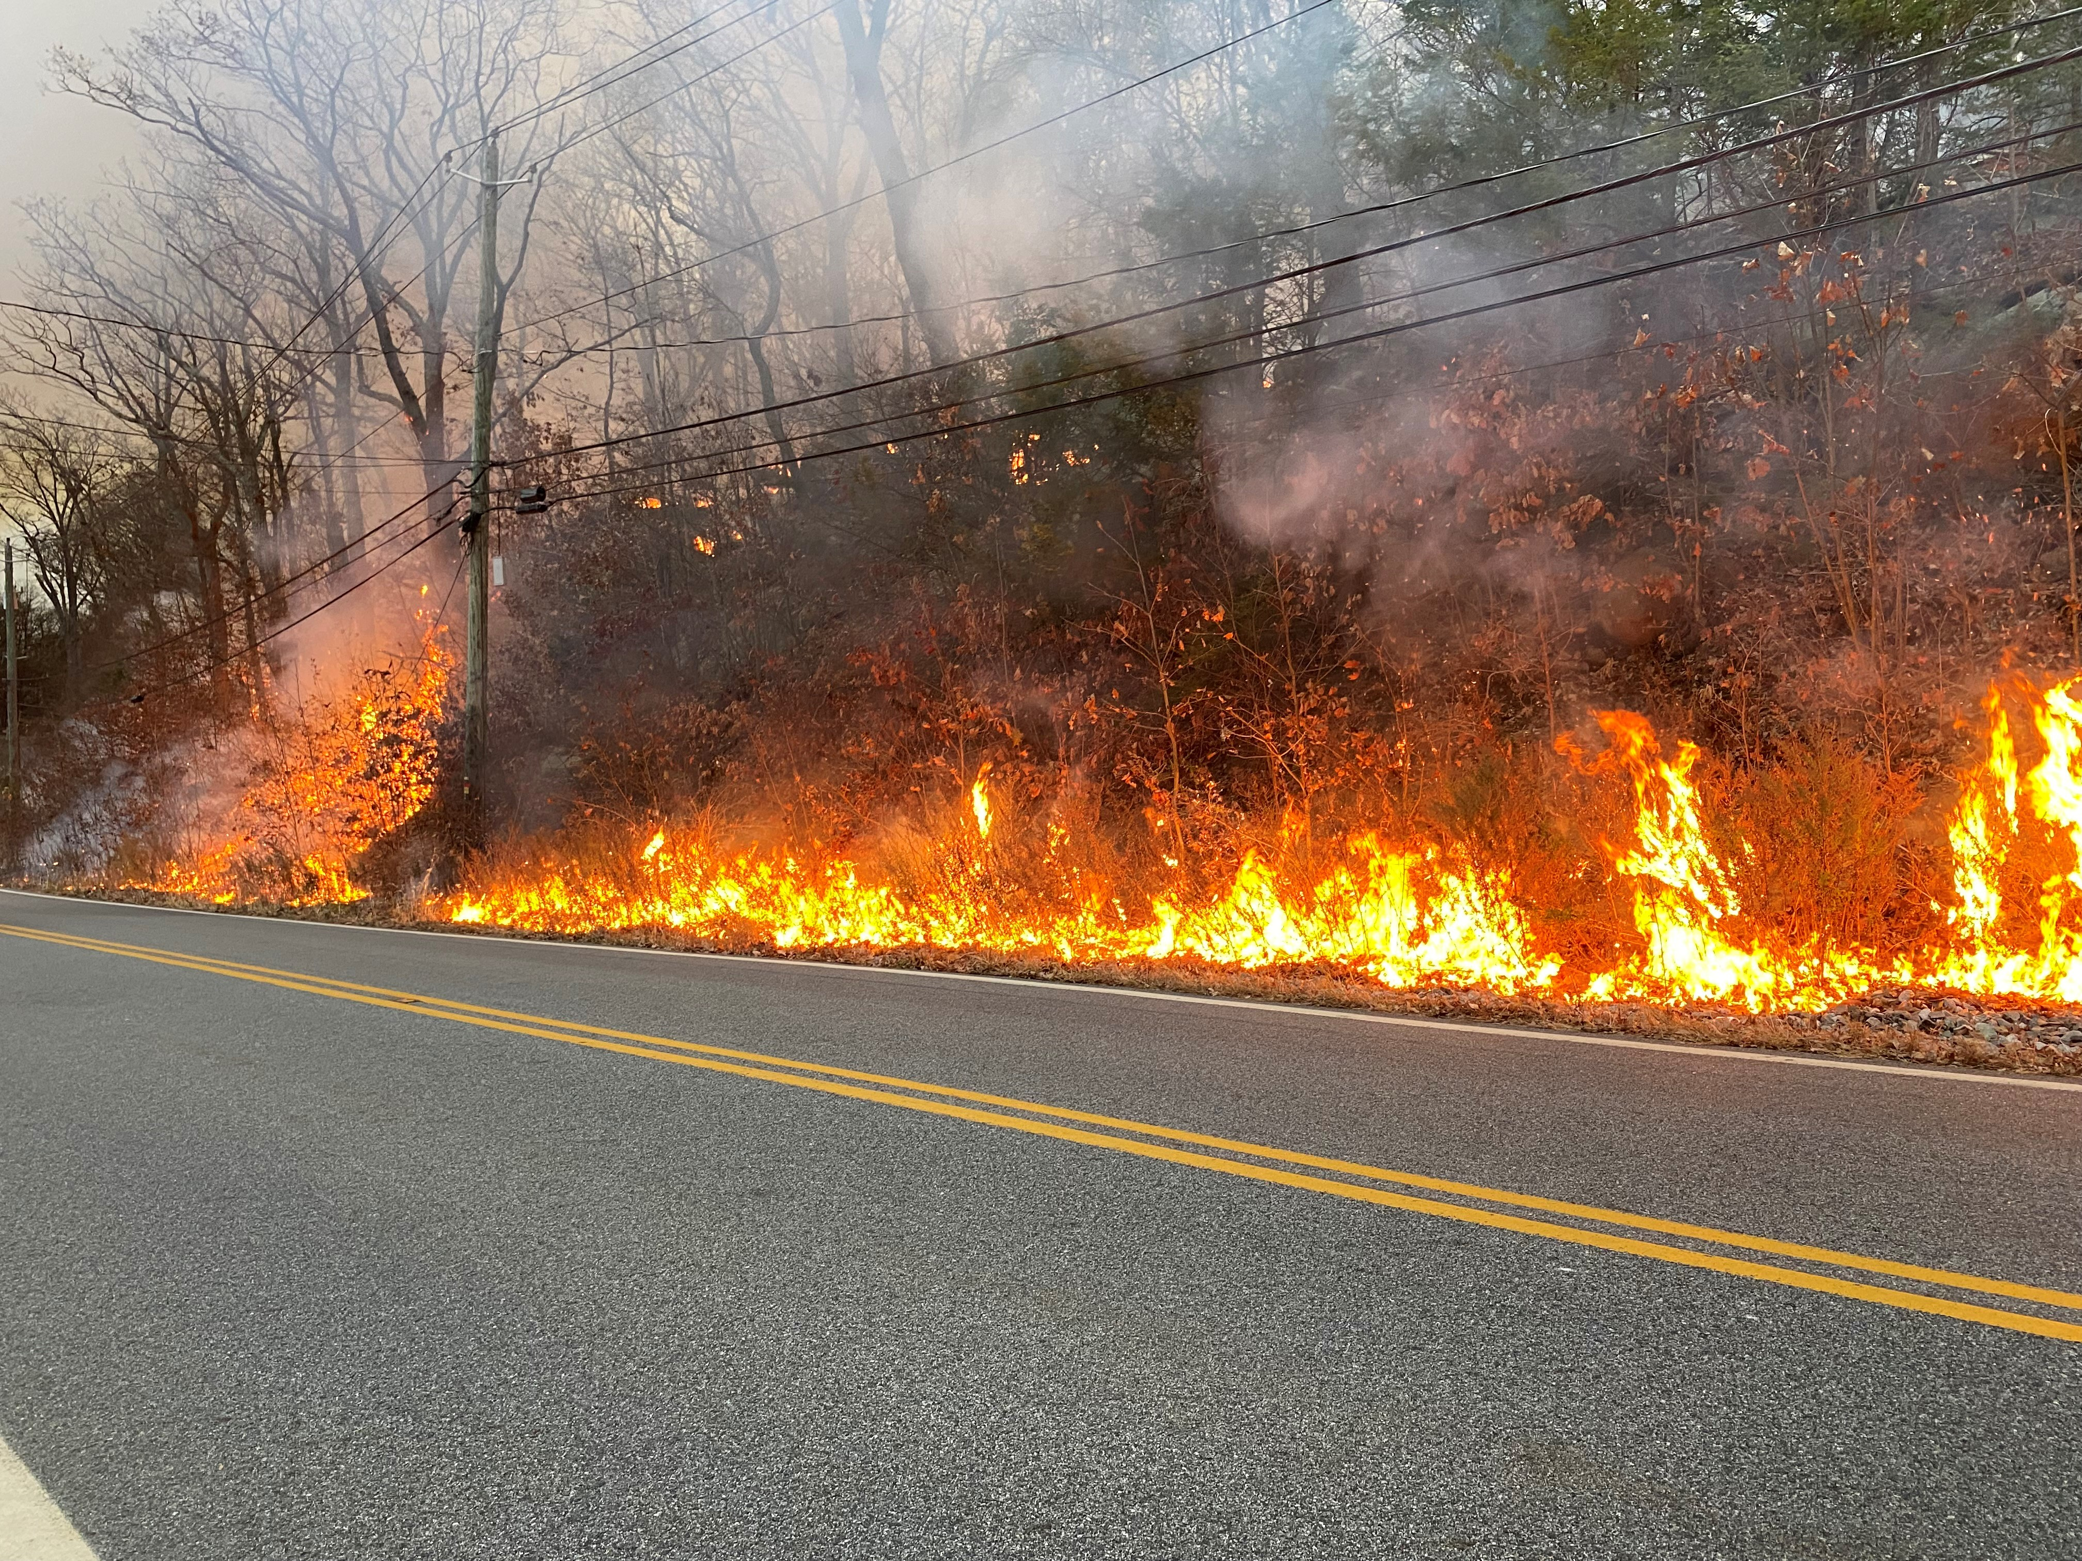
Jennings Creek Wildfire Electric Distribution
Total impacted area
5,307 acres around Sterling Forest State Park
Customer outages to facilitate firefighting activities
East side of Greenwood Lake
New York – 793 customers
New Jersey – 192 customers
Total impacted area
5,307 acres around Sterling Forest State Park
Customer outages to facilitate firefighting activities
East side of Greenwood Lake
New York – 793 customers
New Jersey – 192 customers

Slide 15
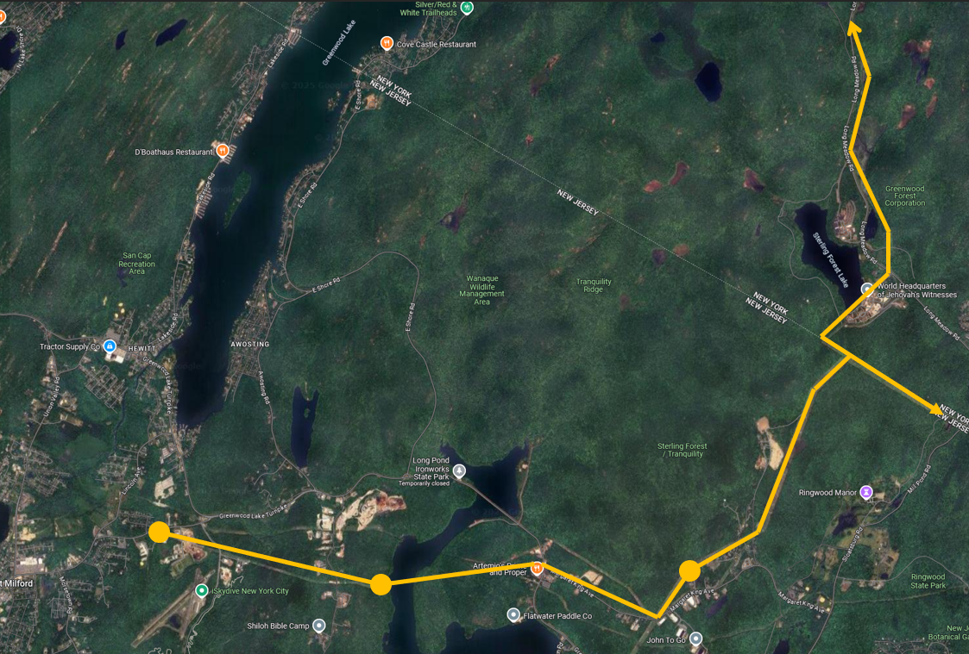
Jennings Creek Wildfire Electric Transmission Operations
Transmission Lines join on common tower
Potential loss of several Substations
~15k customer impact with minimal recovery via distribution ties
Coordinated efforts with Fire Rangers to identify alternate fire break lines
Winds ultimately shifted from N/NW to S/SE
Fire Break

Slide 16
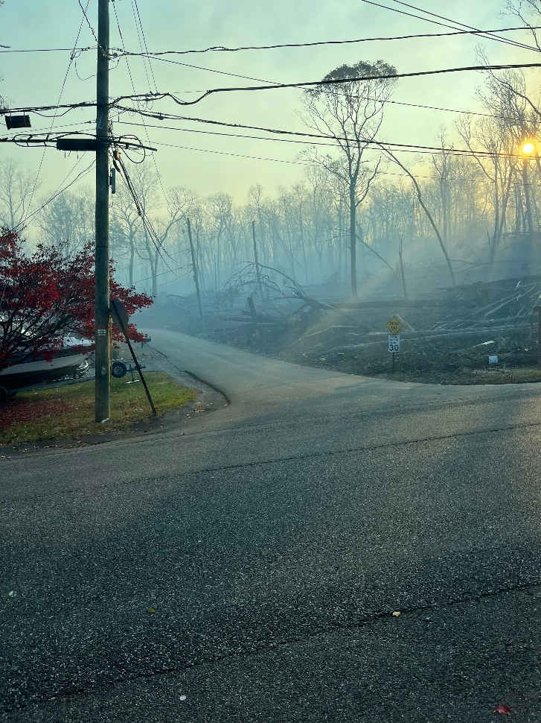
Jennings Creek Wildfire Support Provided
Operations/Emergency Preparedness
Staffed NY/NJ Command Posts
Distribution Control Center
Coordinated customer notifications
Line Crews
Conducted line patrols
Emergency switching
Vegetation Management
Cleared ~350 trees
Cleared brush and other fuels

Slide 17
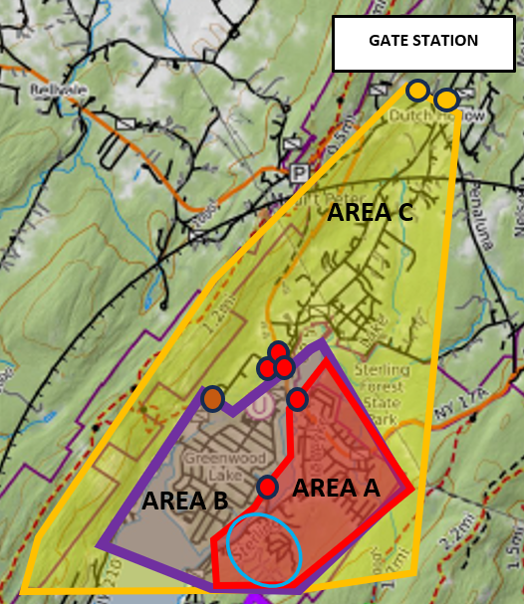
Jennings Creek Wildfire Gas Operations
Initial contingency isolation plans
Wah Ta Wah Park was greatest risk of fire impact
52 customers
November 16th
Wildfire within 1,000 feet
Shutdown trigger was mandatory evacuations
November 18th
Fire lines held
Voluntary evacuation lifted

Slide 18
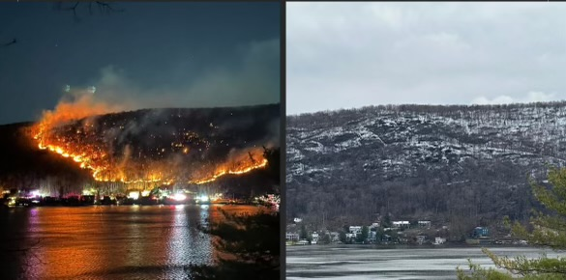
What a Difference a Week Makes

Slide 19
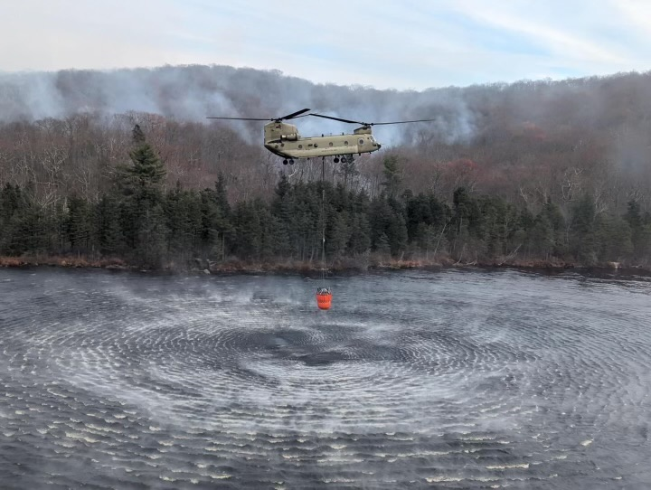
Next Steps
Wildfire Response Plan
Training and annual exercise
Customer communications plan
Design considerations
Lessons learned
Drone applications

Slide 20
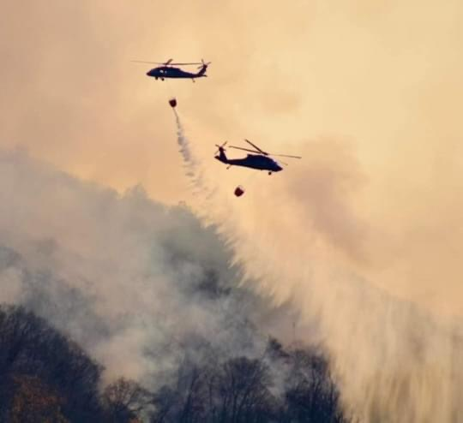
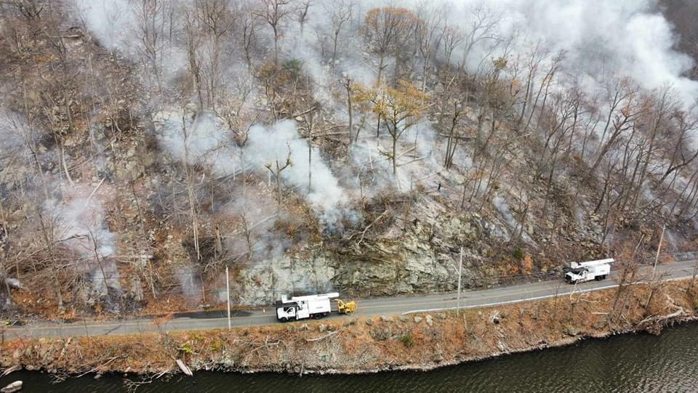
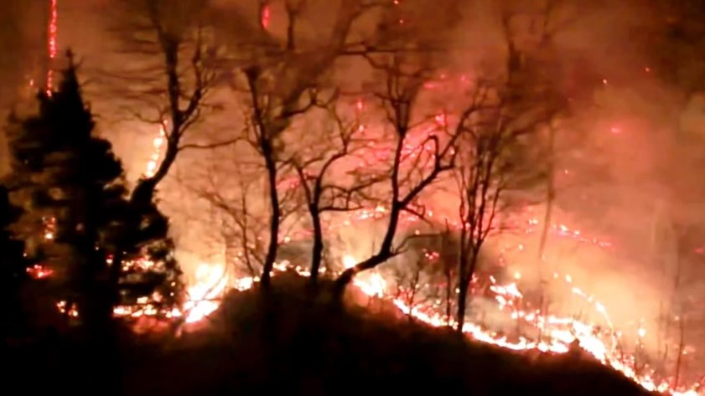
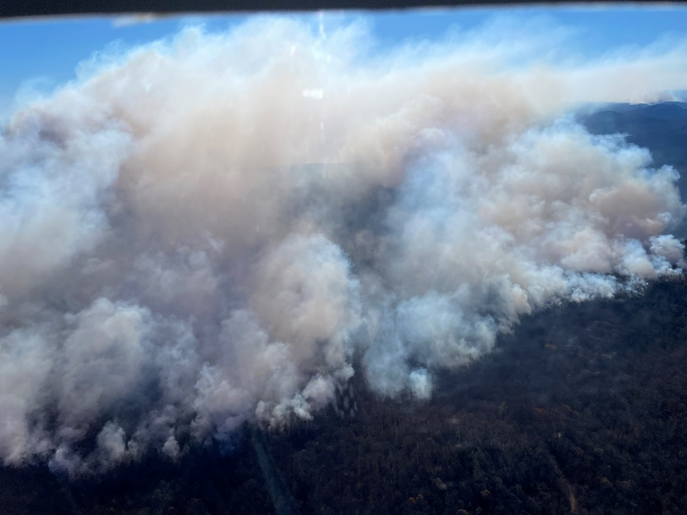
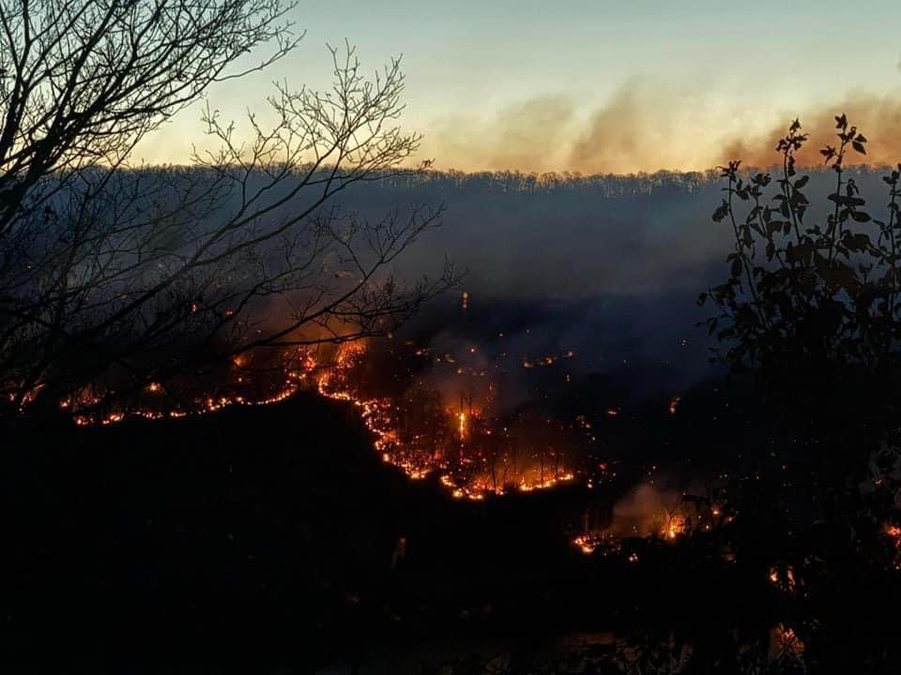

Slide 21
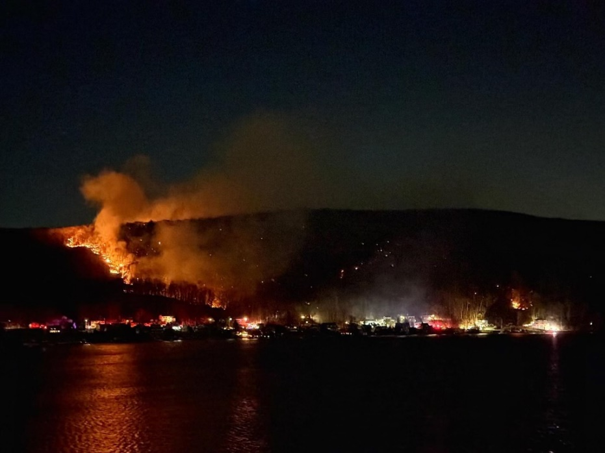
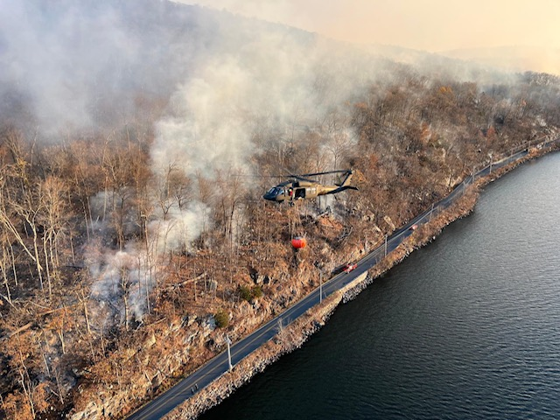
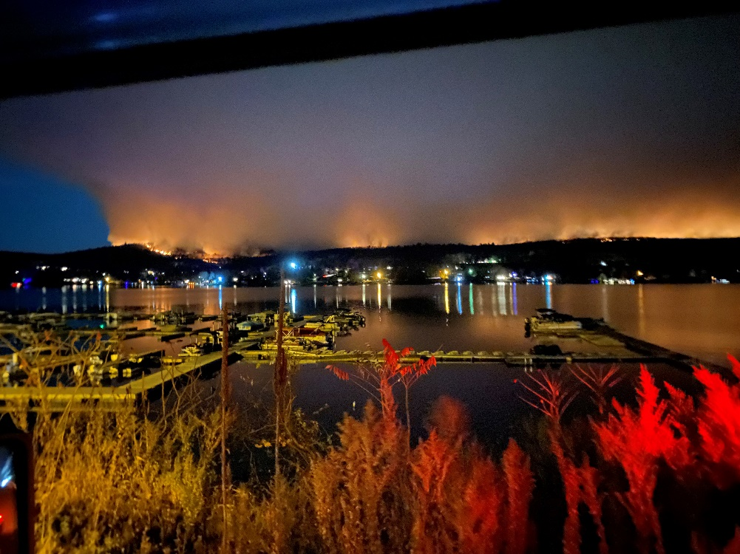

Slide 22
Q&A
Points of Contact
Josh White, Director - Gas Emergency Preparedness & Business Continuity
Joshua.White@eversource.com
- Geoff Greene - Sr. Specialist, Emergency Preparedness
Greeneg@oru.com

