Slide 1
New Jersey Natural Gas
Innovation
Jerry Ryan
Managing Director, Innovation

Slide 2
NJNG’s Current and Potential Innovation and Clean Fuels Projects
Gas Heat Pump Pilot Program - for commercial and residential applications
Hydrogen Power to Gas projects - preliminary engineering on to be determined hydrogen project
Geothermal Feasibility Study - determine if district geothermal is suitable for NJNG’s service territory
Carbon Capture - deployment of CarbinX units in service territory and pilot of Carbon Reform carbon capture technology
Renewable Natural Gas - Landfill and various RNG projects at waste water treatment plants
UpGen Fuel Cells - demonstration project for product validation and potential value
CNG - construction of new CNG fueling stations
Hybrid Heat - deployment of hybrid heat units to demonstrate effectiveness

Slide 3
NJNG’s Decarbonization Strategy
Behind the Meter Solutions
Innovation in Operations
Clean Fuels
Continue to support significant investment in energy-efficiency programs
Support the development of the market for gas heat pumps, hybrid heat and similar products
Explore the utilization of carbon-capture technologies in end-use/customer applications
Implement advanced leak detection strategy through programs, such as direct measurement and satellite monitoring of methane emissions
Develop a comprehensive strategy to mitigate stationary combustion sources
Advance strategies to decarbonize NJNG operations and related services
Expand the deployment of green hydrogen facilities owned and operated by NJNG
Drive continued progress of other hydrogen initiatives including the hydrogen hub, potential partnerships with wastewater plants, etc.
Advance NJNG’s efforts on RNG through landfill and waste-water treatment plant projects
Our objective is to enable a renewable energy transformation that is affordable and reliable through the reduction of emissions and the storage, transport and delivery of diverse renewable energy sources.
Notes:
This is a slide we have used several times in presentations to ground ourselves in the three pillars of our decarbonization strategy. With my position, the Office of Innovation is focused on Behind the Meter Solutions, and in doing so, we look for new energy efficiency opportunities and technologies such as gas heat pumps and hybrid heat. We also are identifying technologies that can capture carbon in end use applications. One of those technologies will be part of our discussion today.

Slide 4
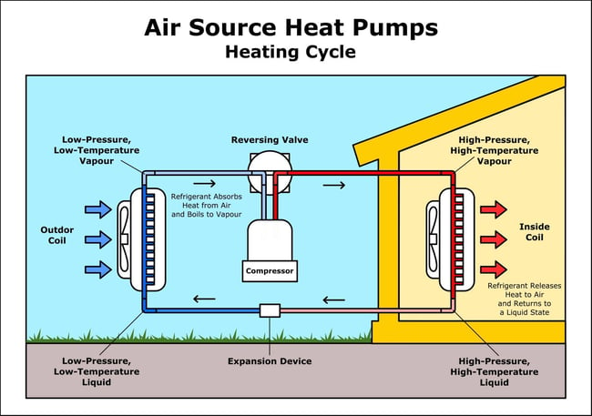
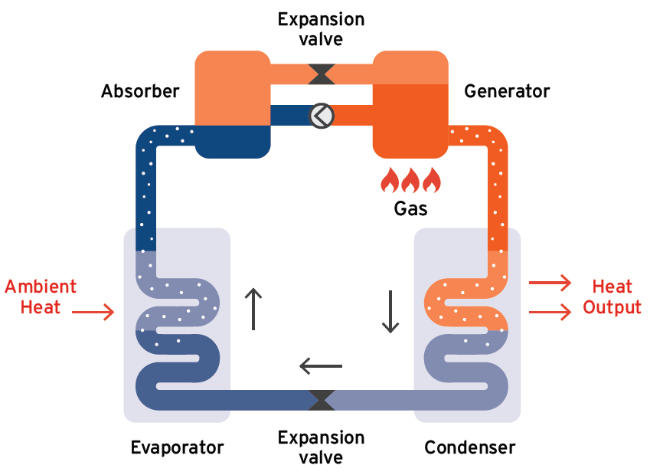
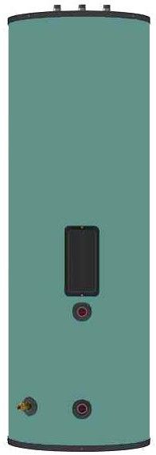
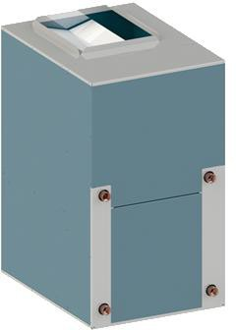
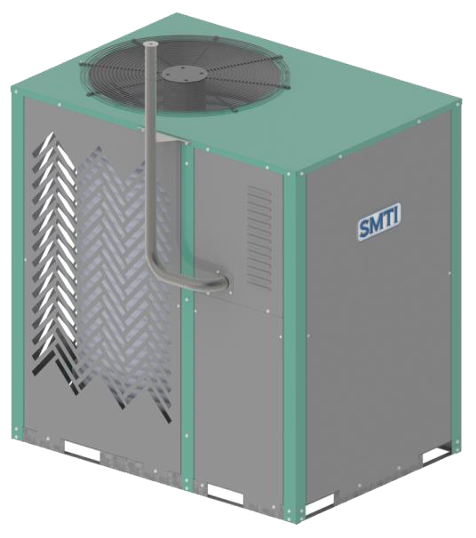
Gas Heat Pumps
A heat pump is an HVAC system that uses the refrigerant cycle to provide both heating and cooling functions. These systems work to pump heat either into or away from a space, depending on the mode.
Notes:
First – a quick background on Carbon Capture terminology and systems. Carbon Capture can be segmented into either Direct Air Capture or Point Source Capture. Furthermore, that capture could include utilization and/or storage of the carbon after capture. I have previously discussed Clean O2 and the ability of that product to capture CO2 from flue gas. This is an example of point source capture at a smaller scale. And yes, that carbon is being both stored, and then utilized to make soaps and cleaning products. Direct Air Capture is normally defined as extracting CO2 from the atmosphere. Our interests at the office of Innovation are looking at technologies that use direct air capture in buildings, specifically those that can be attached to the air stream of HVAC systems. One of these technologies will be our focus today.

Slide 5
NJNG’s Current Gas Heat Pump Strategy
NJNG is currently working with the Gas Heat Pump Collaborative to develop a common framework to (1) Ready, (2) Validated and (3) Deploy near-market residential gas heat pumps
Ready Technology for Market
Validate Final Production Units
Field Deployment
Design for forced air applications (AHU + controls)
Cold climate readiness
Installation guidelines
Servicing
Certification
Simulated Use Testing
Certified, warrantied units
QA/QC testing for production units
Accelerated life testing in a phased approach
Simulated use testing
Workforce development and training
Controlled demonstrations
Early adopter pilots
Working with Utilities across North America to study this technology

Slide 6
Picture of Anesi HP at training Center

Slide 7
Different Types of Carbon Capture
Technology that actively removes CO2 directly from the atmosphere via a chemical solution that binds to CO2, allowing for its extraction and storage or potential repurposing into other products
Direct-Air Capture
CO2 is captured directly at the source of emission (e.g., power plant smokestack), before it is released into the atmosphere, typically from a single, identifiable point
Point-Source Capture
Carbon Capture Utilization & Storage captures CO2 from sources like coal-fired power plants and either re-uses or stores it so it will not enter the atmosphere. CO2 storage in geologic formations includes oil and gas reservoirs, coal seams and deep saline reservoirs
Utilization & Storage
Notes:
First – a quick background on Carbon Capture terminology and systems. Carbon Capture can be segmented into either Direct Air Capture or Point Source Capture. Furthermore, that capture could include utilization and/or storage of the carbon after capture. I have previously discussed Clean O2 and the ability of that product to capture CO2 from flue gas. This is an example of point source capture at a smaller scale. And yes, that carbon is being both stored, and then utilized to make soaps and cleaning products. Direct Air Capture is normally defined as extracting CO2 from the atmosphere. Our interests at the office of Innovation are looking at technologies that use direct air capture in buildings, specifically those that can be attached to the air stream of HVAC systems. One of these technologies will be our focus today.

Slide 8
Carbin X – Point Source Carbon Capture at NJNG Headquarters
Two CleanO2 CarbinX units were installed at NJNG’s Corporate Headquarters in 2024 and are operational
GTI will perform Evaluation, Measurement and Verification services for NJNG to independently confirm the benefits of the CarbinX units

Slide 9
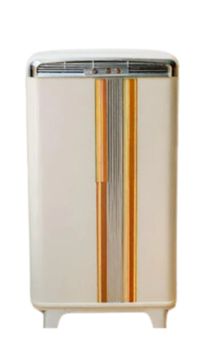
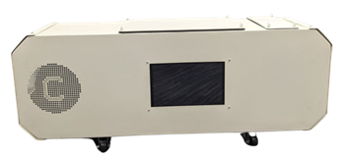
Direct Air Carbon Capture
Retrofit unit that scrubs building CO2, VOCs, particulates and pathogens from indoor air
10 tons CO2 captured/year
50% HVAC energy savings
One carbon capsule at NJNG Lakewood office
Reduces the amount of outside air that needs to be introduced and conditioned to high volume office areas – as a result, there are energy savings
Plug-and-play units that scrubs in-room CO2, VOCs, particulates, and pathogens
1 ton CO2 captured/year
Advanced air purification
Installing units at Lakewood Field Office and Wall GO conference rooms

Slide 10
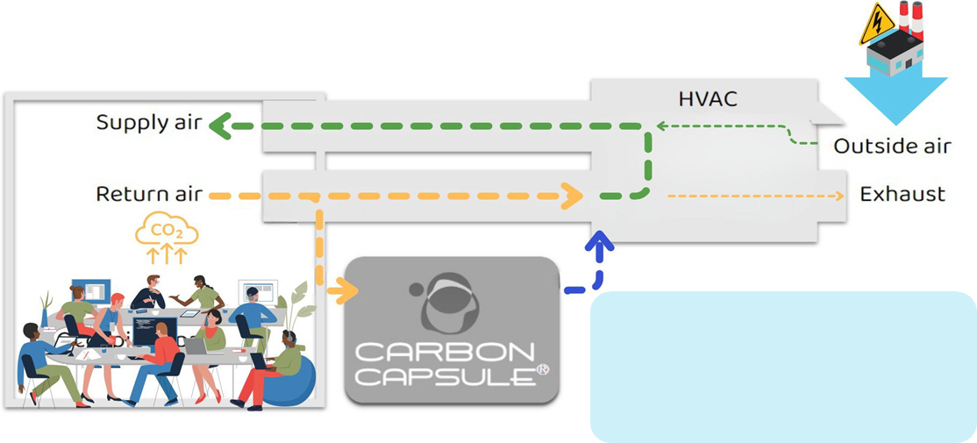
How the Carbon Capsule Works
✔ Reduce stress on HVAC
✔ Recirculate clean, healthy air
✔ 50%* HVAC energy reduction
Notes:
The Carbon reform Carbon Capsule attaches to the return air stream of an HVAC duct system as shown here. Air is rerouted through the capsule, scrubbing the CO2 and other harmful pollutants and then returned to the system. This is achieved by utilizing limestone aggregate in the filtering system, which collects the CO2 and permanently captures it. By cleaning the air with the capsule, we mitigate the amount of outside air necessary to be introduced into the system, thereby reducing the amount of air that needs to be conditioned – i.e. warm air in the summer needs to be cooled, and cold air in the winter needs to be warmed – this is where our energy savings comes from and thereby reduces operational cost to our customers. The total cost to a customer is currently about $80K. We project payback without incentives to be between 8-10 years. With Engineered Solutions, we buy down that payback by 6 years resulting in an attractive Energy Conservation Measure for Commercial Customers.

Slide 11
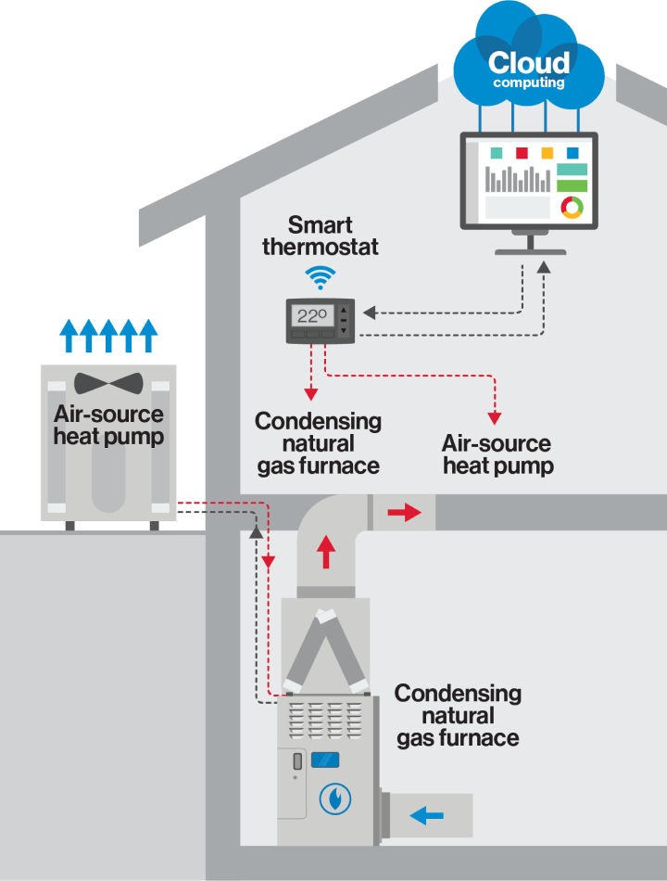
Hybrid Heat System
A hybrid heat system is comprised of an electric heat pump and a gas furnace
The system operates based on the type of comfort control for dual fuel to help maximize efficiency and effectively heat and cool your home all year long

Slide 12
Hybrid Heat Options

Slide 13
Ductless Mini Splits
Ductless splits, also called “mini-splits” pump cooled or heated refrigerant directly to the wall or ceiling-mounted air-handling unit, and each unit has its own wireless electronic temperature control system, a.k.a., a remote
Refrigerant and electrical lines connect the outdoor unit to the indoor unit through a 3” opening in the exterior wall
The outdoor unit’s heat pump cools or warms refrigerant and sends it back inside to the air handler, which continuously monitors the room for changes in temperature and sends conditioned air to the areas of the room that need it

Slide 14
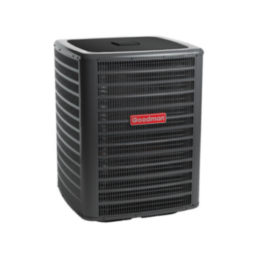
Mix-Match Split Systems
A split HVAC system is an air conditioner system or heating system that has both indoor and outdoor units that are connected with copper tubing
Traditionally, the outdoor portion of the unit contains the compressor and condenser, and the indoor portion of the unit contains an evaporator coil and indoor air handling unit that sends the air through the ductwork in your home
This could be implemented by adding a compatible HP to an existing furnace replacing an AC, or sold as a new system install

Slide 15
Advanced Hybrid Systems
System gives you maximum control and comfort by helping minimize temperature swings and hot and cold spots within your home, while saving you money on energy costs
Products work together seamlessly to let you customize your home’s indoor environment, while also giving you information to make smarter decisions about energy management

Slide 16
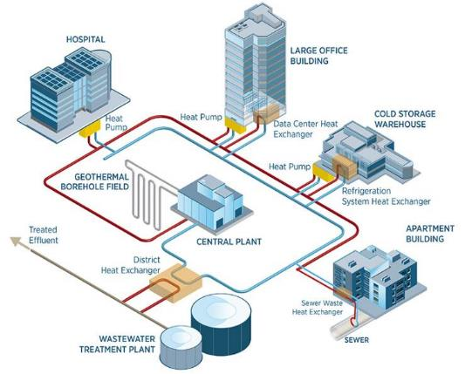
District Heating & Cooling
For community-scale heating and cooling systems, geothermal boreholes are usually drilled 100–1000 feet deep. The boreholes provide interconnected buildings (districts) with constant temperatures that are used to both heat and cool buildings via heat pumps. The district uses pipes so water can circulate between buildings. In the summer, an energy station pumps cool water through pipes to buildings in the system. In the winter, hot water is pumped through the pipes while cool water returns to the energy station for reheating. Graphic, NREL

Slide 17
District Geothermal
Advantages
Reduced Carbon Emissions
Delivered Energy Cost Reductions
Reliable and Consistent Energy for Heating and Cooling
Waste Heat Recovery
End Use Equipment on the system is highly efficient
Reduces Demand on the Grid
Other
High Initial System Cost – Makes Utility Model Preferable
Location Dependent - Need Energy Density and Diversity
Tax Credits for homeowners:
30% when your GHP is placed in service after Dec. 31, 2021 and before Jan. 1, 2033.
26% when your GHP is placed in service after Dec. 31, 2032 and before Jan. 1, 2034.
22% when your GHP is placed in service after Dec. 31, 2033 and before Jan. 1, 2035.

Slide 18
District Geothermal
Approved through our energy Efficiency Filing
Currently underway
Site selection process in development
Cost benefit analysis and other criteria used in a scoring matrix to select

Slide 19
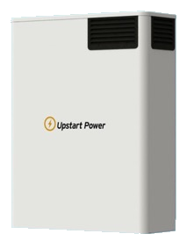
Upgen NXG Home Generator

Slide 20
Upstart Upgen NXG – The Future of Resiliency & Power Independence
A Smarter Generator for a Cleaner Tomorrow
Leveraging Next Gen Solid-Oxide Fuel Cell Technology
A Far Superior Backup Generator 100% Resilient & Better for the Environment
Long-duration backup system:
Clean, quiet, wall mounted and negligible maintenance
Pairs with today’s clean energy technology:
Optimized to work with batteries and solar (optional)
Versatile:
Supports Grid Connected and back-up applications, Virtual Peaker Plant (VPP) ready
Lower installed cost:
Eligible for 30% Federal Investment Tax Credit, low- cost installation
Lower total cost of ownership:
There for you:
Unlimited backup to cover all grid failures and sun shortfalls
Ready Today:
Runs 24x7 on natural gas (or propane/hydrogen blends) to produce power equivalent to 4 solar panels (1.25 kW -> ~30 kWh per day)
Highly Efficient & Environmentally Friendly:
¼ of the fuel and ¼ of the CO2 emissions. Negligible CO/NOx/SOx/Particulate emissions and low noise align with home of the future mindset
© 2024 Upstart Power - Proprietary and Confidential
19

Slide 21
Homeowner Objectives & Options
Homeowner Pain Points
I want my Home Energy System to
1…. Power my home through short and long grid outages
Power my home even when the sun is not shining
Minimize my electric bill & utility dependence
Reduce carbon footprint of my home
Allow me to sell power
Grid Failures
High Electricity Costs
Climate Concerns
GRID INDEPENDENCE SOLUTIONS
Solar | Solar + Storage | XL Solar + XXL Storage | Solar + Storage + Combustion Generator | Solar + Storage + Fuel Cell Generator
✓ | ✓ | X | ✓ | ✓
X | Short-duration | 95-97% | 100% | 100%
✓ | ✓ | ✓ | X | ✓
PERFORMANCE CRITERIA
System Economics Resiliency Environmental
20

