Slide 1
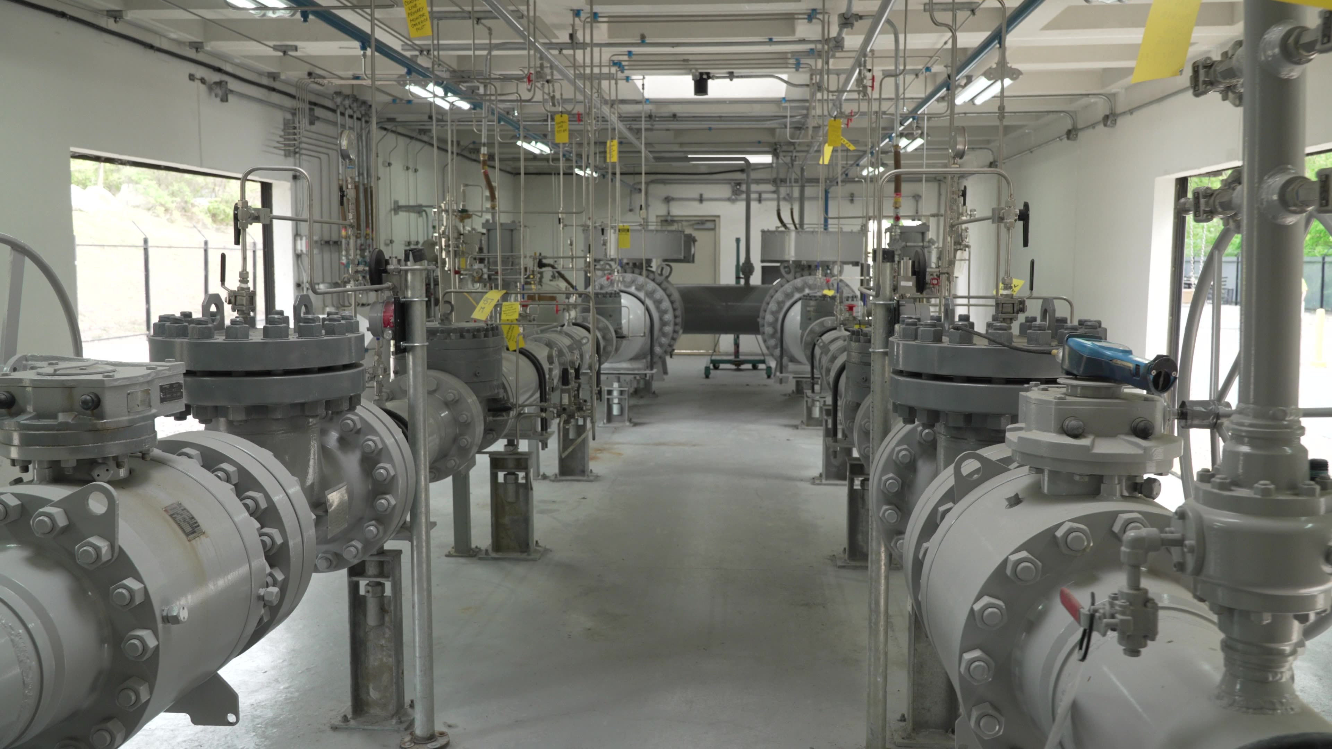
Pipeline Safety Management System (PSMS) Learning Series
Joan Turba, GTI Energy
Mike Gallinaro, Northeast Gas Association
NGA Spring Operations Conference | April 10, 2025

Slide 2
Agenda
Speaker introductions
PHMSA Advisory Bulletin 3/25/2025
What is an SMS?
Pipeline Safety Management System (PSMS)
GTI Energy’s PSMS Learning Series curriculum
NGA PSMS Collaborative
NGA Resource Center Access
Flexible Delivery Options
Continuous Improvement
Q & A

Slide 3
Speaker Introduction
Joan Turba, Sr Program Manager, GTI Energy
3 years GTI Energy
12 years Northeast Wisconsin Technical College (NWTC)
Workforce and Corporate Training, specialized in energy education
Wisconsin Energy Workforce Consortium (WEWC), Executive Committee 2014-2022, 2024-present
Education
MSEd, Learning Design and Technology, Purdue University

Slide 4
Speaker Introduction
Mike Gallinaro, Northeast Gas Association (NGA)
5 years at NGA
40 years at National Grid
Education/Certifications
BS Engineering Science – City University of New York (CUNY), College of Staten Island (CSI)
American Society for Quality (ASQ) – Six Sigma Black Belt (SSBB), Certified Quality Engineer (CQE)
Project Management Institute (PMI) – Project Management Professional (PMP)

Slide 5
PHMSA Advisory Bulletin March 25, 2025
“NTSB has long advocated for PSMS
implementation by the pipeline
industry. After investigating two serious
accidents in 2010, NTSB found that
pipeline safety would be enhanced if
pipeline companies implemented SMSs.
The first accident occurred on July 25,
2010, when a 30-inch pipeline ruptured
in Marshall, Michigan, resulting in the
estimated release of 840,000 gallons of
crude oil into the Kalamazoo River.
The second accident occurred on September
9, 2010, when a natural gas transmission
pipeline ruptured in San Bruno,
California, killing eight people, injuring
many more, and destroying 38 homes.”
Notes:
Closer to home, here in the northeast, the 2018 Merrimack Valley Overpressurization incident leading to significant changes in pipeline safety regulations, the Pipes Act of 2020 and PHMSA reenforcing the recommendation to operators to voluntarily adopt PSMS principles into their business.

Slide 6
What is a Safety Management System (SMS)?
The Federal Aviation Administration (FAA) defines SMS as a ‘‘formal, top-down, organization-wide approach to managing safety risk and assuring the effectiveness of safety risk controls. It includes systematic procedures, practices, and policies for the management of safety risk.’’ 1
In the pipeline community, SMS is similarly described as a ‘‘systematic approach to managing safety, including the structures, policies, and procedures an organization uses to direct and control its activities.’’ 2
1. FAA Order 8000.369C, Safety Management System, (June 24, 2020), https://www.faa.gov/documentLibrary/media/Order/Order_8000.369C.pdf.
2. Pipeline SMS Industry Team, Introduction to Pipeline SMS Implementation, Book 2: What is a Pipeline SMS?, https://pipelinesms.org/wp-content/uploads/2021/01/DM2018-045-Pipeline-SMS-Book-2_PRINT-READY_CMYK_062119_Branding-Updates.pdf.
Notes:
A safety management system (SMS) is a structured approach to managing the safety of complex processes and provides a detailed framework inclusive of structures, procedures, information, and governance used to direct an organization’s operations.

Slide 7
API RP 1173 – Pipeline Safety Management System
Source: API | Pipeline Recommended Practices (RP)

Slide 8
GTI Energy PSMS Learning Series
Series I – Introduction to API RP 1173
Series II – API RP 1173 Essential Elements
Introduction to API RP 1173 PSMS
Overview of API RP 1173 Essential Elements
Introduction to the PSMS Journey
The Importance of Safety Culture
Contractor Engagement for the Operator
Contractor Engagement for the Pipeline Contractors
Leadership and Management Commitment
Stakeholder Engagement
Risk Management
Operational Controls
Incident Investigation, Evaluation, and Lessons Learned
Safety Assurance
Management Review and Continuous Improvement
Emergency Preparedness & Response
Competence, Awareness, & Training
Documentation and Record Keeping
16 Modules total
Self-paced, eLearning
Knowledge checks
15 minutes each

Slide 9
GTI Energy PSMS Learning Series Example: Series 1, Module 6

Slide 10
GTI Energy PSMS Learning Series Example: Series 1, Module 6

Slide 11
GTI Energy PSMS Learning Series Example: Series 1, Module 6

Slide 12
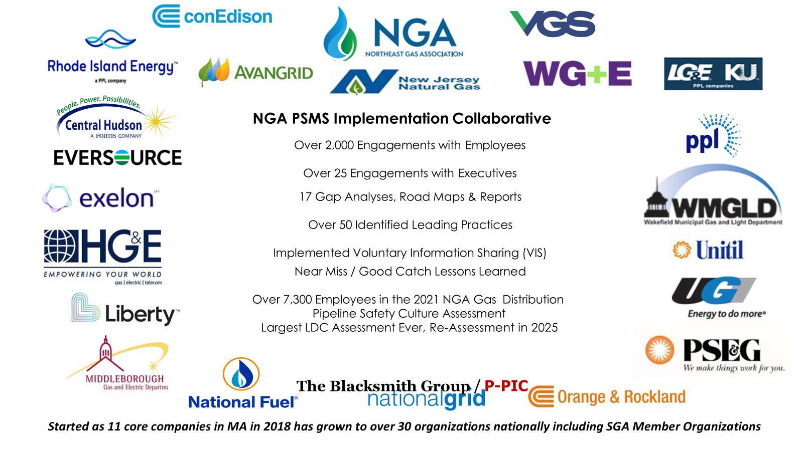
NGA PSMS Collaborative
Notes:
In December of 2018, the NGA Board of Directors approved the creation of the NGA PSMS Collaborative to concentrate on embedding API RP 1173 Pipeline Safety Management Systems (PSMS) principles into day-to-day natural gas utility operations. The Collaboratives’ focus is on operationalizing safety management system strategy by adopting a Plan-Do-Check-Act (PDCA) framework applicable to daily engineering, construction, operations and maintenance activities. What started as a pledge to improve our safety performance has become out way of working together on PSMS implementation and continuous improvement. Through the NGA Collaborative we share information to continuously learn as a group, because we believe it’s our best path forward to implement and mature pipeline safety management in our industry.

Slide 13
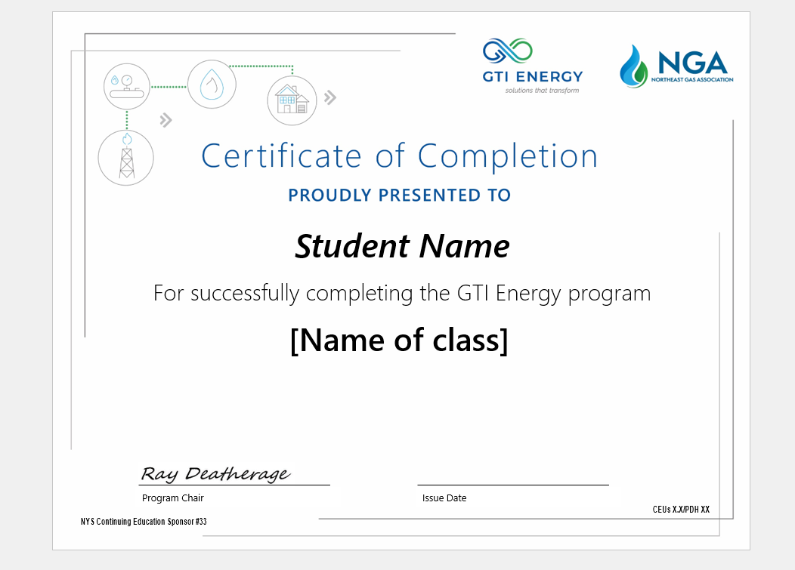
NGA PSMS Collaborative

Slide 14
NGA Resource Center Access
Click on Members
After you enter NGAPSMS.com in the search bar you land on this page

Slide 15
NGA Resource Center Access
Click on Members Home

Slide 16
NGA Resource Center Access
Click on PSMS eLearning

Slide 17
NGA Resource Center Access
Click on GTI eLearning Link

Slide 18
NGA Resource Center Access
Clink on Link to GTI Training

Slide 19
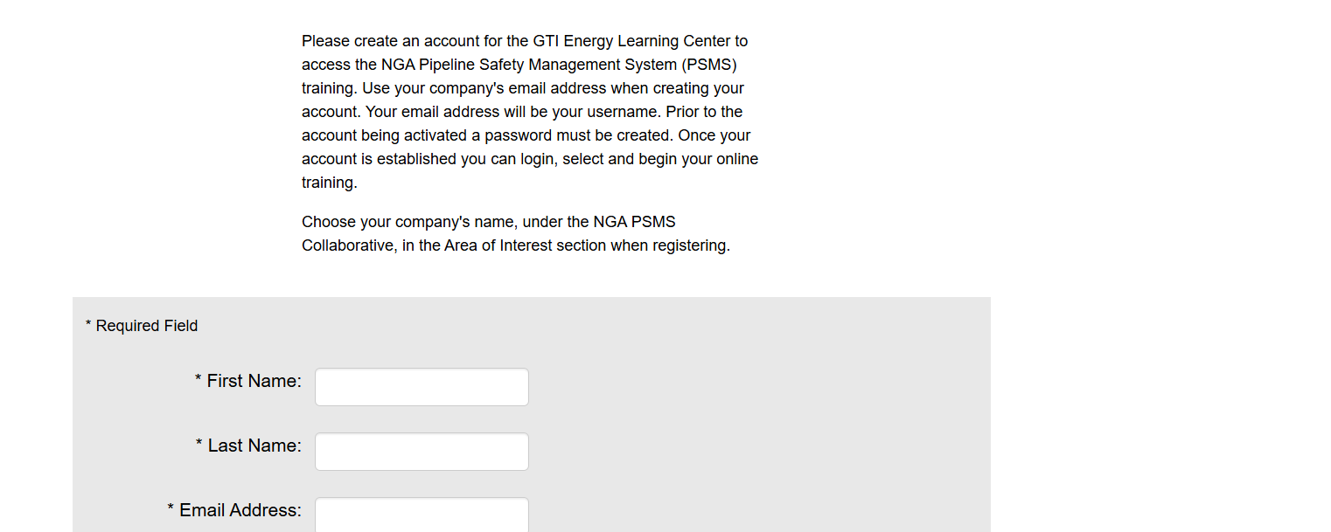
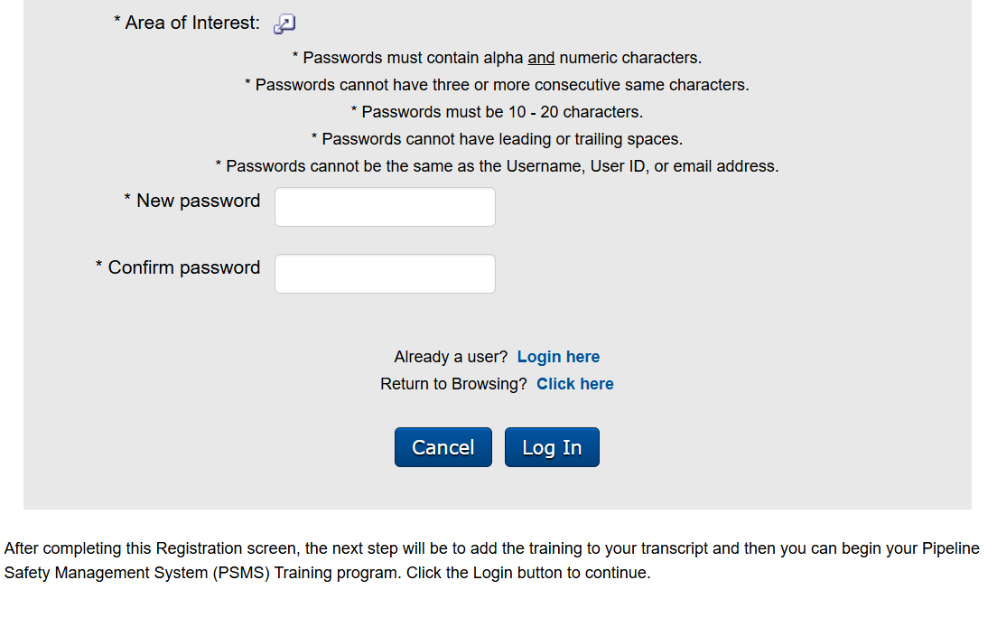
NGA Resource Center Access
Sign up here

Slide 20
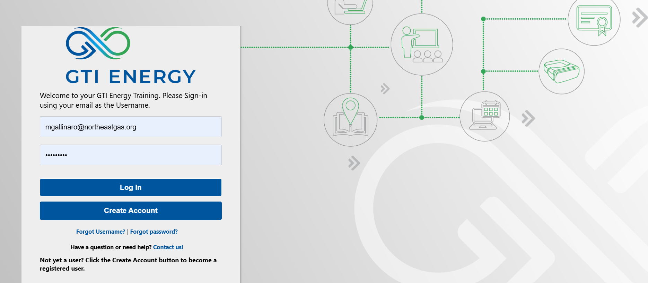
NGA Resource Center Access
Enter username and password and login or create an account

Slide 21
NGA Resource Center Access

Slide 22
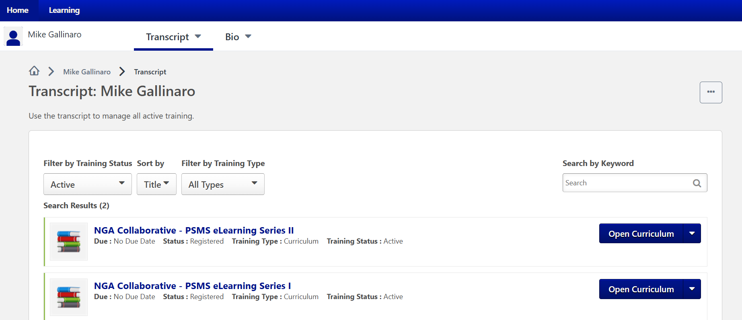
NGA Resource Center Access
Click here to select Series 1 if just starting the program

Slide 23
NGA Resource Center Access
Click here to activate the course

Slide 24
Flexible Delivery Options
NGA Resource Center
ITS User Platform
GTI Energy
Host PSMS training on your company’s learning management system (LMS)
Coordinate with NGA
GTI Energy will share PSMS eLearning SCORM files with your organization
Enroll your employees, track their progress in your company LMS
Customize the Certificate of Completion by adding your logo

Slide 25
Program Continuous Improvement Enhancement through Engagement
Currently, a sub team consisting of members from various operating organizations involved in the NGA PSMS Collaborative are engaged in a comprehensive review of all the modules in Series 1 and Series 2.
Review check point questions to verify they are correct
During review if you identify an issue, you record time and slide number
Look for safety PPE issues
Verify all the resources in the resource tab open correctly
Look for grammatical and typographical errors
Tactical Guide image updates
Make sure narrations line up with slide content
Image clarity
Audio quality and clarity
Additional comments

Slide 26
Questions?
Joan Turba
jturba@gti.energy
Mike Gallinaro
mgallinaro@northeastgas.org

