Slide 1
The Best Tool for Empowerment in the World

Slide 2
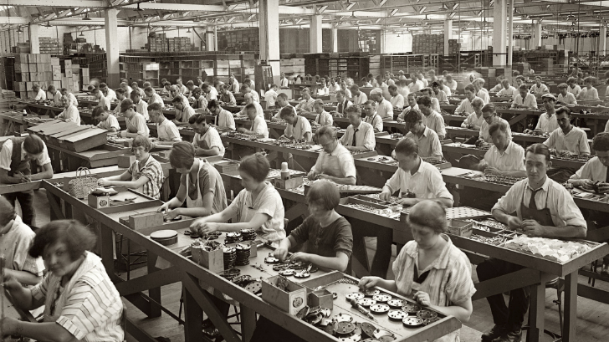
Decisions are made by people not doing the work
Leaders add stress to force better results
People have to prove they can be trusted to be given more control
Six Typical Challenges for Teams
When things go wrong, the solution is more control and training
Avoiding errors is valued more than learning and growth
A lot of time is spent talking about change, but nothing really changes
Notes:
If we think about the language that we might expect from the supervisor and team members, we can see the separation – supervisors tend to tell – team members ask…..
Imagine if that was reversed ….where team members tell leaders what they are doing, and leaders ask questions to help them….

Slide 3



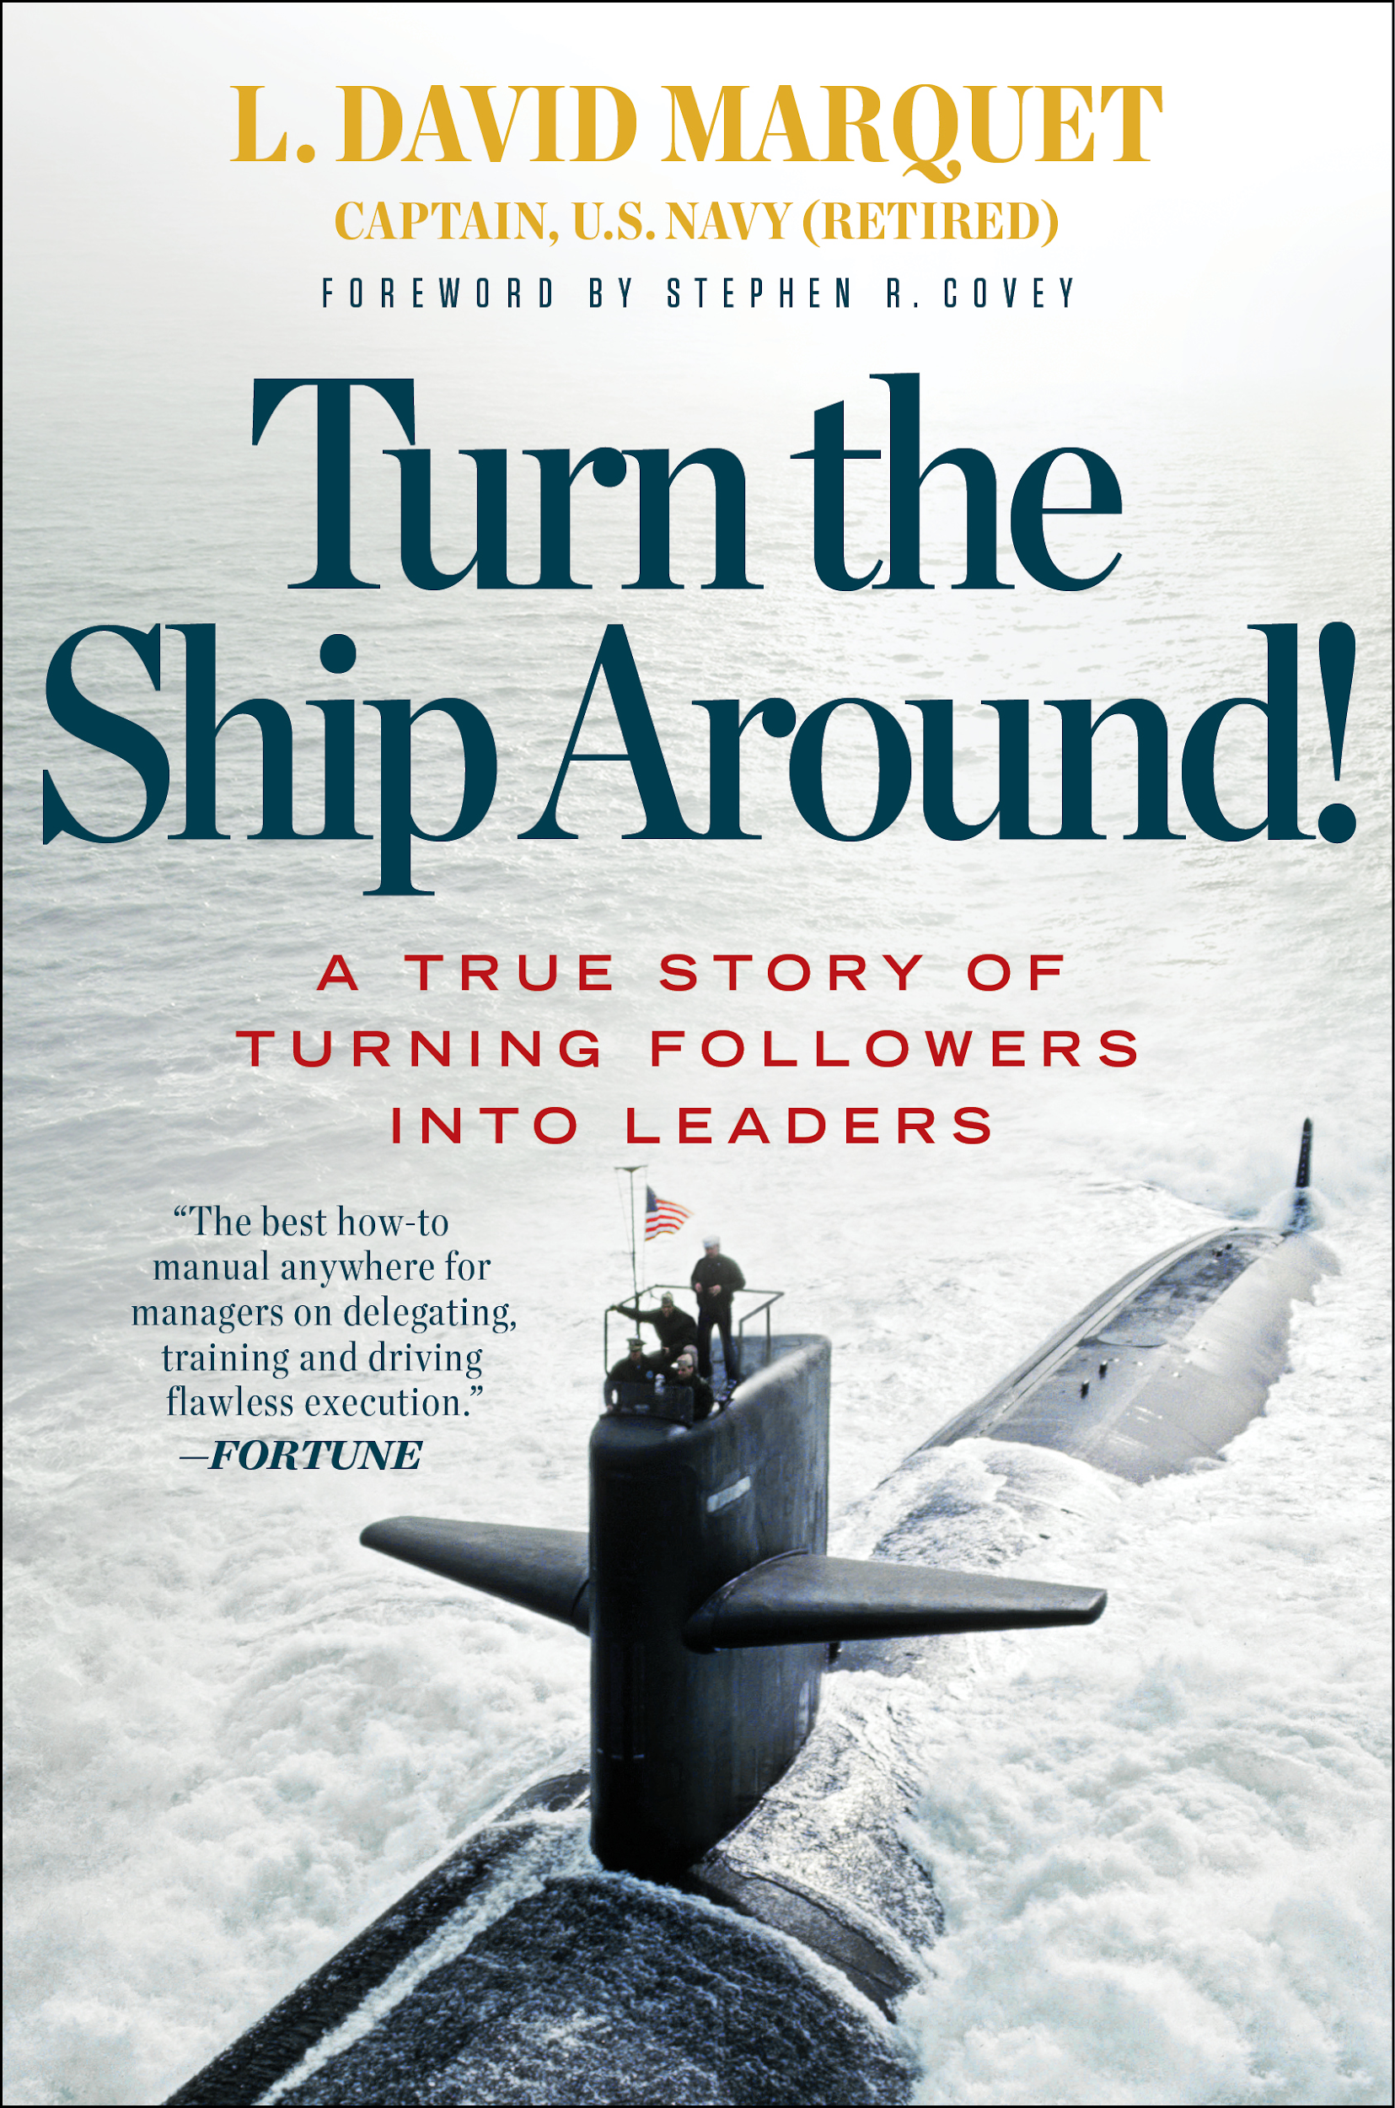

Light Bulb
My door is always open !
Super Boss
Solve problems
Motivate
Inspire
Makes great
decisions

Slide 4
Light Bulb
Help others solve problems
Create the best environment
Get insight and ideas
Stop making decisions that others can make

Slide 5
The Origins of Intent

Slide 6
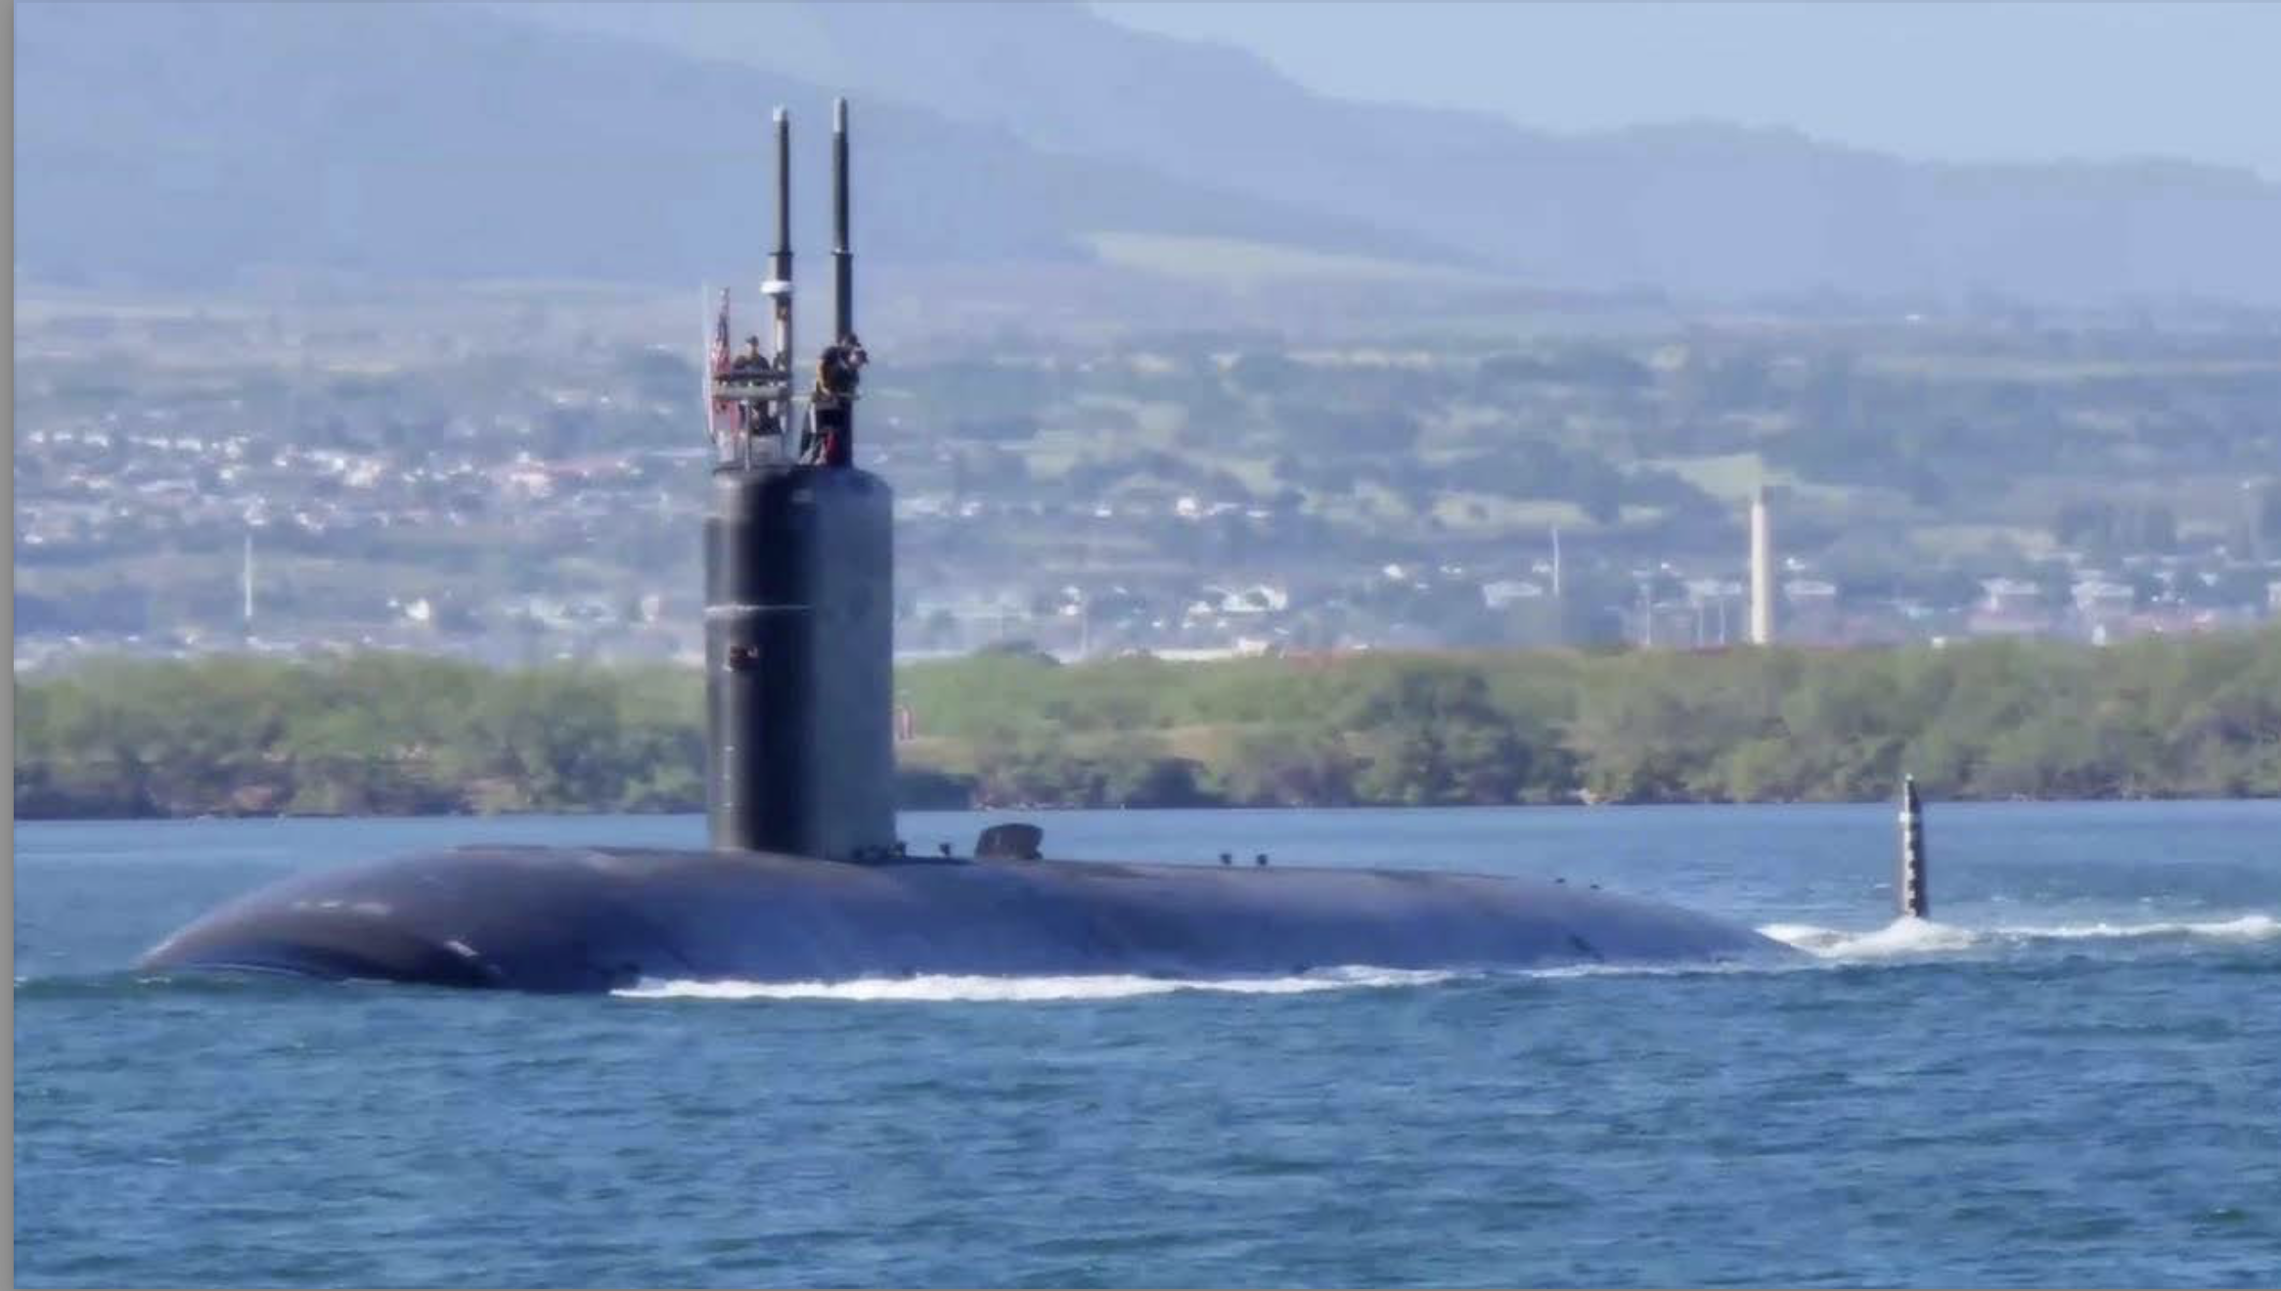

Slide 7
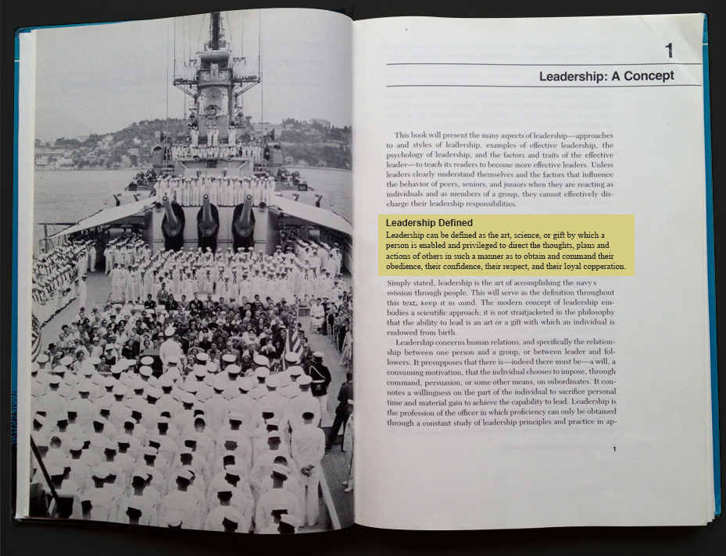
Leadership can be defined .. as directing the thoughts, plans, and actions of others .. so as to obtain and command their obedience, their confidence, their respect, and their loyal cooperation.
@ldavidmarquet

Slide 8
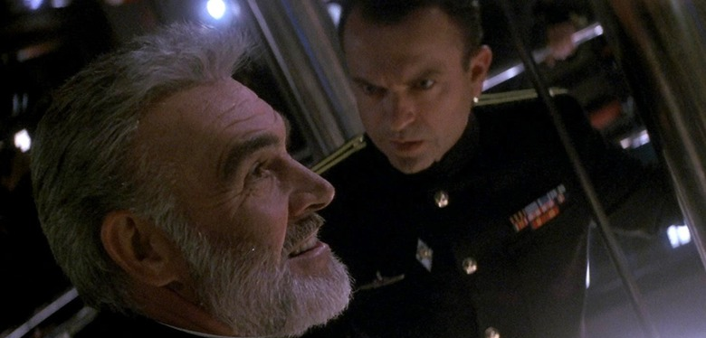

Slide 9
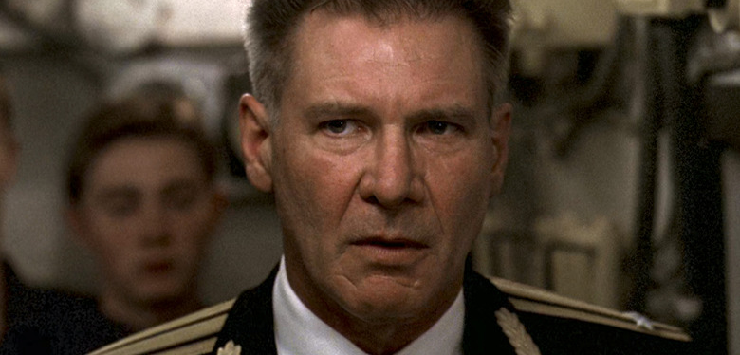

Slide 10
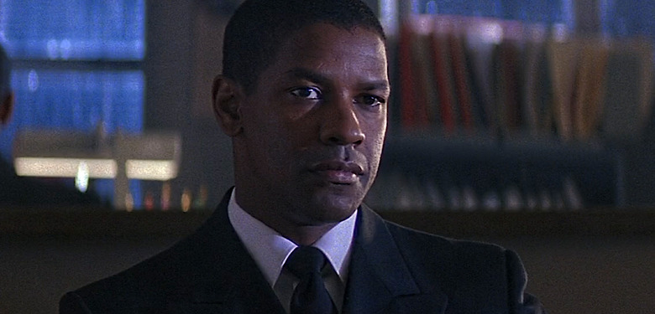

Slide 11


Slide 12
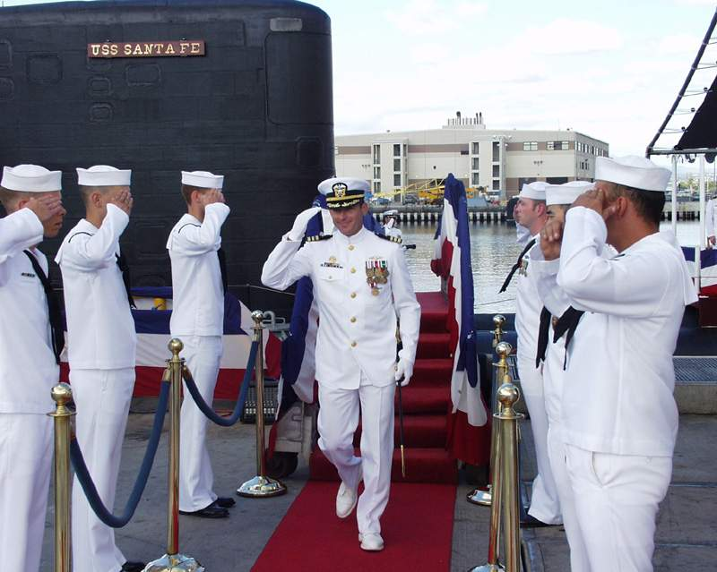
@ldavidmarquet

Slide 13
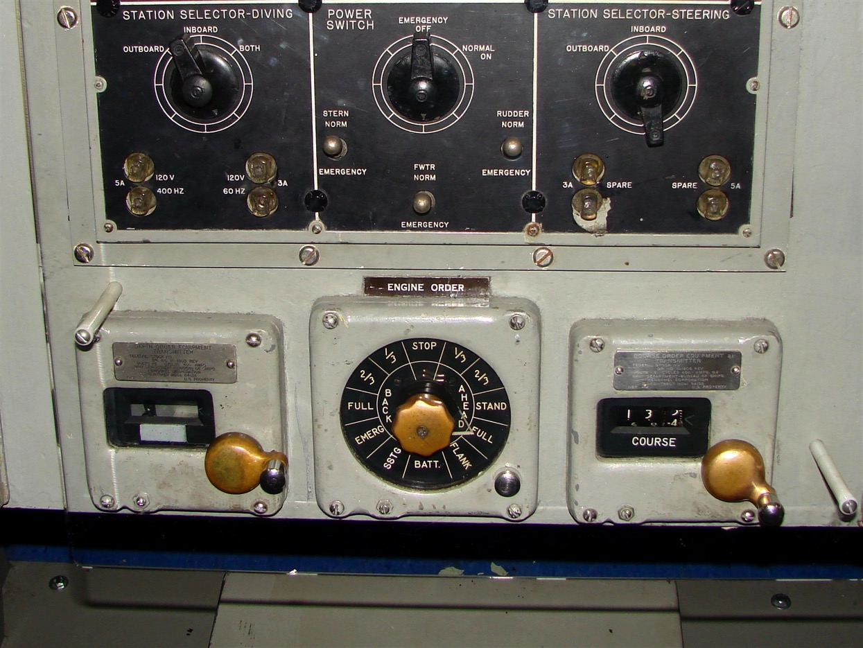
@ldavidmarquet
Notes:
David had spent 11 months learning all about the Olympia, 2 weeks about the Santa Fe
And then, on the first day at sea, he orders the Submarine to move ahead two thirds on battery power.

Slide 15
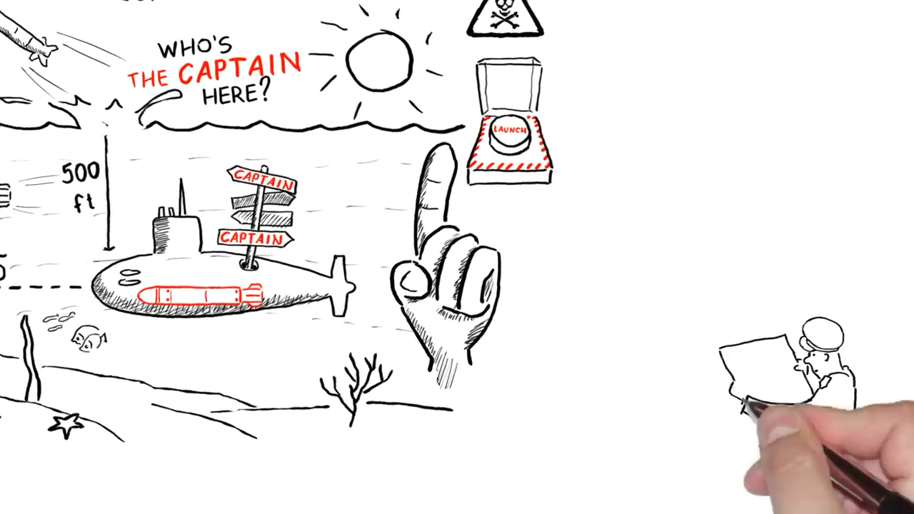
https://www.youtube.com/watch?v=pYKH2uSax8U

Slide 16
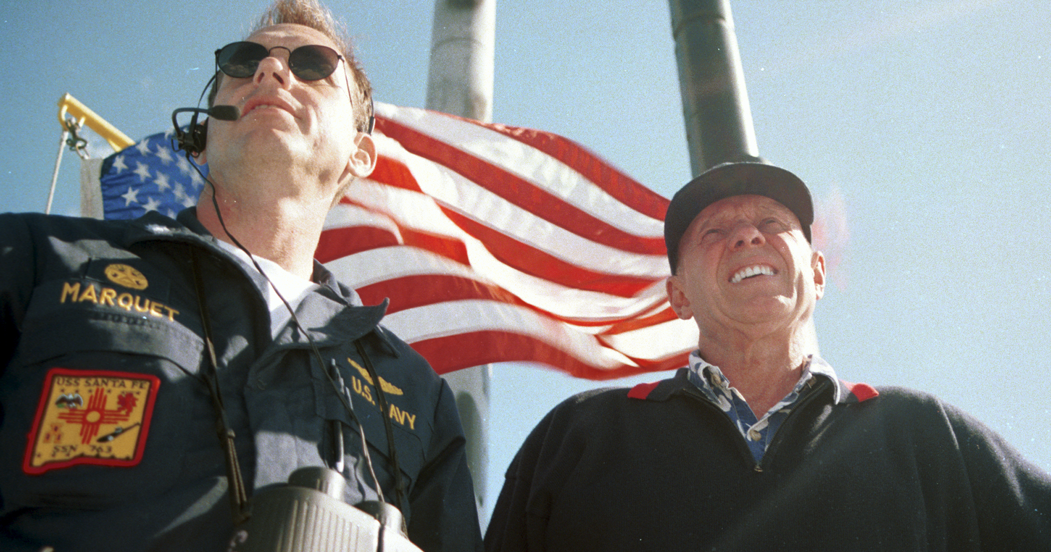
“I don’t know of a finer model of empowering leadership”
Stephen R Covey
Notes:
The Ladder of Leadership was created by Stephen Covey (author of the Seven Habits of Highly Effective People…) and Captain David Marquet.
Covey was invited to ride the Santa Fe the US nuclear submarine under the command of David Marquet, to observe the crew in action. He was interested to know what had led the Santa Fe’s transformation from the worst performing boat in the fleet to an award winning exemplar – with largely the same crew.
His conclusion was that it was the most empowered team he had ever seen
He and David then codified this into the Ladder of Leadership

Slide 17


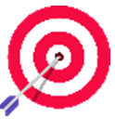





The Ladder of Leadership ®
© Intent-Based Leadership International 2025

Slide 18
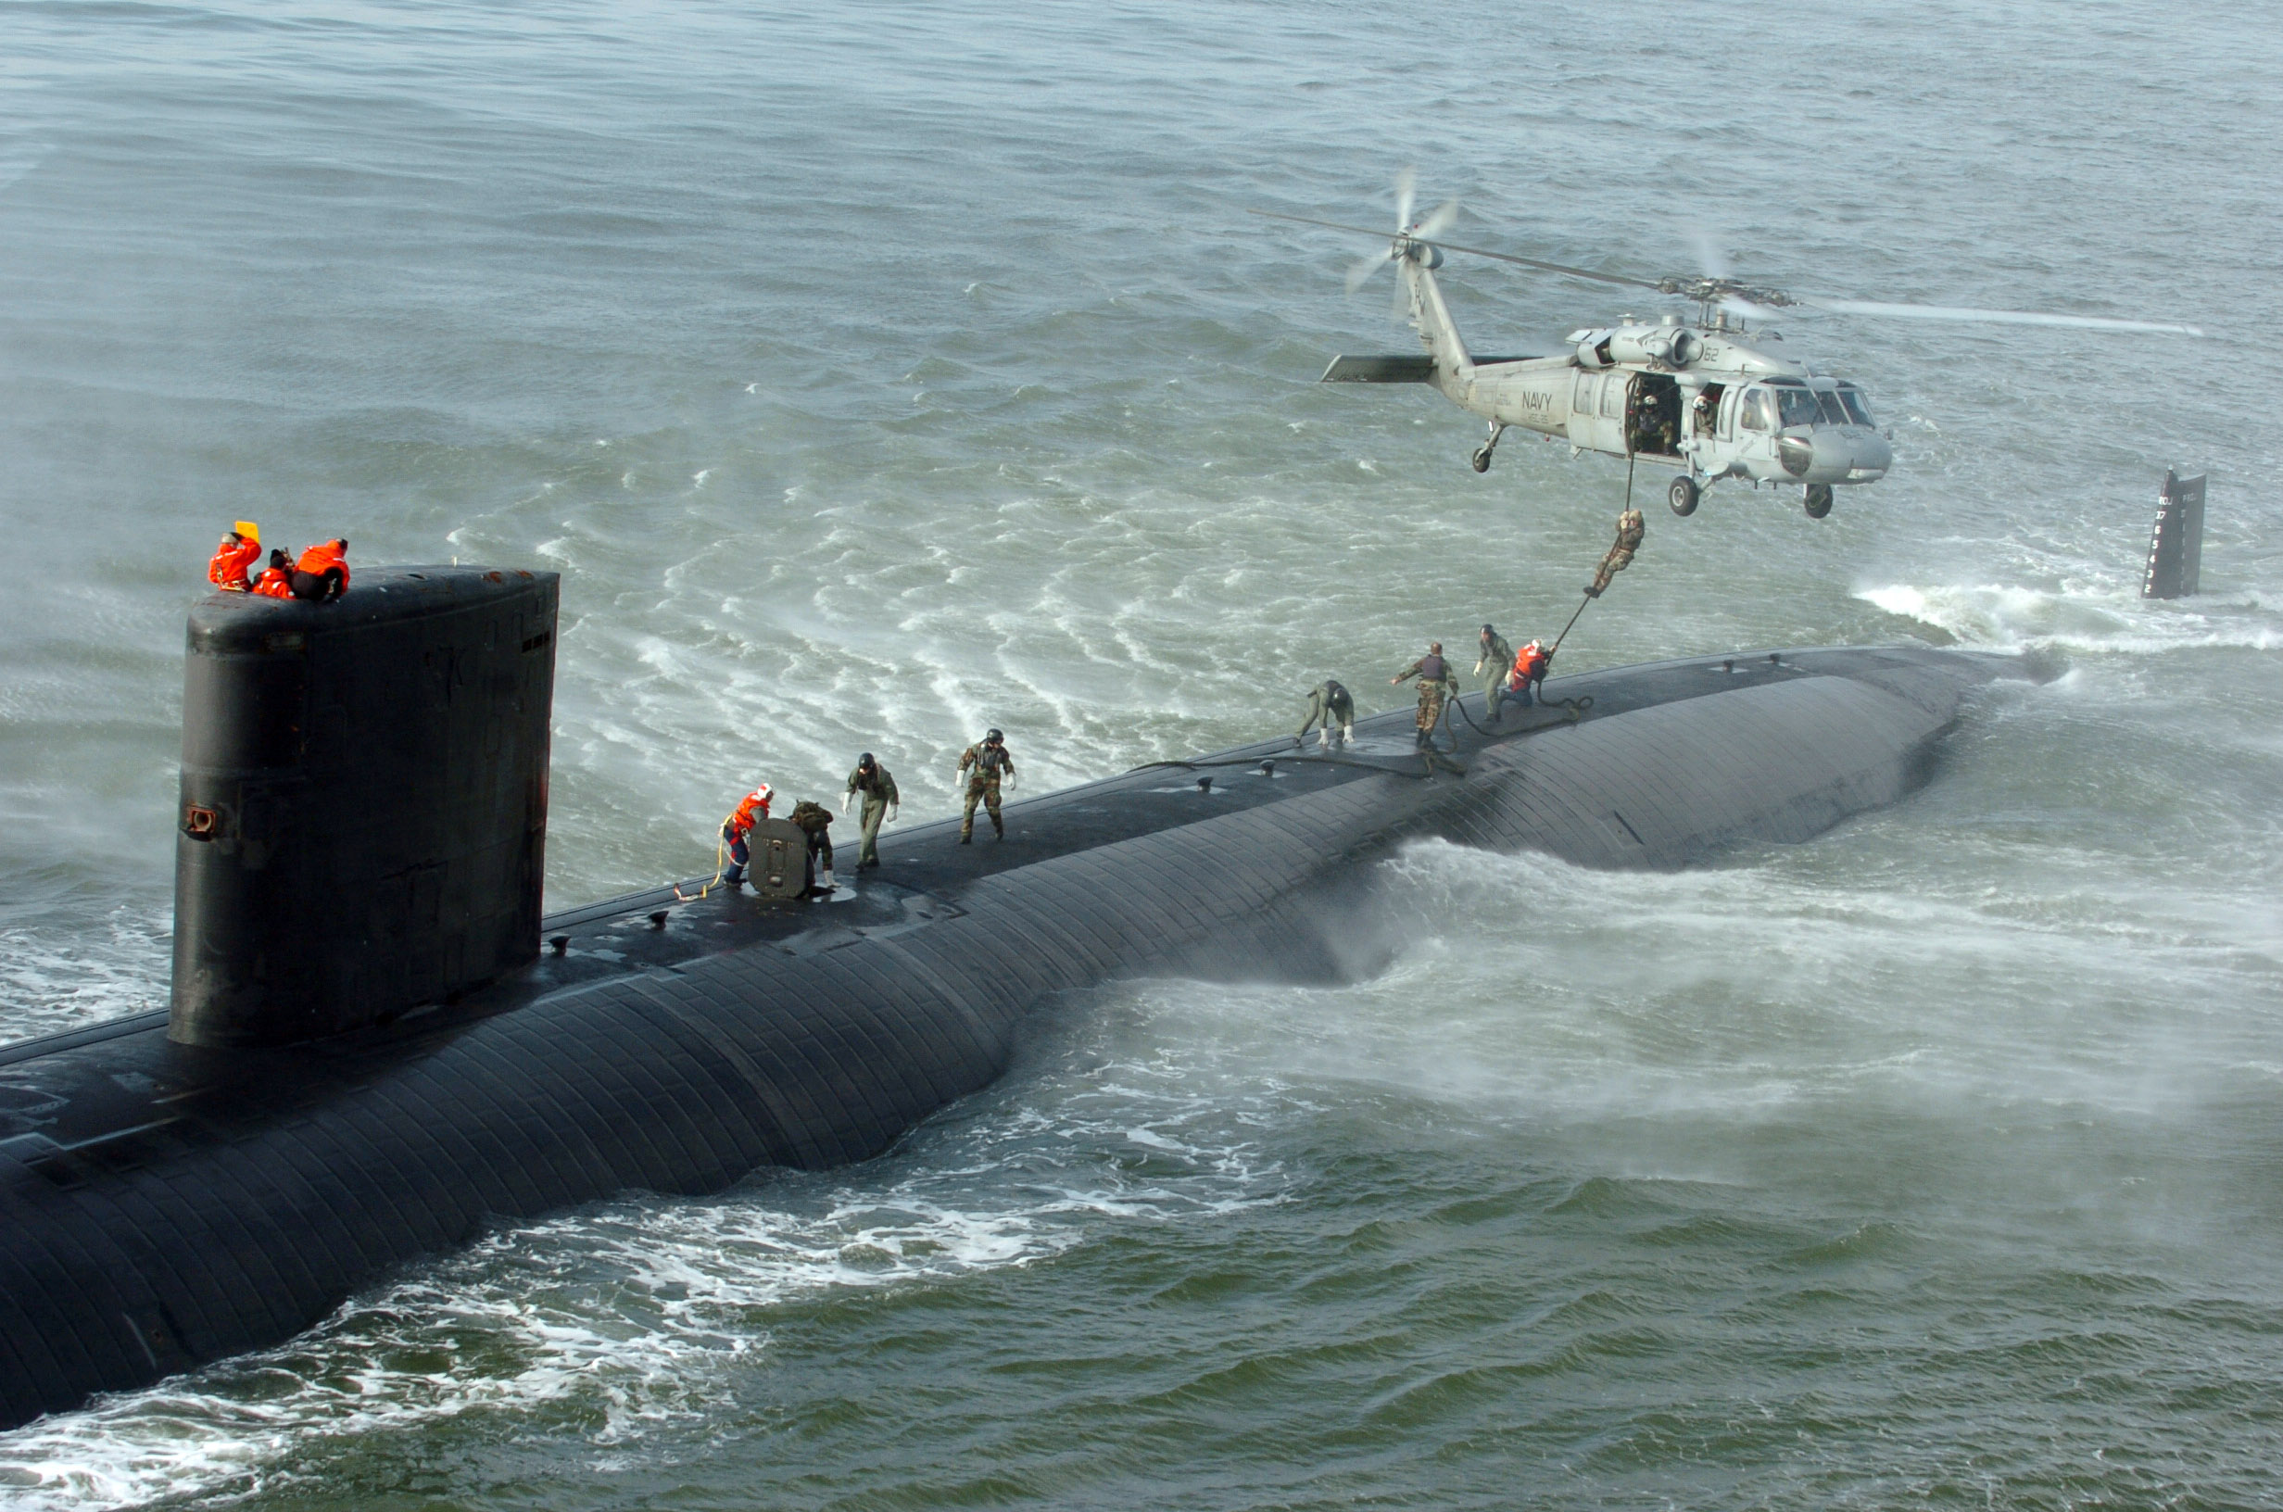

Slide 19
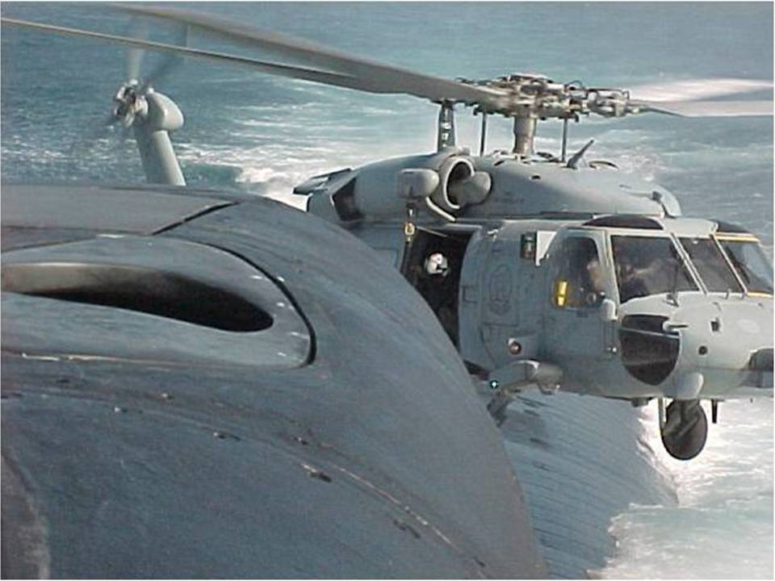

Slide 20
How We Work
Who knows the business best?
How do we sustain change ?
How do you get into the the DNA of the business ?

Slide 21

But what happens if…
Creating more engaged, thinking, active team members reduces risk
Intent creates a safety valve for leader and teams
© Intent-Based Leadership International 2025

Slide 23
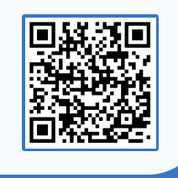
Is it better to seek permission before acting, or act and ask for forgiveness afterwards?
Pollev.com/iblp009
Notes:
We want to start this workshop by asking people to engage in a discussion relating to decision-making
The juxtaposition of seeking permission for decisions versus seeking forgiveness for decisions made is it common feature of organisations, but does it have to be this way?
Use the one sum all method and ask people to consider this question . Ask them to note down decisions which they feel they must seek permission for and decisions which they tend to take without needing to consult others
What to listen out for :
Do people prefer to operate in seeking forgiveness then permission or the other way around ?
are there any factors which would influence people’s preference?
What do people think is the best way to work for the company in its current state of development ?

