Slide 1
NGA’s 2025 Spring Operations Conference Thomas Kennedy Director, LNG, Gas Control and SCADA Instrumentation
April 11, 2025

Slide 2
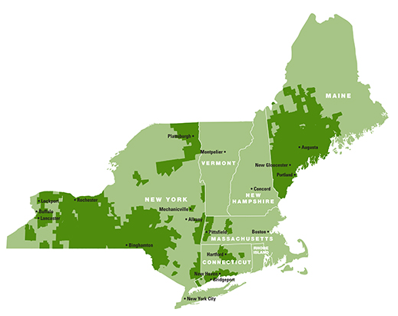
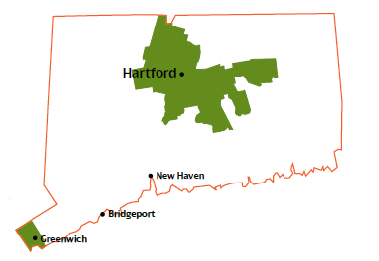
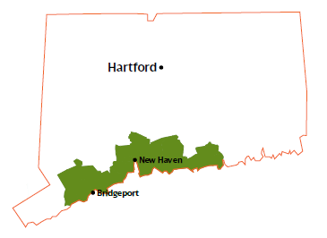
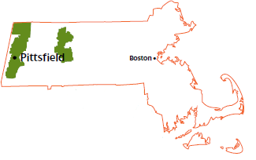
Connecticut and Massachusetts Service Areas
CNG
SCG
Berkshire
*
414,225 customers
Peak Load: 0.7 BCF
176,836 customers
2,160 mi Distribution
26 communities
1 LNG Plant
14 Gate Stations
197,253 customers
2,426 mi Distribution
24 communities
1 LNG Plant
15 Gate Stations
40,136 customers
764 mi Distribution
20 communities
1 LNG Plant
3 Propane Air Plants
6 Gate Stations

Slide 3
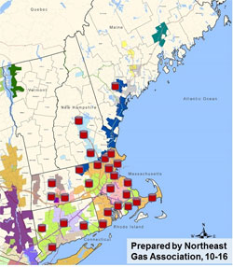
New England System and LNG

Slide 4
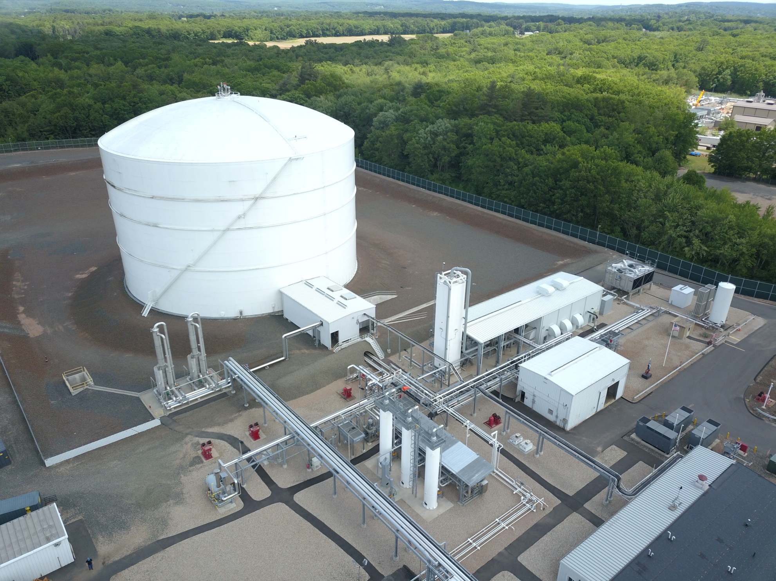
LNG Plants
Rocky Hill CT LNG Plant
Milford CT LNG Plant
Whately MA LNG Plant

Slide 5
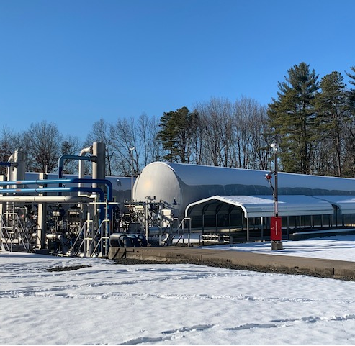
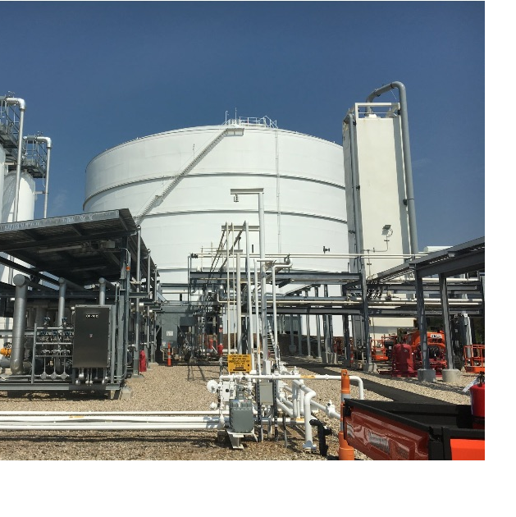
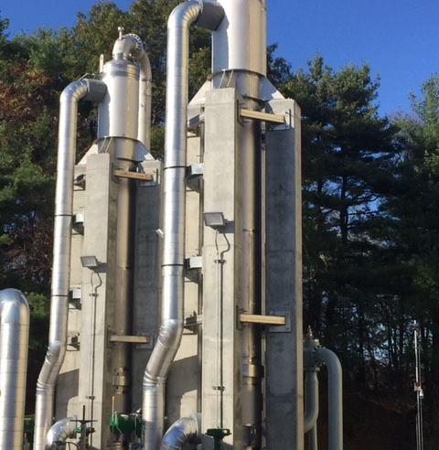
LNG Plant Details
Responsibilities LNG Plants (LNG Storage = 29,350,000 Gallons / 2.4 BCF)
Whately MA LNG Plant
MDQ = 3,300 Mcf/Day
140,000 Gallons storage
Runs 80 to 100 Days per heating season
Receives LNG via truck
≈300 Annual work orders for Inspection and Maintenance activities
Rocky Hill CT LNG Plant
MDQ = 115,000 Mcf/Day
14,600,000 Gallons storage
Runs 10 to 15 Days per heating season
Filling via liquefaction or receives trucks
Liquefaction System makes about 80,000 Gallons / Day = 6,600 Mcf/Day
≈ 700 Annual work orders for Inspection and Maintenance activities
Milford CT LNG Plant
MDQ = 105,000 Mcf/Day
14,600,000 Gallons storage
Runs 10 to 15 Days per heating season
Receives LNG via truck
≈ 700 Annual work orders for Inspection and Maintenance activities
Coordination of SCG Fire Department training
Notes:
Use this slide to describe project scope and business need/driver

Slide 6
Major LNG Initiatives
Roll out PolicyTech - Document Management System Upload all
LNG documentation into system
Whately MA LNG Plant
Add Control and Maintenance building
Rocky Hill CT LNG Plant
Boil off Compressor upgrade
MCC Upgrade and removal
Milford CT LNG Plant
LNG Pumps
MCC Upgrade and removal
Gas Control Room upgrade
Notes:
Use this slide to describe project scope and business need/driver

Slide 7
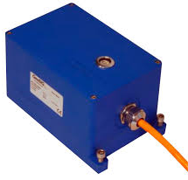
LNG Plant Seismic Considerations & Monitoring
Title 49 CFR 193.2623 – Each LNG storage tank must be inspected or tested to verify that each of the following conditions does not impair the structural integrity or safety of the tank:
(a) Foundation and tank movement during normal operation and after a major meteorological or geophysical disturbance.
(b) Inner tank leakage.
(c) Effectiveness of insulation.
(d) Frost heave.
Avangrid LNG Storage Tank Survey & Thermographic Procedure Highlights –
After a Meteorological or geophysical disturbance and within 24 hours:
Document details, when LNG Management learned about the event and record date
Review the Boil-off levels and perform a visual inspection of the tank foundation for cracks or damage and review the foundation temperatures noting any areas of concern below.
Check for additional details on disturbance: https://earthquake.usgs.gov/earthquakes/map/ Search Earthquake Catalog
Perform LNG storage tank survey and thermographic inspection looking for cold spots.
Installation of Seismic, Earthquake and Structural measuring and monitoring
GeoSIG Measuring System Accelerometer installation
Notes:
Use this slide to describe project scope and business need/driver

Slide 8
QUESTIONS???
Thank You for your time with us!
Gas Supply Overview

