Slide 1
National Grid LNG Natural Disaster Response
Chris Copson
April 10, 2025

Slide 2
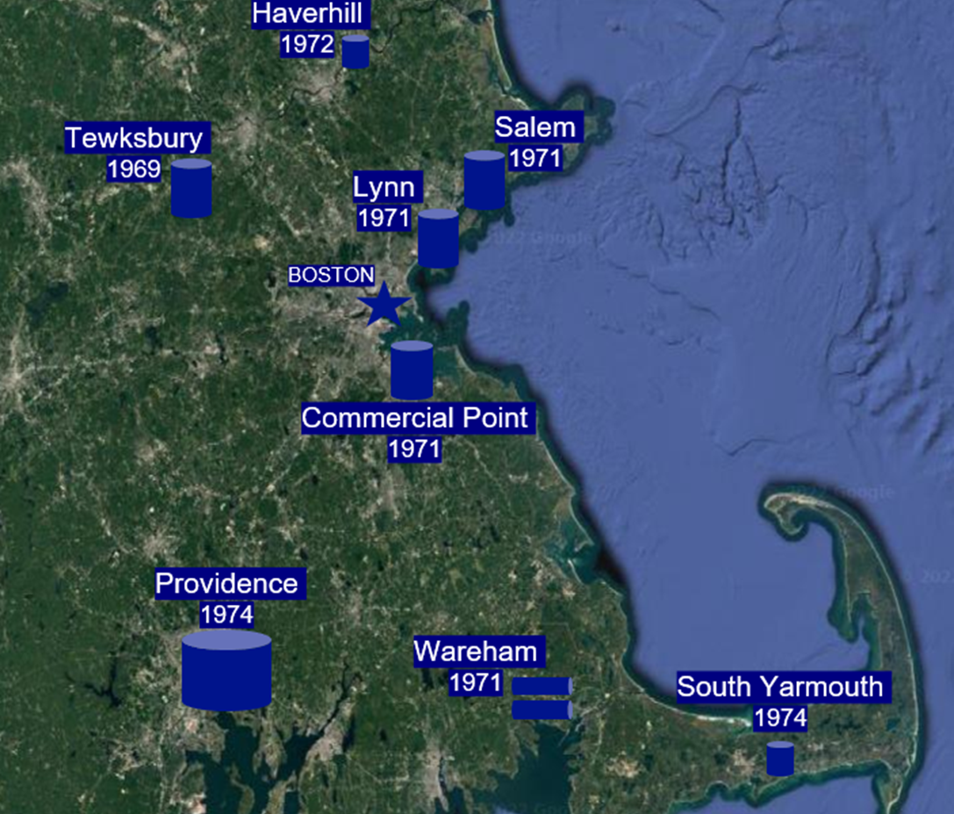
National Grid LNG Overview
National Grid owns and operates 8 LNG Plants in the New England region.
Additional 2 plants in New York include Holtsville and Greenpoint

Slide 3
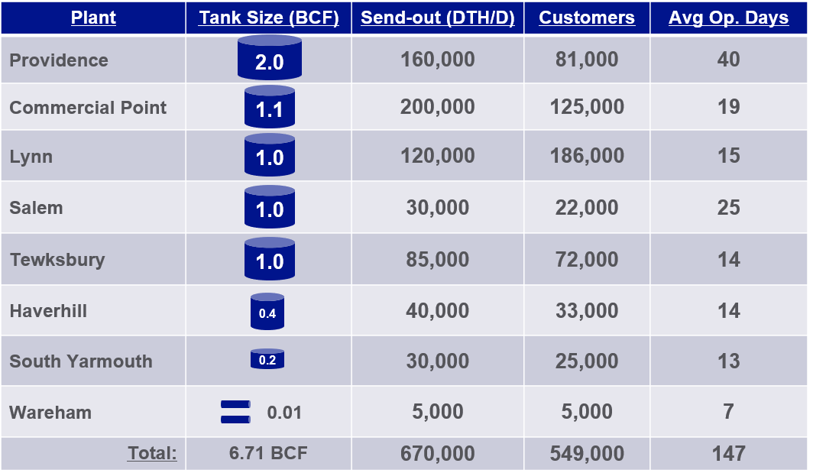
NATIONAL GRID NE LNG PLANTS

Slide 4
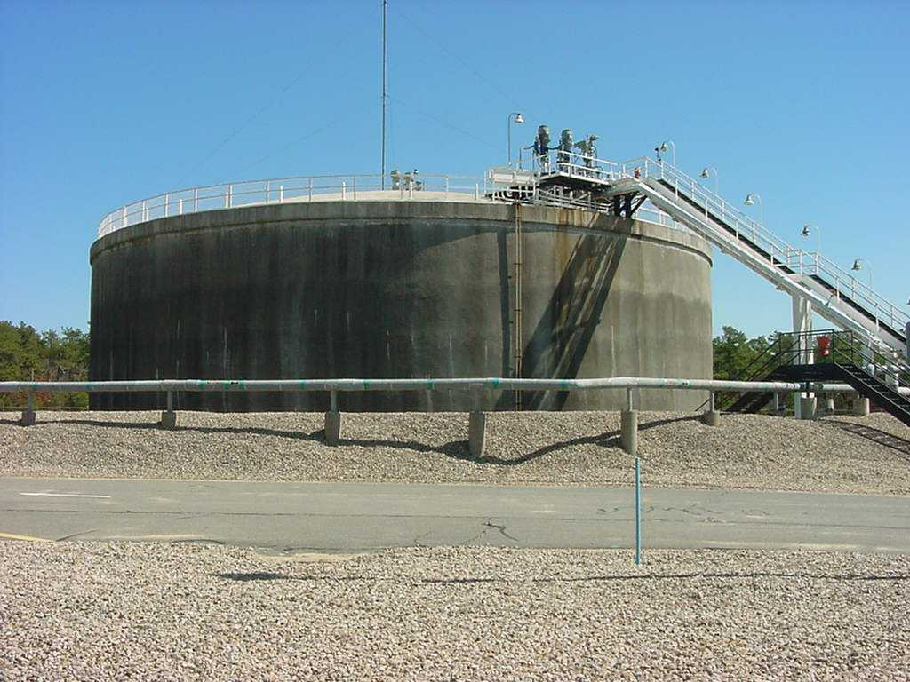
Key Upcoming Projects
Control Buildings CP and HV
Designs complete and out to bid for construction
Tank in SY
Feed study underway
Commissioned in 1973
Last remaining 70s vintage Preload prestressed concrete LNG tank with membrane
Vaporizers in TK
Out to bid for EPC contract

Slide 5
Focus on Seismic Events: Foundation Differences
Salem: 1971 PDM Tank
The entire vessel is erected on a 4” thick concrete leveling pad. The entire vessel is erected on a soil bearing, center section with an outer ring wall.
Lynn: 1971 PDM Tank
The entire vessel is erected on a soil bearing; pile supported concrete pile cap and 4” thick concrete leveling pad.
Commercial Point: 1971 CB&I Tank
The outer tank is supported by a concrete ring wall that is 4' 6" wide and 5' 6" high and reinforced with rebar. The outer tank is connected to the ring wall by 80 anchor bolts. The outer tank bottom rests on compacted select soil and a 6" deep sand pad which is directly under the steel plates.

Slide 6
Focus on Seismic Events: Foundation Differences
Providence: 1974 CB&I Tank
The outer tank is supported on a concrete ring wall foundation and compacted earth fill.
Tewksbury: 1969
The foundation of the LNG storage tank is a ring wall beginning under the vertical sidewall of the outer tank extending under the vertical sidewall of the inner tank, thus beari1ng the weight of the side and dome of both tanks.
Haverhill: 1972 PDM Tank
The outer tank is supported by a concrete ring wall that is 6’ 9” wide and 5' high and reinforced with rebar. The outer tank is connected to the ring wall by 56 anchor bolts. The outer tank bottom rests on compacted select soil and a 1" deep sand pad.
South Yarmouth:
The base (foundation) is cast in place reinforced concrete with a carbon steel cover.

Slide 7
Seismic Events
Earthquake
In the event of a local earthquake that has been determined to be severe enough to affect plant operations the plant shall be immediately shutdown and secured.
If gas leaks, liquid spills or fires occur as a result of an earthquake, follow the General Emergency Procedure.
If the event was a hurricane, earthquake, or as determined by the Regional Manager/Director:
Perform an LNG Tank Inspection per 01 LNG M01.
Arrange for an Elevation Survey of plant components to be completed and recorded.
Earthquakes require an Elevation Survey if the magnitude is greater than a 4.0 on the Richter Scale and the epicenter is within 60 miles of the plant.
Earthquake location and magnitude data can be found here: https://earthquake.usgs.gov/earthquakes/map/
Bring the LNG storage tank pressure back into normal operating parameters, as necessary.
Plant startup should not be attempted without the authorization of plant management.
Plant Management shall determine if other actions are required before putting plant equipment into service, such as:
Additional tests and/or inspections.
Additional personnel required to monitor the startup.
Pre-Startup Safety Review (PSSR).
Other risk assessments.

Slide 8
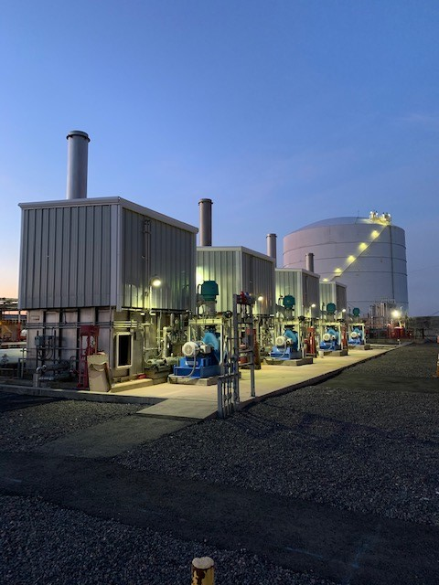
Seismic Response
Personnel Completing Elevation Surveys
Measurements of plant elevations shall be performed by personnel experienced in the types of measurement procedures being performed, using equipment capable of sufficient accuracy to distinguish settlement differences, such as a Licensed Surveyor or someone qualified according to API 653.
LNG Storage tanks shall have a minimum of 8 survey points.
These points shall be evenly spaced (as much as practical) and no more than 32 feet appart around the circumference.

Slide 9
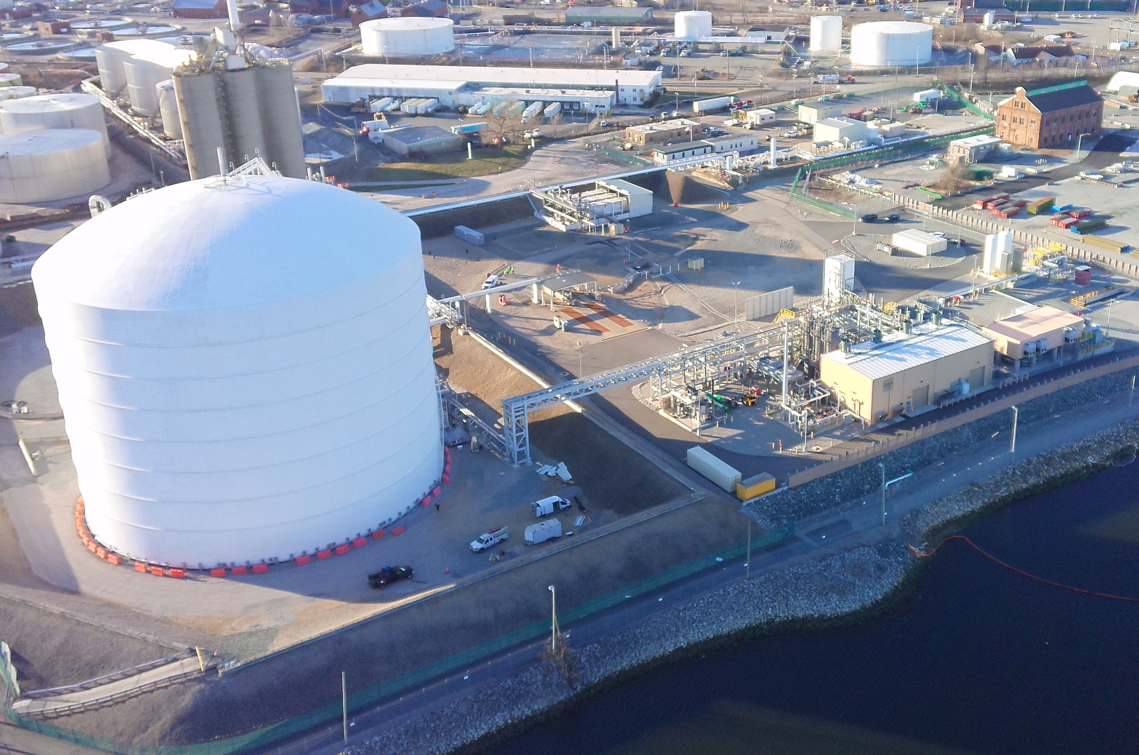
Providence LNG
As part of the recent liquefier project a Kinemetrics Condor 2 seismic monitoring system was installed.
Prompted by FERC recommendation. Equipment is typically used at NERC facilities.
Provides discrete output signal with automatic trip of liquefier.
System placed in bypass for maintenance and construction work.
Currently evaluating expansion to include tank sensors.

Slide 10
Questions

