Slide 1
NGA’s 2025 Spring Operations Conference
Eversource LNG
April 11, 2025

Slide 2
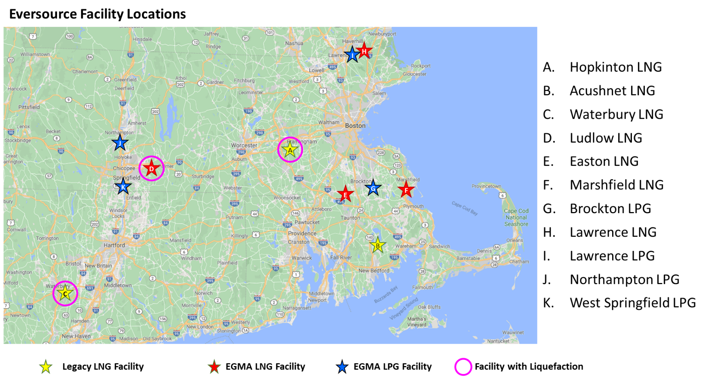
Locations
Hopkinton LNG Corp is a subsidiary of Eversource Energy.
Nine of our ten supplemental gas facilities are owned by HOPCO.
In 2020 HOPCO acquired the Columbia Gas of MA assets.

Slide 3
LNG/LPG Facility Attributes
FACILITY | STORAGE CAPACITY | SENDOUT (SCF/Hr) | YEAR BUILT | VAPORIZATION CAPACITY | **O&M PERSONNEL
Hopkinton LNG | 3.00 BCF 36,000,000 Gal. | 10,000,000 | 1967 | 240,000 MCFD | 23
Waterbury LNG | 1.20 BCF 14,500,000 Gal. | 5,000,000 | 2007 | 120,000 MCFD | 15
Ludlow LNG | 1.00 BCF 12,000,000 Gal. | 2,213,000 | 1973 | 53,112 MSCFD | 16
Easton LNG | 0.80 BCF 9,450,000 Gal. | 2,083,000 | 1972 | 49,992 MSCFD | 12
Acushnet LNG | 0.50 BCF 6,000,000 Gal. | 1,250,000 | 1970 | 30,000 MCFD | 7
Brockton LPG | 0.07 BCF 867,500 Gal. | *842,000 | ~1965 | 20,208 MSCFD | Uses Easton LNG Employees
Northampton LPG | 0.02 BCF 267,500 Gal. | *200,000 | ~1965 | 4,800 MSCFD | Supervised by Ludlow Uses I&R Employees
Lawrence LNG | 0.01 BCF 168,000 Gal. | 800,000 | 1972 | 19,200 MSCFD | 5
Lawrence LPG | 0.01 BCF 160,500 Gal. | *561,000 | ~1975 | 13,464 MSCFD | Uses Lawrence LNG Employees
Marshfield LNG | 0.01 BCF 110,000 Gal. | 500,000 | 1973 | 12,000 MSCFD | Uses Easton LNG Employees
*Natural Gas Equivalent (NGE by assuming 1040 btu/SCF)
** Includes supervision and administration

Slide 4
Importance of LNG/LPG Supply
Serving customer peak day demand independent of interstate pipeline gas.
Maintains seasonal price stability for rate payers.
LNG/LPG represents approximately 28% of Eversource “Design Day”:
Yankee Gas LNG (Approximately 20% of Design Supply)
NSTAR Gas LNG (Approximately 40% of Design Supply)
EGMA LNG/LPG (Approximately 25% of Design Supply)
Design Day Supply Sources (Dth/day)
Waterbury LNG
Ludlow LNG
Easton LNG
Marshfield LNG
Lawrence LNG
Brockton LPG
Lawrence LPG
Northampton LPG

Slide 5
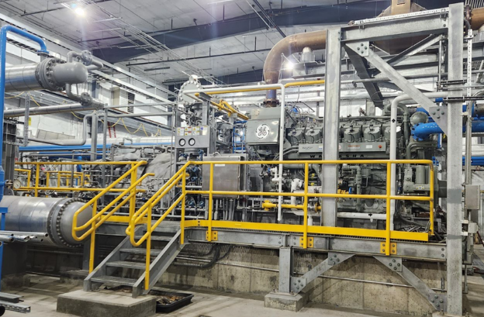
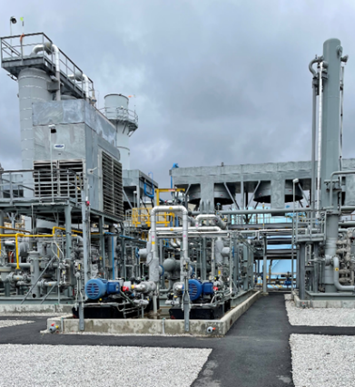
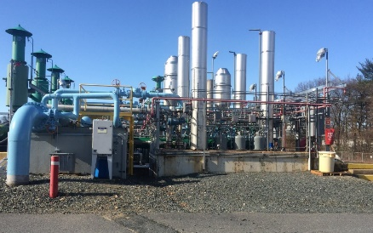
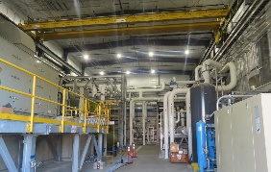
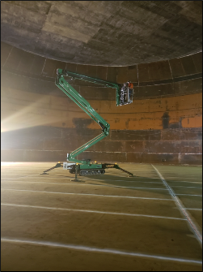
Introduction to LNG
LNG is natural gas which has been cleaned of impurities and lowered to a temperature of approximately -263°F. At this temperature it condenses into a liquid.
Liquid natural gas is 1/600th the volume of vaporized natural gas.
LNG is stored in the largest tanks at < 2PSIG.
Process Flow of Hopkinton LNG
Boil Off Comp
Removes heavy hydrocarbons and condenses pure methane.
Pipeline
Pre-Treatment
Cold
Boxes
LNG Storage Tanks
Vaporizers
Gas Dist. Customers
Removes oils, water, debris, CO2 and protects against mercury.
Cooler
Gas Turbine
N2 Comp

Slide 6
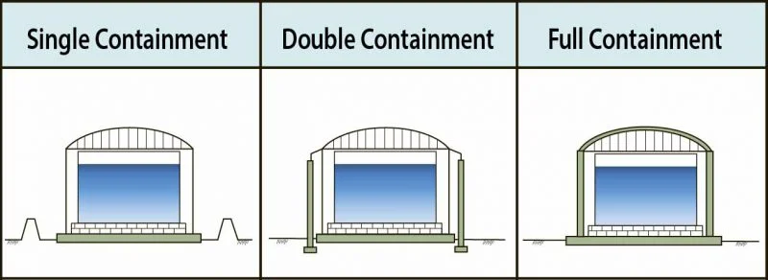
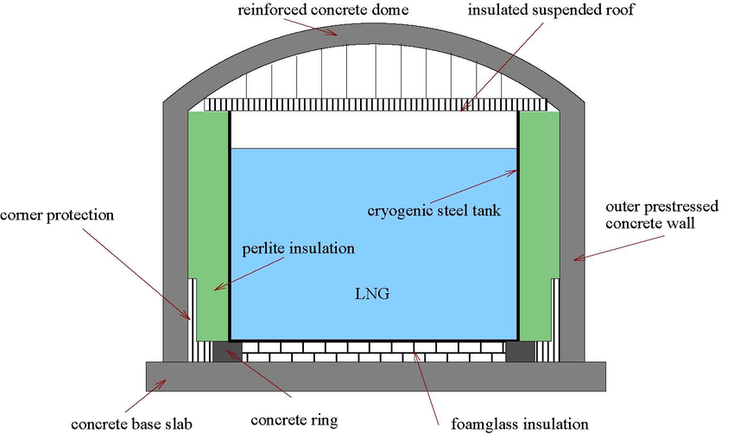
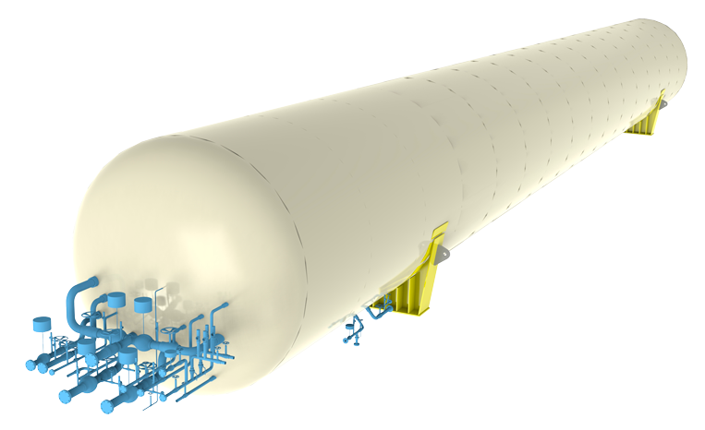
LNG Tank
Holds and stores LNG
Either:
Single containment
Double containment
Full containment
Bullet tank

Slide 7
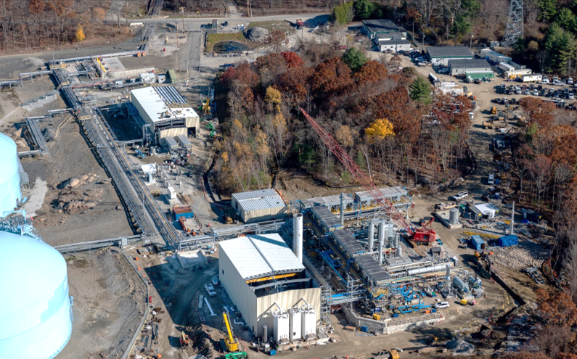
Liquefier Project and Capital Investments

Slide 8
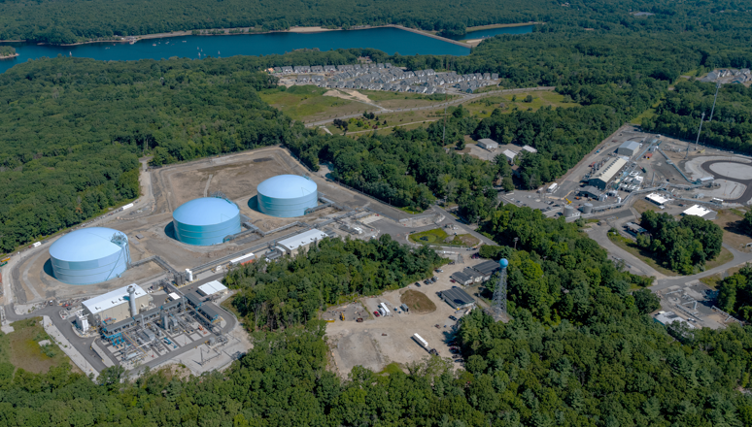
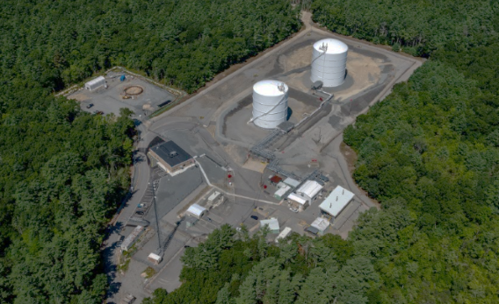
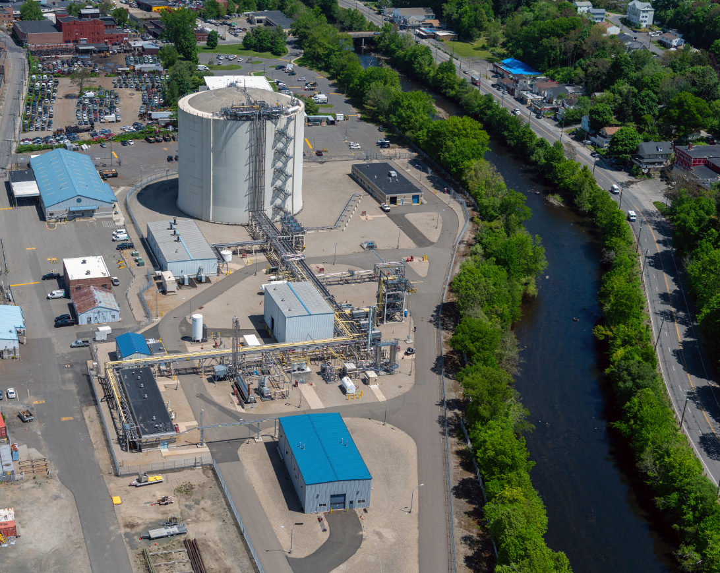
Facility Aerial Photos
Hopkinton LNG
Acushnet LNG
Waterbury LNG

Slide 9
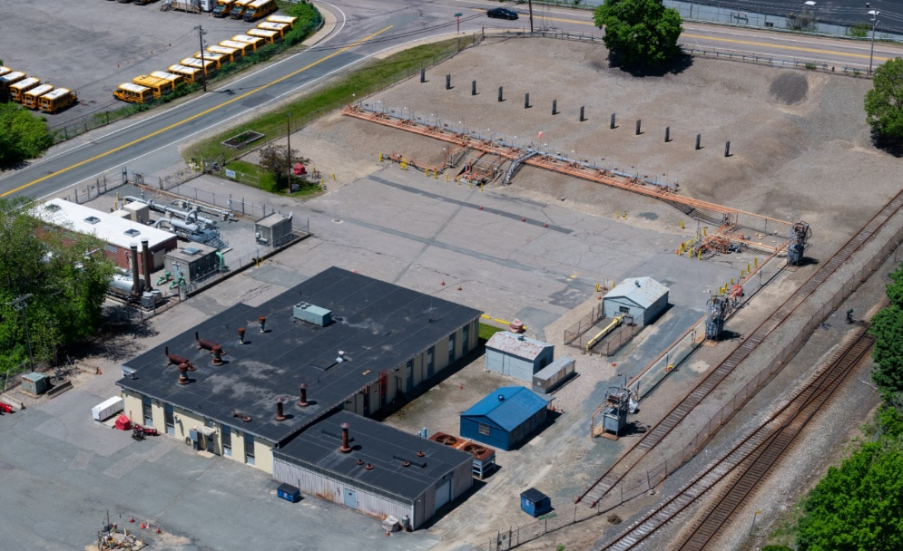
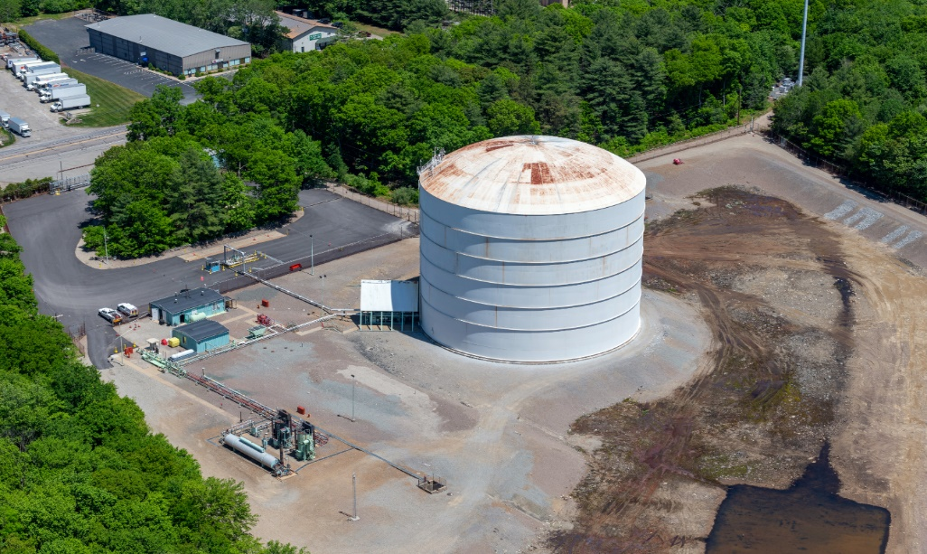
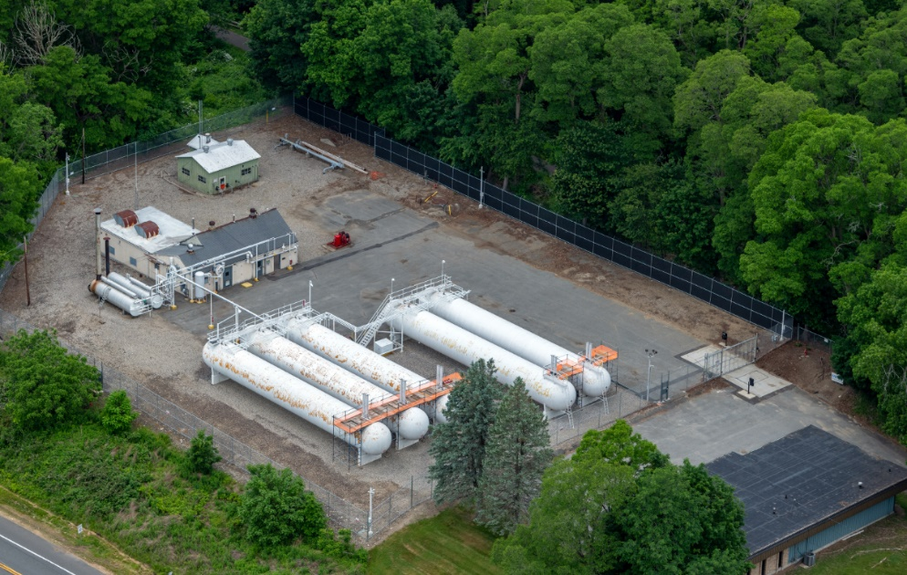
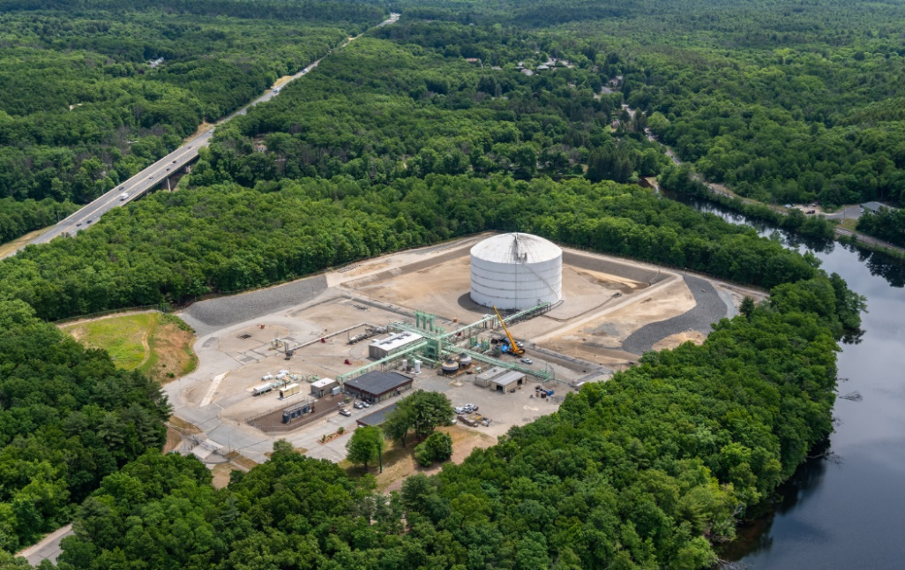
Facility Aerial Photos
Brockton LPG
Easton LNG
Northampton LPG
Ludlow LNG

Slide 10
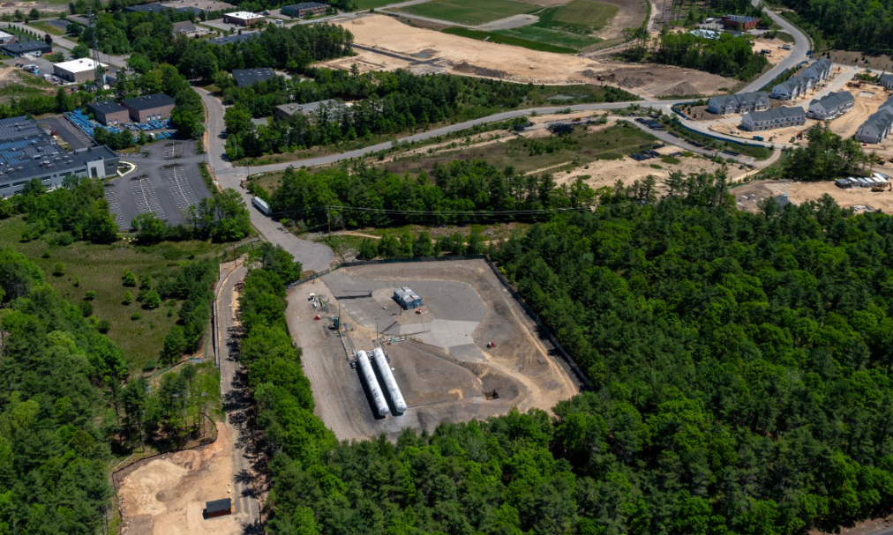
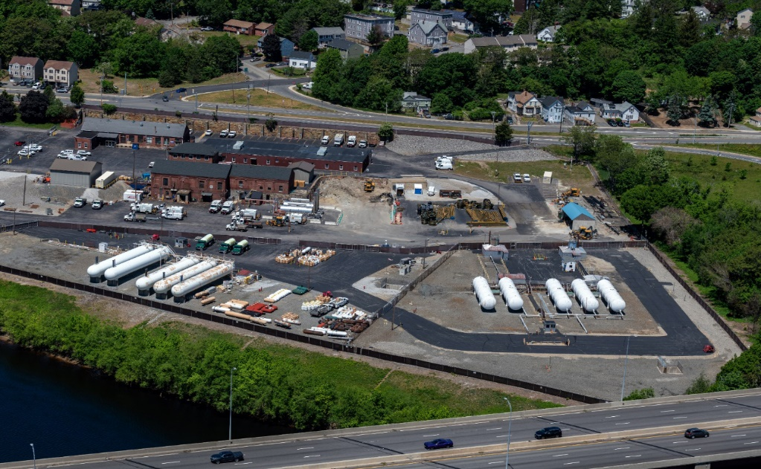
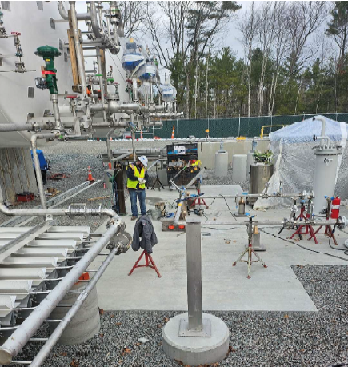
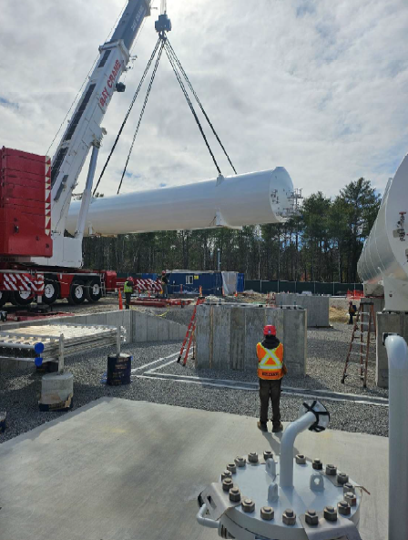
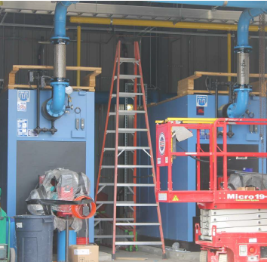
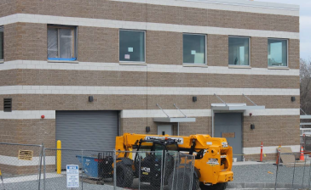
Facility Aerial Photos
Marshfield LNG
Lawrence LNG / LPG

Slide 11
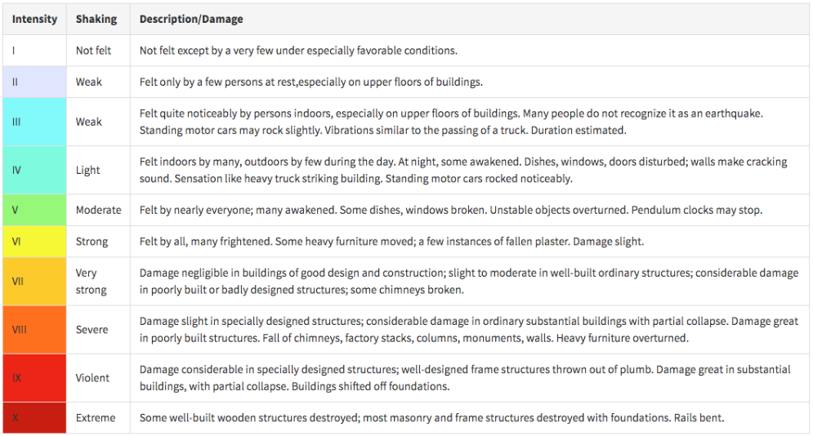
LNG Facility – Earthquake Response
Eversource has implemented seismic responses based on the intensity of the event observed local to the facility.
Utilizes the Modified Mercalli Intensity (MMI) Scale.
MMI is different then the earthquakes magnitude at its epicenter, which is measured in Moment Magnitude (M_{W}).
MMI Scale

